Slide 1
Role of the RENTAL agent to THE landlord and tenant
Marlon Shevelew
Marlon Shevelew and Associates, Attorneys at Law
021 4257069
08277 999 37
marlon@marlonshevelew.co.za
www.marlonshevelew.co.za

Slide 2
INTRODUCTION
Part One

Slide 3
Overview
Real Estate profession is driven by agency relationships
Agent: Someone who has been authorised by another person to represent him in dealings with third parties.
Principal: Person represented by an agent (in this case the owner / landlord)
Each real estate agent must be registered with the Estate Agency Affairs Board
Each firm must also be registered.

Slide 4
Choosing THE AGENT
Part Two

Slide 5
Qualities the agent should have
Membership of the Estate Agency Affairs Board (MANDATORY).
A record of property administration and the hiring and letting of property.
A division to monitor the condition of the property, maintain contact with the owner and effect minor repairs and maintenance at a relatively low cost.
Offices equipped with computers and other office equipment and staff.
Experience, reputation and expertise.
Ability to give good advice on the property.
Knowledge of the local market and good contacts for tenants.
Competitive fees, with no hidden costs or surprises.
Tenant Verifying - Proper systems to check on the creditworthiness and payment history of prospective tenants, and to establish that they are not currently under debt review or administration.
Modern lease agreements which comply with the Consumer Protection Act.
Good reliable contractors for their property maintenance and through their retained contractors to get jobs done very quickly.
Staff that are properly trained and qualified and they are fully conversant with laws including the Rental Housing Act and Consumer Protection Act.

Slide 6
Qualities the agent should have(ctd)
Competitive fees, with no hidden costs or surprises.
Tenant Verifying - Proper systems to check on the creditworthiness and payment history of prospective tenants, and to establish that they are not currently under debt review or administration.
Modern lease agreements which comply with the Consumer Protection Act.
Good reliable contractors for their property maintenance and through their retained contractors to get jobs done very quickly.
Staff that are properly trained and qualified and they are fully conversant with laws including the Rental Housing Act and Consumer Protection Act.

Slide 7
Benefits of using an agent
Ability to prepare timetables for maintenance and repair.
Constant inspection and supervision of works.
Independent assessment of work done at property based on their fiduciary duties.
Impartial assessment, management and resolution of issues and disputes between owners and tenants.
Access to extra resources such as full-time staff employed for that sole purpose, purpose-bought IT for account-handling and ready access to lawyers, professional bodies and colleagues.
Fidelity insurance cover to protect tenants funds -this is a significant advantage over self-regulation of funds by individual owners. The agent's separate professional indemnity cover is a further protection against negligent acts or incompetence.

Slide 8
DUTIES OF THE RENTAL AGENT UNDER THE MANDATE
Part Three

Slide 9
Duties Primarily Found In the Mandate
Mandate could be written, oral or tacit
It provides that the agent must fulfill the terms of the mandate, after which the agent is entitled to his commission
Commission amount -Previously no legal obligation on the agent to find a tenant, even if the agent negligently fails to do so
Damages may not be claimed from an agent who fails to find a tenant under the mandate (Mackenzie v Flight 1922 TPD 410)
The Consumer Protection Act likely changes this

Slide 10
Terms of the Mandate to be Decided by the Owner Based on Requirements
Agents offer a range of services
Entirely up to the owner to decide which services he wants
The owner can choose to leave everything to the agent or have the agent only take on specific tasks (eg. collection of rental and issues of arrears).
The owner will need to decide whether the tenants will share some duties, like cleaning or gardening or whether the agent should arrange this through a contractor.

Slide 11
Terms of the Mandate to be Decided by the Owner Based on Requirements(ctd)
The OWNER must thus decide which:
duties or responsibilities they can handle themselves (or want the tenant to handle) and thus retain; and
duties or responsibilities can usefully be delegated to the agent and thus delegate such duties and responsibilities in the mandate.
The mandate must be drafted according to the owner’s requirements.

Slide 12
Two General Types of Mandates
Marketing Only:
-The agent is only responsible for finding a tenant, nothing further, and is not responsible for the ongoing management of the property.
Management:
-The agent will take care of virtually everything (apart from what the owner excludes).
Remuneration is usually higher than in the case where the Rental agent only markets the property.

Slide 13
Typical Terms of Mandates Generally
Marketing the property:
-The agent will analyse the local market, noting trends and ensuring that rents are competitive.
-The agent will advertise the leasing agency and the specific property to prospective tenants.
Screening tenants:
-The agent interviews prospective tenants to determine their needs and pre-qualifies them to ensure that they will be good tenants.
-Related to that, the agent may perform background checks and obtain credit reports.
Showing the property to prospective tenants:
- The agent will need to be fully knowledgeable on all aspects of the property, from physical dimensions to amenities and nearby services. If applicable, the agent may supply specifics on the community or commercial facility and note any local regulations the tenant would need to know.

Slide 14
Typical Terms of Mandates Generally (ctd)
Documentation:
-The agent supplies lease forms and completes them, explaining all terms of the lease. He collects the security deposit and first month's rent.
-The agent then follows through, answering any questions the tenant may have prior to moving in.
Inspections and/or Management:
-The agent inspects the property prior to leasing and at the conclusion of the lease and notes it.
-Some agents may also manage the property, collecting monthly rents and arranging for maintenance as necessary.

Slide 15
Additional Terms in Management Mandate
Collection of monthly rental by the agent
Administrative duties like inspecting the property on a regular basis and arranging for repairs and maintenance up to an agreed amount
Bringing complaints from neighbours to the tenant's and owner’s attention and ensuring that they are addressed
Supervision of maintenance at the property

Slide 16
Typical Duties of an Agent Operating under a Management Mandate
Accounting:
Keeping proper books in terms of normal accounting principles.
Submitting monthly schedules of income and expenditure to the owner and providing proof of all income received.
Providing the tenant with a receipt for rental and deposits received.

Slide 17
Typical Duties of an Agent Operating under a Management Mandate(ctd)
Administration:
Collecting rental, and the accounting thereof to the owner.
Verifying and paying all accounts due in respect of the property.
Attending to the collection of arrear rental, and instituting legal action when so instructed by the owner.
Preparing and dispatching notices to the tenant when requested to do so by the owner.
Attending incoming and outgoing inspections with the tenant.
Negotiating on behalf of the owner with contractors for maintenance work.

Slide 18
Typical Duties of an Agent Operating under a Management Mandate(ctd)
General:
Conducting periodic inspections of the property, at least every 3 months
Assisting and advising the owner with regard to the enforcement of the lease and any house rules, should the agent be so instructed by the owner.

Slide 19
Important Aspects to Cover in the Management Agreement
Ensure there is a clear, written contract detailing exactly what services the agent will provide in return for his management.
Commission fees: How much?
Management fees: Is it a set amount or a percentage of the rent?
Renewal fees: What charges does the owner incur when the tenant wishes to renew the lease?
Deposit details: Who holds the deposit? Can the agent hand over the keys to the premises before the deposit and first month’s rental is received?

Slide 20
Important Aspects to Cover in the Management Agreement (ctd)
Payment of rental: How long after the agent receives the rental will it be paid over to the landlord?
Repairs and emergencies: How much can the agent spend without the owner’s consent?
Marketing of the property: Will it be done via newspaper, internet, signs in front of property, etc.?
Rent arrears: What steps will the agent take to ensure arrear rentals are paid?

Slide 21
Make the Tenant Aware of the Type of Mandate
Problem: Tenants often go to the wrong person with their problems. Eg - To the owner directly when there is a management lease
Solution: Send the tenant a letter explaining the allocation of functions between the agent and the owner. Up date this letter in the event of any changes.

Slide 22
DUTIES OF THE RENTAL AGENT UNDER THE CODE OF CONDUCT
Part Four

Slide 23
General Duties
A Rental agent must:
Not do or omit to do any act which is or may be contrary to the integrity of Estate agents.
Protect the interest of the client (the owner) at all times to the best of his ability, with due regard to the interest of all other parties concerned.
Not willfully or negligently fail to perform any work or duties with such degree of care and skill as might reasonably be expected of an Estate agent.

Slide 24
Disclosure
The Rental agent must:
Convey to a prospective Tenant all facts concerning the property as are, or should reasonably in the circumstances be ,within his personal knowledge and which are or could be material to the prospective tenant
Avoid conflicts of interest between mandates and disclose any potential conflict of interest to the tenant

Slide 25
Representations
The Rental agent must not:
Claim to be an expert or to have specialised knowledge in respect of any Rental agency service if, in fact, he is not such an expert or does not have such special knowledge.
Willfully or negligently make false statements as to any fact or make any harmful or misleading statements or use such marketing techniques.

Slide 26
DUTIES OF THE RENTAL AGENT UNDER THE CONSUMER PROTECTION ACT
Part Five

Slide 27
The Requirement of Quality Service
Section 54 of the Consumer Protection Act provides the owner with the right to:
The timely performance and completion of services, and timely notice of any unavoidable delay in the performance of the services by the agent
The performance of the services in a manner and quality that persons are generally entitled to expect from the agent
Failure to comply with the Code of Conduct would arguably be a contravention of the above

Slide 28
The Prohibition Against Deceptive, False and Misleading Representations
A Rental agent must not:
directly or indirectly express or imply a false, misleading or deceptive representation concerning a material fact to a consumer;
use exaggeration, innuendo or ambiguity as to a material fact, or fail to disclose a material fact if that failure amounts to a deception; or
fail to correct an apparent misapprehension on the part of a consumer, amounting to a false, misleading or deceptive representation

Slide 29
The Prohibition Against Deceptive, False and Misleading Representations(ctd)
Examples, include falsely stating the property:
has characteristics, accessories, uses, benefits, or qualities or is of a particular standard or quality;
has or is proximate to any facilities, amenities or natural features that are not available or proximate;
needs service, maintenance or repairs which are readily available

Slide 30
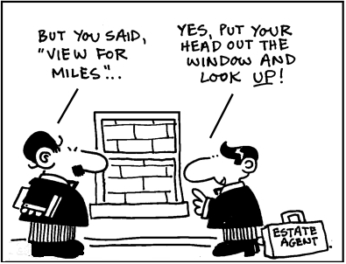

Slide 31
Unconscionable Tactics
A Rental agent must not:
use physical force against a consumer, coercion, undue influence, pressure, duress or harassment, unfair tactics or any other similar conduct, in connection with:
demand for, or collection of, rental payment; or
the repossession of the property from the tenant.

Slide 32
COMMON LAW FIDUCIARY DUTIES
Part Six

Slide 33
Fiduciary duties
Fiduciary: person who occupies a position of special trust in relation to another person.
A Rental agent is in a fiduciary position with his or her principal

Slide 34
Fiduciary duties
Loyalty
Obedience
Disclosure
Confidentiality
Reasonable Care
Accounting

Slide 35
Fiduciary duties
The agent must act solely for the benefit of the owner and must disclose any conflict of interest - Mallinson v Tanner 1947 4 SA 681 (T);
The Rental agent cannot make a secret profit out of the lease

Slide 36
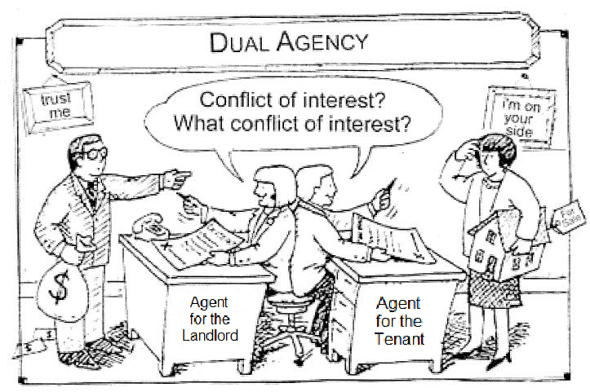

Slide 37
ANALYSIS OF DUTIES OF THE AGENT – AS DERIVED FROM STATUTE, CASE-LAW & THE CONSUMER PROTECTION ACT
Part Six

Slide 38
Disclosure
Agents should consider giving both parties a disclosure statement stating which party they represent.

Slide 39
Reasonable Care & Skill
An Agent owes a duty of reasonable care and skill to all parties to a transaction.
An Agent who causes harm because of negligence may be held liable for damage.

Slide 40
Honesty
An Agent may not: make inaccurate statements, or misrepresent facts about property or transaction.
Includes intentional as well as unintentional misrepresentation.

Slide 41
Honesty
An Agent may not: make inaccurate statements, or misrepresent facts about property or transaction.
Includes intentional as well as unintentional misrepresentation.
An Agent must disclose “material facts” to all parties, including all information that has a substantial negative impact on the value of the property, on a party’s ability to perform, or on the purpose of the transaction.

Slide 42
Accounting
An Agent must report to clients on a regular basis on the status of all entrusted funds.
Trust funds: funds given to an agent by a client / third party for safe-keeping.

Slide 43
Loyalty
An Agent must put principal’s interests above anyone else’s, including Agent’s own interests.

Slide 44
Conflict of Interest
The Agent must disclose any conflict of interest to the principal.
There may be a conflict of interest if the Tenant is a:
friend
relative
business associate of the agent
company in which agent has an interest.

Slide 45
MARLON SHEVELEW AND ASSOCIATES
9th FLOOR ZEELAND HOUSE
7-9 HEERENGRACHT STREET
CAPE TOWN
021 4257069
08277 999 37
marlon@marlonshevelew.co.za
www.marlonshevelew.co.za

