Slide 1


“Rental Market Analysis”
Michelle Dickens | TPN Credit Bureau
June 2012

Slide 2
Objective – Favourable Rental Returns
Realised via:
Quality Tenants
Well maintained property
Well managed rent collection
Property Management Systems
Payment Collection Systems

Slide 3
Objective – Favourable Rental Returns
Elements of a Quality Tenant:
Past tenant behaviour (best prediction of future Payment)
Affordability
Ability to pay vs. desire to pay
Tenant who has the means & wants to pay
Tenant who has the means but won’t pay
Tenant who does not have the means and can’t pay

Slide 4
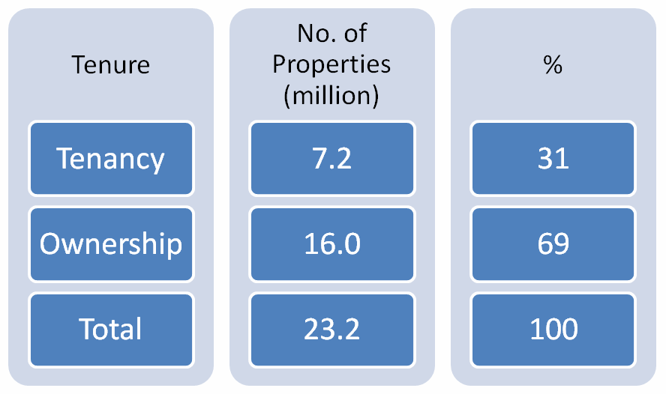
Market Analysis – United Kingdom
Number of UK properties by Tenure (2009)
Source: Big Issue Invest – The impact of social housing rent-payment data on credit scoring

Slide 5
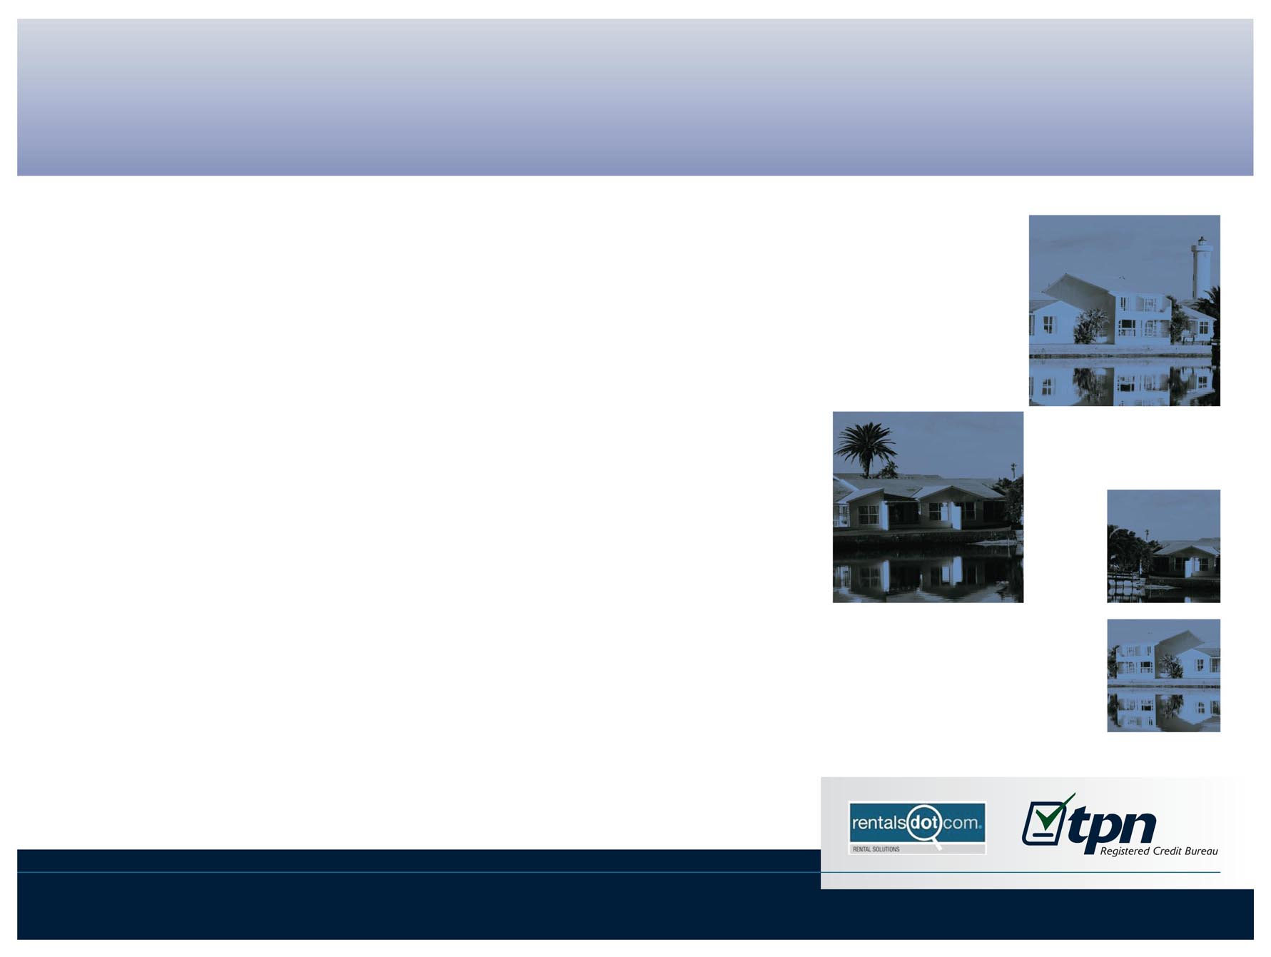
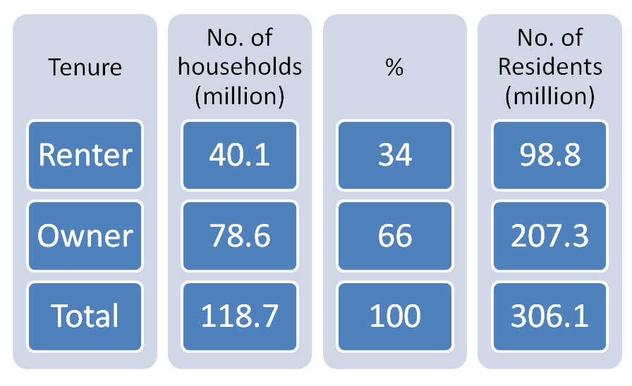
Market Analysis – United States
US Households: Renters & Owners (2011)
Source: NMHC tabulations of 2011 Current Population Survey, Annual Social & Economic Supplement, US Census Bureau

Slide 6
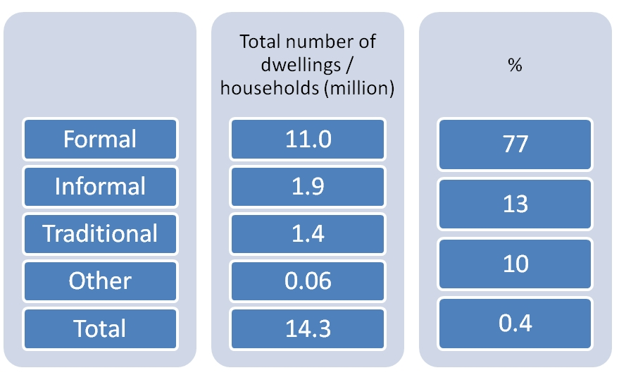
Market Analysis – South Africa
Total number of dwellings
Source: Stats SA, General Household Survey 2010

Slide 7
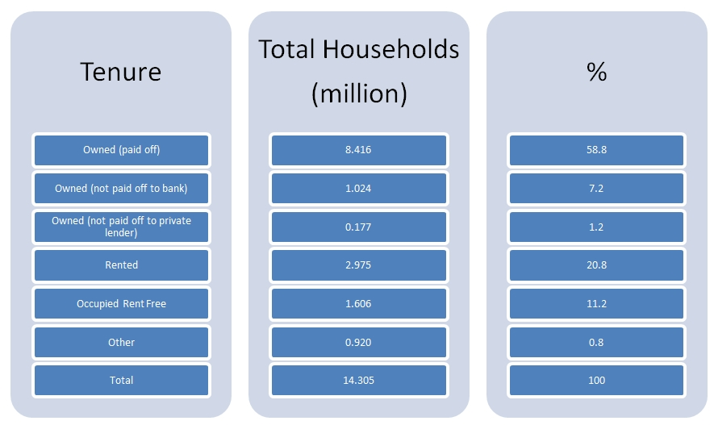
Market Analysis – South Africa
SA Household Tenure Status
Source: Stats SA, General Household Survey 2010

Slide 8
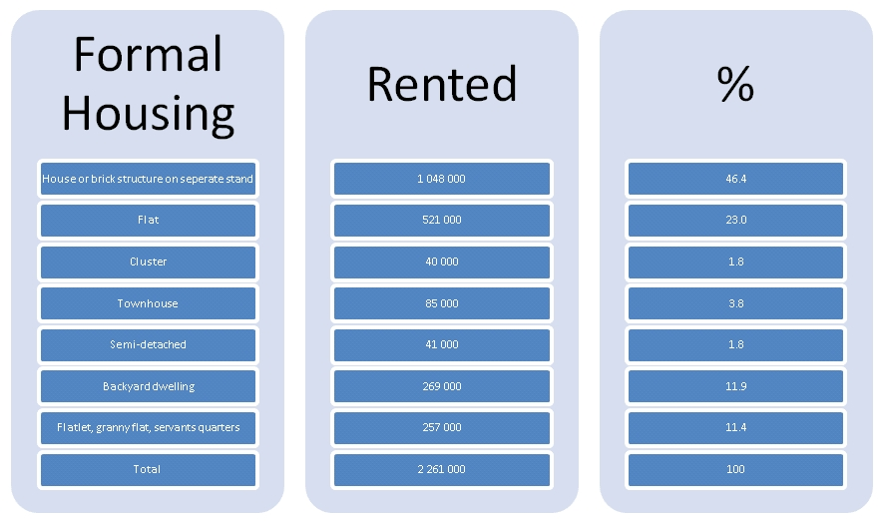
Market Analysis – South Africa
Source: Stats SA, General Household Survey 2010

Slide 9
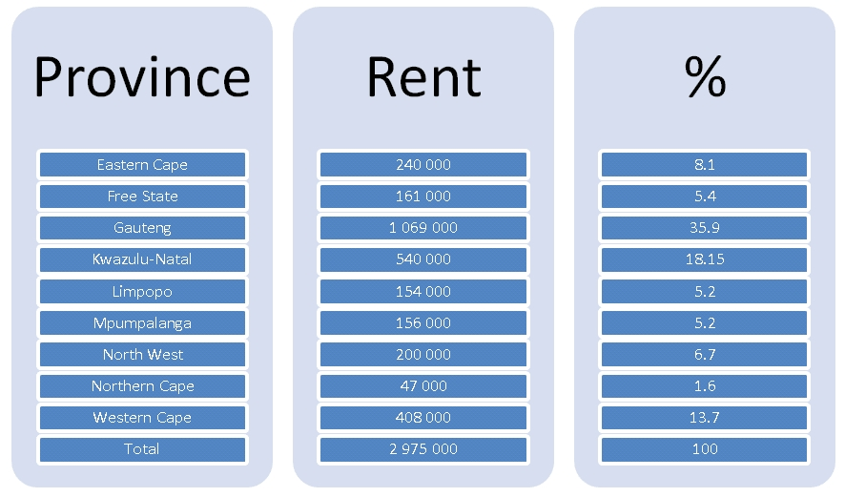
Market Analysis – South Africa
Source: Stats SA, General Household Survey 2010

Slide 10
Market Analysis – SA residential tenant trends
TPN Credit Bureau Statistics : National Average Q1 2012

Slide 11
Market Analysis – SA residential tenant trends
TPN Credit Bureau Statistics : National Average Q1 2012
Cause & Effect
<R3000 : Inflation (specifically electricity)
>R12000 : Interest rates (9 month lag)

Slide 12
Market Analysis – SA Credit Bureau trends
NCR Credit Bureau Monitor: Q4 2012

Slide 13
Market Analysis – South Africa
TPN Survey
Institutional landlords (City Props, POMA)
Micro Investors (1-10 props): 75%
< 100 investors with 100 + properties

Slide 14
Tenant Behaviour
Risk factors
Deposit used as last months rent
Application to rent in spouses name / family
member notably children
Delinquent tenants target private landlords
Negotiating hand over of keys prior to payment
Fraudulent supporting documentation notably
ID, proof of payment

Slide 15
Market Analysis – SA commercial tenant trends
TPN Credit Bureau Statistics : National Average Q1 2012

Slide 16
Market Analysis – Good standing trends
Commercial Tenant vs. Residential Tenant vs. Consumer Credit

Slide 17
Any Questions?
Michelle Dickens
Twitter @michelle_tpn
Web: www.tpn.co.za

