Slide 1
Chef and the Opscode Platform
System Administration Made Awesome

Slide 2

Me
Nathan L Smith
http://cramerdev.com/
https://github.com/smith/
@nlsmith

Slide 3
Chef
http://www.opscode.com/chef/
“Chef is an open source systems integration framework built to bring the benefits of configuration management to your entire infrastructure. You write source code to describe how you want each part of your infrastructure to be built, then apply those descriptions to your servers. The result is a fully automated infrastructure: when a new server comes on line, the only thing you have to do is tell Chef what role it should play in your architecture.”

Slide 4








Demo Application
Web / App
(https://github.com/smith/demo-rails-app)
DB
Cache

Slide 5
Opscode
http://opscode.com/
Hosted Chef platform
Main developers of Chef
Training & support

Slide 6
Why?
Living documentation
Infrastructure as code
Disasters will happen
Repeatability & Idempotence

Slide 7

“I maintain standards and I strive for perfection. That level of pressure is conveyed in a very bullish way and that's what cooking is all about.”
http://www.youtube.com/watch?v=gr3MGCmd03U

Slide 8
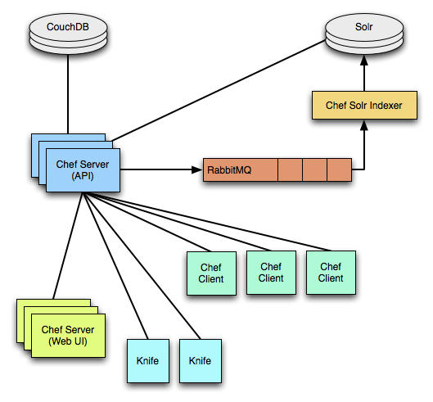
Chef Server Architecture
(http://wiki.opscode.com/display/chef/Architecture)

Slide 9
Nodes
Attributes
Run list

Slide 10
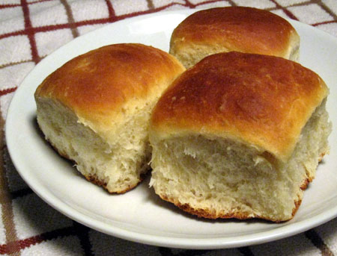
Roles

Slide 11
Cookbooks
Definitions
Recipes
Templates (.erb)
Files
Providers
Libraries
(use Resources)

Slide 12
Resources
http://wiki.opscode.com/display/chef/Resources

Slide 13
Data Bags
{
"id": "demo",
"server_roles": ["demo_web_app"],
"type": { "demo_web_app": ["rails", "passenger_apache2"] },
"packages": { "libmysqlclient-dev": "" },
"gems": { "rake": "0.8.7", "bundler": "1.0.12", "mysql": "2.8.1" },
"deploy_to": "/var/apps/demo",
"owner": "demo",
"group": "demo",
"database_master_role": ["demo_database_master"],
… (it’s JSON, yo!) …
"revision": { "production": "HEAD" },
"repository": "git://github.com/smith/demo-rails-app.git",
"force" : { "production": true },
"migrate": { "production": true }
}

Slide 14
Application & Database Cookbooks
Data Bags + Recipes = Deploy!

Slide 15
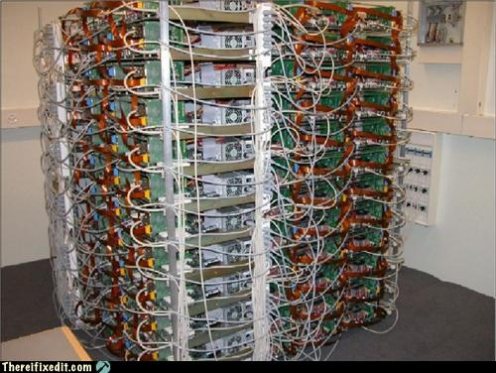
Environments

Slide 16
Chef Disadvantages
Time investment
Testing
You’re going to need a sous chef
Opscode not cheap (http://www.opscode.com/pricing/)

Slide 17
Opscode Links
Chef Wiki: http://wiki.opscode.com/display/chef/Home
Manage: https://manage.opscode.com/
Cookbooks: http://community.opscode.com/cookbooks
GitHub: http://github.com/opscode
Twitter: @opscode

Slide 18
“I have a very assertive way. It’s wake up, move your ass, or piss off home.”

Slide 19
Thank You
Questions?
Rate this: http://spkr8.com/t/7359

