Slide 1
From Guidelines to Questions: Knowledge Graph Construction and Question Generation from Clinical Practice Guidelines
Sushmitha Chandrakumar
Master's thesis colloquium | Supervisor: Prof. Dr. Michael Gertz
Heidelberg University, Institute of Computer Science, Data Science Group

Slide 2
Outline
Motivation
Background
Approach
Evaluation
Wrap-up
1
Motivation
Why comparing guidelines is hard, aims, contributions
2
Background
Knowledge graphs, LLMs and grounding, related work
3
Approach
Pipeline, normalisation, question generation
4
Evaluation
Graph, equivalence links, questions, clinical review
5
Wrap-up
What it shows, limits, conclusions
2 / 36

Slide 3









Clinical practice guidelines: why they matter
Motivation
Background
Approach
Evaluation
Wrap-up
Clinical Practice Guidelines = evidence-based recommendations for diagnosis, treatment, targets and monitoring
Published by different professional and national organizations
Goal: better care and less unjustified variation in practice
Many grade their evidence and recommendation strength (e.g. GRADE)
Written for clinicians to read, not for software to parse
3 / 36

Slide 4
Same topic, four different answers
Motivation
Background
Approach
Evaluation
Wrap-up
Guideline | Who | Recommendation
The U.S. Preventive Services Task Force (US) | women 40 to 74 | Biennial screening
The American Cancer Society (US) | 45 to 54; 55 and older (from 40 optional) | yearly; from 55 every 2 years or yearly
EUROPA DONNA (EU) | 45 to 74 | 2 to 3 years (45 to 49), 2 years (50 to 69), 3 years (70 to 74)
NHS Breast Screening Programme (UK) | 50 up to 71st birthday | every 3 years
Same question, four answers
different wording, intervals, age bands
In our corpus: units
126 mg/dL = 7.0 mmol/L, same threshold
Illustrative example from breast cancer screening. The thesis corpus is on diabetes.
4 / 36

Slide 5
Research gap and aims
Motivation
Background
Approach
Evaluation
Wrap-up
Gap
Aims
No common normalised, queryable view across guidelines
Clinical KGs: one source type
Question generation: one guideline
Every fact should trace back to organisation and page
1
One graph
different structures, terminology, units
2
Explicit links
relations across guidelines through normalisation
3
Grounded questions
checked against their graph anchor
5 / 36

Slide 6
Key contributions
Motivation
Background
Approach
Evaluation
Wrap-up
1
Four-stage pipeline
2
Dual-layer extraction
guidelines to queryable graph to validated questions
rules for patterns, constrained LLM for context
3
Equivalence edges
4
Graph-anchored questions
created by unit normalisation, stated by no source
graph fixes the fact, LLM phrases it, rules validate
6 / 36

Slide 7
Outline
Motivation
Background
Approach
Evaluation
Wrap-up
1
Motivation
Why comparing guidelines is hard, aims, contributions
2
Background
Knowledge graphs, LLMs and grounding, related work
3
Approach
Pipeline, normalisation, question generation
4
Evaluation
Graph, equivalence links, questions, clinical review
5
Wrap-up
What it shows, limits, conclusions
7 / 36

Slide 8
Knowledge graphs and the property graph
Motivation
Background
Approach
Evaluation
Wrap-up
Nodes = entities (drug, condition, guideline)
Edges = relations
Properties: value, unit, source, page
Property graph: properties on the edge
RDF: extra nodes (reification)
FIRST_LINE_FOR
Drug
Condition
edge properties
guideline, page, ...
attached to the relation
Illustration, not a result
8 / 36

Slide 9
LLMs: hallucination and grounding
Motivation
Background
Approach
Evaluation
Wrap-up
Hallucination: fluent but unsupported output
Clinical risk: wrong threshold or dose
RAG: retrieve evidence, then generate
Schema-constrained prompting: fixed output structure
Graph anchor
chosen by rule-based traversal
LLM
formulates the question
Validator
checks against the anchor
Similar in spirit to RAG, but no similarity search
9 / 36

Slide 10
Related work and gap
Motivation
Background
Approach
Evaluation
Wrap-up
Work | What it does | Missing
Li 2020, Harnoune 2021 | medical KGs from records or text | one source type
Bi 2020, Liang 2023, Guo 2024 | KG-based question generation | general domain, not guidelines
Nyameino 2020 | questions from one guideline | no cross-guideline, no anchor
Sousa-Pinto 2024 | LLMs propose guideline questions | single case study
Peleg 2013 | computer-interpretable guidelines | decision support only
Not found in the reviewed literature: multi-guideline KG + unit normalisation + provenance + graph-anchored questions
10 / 36

Slide 11
Outline
Motivation
Background
Approach
Evaluation
Wrap-up
1
Motivation
Why comparing guidelines is hard, aims, contributions
2
Background
Knowledge graphs, LLMs and grounding, related work
3
Approach
Pipeline, normalisation, question generation
4
Evaluation
Graph, equivalence links, questions, clinical review
5
Wrap-up
What it shows, limits, conclusions
11 / 36

Slide 12
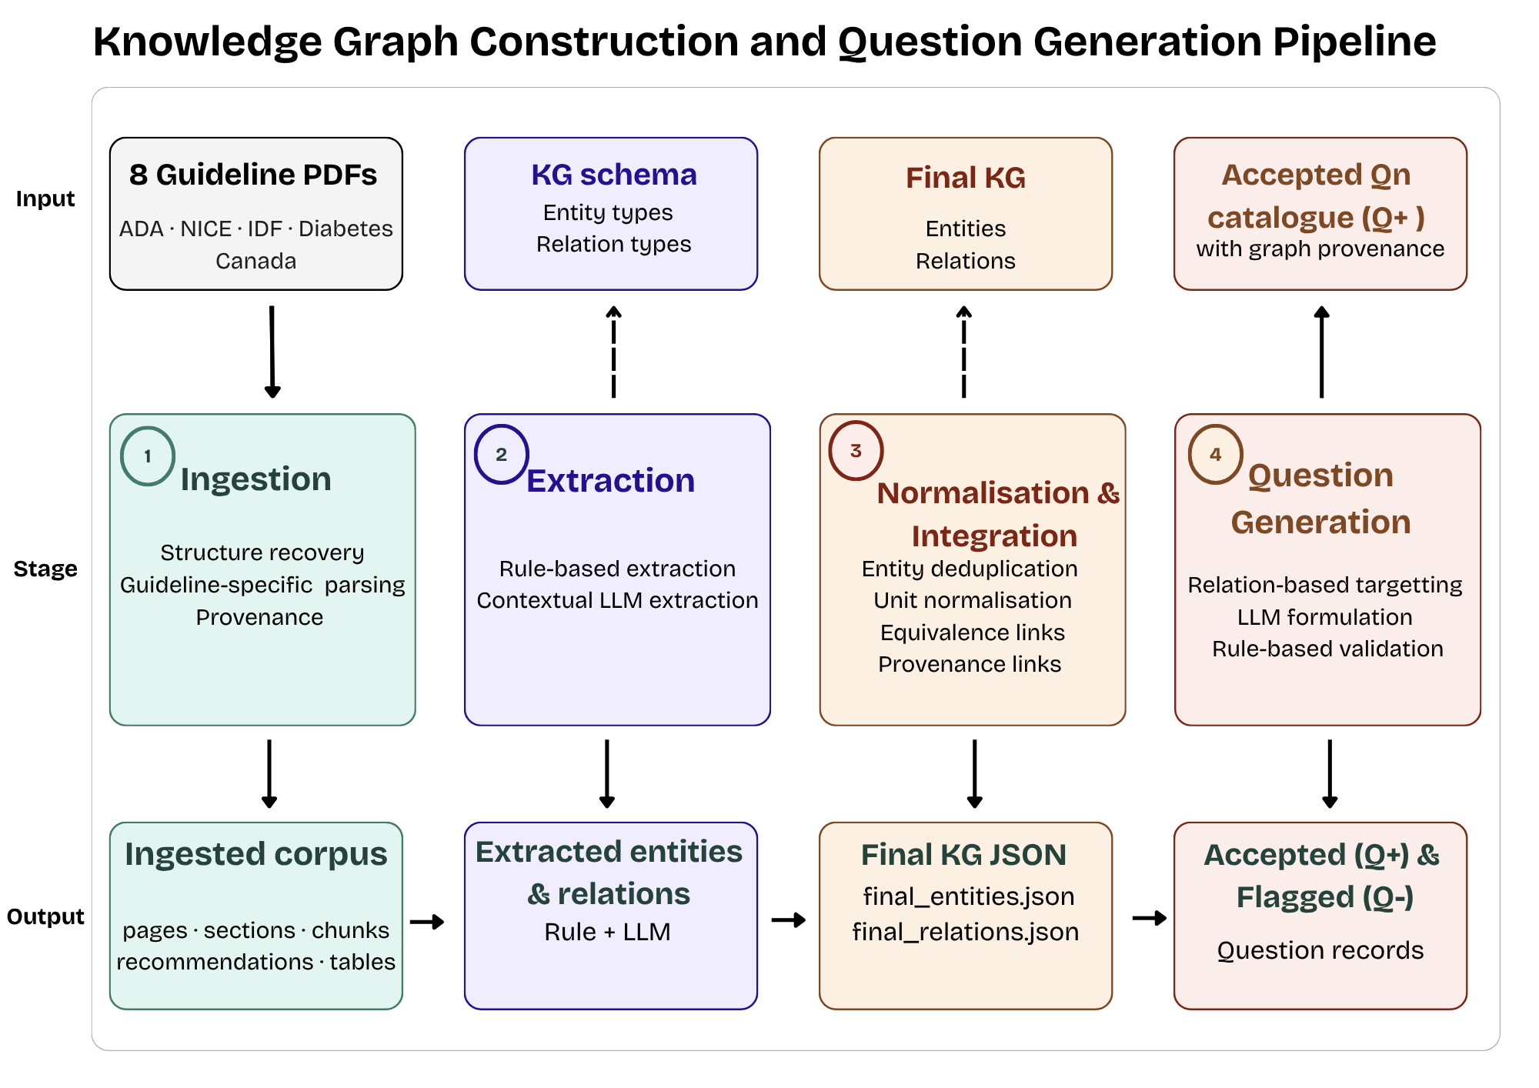
Pipeline overview
Motivation
Background
Approach
Evaluation
Wrap-up
4 stages, clear input and output
Each stage evaluated separately
Architecture general, rules and dictionaries corpus-specific
12 / 36

Slide 13
Challenges of a multi-guideline setting
Motivation
Background
Approach
Evaluation
Wrap-up
Challenge
Example
Handled in
Structural heterogeneity
clean text vs extraction artefacts, no uniform layout
Ingestion
1
Terminological variation
fpg = fasting plasma glucose = fasting glucose
Deduplication
2
Unit inconsistency
126 mg/dL = 7.0 mmol/L
Unit normalisation
3
LLM adding information
invented indication, or an age the source never states
Constrained extraction, anchored questions, validation
4
Entity scoping
a drug is one global node, a threshold stays per organisation
Schema, deduplication, EQUIVALENT_TO
5
13 / 36

Slide 14
Corpus: 8 documents, 4 organisations
Motivation
Background
Approach
Evaluation
Wrap-up
Organisation | Documents | Pages | Recs | Tables | Layout | Glucose unit
ADA | Standards of Care 2026 | 377 | 176 | 113 | 3 columns, numbered recs | mg/dL
NICE | NG17, NG28 | 188 | 216 | 0 | numbered, graded statements | mmol/litre
IDF | Global Recommendations 2025 | 112 | 10 | 21 | prose, care-tier tables | mmol/L and mg/dL
Diabetes Canada | CPG 2018, 4 chapters | 22 | 17 | 8 | journal-style | mmol/L
Total | 8 documents | 699 | 419 | 142
Four selection criteria: geography and system, clinical coverage, format diversity, recommendation specificity
Grading differs: ADA A to E, NICE strength ratings, Diabetes Canada A to D
14 / 36

Slide 15
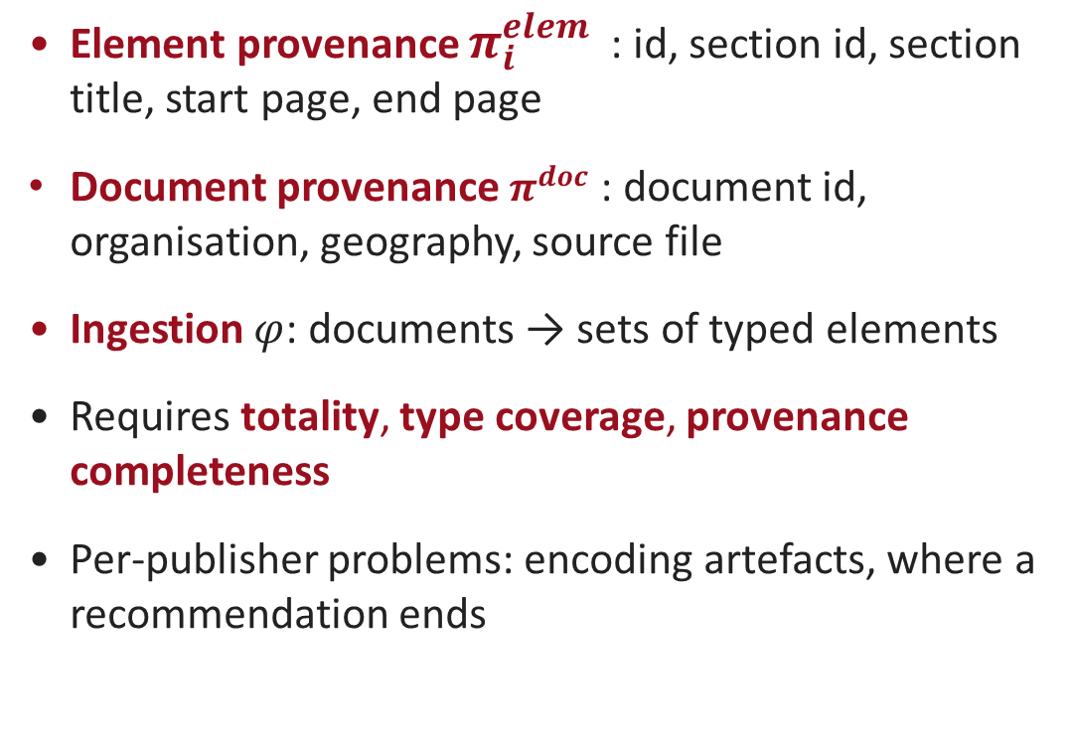
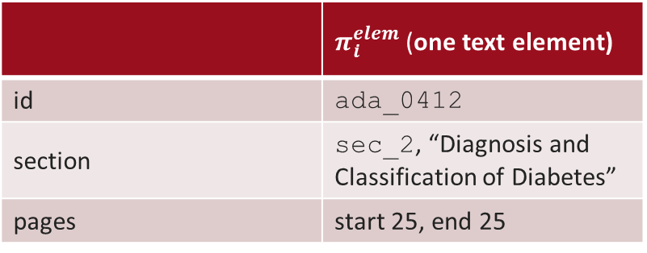
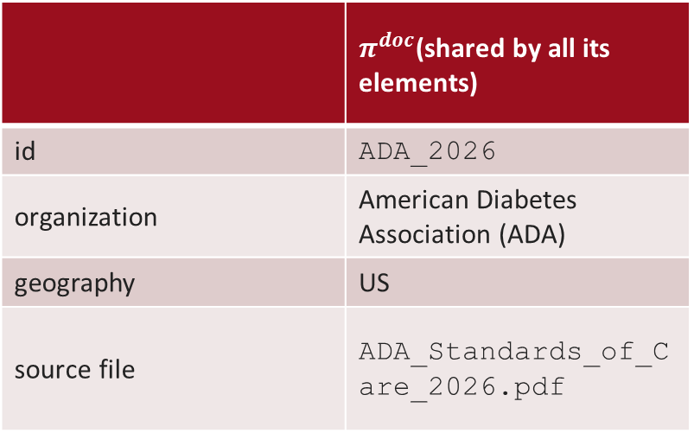
Formal ingestion model
Motivation
Background
Approach
Evaluation
Wrap-up
 | $π_{i}^{elem }$(one text element)
id | ada_0412
section | sec_2, “Diagnosis and Classification of Diabetes”
pages | start 25, end 25
Element provenance $π_{i}^{elem }$: id, section id, section title, start page, end page
Document provenance $π^{doc}$: document id, organisation, geography, source file
Ingestion $φ$: documents → sets of typed elements
Requires totality, type coverage, provenance completeness
Per-publisher problems: encoding artefacts, where a recommendation ends
 | $π^{doc}$(shared by all its elements)
id | ADA_2026
organization | American Diabetes Association (ADA)
geography | US
source file | ADA_Standards_of_Care_2026.pdf
15 / 36

Slide 16
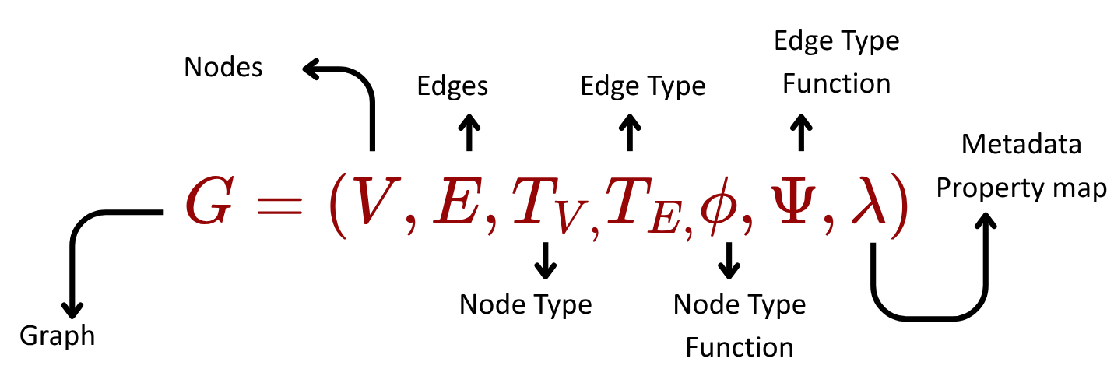
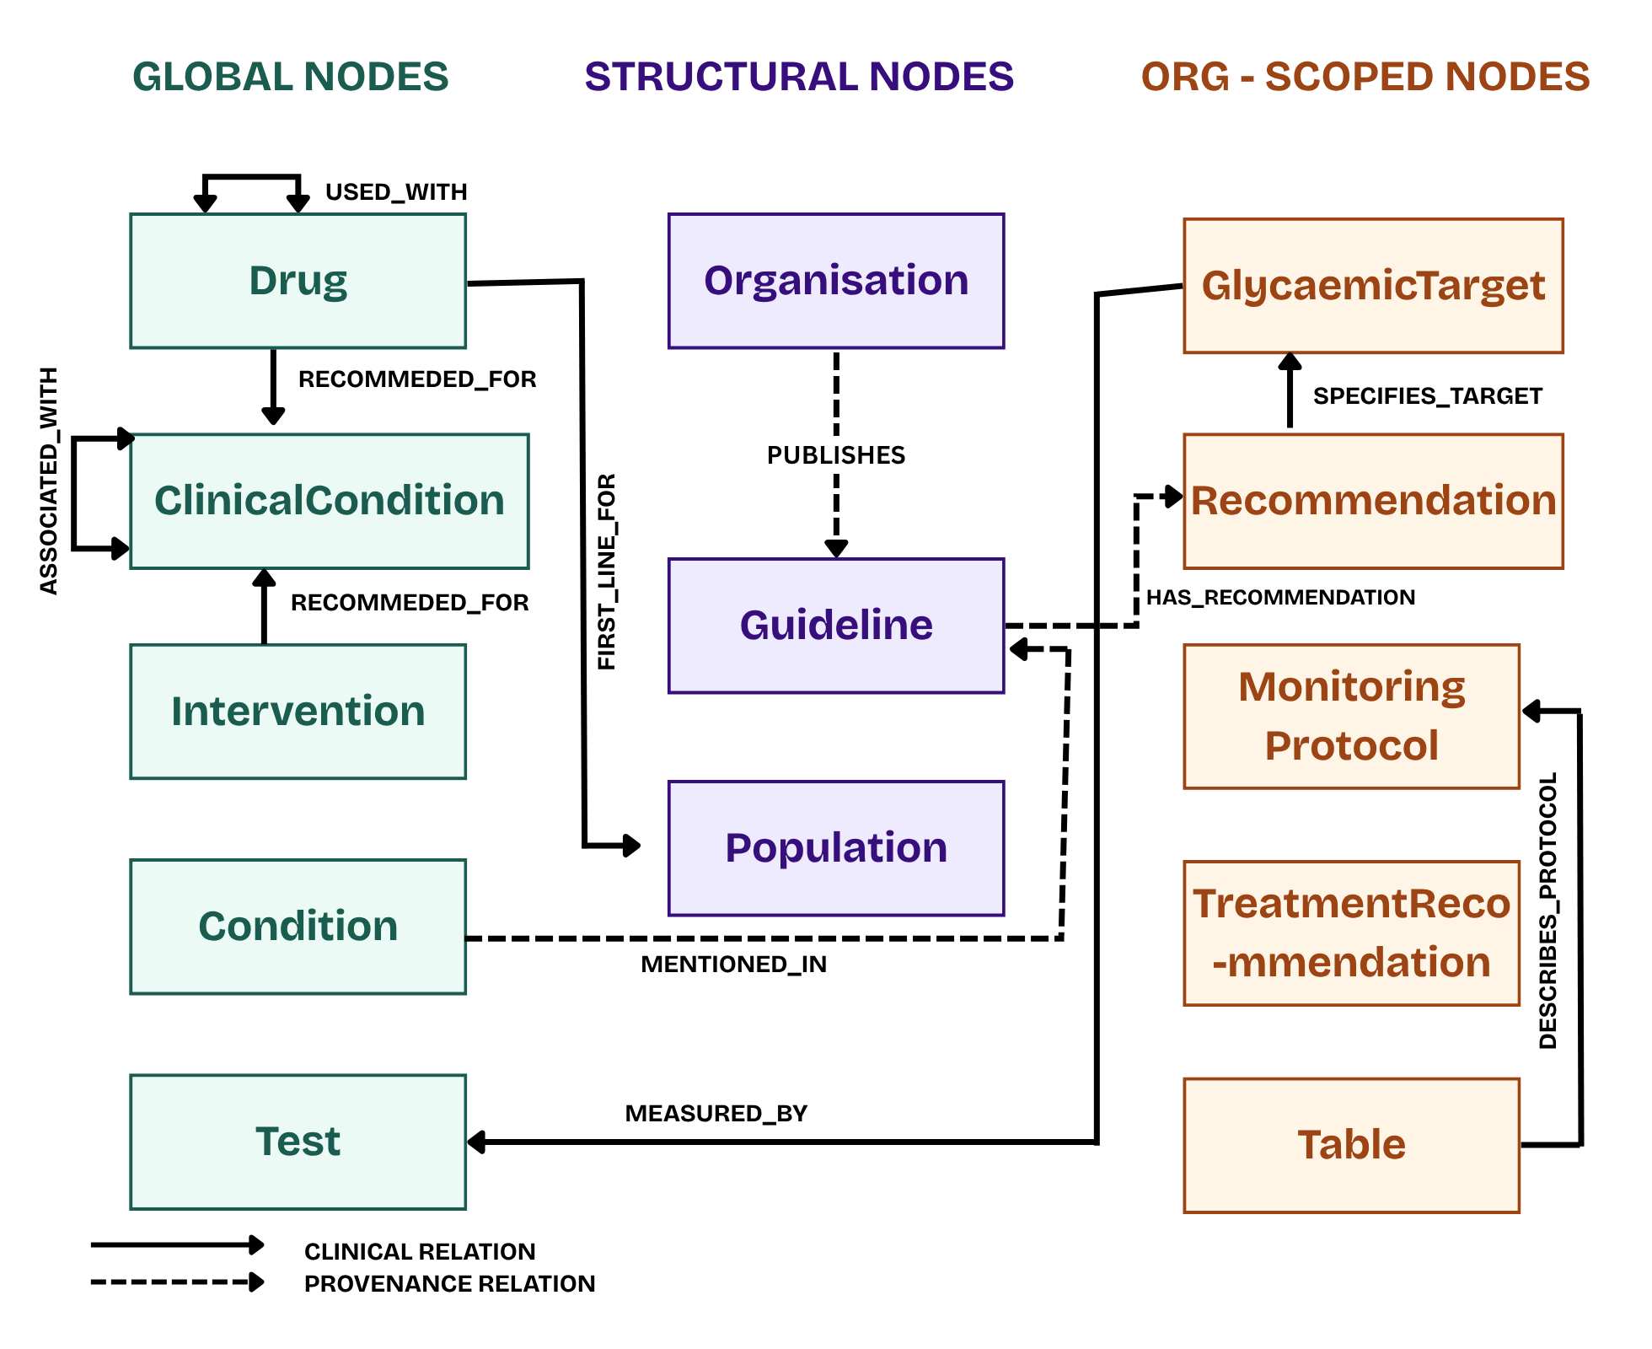
Graph schema
Motivation
Background
Approach
Evaluation
Wrap-up
13 node types in 3 scopes
18 relation types
Properties + provenance on nodes and edges
Global: Drug links guidelines
Scoped: GlycaemicTarget stays per organisation
16 / 36

Slide 17
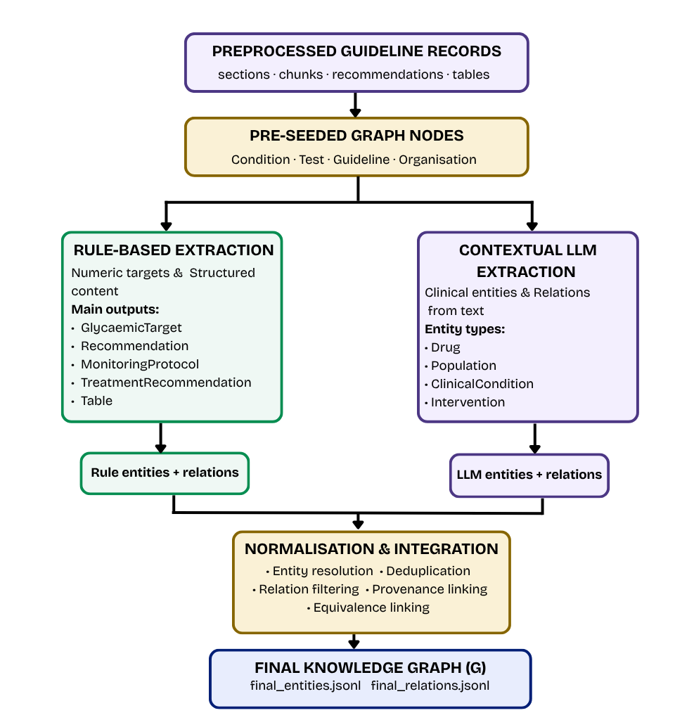
Dual-layer extraction
Motivation
Background
Approach
Evaluation
Wrap-up
Rule layer example
FPG
≥
7.0
mmol/L
metric
operator
value
unit
Rule layer: numeric targets, protocols
LLM layer: drugs, populations, conditions
Each type goes to one layer, chosen up front
Method label on every record
18 / 36

Slide 18
Deduplication and integration
Motivation
Background
Approach
Evaluation
Wrap-up
fpg
Names
normalise the string, then apply the alias list
FPG
fasting plasma glucose
one Test node
Targets
exact match on metric, units, operator, value
fasting glucose
Scope
global types merge across the corpus, organisation-scoped only within one organisation
Alias list fixed at design time, unlisted variants stay separate.
Integration
LLM duplicates of canonical entities are dropped
duplicate relations collapse into one
provenance of merged records = union
19 / 36

Slide 19
Unit normalisation and equivalence
Motivation
Background
Approach
Evaluation
Wrap-up
ADA
÷ 18.0 = 7.0 mmol/L
EQUIVALENT_TO edge
FPG ≥ 126 mg/dL
same metric
same operator
same rounded value
different organisations
IDF
FPG ≥ 7.0 mmol/L
Diabetes Canada
Stated by no guideline
FPG ≥ 7.0 mmol/L
The original value and unit stay on the node.
20 / 36

Slide 20
Unit conversions
Motivation
Background
Approach
Evaluation
Wrap-up
mmol/L = mg/dL ÷ 18.0
126 mg/dL → 7.0 mmol/L. Using 18.016 gives the same rounded values for this corpus.
HbA1c (mmol/mol) = (HbA1c % − 2.152) ÷ 0.09148
IFCC relation (Hoelzel et al., 2004). Both forms are stored on the node.
HbA1c is converted and stored but not compared, so it creates no equivalence edges.
21 / 36

Slide 21

Question generation: the graph decides what is asked
Motivation
Background
Approach
Evaluation
Wrap-up
α Targeting
β Formulation
$γ$ Validation
rule-based, no LLM
LLM wording
rule-based
Anchor: Condition, has_target, FPG ≥ 7.0 mmol/L, plus guideline and page
“What is the threshold for diagnosing diabetes in adults using a Fasting Plasma Glucose (FPG)”
Answer 7.0 mmol/L or higher comes from the graph node, not from the LLM
The graph decides what is asked. The LLM decides how it is phrased.
22 / 36

Slide 22
Validation: three checks
Motivation
Background
Approach
Evaluation
Wrap-up
1
Answer matches the anchor
Pass: Q+
answer key consistency
added to the catalogue
2
No numbers outside the anchor
hallucinated number detection
Fail: Q−
3
No wrong organisation
Example: question says 8.0 mmol/L, check 2 flags it. Goes to manual review, not thrown away.
guideline attribution
Checks consistency with the anchor, not clinical correctness
23 / 36

Slide 23
Outline
Motivation
Background
Approach
Evaluation
Wrap-up
1
Motivation
Why comparing guidelines is hard, aims, contributions
2
Background
Knowledge graphs, LLMs and grounding, related work
3
Approach
Pipeline, normalisation, question generation
4
Evaluation
Graph, equivalence links, questions, clinical review
5
Wrap-up
What it shows, limits, conclusions
24 / 36

Slide 24
Experimental setup
Motivation
Background
Approach
Evaluation
Wrap-up
Corpus
Question runs (not pooled)
Baseline
8 documents, 4 organisations
full pipeline
GPT-4o-mini: full run, 1,289 questions
Claude Opus 4.8: partial run, 491 questions, used for review
rule-only generator
one template question per anchor, no LLM
Evaluation questions
Four formats, one graph?
Cross-guideline links?
Consistent, varied questions?
Sound for clinicians?
25 / 36

Slide 25
Two question-generation runs
Motivation
Background
Approach
Evaluation
Wrap-up
GPT-4o-mini
Claude Opus 4.8
full run
1,289 questions, 1,280 accepted
source of the catalogue statistics
3048 Reformulations
4328 Total Phrasings
partial run, stopped early (token cost)
491 validated questions
source of the 30 reviewed questions
1035 Reformulations
1526 Total Phrasings
The two runs are never pooled.
26 / 36

Slide 26
The final graph
Motivation
Background
Approach
Evaluation
Wrap-up
2,503
nodes, 13 types
3,485
edges, 18 types
2,275 → 1,942
LLM entities after deduplication
27 / 36

Slide 27
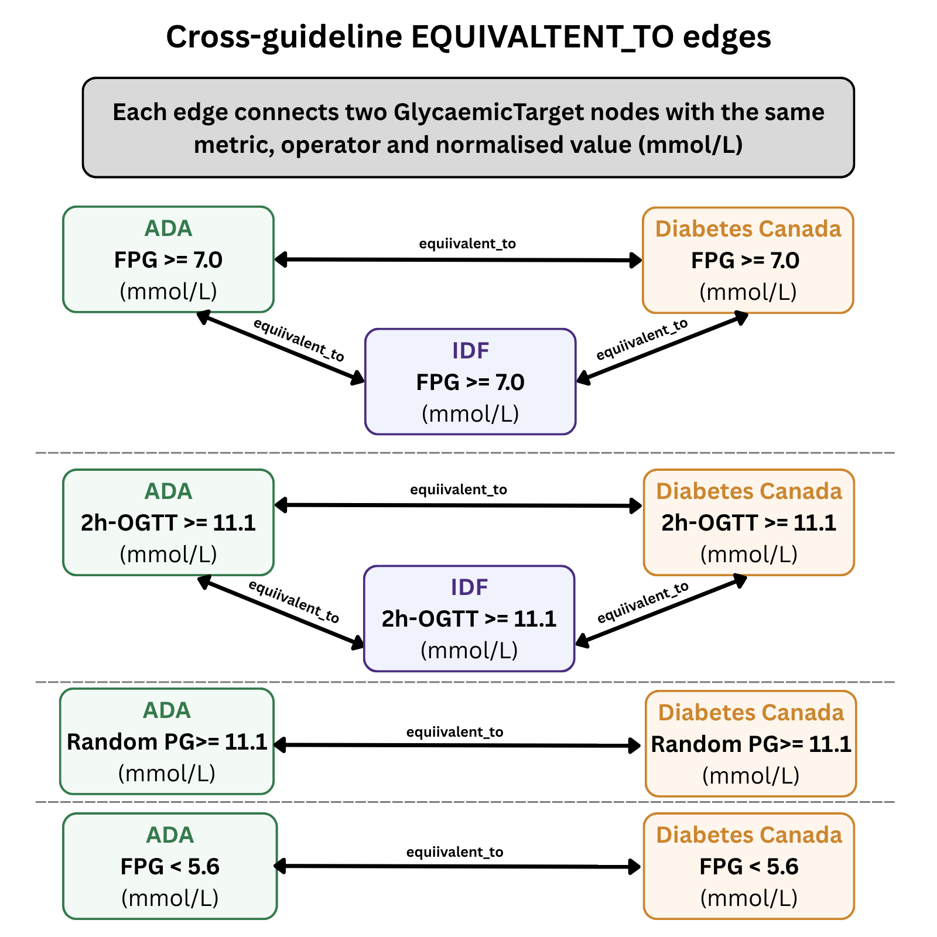
Cross-guideline equivalence
Motivation
Background
Approach
Evaluation
Wrap-up
8
3
EQUIVALENT_TO edges
organisations agree on two thresholds
FPG ≥ 7.0 and 2h-OGTT ≥ 11.1: ADA, IDF, Canada
2 single pairs: random PG, FPG < 5.6
No NICE target under the criterion
Plasma glucose only, HbA1c not compared
28 / 36

Slide 28
Generated questions
Motivation
Background
Approach
Evaluation
Wrap-up
1,280
9
294
4,328
accepted of 1,289 (99.3%)
flagged for review
questions with MCQ options
phrasings, 3.38 per anchor
 | Rule-only | Hybrid
Pass rate | 100% | 99.3%
MCQs | 0 | 294
Phrasings per anchor | 1.00 | 3.38
The baseline passes by construction: fixed template, no LLM.
29 / 36

Slide 29
Question types and methods
Motivation
Background
Approach
Evaluation
Wrap-up
first_line_for → which
“Which pharmacological approach is recommended for managing blood glucose in people with diabetes who are at higher risk of hypoglycaemia?”
manages → how (vignette)
“A middle-aged man with type 2 diabetes and recently diagnosed stable heart failure presents for a medication review . Which management strategy should be prioritised?”
equivalent_to → how (cross-guideline)
“How does the fasting plasma glucose threshold used to diagnose diabetes compare between the American Diabetes Association and Diabetes Canada guidelines?”
Type follows the relation type, not the model

Slide 30
Human clinical review
Motivation
Background
Approach
Evaluation
Wrap-up
2 doctors, 15 questions each, no overlap
Blind to the model, provided with question text along with the canonical question
26 accepted, 3 clear failures, 1 borderline
Failure example (Q9)
Metformin –MANAGES→ hypoglycaemic events: not supported by the source
All 3 failures: wrong graph relation, not wrong wording
31 / 36

Slide 31
Outline
Motivation
Background
Approach
Evaluation
Wrap-up
1
Motivation
Why comparing guidelines is hard, aims, contributions
2
Background
Knowledge graphs, LLMs and grounding, related work
3
Approach
Pipeline, normalisation, question generation
4
Evaluation
Graph, equivalence links, questions, clinical review
5
Wrap-up
What it shows, limits, conclusions
32 / 36

Slide 32
Limitations
Motivation
Background
Approach
Evaluation
Wrap-up
1
Extraction
2
Entity matching
3
Equivalence
LLM extraction not checked against annotated data
fixed alias lists, unlisted variants stay separate
plasma glucose only, HbA1c not compared
4
Validator
5
Human review
6
Generalisability
checks consistency, not clinical correctness. Vignette details only checked for numbers
30 questions, 2 reviewers, from the Opus run
one corpus, publisher-specific ingestion rules
Question quality is bounded by graph quality

Slide 33
Conclusions and future work
Motivation
Background
Approach
Evaluation
Wrap-up
Contributions
Future work
four-stage pipeline
dual-layer extraction
equivalence edges
graph-anchored questions
check LLM extraction against annotated data
HbA1c equivalence (adds NICE)
Docling with GPU as parser
larger review, another domain
2,503
3,485
8
1,280
nodes
edges
equivalence edges
accepted questions
35 / 36

Slide 34
Thank you! Questions
?

Slide 35
B1. Schema rules for targets and Population
Motivation
Background
Approach
Evaluation
Wrap-up
HAS_TARGET only if the source names the condition (24 edges for 46 targets)
SPECIFIES_TARGET needs a Recommendation or Table
MENTIONED_IN created during normalisation
Population is structural: “older adults” vs “aged 70 and older”, merging loses the source phrasing
17 / 36

Slide 36
B2. What the evaluation shows
Motivation
Background
Approach
Evaluation
Wrap-up
Combines diverse guidelines into one queryable graph
Normalisation reveals cross-guideline links (8 edges, 8 questions)
Controlled generation: fixed anchors, model phrasing, validator checks
Control ≠ correctness: quality depends on the quality of the graph
Use: comparison, lookup, educational questions, not a replacement for guidelines
33 / 36

