Slide 1
Audio Processing SYSTEM Professional Experience introduction
Smith.Hu (胡峻哲)
+886986211886
smith.a1672@gmail.com

Slide 2
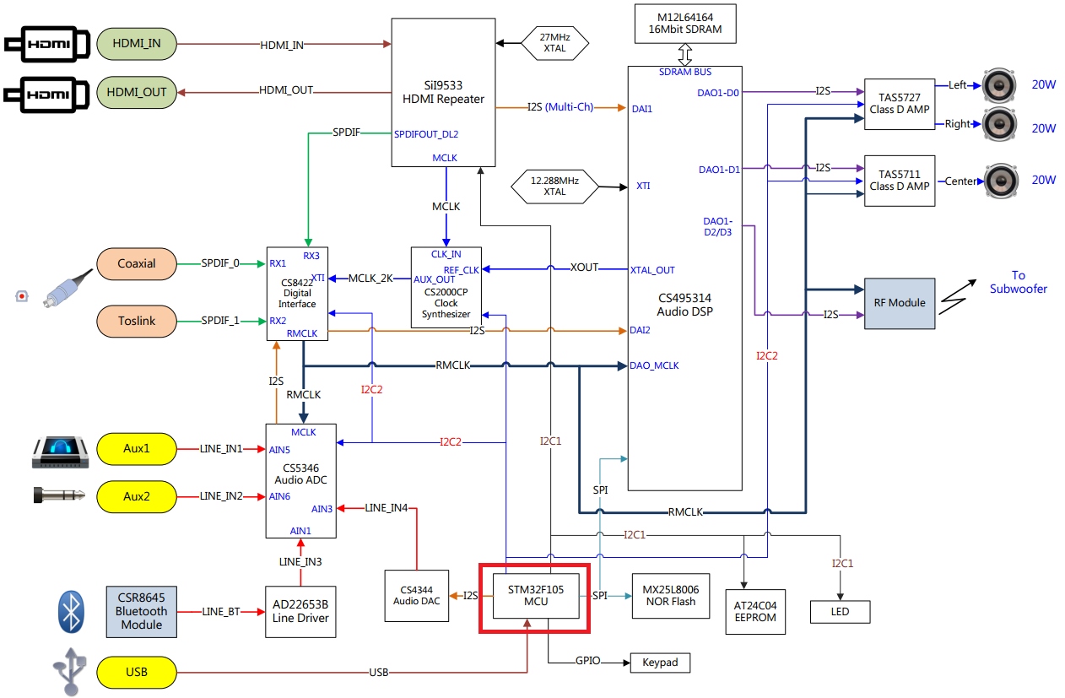
Audio Processing System

Slide 3
Audio Processing System
Design Material
I2C, RS-232/UART, SPI, ADC, I2S, GPIO
Bare-metal programming.
MCU bootloader.
USB pen driver, UART firmware upgrading.
RTOS Porting (FreeRTOS)
Memory management, Mutexes, Multitasking, Message Queues, Interruption Management…etc.
Modular design and porting.
Audio CODEC, ADC, DAC, LED indicators, IR remote decode.
Assistant debug tool
Experience in Audio Precision
Digital multimeters, Oscilloscope, Logic analyzer.
Tracking System
Git, JIRA, Redmine

