Slide 1
HOUSEHOLD FOOD SPENDING & TAXATION
EVIDENCE FROM STATE AND YEAR FIXED EFFECTS (2020-2024)
Research Motivation
Structural shifts in the economy since 2020 may have changed how grocery (FAH) and restaurant (FAFH) tax rates affect household food spending, and these effects may vary by state and income group. Prior USDA research on food taxes relies on the National Household Food Acquisition and Purchase Survey (FoodAPS) rather than the Current Population Survey (CPS), which offers a larger and more demographically detailed alternative for TWFE regression
276,077
50 states + Washington DC
Household-level
Observations
Panel Design
USDA Food Expenditure Series • Current Population Survey

Slide 2
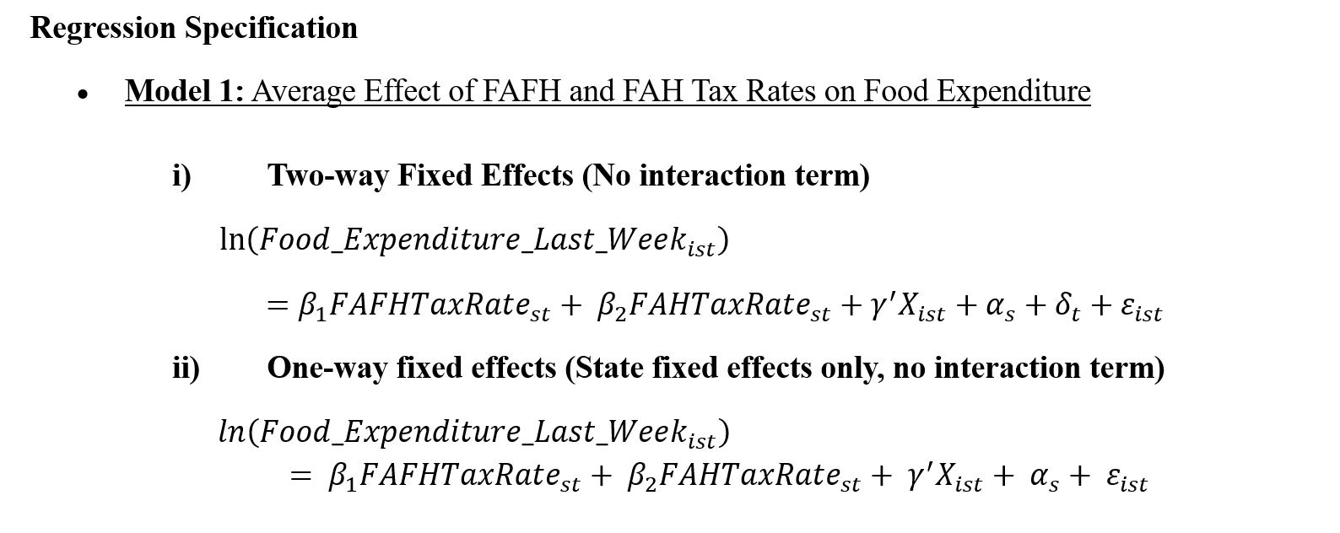
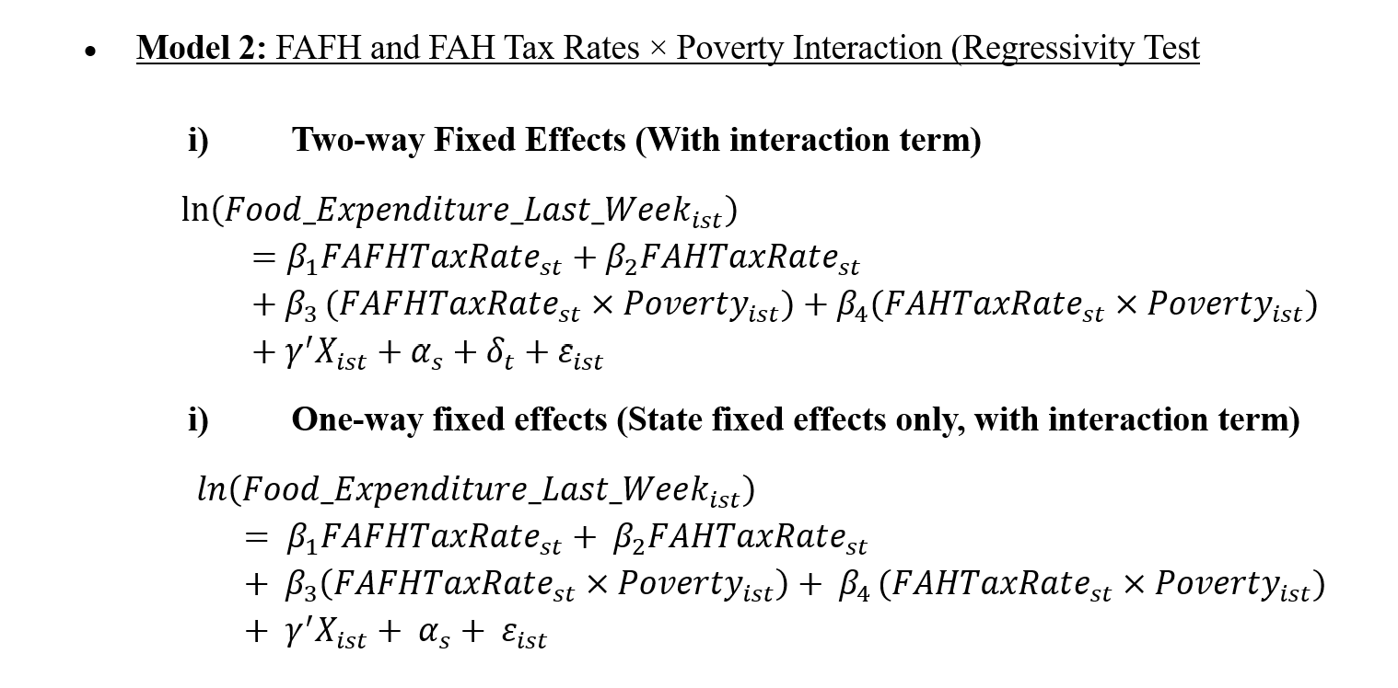
Research Objectives
To examine whether changes in FAH and FAFH sales tax rates affect household food spending across U.S. states + Washington DC (2020–2024), controlling for state and year fixed effects
To test whether the effect is regressive for households below 185% of the poverty line
Note: This study captures both pandemic shocks (2020–2021) and post-pandemic stabilization (2022–2024)

Slide 3
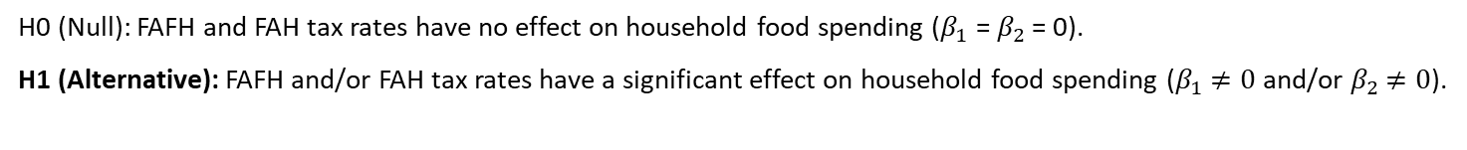
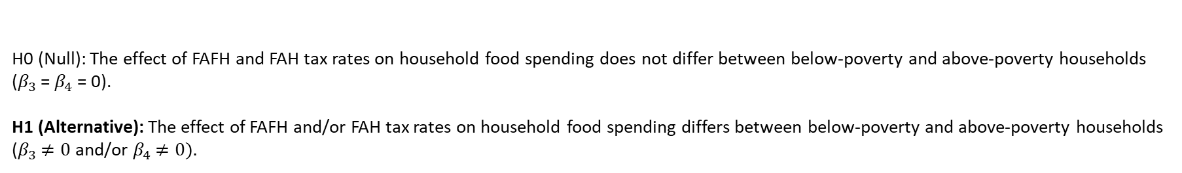
Hypotheses + Findings
Model 1
H0 (Null): FAFH and FAH tax rates have no effect on household food spending ($β_{1}$ = $β_{2}$ = 0).
H1 (Alternative): FAFH and/or FAH tax rates have a significant effect on household food spending ($β_{1}$ $≠0$and/or $β_{2}$ $≠0$).
Findings: Neither FAFH nor FAH tax rates show a statistically significant effect on food spending when tested without accounting for income differences.
Under one-way FE (no year controls), FAFH becomes significant and positive, while FAH turns significant and negative
Model 2
H0 (Null): The effect of FAFH and FAH tax rates on household food spending does not differ between below-poverty and above-poverty households ($β_{3}$ = $β_{4}$ = 0).
H1 (Alternative): The effect of FAFH and/or FAH tax rates on household food spending differs between below-poverty and above-poverty households ($β_{3}$ $≠0$and/or $β_{4}$ $≠0).$
Findings: FAH increases raise spending 0.97% for below-poverty households versus 0.54% for above-poverty households. FAFH show no significant effect for either group. Under one-way FE, FAFH turns positive (significant) for below-poverty households and FAH’s effect for below-poverty households becomes negative (marginally significant). The 1.8× regressivity gap itself stays stable and remains statistically significant in both specifications, confirming TWFE, as the preferred model.

Slide 4
Implications & Policy Takeaways
Translating a regressivity finding into where policy attention belongs
01
02
Grocery taxes are regressive; restaurant taxes are neutral
Focus policy attention on grocery taxation
Poorer households are more sensitive to grocery (FAH) tax changes and bear a heavier burden. Restaurant (FAFH) taxes show no comparable effect for any income group.
Policy debates should prioritize FAH tax design over FAFH. A targeted rebate (tax credit, direct payment, or benefit program) puts relief directly into the hands of below-poverty households (71,545 households - 25.9% of the sample), closing the 1.8× burden gap without spreading limited resources to households who aren't disproportionately affected
Note: results come from a fixed-effects panel design, which controls for state and year differences but does not establish causality — tax changes may correlate with other unobserved state-level shifts.

