Slide 1
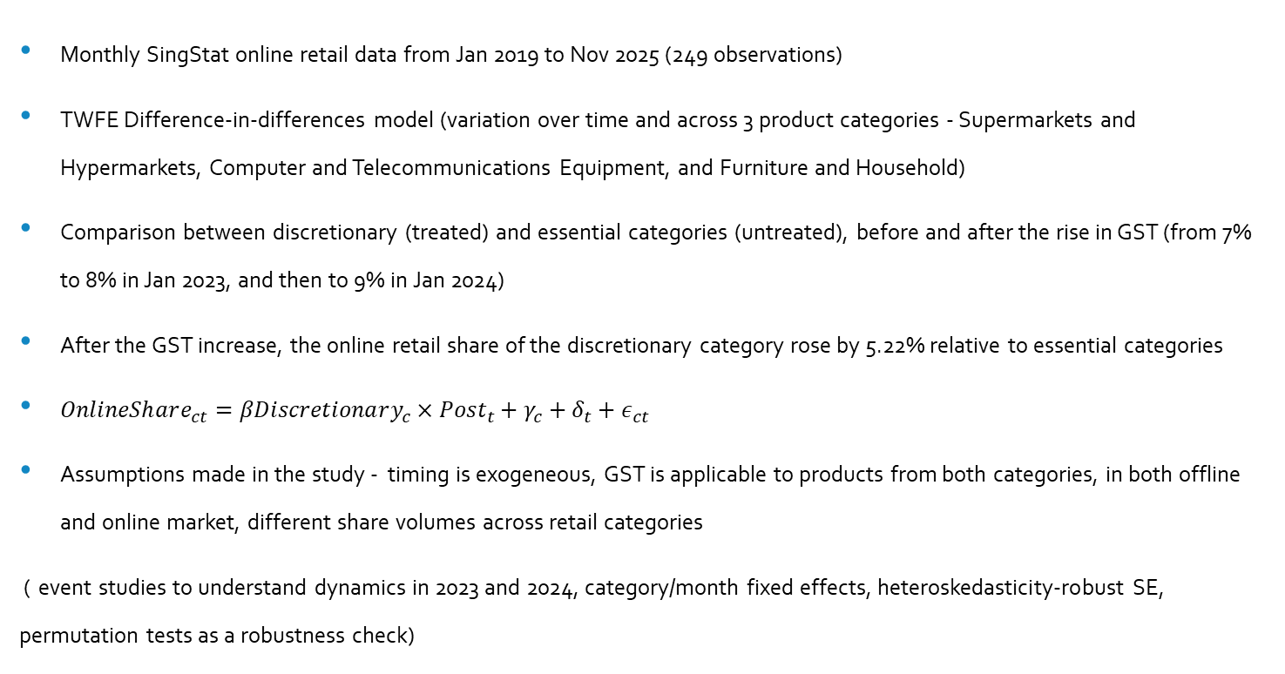
SUMMARY OF PAPER Do GST Increases Induce a Shift Toward Online Retail?
Monthly SingStat online retail data from Jan 2019 to Nov 2025 (249 observations)
TWFE Difference-in-differences model (variation over time and across 3 product categories - Supermarkets and Hypermarkets, Computer and Telecommunications Equipment, and Furniture and Household)
Comparison between discretionary (treated) and essential categories (untreated), before and after the rise in GST (from 7% to 8% in Jan 2023, and then to 9% in Jan 2024)
After the GST increase, the online retail share of the discretionary category rose by 5.22% relative to essential categories
$OnlineShare_{ct}=βDiscretionary_{c}×Post_{t}+γ_{c}+δ_{t}+ε_{ct}$
Assumptions made in the study - timing is exogeneous, GST is applicable to products from both categories, in both offline and online market, different share volumes across retail categories
( event studies to understand dynamics in 2023 and 2024, category/month fixed effects, heteroskedasticity-robust SE, permutation tests as a robustness check)

Slide 2
STRENGTHS
There is clear explanation to every concept the author has used. Have given honest explanation on limitations of the study.
The author has economically interpreted the results
The event study is estimated separately for the January 2023 and January 2024 GST increases.
The sample is restricted to a window of six months before and six months after the policy, to focus on short-term adjustments
Rigorous DiD with event studies, specified that it is not causal evidence
Heteroscedasticity robust standard errors rather than clustering by category
LIMITATIONS
Small cross-section (n=3 categories) limits clustering and power (permutation p=0.333)
Data is a limitation
Uses category totals, not individual shopping data – can't see who made purchases or why online sales were high/low
COVID e-commerce boom + platform sales might explain the shift, not just GST

Slide 3
Improvements
Formatting – times new roman, 12, justify the paragraphs, 1.5 line space, bold numbered headings
A few sections in the paper – 1 paragraph has only 2-4 lines. Merge for better flow
Few repetitions, can remove where unnecessary
Consolidate limitations into single final section post-results
Add more categories for robust inference -clustered SE
Include DiD for 2023 and DiD for 2024 to make a comparison between the coefficients (Does 2nd hike (2024) have larger effect than 1st (2023)?)
The author mentions on COVID but would be good to test fake treatment dates (ex:2021)
Have added visuals only to show parallel trends but can conduct F-test

Slide 4
Question
1. You have mentioned on parallel trends through a graph, and you cannot test it. Can you help me understand reasons behind it? There were no pre-trends in your graph

