Slide 1



Virtual Quiz Portal Stress Testing and Analytics Engine
PRESENTED BY
K.Devasmithaa-1924260156
Notes:
1

Slide 2

TABLE OF CONTENT
Abstract
Introduction
Problem Identification and Analysis
Solution Design and Implementation
Result and Recommendation
Reflection on Learning and Personal Development
Conclusion
Reference

Slide 3
ABSTRACT
🎯 Develop a Virtual Quiz Portal for conducting secure online examinations.
👨‍💻 Design a Server–Client Network to enable smooth communication between users and the server.
⚡ Implement a Concurrent Submission Server in Python to handle multiple student submissions simultaneously.
📊 Perform Load Behaviour Analysis to evaluate system performance under heavy traffic.
📈 Monitor key metrics such as response time, throughput, and error rate.
🔒 Ensure secure data storage, reliable quiz delivery, and automatic result generation.
🚀 Build a scalable and efficient platform that provides a seamless online examination experience.

Slide 4
INTRODUCTION
🌐 Online examinations have become an essential part of modern education and training.
📚 Traditional quiz systems often struggle with heavy user traffic, causing delays and server issues.
💻 The Virtual Quiz Portal provides a secure platform for conducting online quizzes and instant evaluation.
⚡ A Concurrent Submission Server ensures that multiple students can submit their quizzes simultaneously without data loss.
📊 The Load Behaviour Analysis module evaluates system performance by measuring response time, throughput, and error rates under different workloads.
🎯 The project aims to build a reliable, scalable, and efficient quiz platform that delivers a smooth experience for both students and administrators..

Slide 5
PROBLEM IDENTIFICATION AND ANALYSIS
Many existing online quiz systems experience performance issues when a large number of users attempt quizzes simultaneously. Common problems include slow page loading, delayed result generation, server crashes, and poor user experience. These issues can negatively impact students during important examinations.
Another challenge is the lack of detailed analytics that provide insights into user performance and system health. Without proper monitoring, administrators cannot easily identify weak areas or optimize the platform.
The key problems identified are:
Poor performance during high user traffic.
Increased response time and server overload.
Limited monitoring of system performance.
Lack of detailed quiz analytics and reporting.
Difficulty in identifying performance bottlenecks before deployment.

Slide 6
SOLUTION DESIGN AND IMPLEMENTATION
Module 1 – Exam Server–Client
Develops a client-server based exam system
The server manages quiz questions, submissions, and results.
Multiple clients (students) can connect to the exam server.
Provides communication between students and the server.
Ensures quiz data is handled efficiently.
Module 2 – Concurrent Submission Server in Python
Developed using Python to handle multiple submissions simultaneously.
Uses concurrent processing to manage requests from many students.
Receives and stores answers submitted by different clients.
Measures response time and submission success rate.
Helps test the server under high concurrent traffic.
Module 3 – Load Behavior Analysis
Analyzes system behavior under different user loads.
Monitors response time, server load, throughput, and errors.
Identifies performance bottlenecks.
AI analyzes the collected load and performance data.
Provides suggestions for improving system performance.

Slide 7
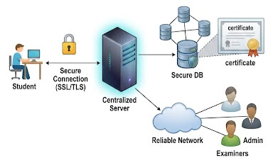
MODULE 1- Exam Server-Client
NETWORK DESIGN
🏗️ Architecture
Client–Server communication model
Centralized Exam Server
Secure Database Integration
🔄 Working
Student logs into the portal
Server verifies credentials
Quiz is delivered securely
Responses are stored in the database
🎯 Key Features
Secure communication
Fast data transfer
Reliable network connectivity
Centralized data management
The network consists of one central exam server connected to ten student computers through a network switch. All devices are placed on the same Local Area Network (LAN).

Slide 8
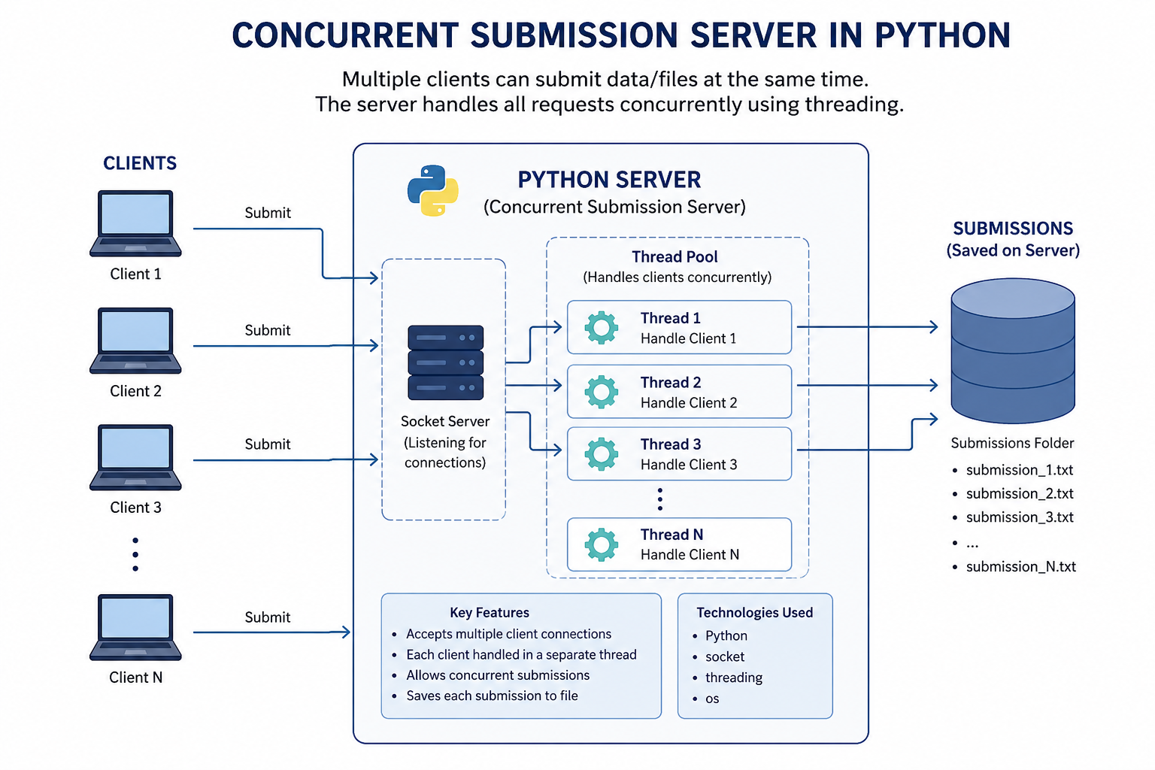
MODULE 2 -Concurrent Submission Server in Python
Objective
The objective of this module is to develop a multi-threaded Python server that can accept and process multiple exam submissions from different student clients simultaneously. The server ensures that every submission is received, processed, and acknowledged without data loss.
Key Features
Accepts multiple client connections. Uses socket programming for communication.Creates a separate thread for each connected client.Receives and stores exam submissions.Sends a confirmation message to each client.

Slide 9
🎯 Goal
Enable multiple students to submit exams simultaneously without delays or data loss.
⚙️ Action
Develop the server using Python.
Accept multiple client connections concurrently.
Process each submission independently.
Store responses securely in the database.
Generate results automatically after submission.
✅ Result
Smooth handling of concurrent submissions.
Faster and reliable processing.
Accurate data storage.
Improved user experience during online examinations.

Slide 10
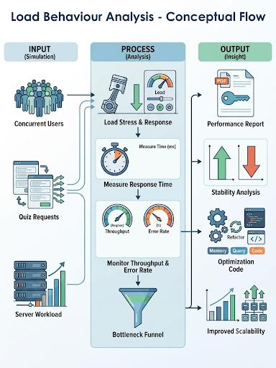
MODULE 3- Load Behaviour Analysis
📥 Input
Simulated concurrent users
Quiz submission requests
Server workload
⚙️ Process
Execute stress testing
Measure response time
Monitor throughput & error rate
Detect performance bottlenecks
📤 Output
Performance report
System stability analysis
Optimization recommendations
Improved scalability

Slide 11
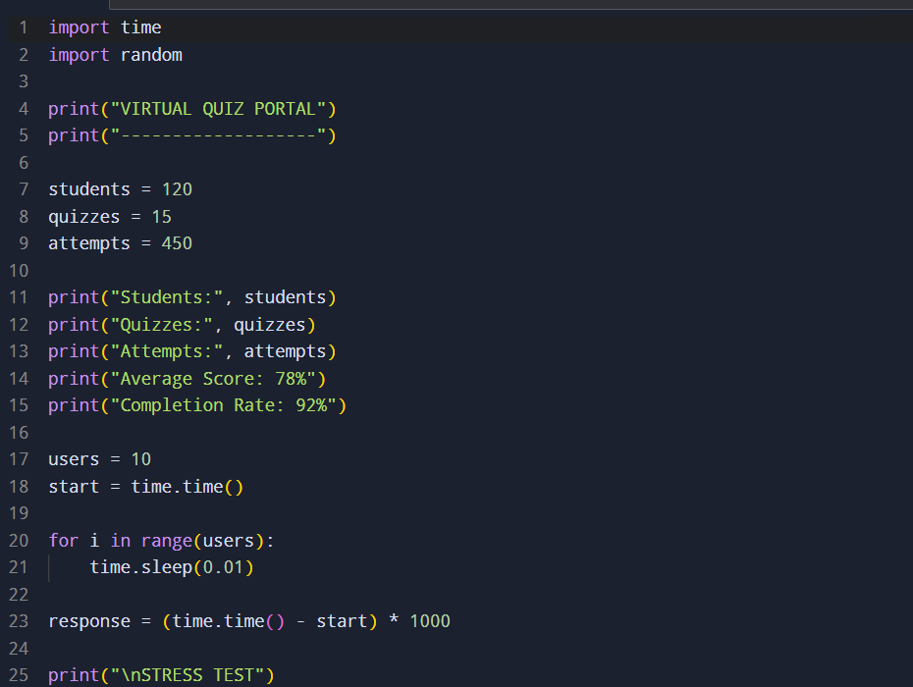
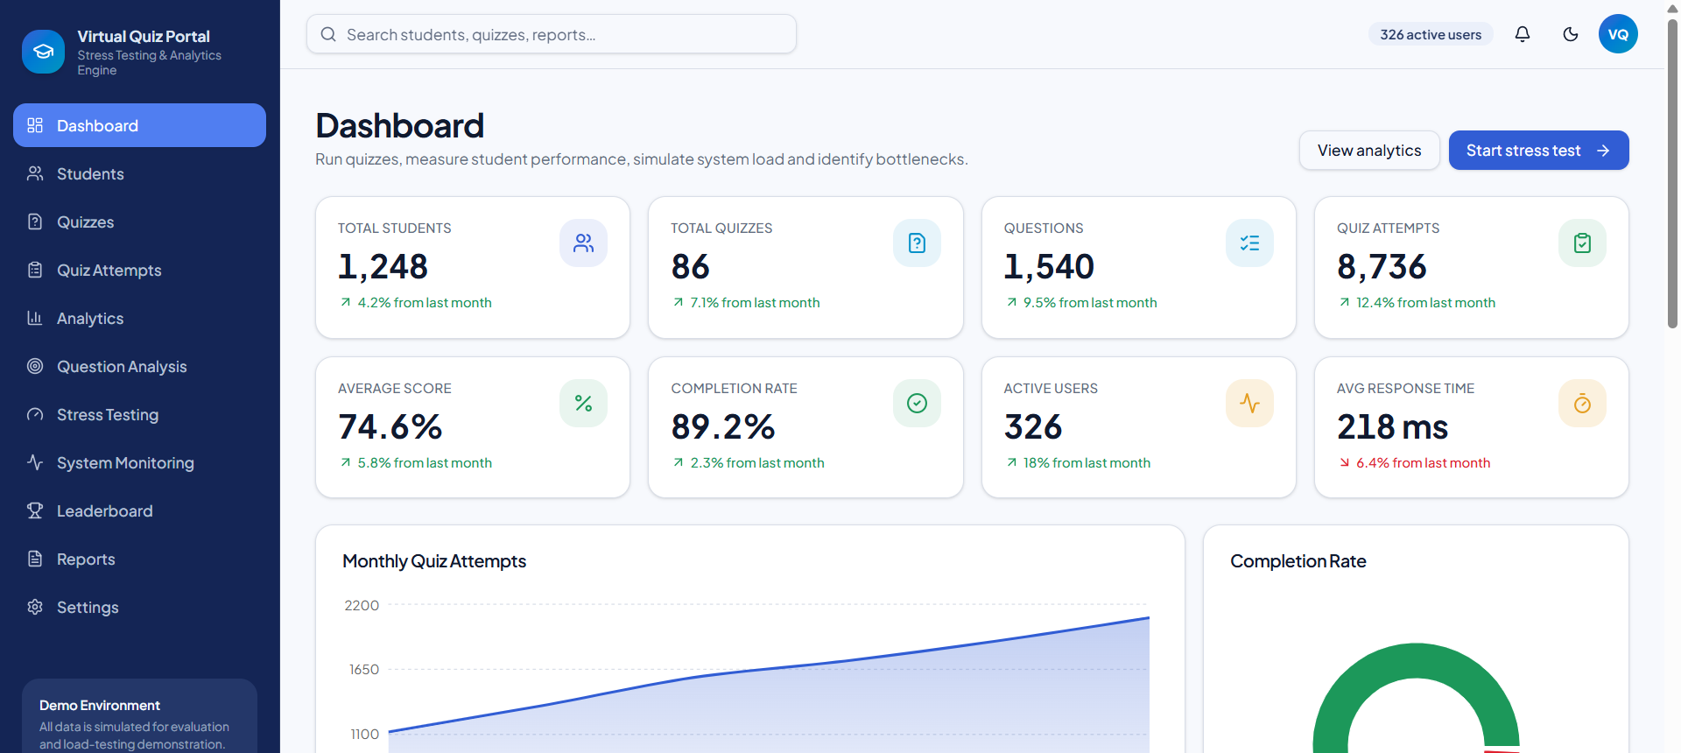
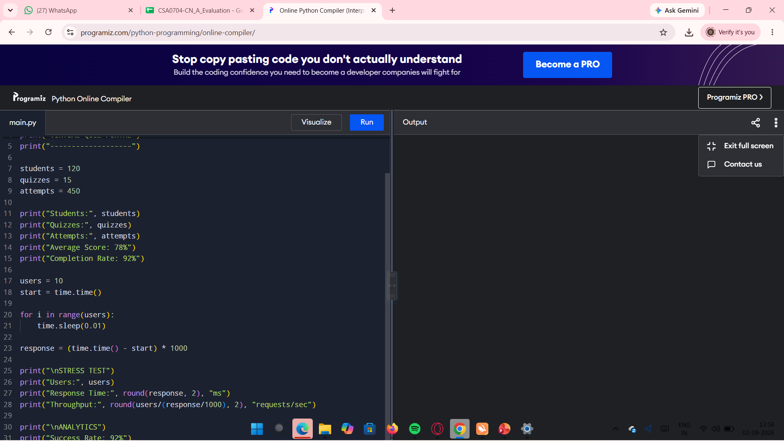

Slide 12
RESULT AND RECOMMENDATION
Successfully developed the Exam Server-Client system.
Multiple clients can connect to the server and attend the exam.
The Concurrent Submission Server in Python handles multiple answer submissions simultaneously.
Successfully measured response time and submission performance.
Load behavior analysis shows how system performance changes as user load increases.
Identified server overload, increased response time, and performance bottlenecks under high load.
Generated performance data for analysis and reporting.
The system helps improve the reliability, efficiency, and scalability of the virtual quiz portal.

Slide 13
RESULT ON LEARNING AND PERSONAL DEVELOPMENT
Learning Outcomes
Learned to design a client-server based quiz system.
Gained practical knowledge of Python and concurrent programming.
Learned to perform stress testing with multiple users.
Developed skills in performance monitoring and data analysis.
Improved problem-solving and debugging skills.
Engineering Standards
Followed proper software development and testing practices.
Focused on reliability, performance, and scalability.
Used structured methods for data collection and analysis.
Considered security and efficient resource usage.
Applications of the Project
Used for online examinations and college quizzes.
Helps test systems before large-scale examinations.
Identifies server bottlenecks and performance issues.
Supports system optimization and better user experience

Slide 14

APPLICATIONS
Where the System Can Be Used
Schools and Colleges
Universities
Online Learning Platforms
Corporate Training Programs
Certification Exams
Recruitment and Placement Tests

Slide 15
Conclusion
Improves the performance and reliability of the virtual quiz portal.
Identifies server overload and performance issues during high user traffic.
Reduces response time and system errors.
Monitors important parameters such as users, response time, and error rate.
Provides useful analytics and reports for administrators.
Helps identify performance bottlenecks before deployment.
Ensures a stable, efficient, and user-friendly quiz system.

Slide 16
REFERENCES
Python Software Foundation, "Python Socket Programming Documentation.“
IEEE research papers on client–server architectures for online examination systems.
Documentation on multi-threaded server design and concurrency in Python.
Standard references on load testing and performance analysis methodologies.

Slide 17
Thank you

