Slide 1

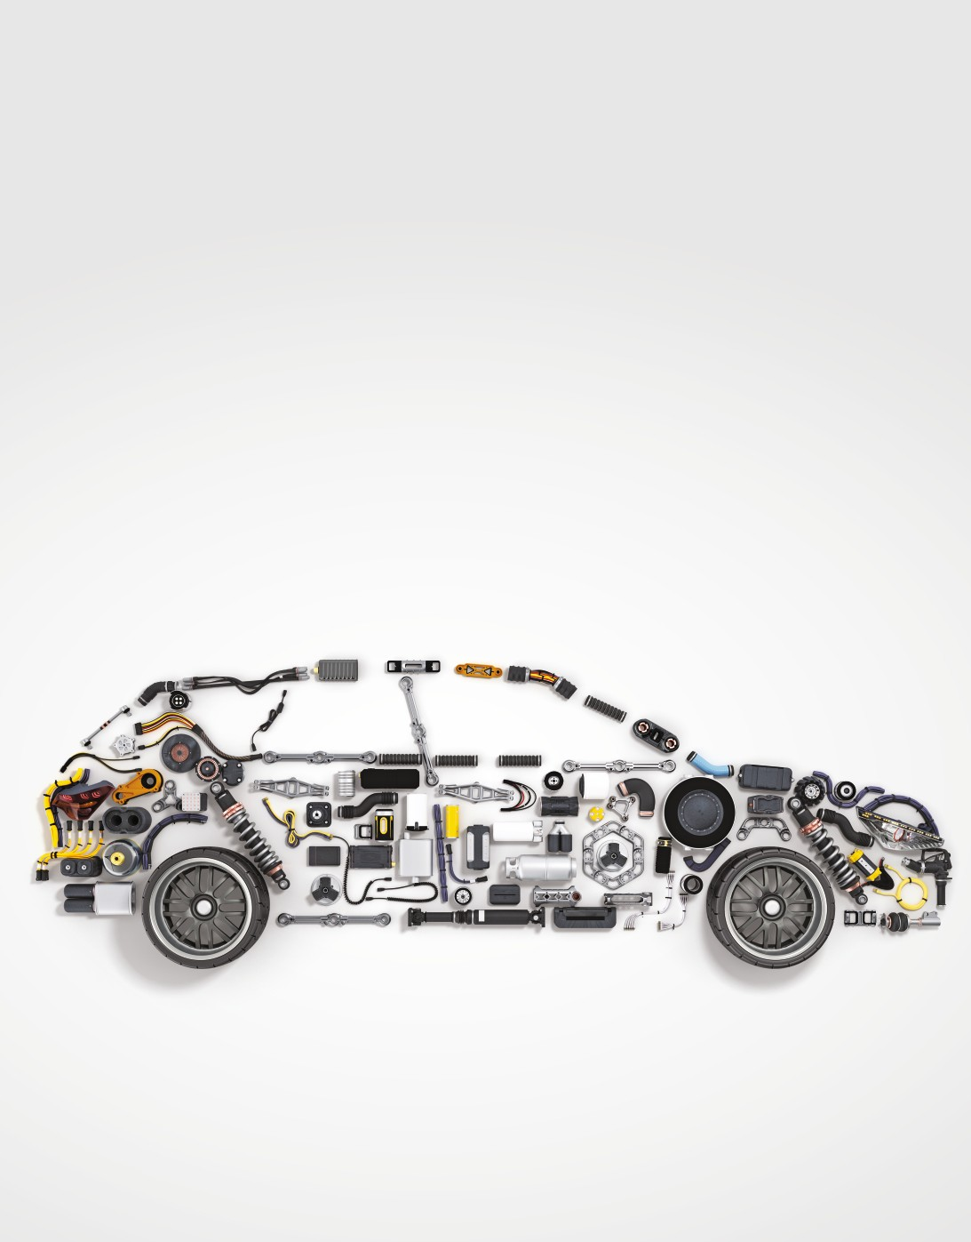




Beneﬁt from India’s Growing Automotive Ecosystem.
NFO Period:
17th May - 31st May 2024
The classiﬁcaNon of companies following the automoNve & allied business acNviNes theme will be largely guided by AMFI industry classiﬁcaNon. For more details, refer Scheme InformaNon Document.

Slide 2







OPPORTUNITIES IN THE INDIAN AUTOMOTIVE SECTOR
Growing per capita income and a young and growing working age population have contributed to India becoming the 4th largest automobile market in the world in terms of domestic sales. Also, India ranks as the 3rd largest automobile industry in the world in terms of production. The share of the automotive sector to India’s GDP has risen to 7.1% as of February 2023 from a mere 2.8% in 1992! This growth has also led to a positive spillover effect on the auto ancillary sector whose turnover has grown from US$
39.05 billion in FY2016 to US$ 69.70 billion* in FY2023.
*AutomoNve Component Manufacturers AssociaNon of India (ACMA), IBEF
KEY FACTORS - THE INVESTMENT POTENTIAL IN INDIA’S AUTOMOTIVE THEME
Income Growth:
In the US, the number of cars per 1000 people is 860, in Germany it is 627 whereas in China the number is 223. In contrast, India still has around 34 cars per 1000 people.
Industry Growth Projections:
The automotive industry in India is projected to grow from $117 billion in 2023 to US$ 188 billion by 2029 (Source: Mordor Intelligence). The auto components sector currently stands at US$ 71 billion is expected to reach $130 billion by Fy29. (Source: Ricardo Analysis).
EV Market Evolution:
The EV (Electric Vehicle) market in India is forecasted to expand from $5.61 billion in 2023 to $37.7 billion by 2028, (Source: Mordor intelligence).
Vehicle Credit Expansion:
As per RBI data, vehicle ﬁnance is among the largest loan segments within retail and commercial credit. The total vehicle loan book is around ` 15 trillion as on date, and it is growing at mid-to-high teens over the last couple of years.
Government Policies and Initiatives:
Policies like the Production Linked Incentive (PLI) scheme, 100% FDI allowance, Automotive Mission Plan (AMP) 2016-26, Vehicle Scrappage Policy (Launched in 2021), and Faster Adoption and Manufacturing of Hybrid & Electric Vehicles (FAME) scheme are expected to drive industry growth and innovation.

Slide 3








PERFORMANCE OF THE BENCHMARK
The Nifty Auto TRI Index comprising of 16 stocks has been taken as a representative for the automotive theme. The index represents auto related sectors like Automobiles 4 wheelers, Automobiles 2 & 3 wheelers, Auto Ancillaries and Tyres.
The value of INR 1000 invested in Nifty Auto TRI since inception would have grown to INR 29,303
representing a CAGR of 18.1%. This investment would have multiplied 29 times in over 20 years!
CAGR Returns
1 Year
3 Year
5 Years
10 Years
Since
Inception
Nifty Auto TRI
71.7%
33.9%
23.3%
15.5%
18.1%
Nifty 50 TRI
26.5%
16.9%
15.3%
14.3%
14.1%
Nifty 500 TRI 39.3% 20.5% 18.0% 16.15% 15.1%
Source: NSE Indices. Data as on April 30, 2024. Since IncepNon returns computed is from Jan 01, 2004 for all the indices that is since incepNon date of Nifty Auto TRI. Past performance may or may not be sustained in future. Returns computed are on CAGR basis. For Disclaimer on NSE Indices please refer the last page of the leaﬂet.
ABOUT SBI AUTOMOTIVE OPPORTUNITIES FUND
Investment Objective
The investment objective of the scheme is to generate long-term capital appreciation to unit holders from a portfolio that is invested in equity and equity related instruments of companies engaged in automotive & allied business activities theme. However, there can be no assurance that the investment objective of the Scheme will be realized.
Fund Manager*
Mr. Tanmay Desai
Category
Thematic
Minimum Application
` 5000/- & in multiples of ` 1 thereafter
First Tier Banchmark Index
NIFTY AUTO TRI
Minimum Monthly SIP
Minimum ` 500/- & in multiples of ` 1
Exit Load
For Ongoing basis: 1% of the applicable NAV - If units purchased or switched in from another scheme of the fund are redeemed or switched out on or before 1 year from the date of allotment.
NIL - If units purchased or switched in from another scheme of the fund are redeemed or switched out after 1 year from the date of allotment.
For Details please refer to the scheme informaNon document (SID). *Mr. Pradeep Kesavan is the dedicated fund manager for overseas securiNes.

Slide 4








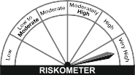
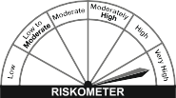
INVESTMENT UNIVERSE FOR THE FUND
Original Equipment Manufacturers (OEMs):
These includes the companies that design, manufacture and sell complete vehicles of all types under their brand names and often have their own manufacturing facilities or assembly lines. OEM’s can be categorised into following -Two-wheeler, three-wheeler, passenger vehicle, commercial vehicle, tractors, off-highway, and construction equipment manufacturers.
AUTO COMPONENT MANUFACTURERS:
Producing various parts for both OEMs and the after market, including engine, electric, transmission, steering, suspension, braking parts, as well as tires and batteries.
Electric Mobility:
Growing focus on EVs due to emission reduction and improving economics. Opportunities exist for EV OEMs and component manufacturers specializing in EV-speciﬁc parts like motors, controllers, batteries, and cooling systems.
Export Potential:
Various automotive subsegments offer signiﬁcant export potential. India can leverage its large domestic market to achieve economies of scale, particularly in areas like forging, casting, and off-highway tyres.
Investment universe consists of many sectors. This is an indicaNve list kindly refer SID for details sectors. The classiﬁcaNon of companies following the automoNve & allied business acNviNes theme will be largely guided by AMFI basic industry classiﬁcaNon.
WHO CAN LOOK TO INVEST
Investors seeking to incrementally allocate in growth opportunities within their overall equity portfolio.
Investors seeking to capitalise on the long-term growth story of automotive demand in domestic & overseas markets.
Investors looking to invest in a portfolio of well researched quality stocks within the automotive theme.
Scheme Riskometer: |  | First Tier Benchmark Riskometer: Nifty Auto TRI
 | Long - term capital appreciation. Investment in equity and equity related instruments of companies engaged in and/or expected to beneﬁt from the growth in automotive & its allied business activities theme.
Investors understand that their principal will be at very high risk |  | The benchmark riskometer is at Very High risk
 | ^Investors should consult their ﬁnancial advisers if in doubt about whether the products is suitable for them.
All information contained herewith is provided for reference purpose only. NSE Indices Limited (formerly known as India Index Services & Products Limited-IISL) ensures accuracy and reliability of the above information to the best of its endeavors. However, NSE Indices Limited makes no warranty or representation as to the accuracy, completeness or reliability of any of the information contained herein and disclaim any and all liability whatsoever to any person for any damage or loss of any nature arising from or as a result of reliance on any of the information provided herein. The information contained in this document is not intended to provide any professional advice.

