Slide 1

JTAG DEBUGGER
Stryker mentor:
Aaron parr
Team members:
Jimena Cuadros
Gregory ostroy
Peter shutt
Austin smith

Slide 2
REQUIREMENTS
id# 001-The NetTag shall allow the user to modify and flash software for the chip on the CC3200 and STM32F4-Discovery board.
id# 002-The NetTag shall provide debugging of software for the chip on the CC3200 and STM32F4-Discovery board.
id# 003-The NetTag shall utilize gdbserver for debugging.
id# 005-The NetTag shall detect the type of chip using the ID register and configure the software appropriately
id# 006-The NetTag shall communicate with the target through JTAG.

Slide 3
…REQUIREMENTS
id# 007-The NetTag shall provide a list of available actions appropriate for the available software for debugging and configuration testing based on the microcontroller, to the programmer.
id# 010-The NetTag shall communicate with the host
B-id# 011-The NetTag physical module shall have the option of being battery powered.
id# 012-The NetTag can be configured to support new targets as required
B-id# 013-The NetTag shall communicate wirelessly

Slide 4

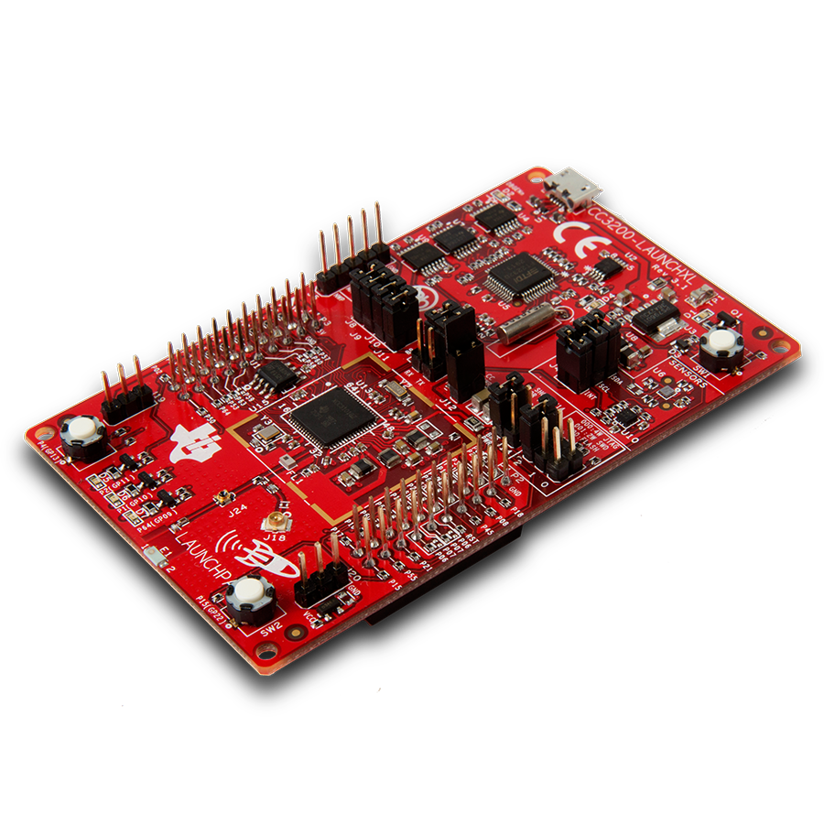
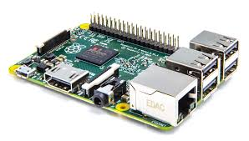
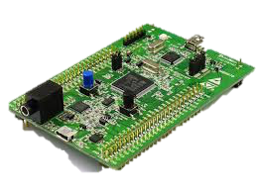
Visual representation
Host
Target
NetTag
Jtag
CC3200
RaspberryPi 2
STM32F4-Discovery

Slide 5

Gui representation
List of possible Binaries that can be selected
NetTag
START
1.bin
2.bin
3.bin
RUN
Script will be called and will return a string
Script receives a string and returns list of possible binaries
Script that will flash, debug,
to step through the code, set break points or watch variables

