Slide 1



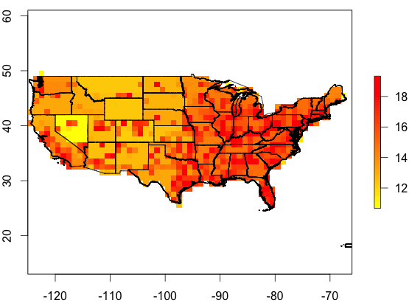
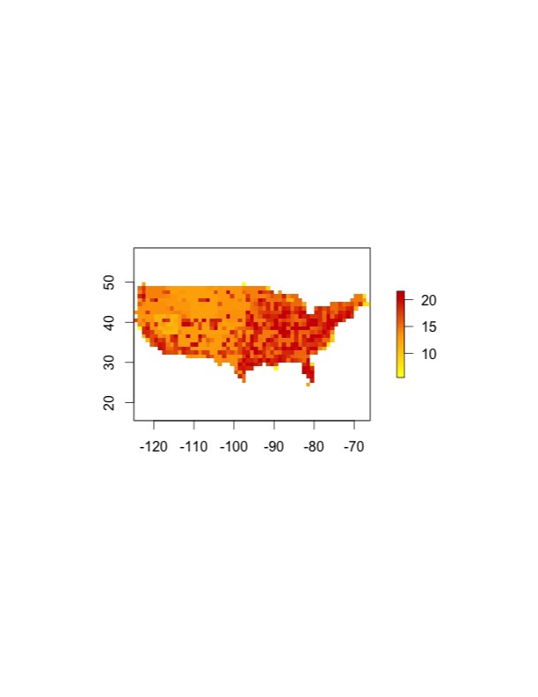
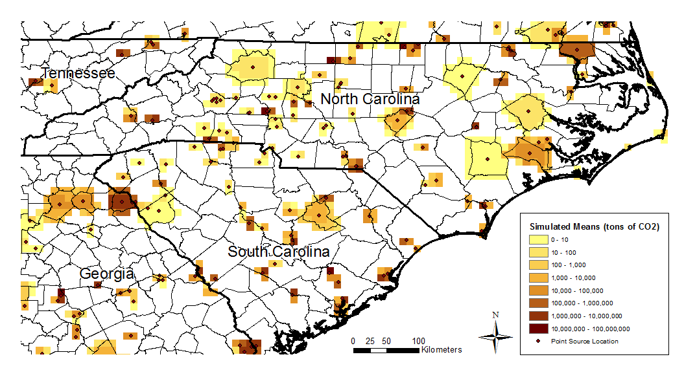
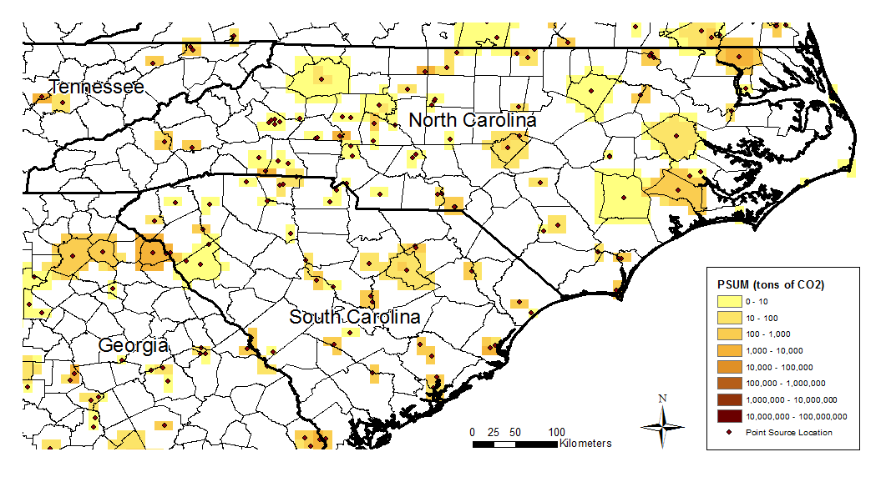
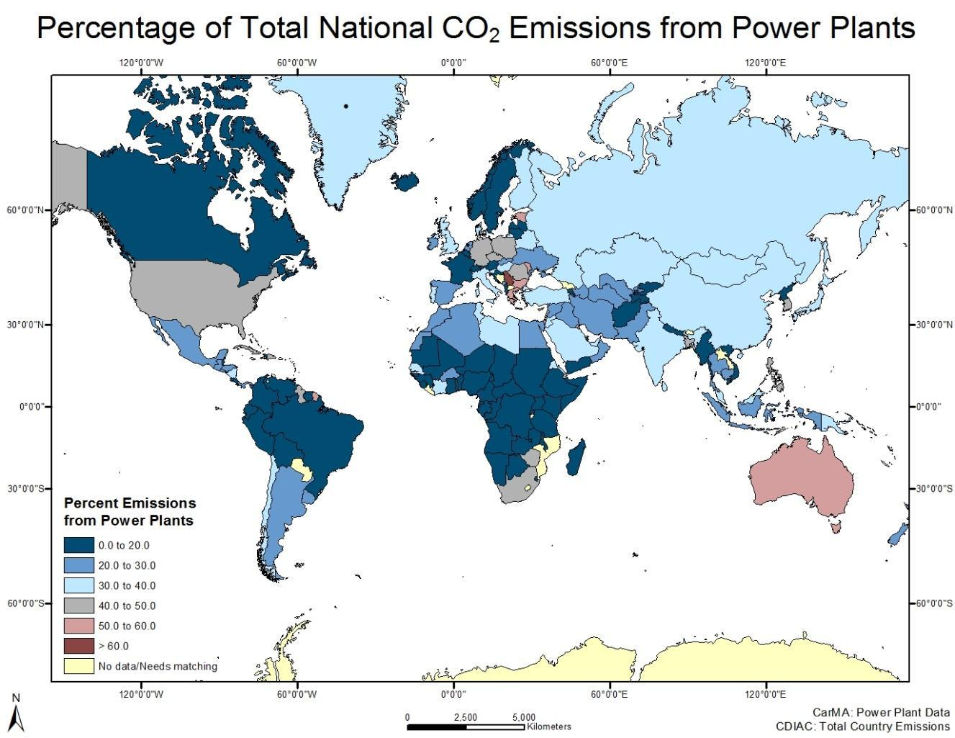
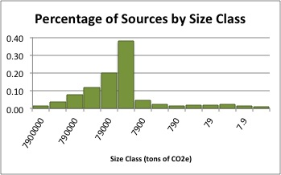
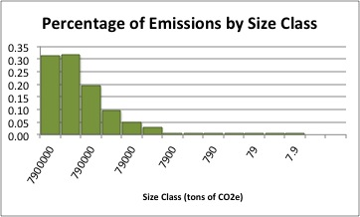
Calculating Uncertainty in Gridded Emissions Products
Susannah Hogue, Maya Hutchins, Dawn Woodard,
Robert Andres, Eric Marland, Gregg Marland
RIEE
Research Institute for Environment,
Energy, and Economics
The Importance of Uncertainty
Spatial Uncertainty in Large Point Sources
CDIAC Test Case
Evidence of Proxy Error
For the improvement of science, improving methods, passing lower levels of uncertainty to downstream models, fine scale attribution, characterizing uncertainty is becoming increasingly important
Random Sample of 500 random points:
68% within 2km of water
(compared to 40.67% of state area)
Average difference in location: 0.84km
Maximum spatial difference: 105.85km
Of the top 81 emitters in eGRID:
60% are farther than 1km from the
actual location
Mean difference in location: 7.94km
Maximum spatial difference: 121.83km
Population density data from LandScan (ORNL) is used as a proxy for emissions. A recent collaborative effort has also separated out large point sources (LPS).
Magnitude Uncertainty for LPS
Spatial Uncertainty for LPS
Magnitude Uncertainty in LandScan (estimate)
Spatial Uncertainty in LandScan (estimate)
Proxy Error in Population Density for Emissions
Lack of agreement at small spatial scales, potential saturation at high population or high night lights levels for some methodologies, and banding in comparisons at low light levels suggest issues with the proxy for emissions.
These data products use different approaches to estimate emissions. All have merit. Ease of use, purpose, format, portability, and accessibility all contribute to the use of the different data products. The differences however are apparent.
Proxy Uncertainty
CDIAC with separate treatment
of power plants
Simulated means are calculated by Monte Carlo simulation based on sample data on the distance between the reported and actual locations of large point sources.
Separate treatment of large point sources drastically reduces the variability in per capita emissions values.
The Components of Uncertainty
The proxy error has been computed by relating the variation in per capita emissions at the state level around the national mean to the expected variation at the grid cell level. This relation follows the relation
Var_{state}• N = Var_{cell}
where N is the average number of cells per state. We also treat ND and LA separately to reduce uncertainty in the rest of the country.
Uncertainty can be broken down in its components which are then analyzed in parts.
Spatial and Magnitude Uncertainty in measured components
Spatial and Magnitude Uncertainty in measured proxies
Uncertainties in the proxy approximation
The point source uncertainty measure (PSUM) is then calculated based on the square difference between the simulated means and the reported emissions value for each power plant.
LPS Uncertainty
Simulated means and PSUM are shown here. Magnitude uncertainty is assumed to be 10.62% (based on Quick 2014).
The Role of Large Point Sources
Total Uncertainty for CDIAC with separate treatment of power plants
In grid cells with a reported point source
In grid cells without a reported point source
LandScan Uncertainty Approximations
Current PSUM estimates include refined calculations based on point source characteristics such as fuel type, proximity to water, and placement within a county.
LandScan uncertainty has yet been released, so we have used some primitive conservative estimates to establish a baseline. Magnitude uncertainty is estimated based on uncertainty estimates from the US Census Bureau at 0.01% and Spatial uncertainty is estimated by evaluating variations from local shifts in the gridded product. As the published resolution of LandScan is 1km, we over estimate the uncertainty with shifts of 0.005 degrees (Just over 0.5km).
Percent of Sources by Size Class in the US
Percent of Emissions by Size Class in the US
One third of all emissions in the US come from only 311 sites.
This research were supported, in part, by NASA Funding, NNH11ZDA001N-CMS and a NASA Student Space Grant

