Slide 1
Apartment Rater
By-Akanksha(akanksha@pdx.edu) And
Smitha Mandhani(smitha@pdx.edu)
Our Github Link-
https://github.com/01akanksha/AppartmentRater

Slide 2
Problem-
When finding the Apartments we have to go to the sites of each apartment and check and compare all the available facilities.
So we are showing area wise all the apartments and the available facilities.
The viewer can compare, rate and book(hold) the apartment and can pay after viewing it actually.
We did Pair Programming and we are using access database and Java REST API (Servlets and jsp) to host the application we have used the GlassFish.
And we have used the MIT license.

Slide 3
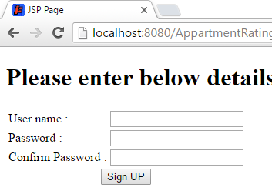
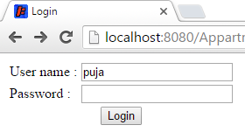
What our web app do?
It is having an option to create an account and then login.
Once we have logged in we can either search all the apartments of the particular area and the bed number we are interested in or compare apartments of that area.

Slide 4
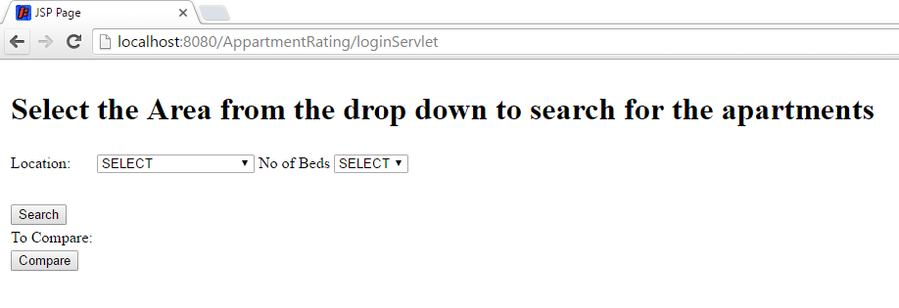
What our web app do? (Continue..)
If we search we will get the all the details of that area and if we compare it will show us the multi select dropdown to select and display details only of the ones we ant to compare.

Slide 5
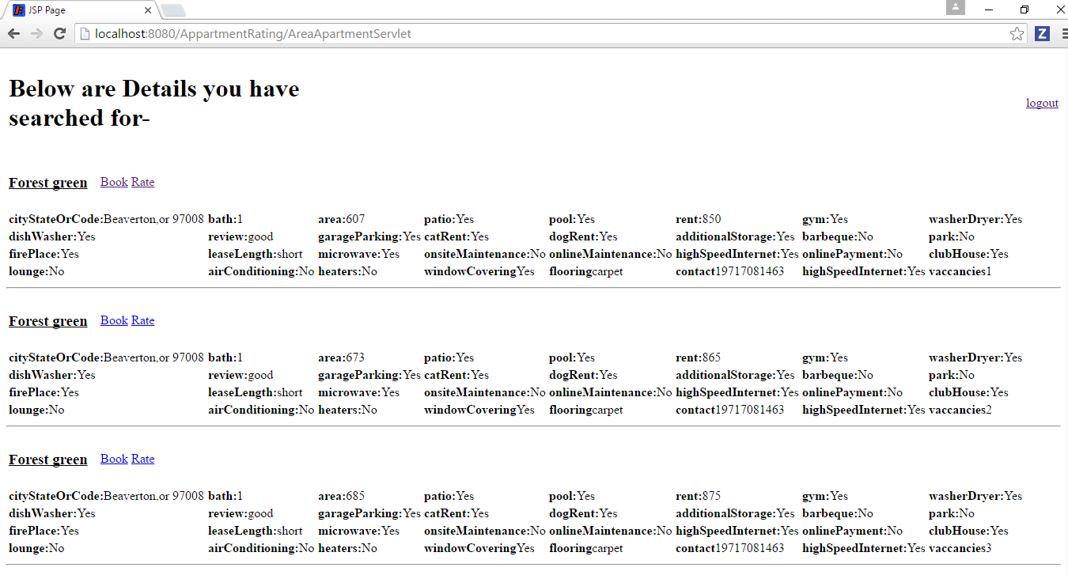
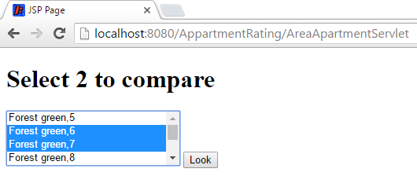
What our web app do? (Continue..)
Search
Compare(display after selection in the similar way as search)

Slide 6
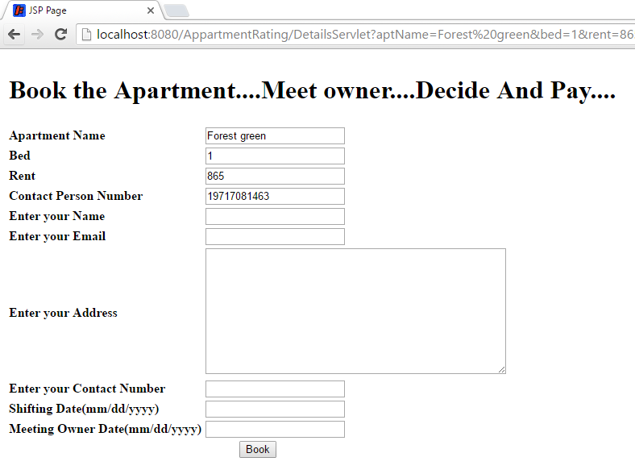
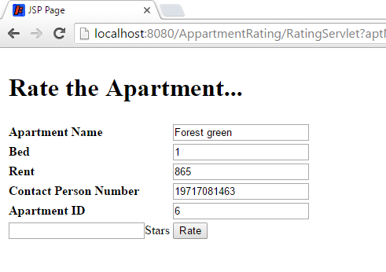
What our web app do? (Continue..)
We can either book from both search and compare page
Or rate the apartment

Slide 7
What our web app do? (Continue..)
Also we can logout from any of the page
User can do multiple Booking(Hold).

Slide 8
Issues we faced and Learnings-
As we were doing this for the first time we were unaware of the fact that jdbc bridge is no more supported in java 8, So we have struggled a lot with the database connectivity .
Then to resolve it we have used ucan access drivers(open source) to connect.
The Email sending on booking.
We have learned how Rest API works,github,OpenSource.

Slide 9
Future Additions
We have to add the email feature when the booking is done
Need to improve the UI
Need to improve the Rating logic
Enhance the database with more areas and switch from Access to any other database tool.
And Once webApp is done we would like to convert it to the Mobile App.

Slide 10
Thanku
Our Github Link-
https://github.com/01akanksha/AppartmentRater

