Slide 1
Internet advertising
Assignment 1- bazc426
Submitted by
smitha .t
(2016mc21032)

Slide 2
Index:
Problem Statement -------------------------------------------------------------------------- 03
Problem Overview --------------------------------------------------------------------------- 05
Solution Q1------------------------------------------------------------------------------------ 06
Solution Q2 ----------------------------------------------------------------------------------- 10
Bloom Filter
Classic Bloom Filter ----------------------------------------------------------------------------------------- 12
Counting Bloom Filter --------------------------------------------------------------------------------------- 14
Temporal Stateful Bloom Filter ---------------------------------------------------------------------------- 15
Bloom Filter for Duplicate Detection ------------------------------------------------------------ 16
Bloom Filter for Sliding Windows ---------------------------------------------------------------- 17

Slide 3
Problem statement
This assignment is on Internet Advertising Case. There are three parties involved in this case.
(1) The Publishers - Those who want to advertise, those who receive the advertisement contract from the advertisers and advertise accordingly.
(2) Advertisers - Provides advertisement to the publishers. The advertiser and publisher gets into an agreement on the kind of remuneration. This corresponds to each kind of user action. That is, clicking an advertisement, filling out a form, bidding on an item, or making a purchase etc.
Publisher works on to maximise his revenue. He displays advertisements, text links, or product links on its page; He uses a form of tracking code for these advertisements on their sites to keep logs of the traffic it drives to each advertiser’s site. On the other hand, the advertiser keeps track of the traffic that is generated by each of its publishers. The inconsistencies between the size of the driven traffic as measured by the advertiser and the publisher are resolved by a third tracking entity, the advertising commissioner.
Whenever a customer uses a link, the customer is referred from the publisher’s Web site to the servers of the advertising commissioner, who logs the click and clicks-through the customer to the Web site of the advertiser.
We know that the publishers earn revenue on the traffic they drive to the advertisers’ Web sites. For each such traffic, there is an incentive. This motivates the publisher to falsely increase the number of clicks their sites generate. This is known as click inflation.

Slide 4
Problem statement
The advertising commissioner's job here is to detect any fraud taking place on either the publisher’s side or the advertiser’s side. So, the advertising commissioner should be able to tell whether the clicks generated at the publisher’s side are authentic or are generated by a script running on some machines on the publisher’s end, to claim more traffic, and thus, more revenue. The advertising commissioner tracks individual customers, by setting cookies. Duplicate clicks within a short period of time, a day for example, raise suspicion on the commissioner’s side. Generally, the advertising commissioners run queries towards the end of the month. The number of clicks over such a month will be quite huge. This test must be carried out real time. So, we have a very fast data channel, like click stream.
Provide Solutions / architectures for each of the following requirement:
(1) Query for elements that have occurred more than an user specified ratio? How can you solve the problem at hand this way? Pros and Cons.
(2) How do you use the blooms filter to solve this problem? Assume that you have to use sliding windows. For at least two kind of sliding windows, explain how are we using the bloom filter to solve the duplicate detection problem.

Slide 5

Problem overview
With the rapid growth of the Internet, online advertisement plays a more and more important role in the advertising market. Among several online advertising models, pay-per-click model is the most popular one. However, pay-per-click model is suffering serious fraud problems: attackers earn extra incomes or deplete competitors’ advertising budget by simply clicking (seldom by hands, often by automated scripts or bots) the pay-per-click advertisements without actual interest in the content of the ad’s link. Such fraudulent clicks not only exhaust online advertisers’ money, but also destroy the trust between on line advertisers and advertising publishers, and hence damage the healthiness of online advertising market. Recently, there are several class action lawsuits against large online advertising publishers. Therefore, the development of feasible and effective solutions to click fraud problems may beneﬁt both the advertisers and the publishers.
An important issue in defending click fraud is how to deal with duplicate clicks. If we simply regard all identical clicks as fraudulent clicks, it is unfair to advertisers in some scenarios such as that an interested client visits the same ad link several times in a week. On the other hand, if the advertisers are charged for any identical clicks, then it is very easy for an attacker to make money by continuously clicking the same ad link. A reasonable tradeoff is to deﬁne a timing threshold and only count identical clicks once within the timing window.

Slide 6
Solution Q1
Query for elements that have occurred more than an user specified ratio? How can you solve the problem at hand this way? Pros and Cons.
To solve the problem of ﬁnding duplicates occurring in a click stream, one way is to query for elements which have occurred more than a user speciﬁed ratio.
This can be done by simple SQL querying or by using Frequent Itemsets and Association Rules
An aggregate query that is widely applicable is SELECT R.EventType, COUNT(*) FROM R GROUP BY R.EventType, where relation R models a stream of events with attribute R.EventType denoting the type of event. In several applications, groups with very low frequencies are uninteresting; the user is interested in only those groups whose frequency exceeds a certain threshold, usually expressed as a percentage of the size of the relation seen so far. The modified query then is SELECT R.EventType, COUNT(*) FROM R GROUP BY R.EventType HAVING COUNT(*) > s |R| where s is a user-specified percentage and |R| is the length of stream seen so far.
A related aggregate query is over an input stream relation whose tuples are sets of items rather than individual items. The goal is to compute all subsets of items, hereafter called itemsets, which occur in at least a fraction of the stream seen so far. This is far more challenging than counting singleton tuples.

Slide 7
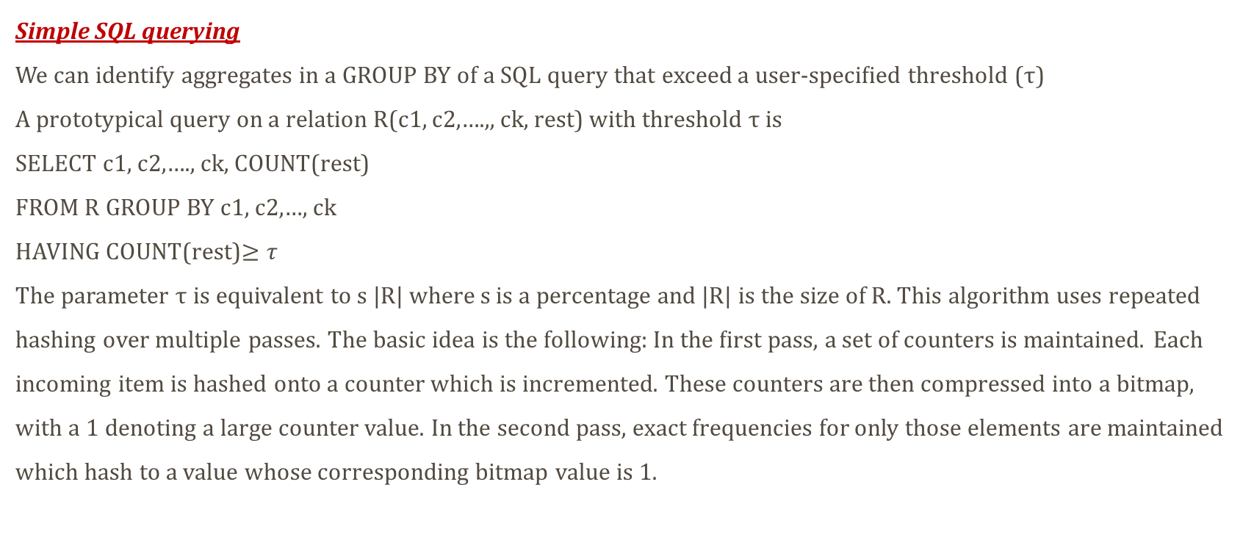
Solution Q1
Simple SQL querying
We can identify aggregates in a GROUP BY of a SQL query that exceed a user-speciﬁed threshold (τ)
A prototypical query on a relation R(c1, c2,….,, ck, rest) with threshold τ is
SELECT c1, c2,…., ck, COUNT(rest)
FROM R GROUP BY c1, c2,…, ck
HAVING COUNT(rest)$≥τ$
The parameter τ is equivalent to s |R| where s is a percentage and |R| is the size of R. This algorithm uses repeated hashing over multiple passes. The basic idea is the following: In the ﬁrst pass, a set of counters is maintained. Each incoming item is hashed onto a counter which is incremented. These counters are then compressed into a bitmap, with a 1 denoting a large counter value. In the second pass, exact frequencies for only those elements are maintained which hash to a value whose corresponding bitmap value is 1.

Slide 8
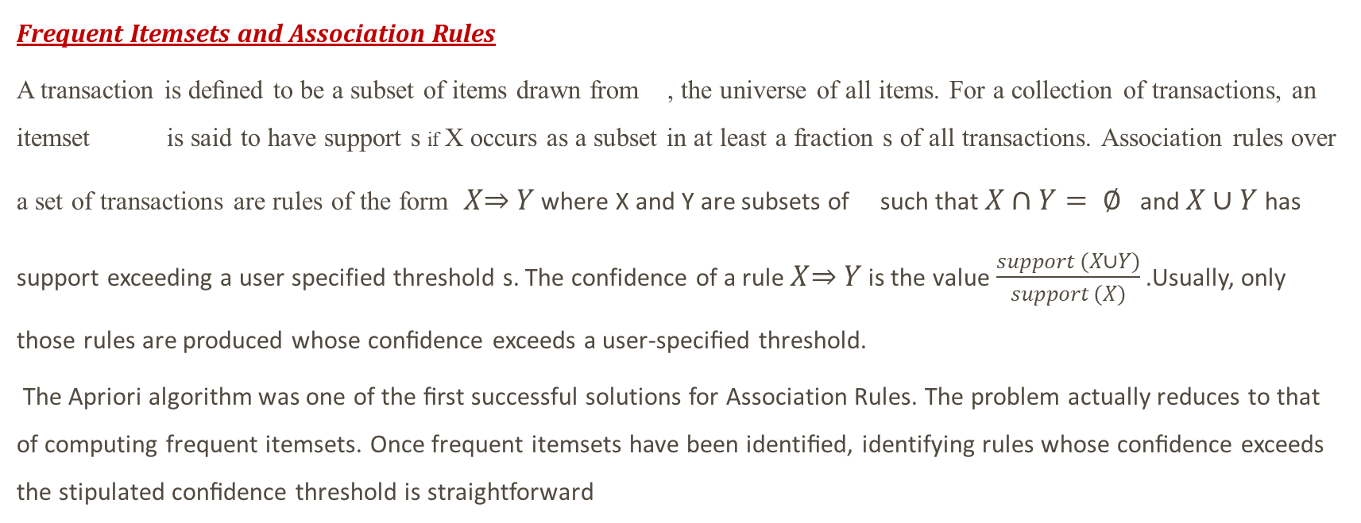
Solution Q1
Frequent Itemsets and Association Rules
A transaction is deﬁned to be a subset of items drawn from , the universe of all items. For a collection of transactions, an itemset is said to have support s if X occurs as a subset in at least a fraction s of all transactions. Association rules over a set of transactions are rules of the form $X\overset{⇒}{} Y$ where X and Y are subsets of such that $X∩Y= ∅$ and $X∪Y$ has support exceeding a user specified threshold s. The confidence of a rule $X\overset{⇒}{} Y$ is the value $\frac{support (X∪Y)}{support (X)}$ .Usually, only those rules are produced whose conﬁdence exceeds a user-speciﬁed threshold.
The Apriori algorithm was one of the ﬁrst successful solutions for Association Rules. The problem actually reduces to that of computing frequent itemsets. Once frequent itemsets have been identiﬁed, identifying rules whose conﬁdence exceeds the stipulated conﬁdence threshold is straightforward

Slide 9
Solution Q1
Pros and Cons of the methods discussed above( i.e querying for elements which have occurred more than a user speciﬁed ratio.)
Pros
One of the advantage of using either one of the above-mentioned solutions is its simplicity to use.
Both these algorithms maintain a small summary structure and does not require repeated rescans of the entire database.
Cons
Both the methods discussed above is more of a finding frequent elements, rather than detecting duplicates. The stream properties that are assumed in the context of ﬁnding frequent elements are different from those that are assumed for duplicate detection. In the context of duplicate detection, the majority of the elements occurring in the data stream are supposed to be distinct. That is, the skew in the data stream is very weak. On the other hand, in the context of ﬁnding frequent elements, the underlying assumption is that a few elements, the frequent ones, are supposed to have much higher frequencies than the other elements. Thus, the number of distinct elements observed in the data stream is much smaller than the size of the stream; and the data is supposed to be more skewed than in the case of streams queried for duplicates. The theoretical space bound for ﬁnding frequent elements is inversely proportional to the error, which is one tenth to one hundredth of the user required ratio . Thus, using these algorithms for duplicate detection is costly and ineﬃcient. Also it is difﬁcult to adapt this algorithm for streams because at the end of the ﬁrst pass, no frequencies are available. These kind of solutions works well for an offline stream.

Slide 10
Solution Q2
How do you use the blooms filter to solve this problem? Assume that you have to use sliding windows. For at least two kind of sliding windows, explain how are we using the bloom filter to solve the duplicate detection problem?
Duplicate detection using a sliding window
An important issue in defending click fraud is how to deal with duplicate clicks. If we simply regard all identical clicks as fraudulent clicks, it is unfair to advertisers in some scenarios such as that an interested client visits the same ad link several times in a week. On the other hand, if the advertisers are charged for any identical clicks, then it is very easy for an attacker to make money by continuously clicking the same ad link. A reasonable tradeoff is to deﬁne a timing threshold and only count identical clicks once within the timing window
There are two kinds of sliding windows: time-sliding window and element-based sliding window.
If we could find out how to do duplicate detection in one sliding window type the other can be deduced from it.
The problem of duplicate detection has two basic variations, depending on the way the stream is handled. The Duplicate Detection on a Sliding Window asks for duplicate elements that have occurred in the last N elements. An example of this query asks for the duplicate clicks that occurred in the last 1,000,000 clicks.

Slide 11
Solution Q2
In the model for sliding window processing in data streams, the goal is to make the query answer relevant to the last observed part of the stream. Applying the sliding window concept to duplicate detection, N could be set large enough so that even if duplicates occur on intervals which are more than N clicks apart, they would have negligible eﬀect on the commission
paid to the publisher. In addition, it is still acceptable, from a practical perspective, that a user might click the same advertisement, a few numbers of times in the span of a long time period. From a practical point of view, in order to slide the window, for every new entry arriving, an old entry has to be evicted. It is necessary to keep the latest N clicks in a circular queue, in order to know which entry to evict. In addition, the entire window has to be summarized in a data structure that supports fast search, incorporation, and deletion of entries.
We deﬁne a data stream as a sequence of numbers: SN = e1,...,ei,...,eN, where N is the size of the stream. Without loss of generality, the value of N can be inﬁnite. Generally, a stream can be a sequence of records, and it is not hard to trans form each record to a number (e.g., through hashing or ﬁngerprinting). We formulate the problem as follows: given a data stream SN, memory space of G bits and sliding window size of W bits we want to ﬁnd out whether each current element ei in SN has duplicates in emax(i−W,1),...,ei−1 or not. For SN, there are two constraints: answers must be provided in an on-line fashion and G is not large enough to store all distinct elements in emax(i−W,1),...,ei−1. Therefore, it is difﬁcult to solve the problem precisely. Our goal is to develop a fast-approximate solution that has a small error rate.
To address this problem, we can use Bloom filters.

Slide 12
Solution Q2
Bloom Filter
A Bloom Filter is a data structure that was proposed to detect approximate membership of elements, it is essentially a compact representation of a set. Given two sets, X, and Y , the Bloom Filter algorithm would loop on every element in set X, to check if it belongs to set Y , too. The algorithm is probabilistic, requires O(|X|) operations, and O(|Y|) space. A Bloom Filter can assert that an element in X does not belong to Y , but cannot assert that an element in X belongs to Y . That is, its errors are only false positive, and never false negative. On the whole, the number of elements that are erroneously found to belong to Y , and that actually do not, is very small, and is inversely proportional to the hidden constant in the big-O of the space and time requirements. a Bloom filter is an inexact representation of a set that allows a few “false positives” when queried. It has a constant space requirement which is independent of size of the element in the set or size of set itself.
Variants of Bloom Filter
(a) Classical Bloom Filter:
It is used for space efficient data structures that maintain a compact inventory of underlying data, supporting membership queries over a given data set. The space requirements of Bloom Filters fall significantly below the information theoretic lower bounds for error-free data structures. This efficiency is at the cost of a small false positive rate (items not in the set have a small probability of being recognized as in the set), but have no false negative (items in the set are always recognized as being in the set). BFs are widely used in practice when storage is at a premium and an occasional false positive is tolerable.

Slide 13
Solution Q2
A BF is a bit array, v of size m, and all of which are initially set to 0 (Figure l(a)). For each element(key 1, key 2, etc.), k bits in BF are set to 1 by a set of hash functions {h1(x), h2 (x), h3(X), ... ,hk(x)}, all for which are assumed to be independently uniform. It is possible that one bit in BF is set multiple times, while only the first setting operation changes 0 into 1, and the rest have no effect on that bit (Figure l(b) and l(c)). To know whether a newly arrived element Xi has seen before, we can check the bits {h1(Xi), h2 (Xi), ... ,hk(Xi)}. If anyone of these bits is zero, with 100% confidence we know Xi is a distinct element. Otherwise, it is regarded as a duplicate with a certain probability of error. An error may occur because it is possible that the cells {h1(Xi), h2 (Xi), h3(Xi), ... ,hk(Xi)} are set before by elements other than Xi.

Slide 14
Solution Q2
(b) Counting Bloom Filter (CBF) Although BF is simple and space efficient, it does not allow deletions. Deleting elements from a BF cannot be done simply by changing them back to zeros, as a single bit may correspond to multiple elements. Therefore, in the data stream environment, if we apply I3F for detecting duplicates, when more and more new elements arrive, the fractions of zeros in BF will decrease continuously, and the false positive rate will increase accordingly, and finally reach the limit one. At this time every distinct element will be reported as duplicate, indicating that BF fails completely. 'We call such a state of the BF as "full“. For the purpose of allowing deletion of stale elements, Counting Bloom Filter (CBF) was proposed.
A CBF uses an array of m counters, C, which replaces the bit vector v in the BF (see Figure 2(b)). The counters in C represent multiplicities of elements; all the counters in C are initially set to 0. When inserting an item, we increase the counters by 1 as shown in Figure 2(c). Also, deletion can now be safely performed with decrementing the counters by 1. A BF can be derived from a CBF by setting all 151 non-zero counters to one. Size of the counters must be chosen large enough to avoid overflow although from the following proof we can safely limit the size of counters to 4 bits.

Slide 15
Solution Q2
(c) Temporal Stateful Bloom Filter (TSBF)
The underline structure is similar to CBF, where counters are decayed with time. TSBF cells are neither bits nor counters but instead a value corresponding to the state. A TSBF consists of,
An array of m counters, {GI , G2 , G3 , ... , Gm }, where each counter Gi is replaced with the status vector, S.
(b) A set of independent k hash functions {hI, h2' h3, ... , hd defined for the range [1..m]
( c) A time decaying step function Ø( t)
The TSBF carries out the following insertion, lookup and modify tasks.
( a) Insertion: If the cell counter is 0, set the count to 2. If the cell value equals 1, set the count to 2 (Figure 3 (b)).
(b) Lookup: Check all cells associated with the insertion. If all cell values are either 1 or 2, then it is a duplicate.
(c) Modify: When decaying function </J(t) decreased to the threshold level adjust he cells accordingly. If the current status value is 2, change the cell value to 1. If the current status value is 1, change the cell value to 3. This is illustrated in Figure 3(c).
The first and second operations the duplicate detection process, and the third operation the update process.

Slide 16
Solution Q2
Bloom Filters for Duplicate Detection
A BLOOM FILTER uses k hash functions h1,h2,...,hk to hash each element of set S into a bit array of size m, where S comes from a universe U. All bits in BLOOM FILTER are initially set to 0. For each element e∈S, the bits at positions h1(e),h2(e),...,hk(e) in the ﬁlter are set to 1. BLOOM FILTER only allows for membership queries. For example, given a newly arrived element u ∈ U, whether u is a duplicate in S can be determined by the bits at positions h1(u),h2(u),...,hk(u). If any of these bits is zero, we know u is a distinct element. Otherwise, it is regarded as a duplicate with a certain probability of error. This method has a small probability of producing a false-positive error, i.e., a distinct element is wrongly reported as duplicate. If the hash functions are perfectly random, the probability of a false positive (false positive rate) Pr(FP) = (1−P0)k = (1−(1−1/m)kn)k ≈(1−e−kn/m)k, where P0 is the probability that a speciﬁc bit is still 0 after inserting n distinct elements. The expression on the right is minimized when k = mln2/n, in which case the error rate is Pr(FP)min = (1−1/2)k = (0.6185)m/n, where m is the number of bits in BLOOM FILTER.
Bloom Filters are very concise when compared to the basic solution using indexed storage. It does not store the excessively long IDs of the clicks, and its false positive errors are almost negligible. Bloom Filters’ errors do not depend on the nature or distribution of the duplicated elements. That is, the number of elements erroneously identiﬁed as duplicates is the same whether one element was duplicated a lot of times, or a lot of elements were duplicated a few times. The probability of outputting false positive errors can be made very low using very limited storage.

Slide 17
Solution Q2
Using Bloom Filters for Sliding Windows
The main challenge when applying Bloom Filters to sliding window streams is that the structure does not store the IDs of the elements observed so far in the stream, and thus, it is diﬃcult to delete elements which have been already inserted into the Bloom Filter, and is now expiring, i.e., sliding out of the sliding window.
We can use a modiﬁcation of Bloom Filters. The purpose of this modiﬁcation is to enable Bloom Filters to implement the delete operation, without necessarily storing the IDs of the elements inserted into a Bloom Filter structure. The underlying idea is to replace the array of bits with an array of counters, of the same size. For every element that is inserted, increment the d counters to which the element hashes. To delete an element, decrement the d counters to which the element hashes. An integer in a cell represents the number of elements which hash to this cell. A cell is decremented to 0, only if all the elements that hashed to this cell expire, i.e., slide out of the current sliding window, which is equivalent to deleting all those obsolete elements from the Bloom Filter structure. Therefore, we will call this solution the counting Bloom Filters. Thus, it is possible to update the Bloom Filter structure as new elements are added to the sliding window, and as aging elements are deleted.

