Slide 1
IBM University Engagement Project Submission
“Exploring the Power of Agentic AI with IBM Granite and LangFlow”

Slide 2
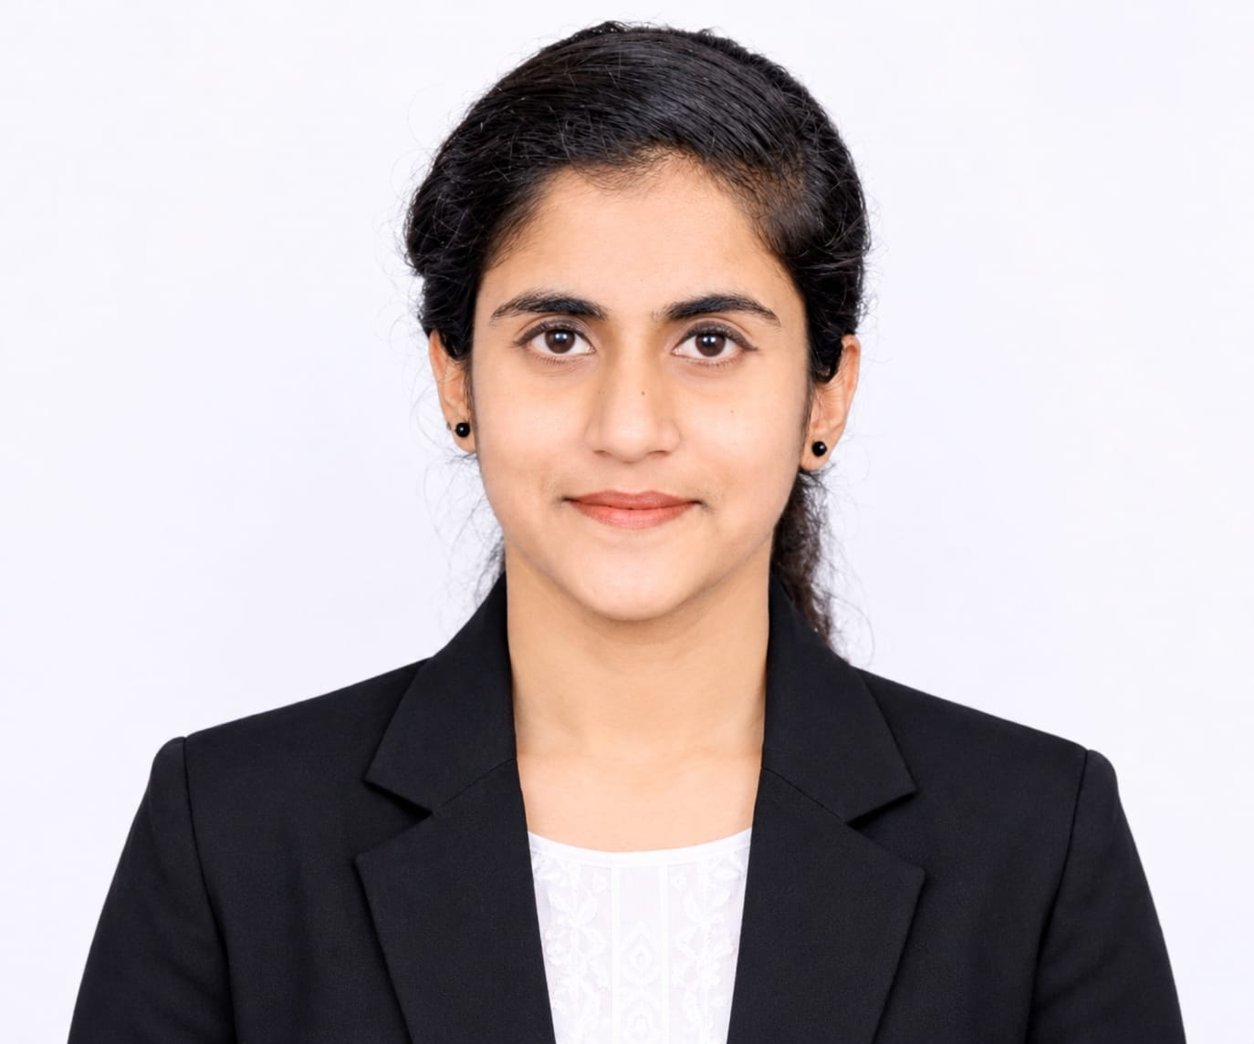
Project Title – IBM Granite Research Agent – AI-Powered Research Assistant
Domain of Project – Artificial Intelligence (AI), Generative AI and Agentic AI (Large Language Models).
Student Name | Recent Passport Photo | Email ID | Mobile number [WhatsApp]
Smitha D |  | smithdns04@gmail.com | 7676542788
Recommended font style and size:
Font Style: Arial
Font Size (Heading): 28
Font Size (Content): 20

Slide 3
Problem Statement -
Problem Statement : IBM Granite Research Agent
The Challenge
Students and researchers face significant challenges when conducting research. Manually searching multiple information sources, reading lengthy academic papers, extracting key insights, and writing structured reports is slow and error-prone. There is no unified local tool that can intelligently assist the entire research workflow — from query understanding to structured report generation — without depending on paid cloud APIs or compromising data privacy.
The Objective
Build an AI-powered Research Agent using IBM Granite that simplifies and automates research activities. The solution should:
Intelligent Research Assistance – Understand user queries and provide relevant research information.
Information Retrieval – Collect information from available online research sources.
Document Processing – Upload, read, summarize, and analyze research documents.
Automated Report Generation – Generate structured research reports with relevant findings.
Research Management – Store and organize generated reports for future access.
Agentic AI Integration – Use IBM Granite to support intelligent research tasks and response generation.

Slide 4
Proposed Solution
Proposed Solution: IBM Granite Research Agent
The application aims to reduce manual research effort by bringing multiple research activities into a single platform. It helps users transform unstructured information into meaningful insights and organized research outputs.
Key Features of the Proposed Solution
Intelligent Query Understanding: Understands user research questions and generates contextually relevant responses using IBM Granite.
Automated Research Assistance: Supports research activities by processing queries and organizing relevant information.
Information Retrieval: Helps collect useful information from available research sources.
Document Processing: Allows users to upload research documents and extract meaningful content for analysis.
AI-Powered Summarization: Converts lengthy research content into shorter, understandable summaries.
Structured Report Generation: Organizes research findings into sections such as introduction, objectives, methodology, findings and conclusion.
Research Data Management: Provides a way to organize and retain research outputs, with SQLite storage where implemented.
Interactive User Experience: Uses Streamlit to provide a simple interface for submitting queries and viewing generated results.
Overall Goal
To develop an intelligent research assistant that makes research activities easier, faster and more organized by combining language-model capabilities, information retrieval and document processing in one application.

Slide 5
Technology Used
IBM Granite 4.2 (via Ollama) – Local AI language model for text generation, summarisation, Q&A and report writing. No cloud required.
Python – Core backend language for all modules including search, document processing, data analysis, database and export logic.
Streamlit – Multi-page web application framework providing the 9-page IBM Carbon-themed user interface.
Wikipedia, OpenAlex and Crossref APIs – Three free public research information sources used for report generation. No API keys required.
SQLite – Local relational database for persistent storage of research reports, processed documents and conversation history.
Pandas and Matplotlib – Data analysis library for CSV/XLSX processing, statistics and chart generation (histogram, scatter, correlation).

Slide 6
Application Components Used –
ollama_client.py – Manages IBM Granite connection via Ollama REST API. Handles status checks, runtime config and text generation with timeout control.
2) information_search.py – Retrieves data from Wikipedia (summaries), OpenAlex (academic papers with abstracts) and Crossref (publications with DOI metadata).
3) IBM Granite Model – granite4.2:3b running locally via Ollama. Used for all NLP tasks: report writing, summarisation, Q&A and insight extraction.
4) Streamlit UI (app.py) – 9-page web application. Renders the Research Assistant, Report Generator, Document Processing, Data Analysis, Insights, Library and Export pages.
5) database.py – SQLite-backed persistence layer storing reports, uploaded document records and multi-turn conversation history with WAL journal mode.
6) exporter.py – Generates professionally formatted PDF reports (ReportLab) and plain text TXT files for download from the Export Centre.

Slide 7
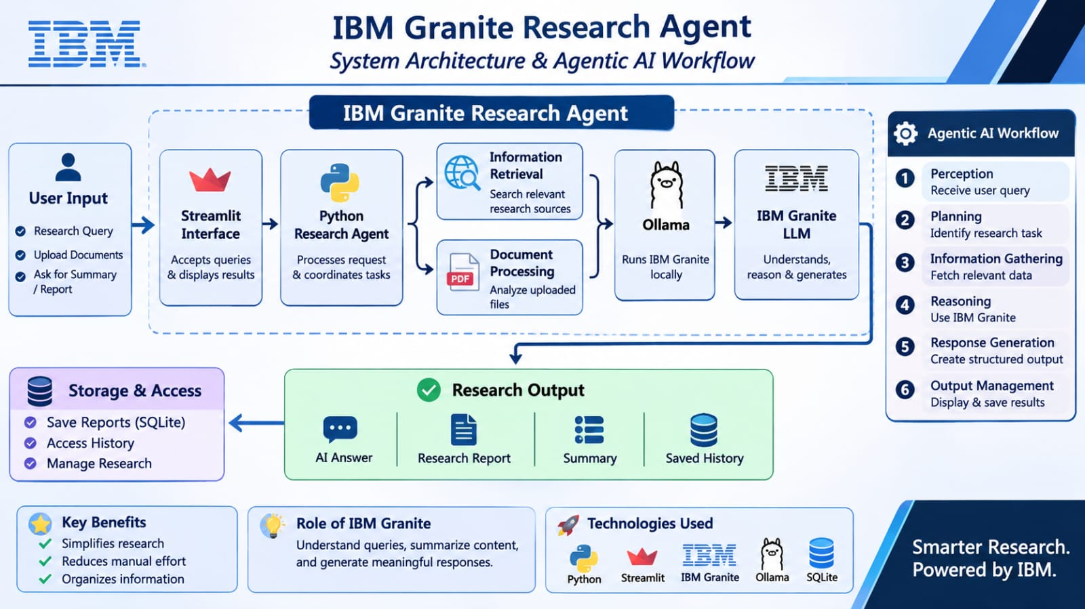
Agentic AI Workflow – IBM Granite Research Agent

Slide 8
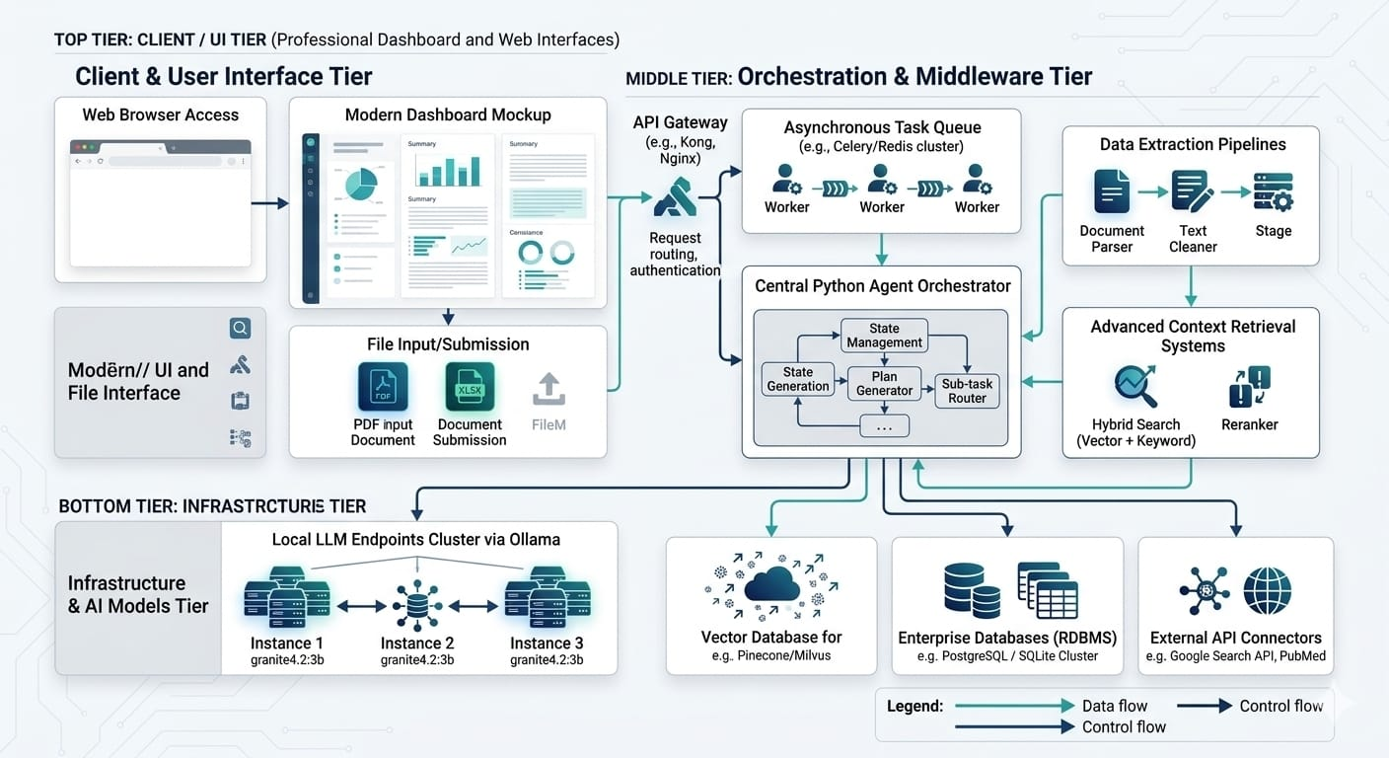
Project Architecture – IBM Granite Research Agent

Slide 9

Role of IBM Granite in the Research Agent
IBM Granite (granite4.2:3b) is the core AI engine of the Research Agent, running locally via Ollama. No cloud dependency, no paid API key required.
Research Assistant: Processes natural language queries and returns detailed structured answers with multi-turn conversation context.
Report Generator: Synthesises Wikipedia, OpenAlex and Crossref content into a structured 14-section academic report.
Document Processing: Analyses uploaded file text to generate summaries, key points and Q&A responses.
Research Insights and Data Analysis: Extracts key findings and trends from research content, and interprets dataset statistics in natural language.
Research Assistant: Processes natural language queries and returns detailed, structured answers while maintaining multi-turn conversation context.
Report Generator: Synthesises content from Wikipedia, OpenAlex and Crossref into a structured 14-section academic report.
Document Processing: Analyses extracted text from uploaded PDF/TXT/CSV/XLSX files to generate summaries, key points and direct Q&A responses.
Research Insights and Data Analysis: Extracts key findings, trends and research gaps from content, and interprets dataset statistics in natural language.

Slide 10
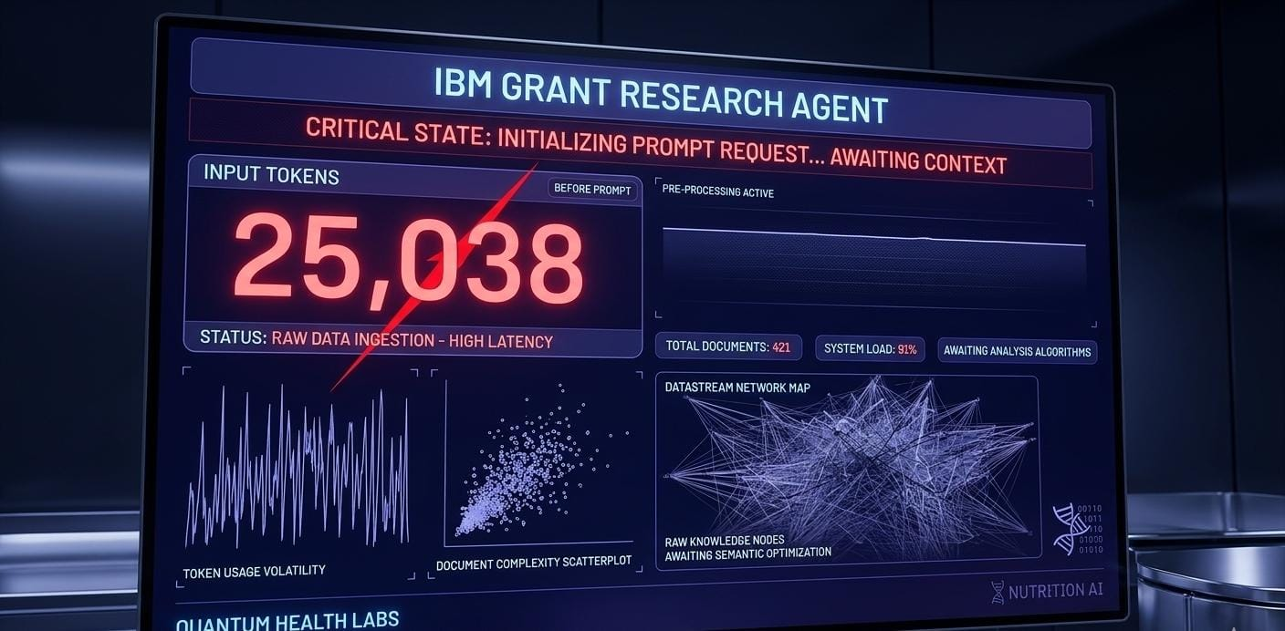
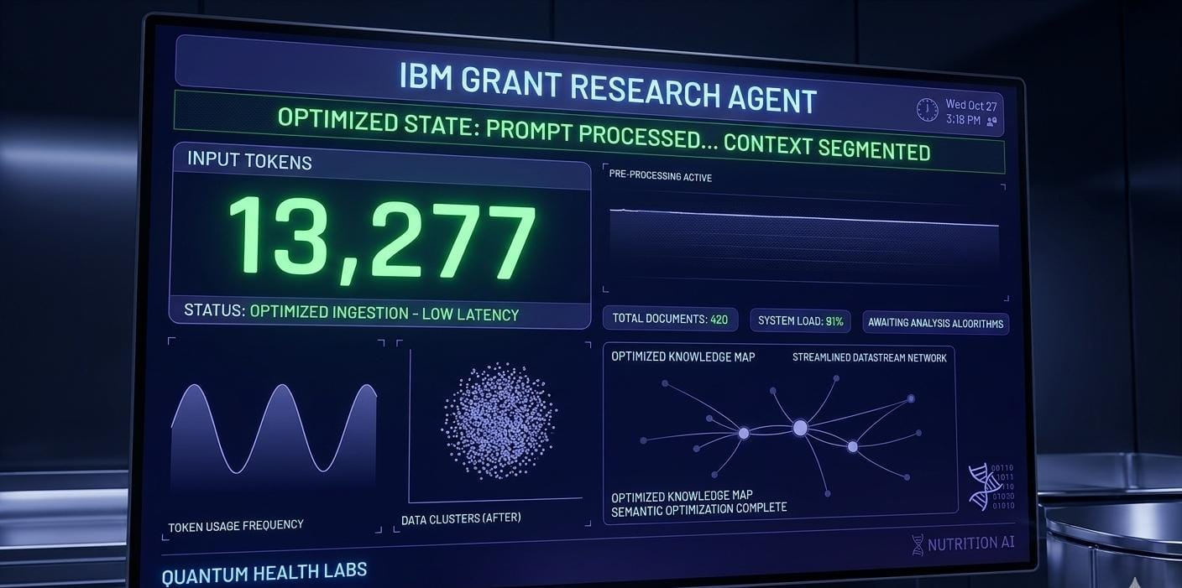
Token Usage
Token count is measured per Ollama API call. Report generation (14 sections, multi-source) uses the largest token context. Add your actual measured values after running the application.
User Query / Input Prompt
IBM Granite Generated Output
·
·
·

Slide 11
Novelty and Uniqueness – IBM Granite Research Agent
Novelty and Uniqueness
1. AI-Powered Research Assistant: Uses IBM Granite to simplify research activities through intelligent responses.
2. Automated Research Support: Reduces manual effort in collecting, understanding and organizing information.
3. Document-Based Analysis: Helps extract important information and summarize uploaded research documents.
4. Context-Aware Responses: Generates relevant answers based on user queries and available information.
5. Structured Report Generation: Organizes research findings into clear and meaningful reports.
6. Unified Platform: Combines research assistance, document processing and report generation in one application.
7. User-Friendly Interface: Provides a simple interface through Streamlit for easy interaction.
8. Local AI Model Integration: Uses IBM Granite through Ollama for local model execution.
Uniqueness: The project brings multiple research activities together in a single AI-powered platform, making research more accessible, organized and efficient.

Slide 12
Git Hub Link
Please create public github repository (Enable Add README button while creating repository) with format –
Please test and Paste the working Github URL –
Make sure you have Uploaded following three files into your github repository
1) app.json file , 2) yourproblemstatement.pdf file 3) your projectpresntation.pptx file 4)any other files
·
·
·

Slide 13
Future Scope
1. Advanced AI Integration: Integrate more powerful IBM Granite models for improved research responses.
2. Real-Time Web Research: Retrieve updated information from reliable online research sources.
3. Multilingual Support: Support multiple languages to make research accessible to more users.
4. Voice-Based Interaction: Allow users to ask research questions through voice commands.
5. Advanced Document Support: Support PDF, Word, Excel and other research file formats.
6. Citation and Reference Generation: Automatically generate citations and references for research reports.
7. Multi-Agent Collaboration: Introduce specialized AI agents for searching, analyzing, summarizing and reviewing research.
·
·
·

Slide 14
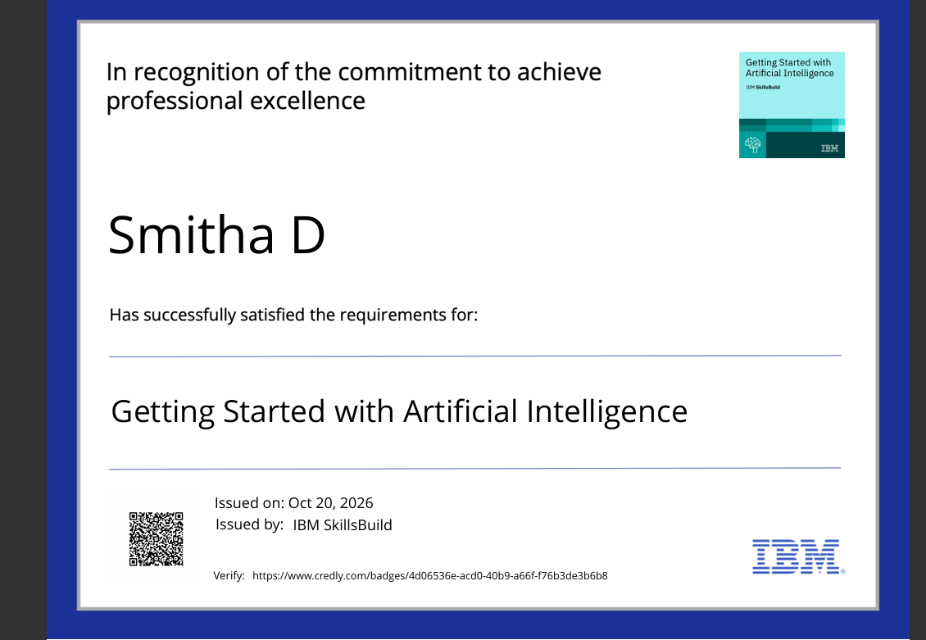
Certificates Earned:
Please add your credly certificate

Slide 15
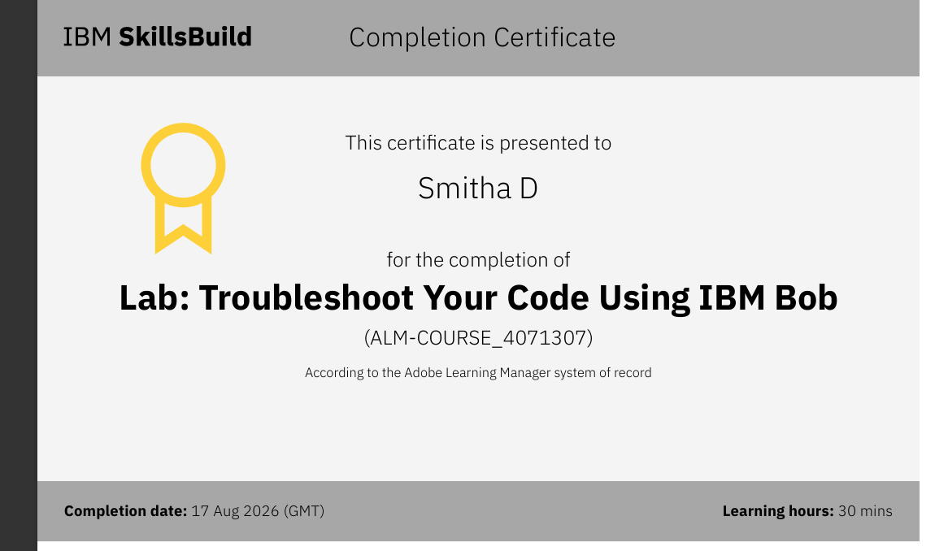
Certificates Earned:​
Add your IBM BOB Certificate

Slide 16


