Slide 1
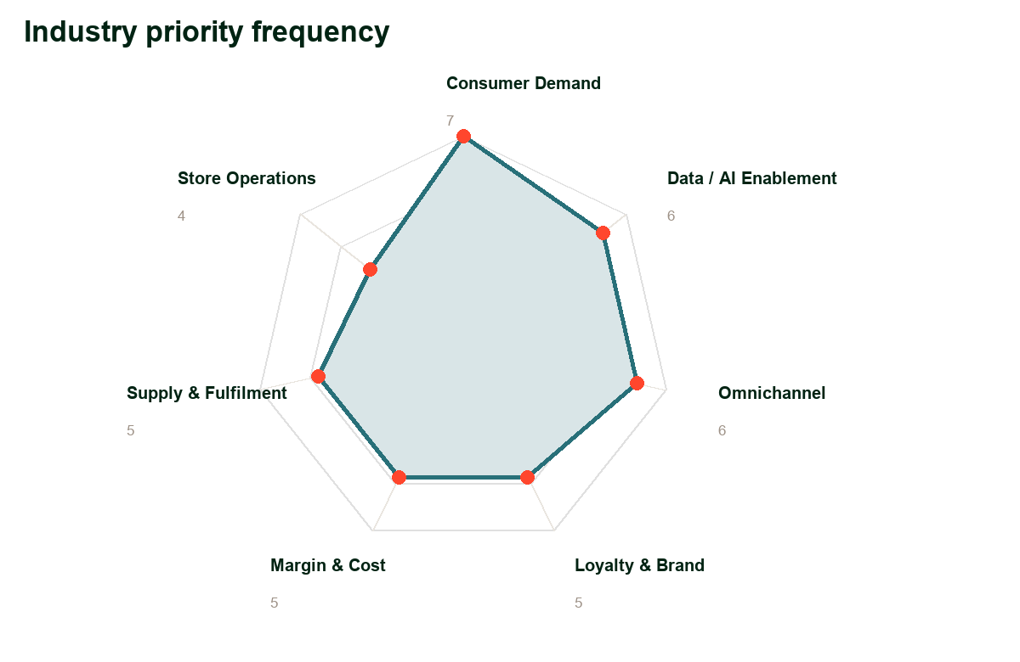
01 INDUSTRY VIEW
Retail economics are being reset by demand, cost and trust
The opening move is to show why the market context creates urgency
SO WHAT
Industry research over the past 18 months indicates UK online retail and consumer finance are in a slower-growth, margin-pressured phase where value, credit affordabil...
Consumer Demand
Data / AI Enablement
Omnichannel
Frequency 7
Frequency 6
Frequency 6
kyndryl
Kyndryl & The Very Group Limited confidential
1

Slide 2
02 COMPANY VIEW
The Very Group Limited has a board agenda that technology must serve
Annual-report priorities should frame the conversation before solutions
Priority 1
Company interpretation
Defend value perception while growing loyalty and basket economics.
The Very Group Limited's board-level tension is whether trusted omnichannel execution can turn consumer Demand into margin expansion faster than retail peers can respo...
Latest revenue signal: £2,125.3m for fiscal year ended June... (FY24 (year to June 2024)).
Use annual-report quotes and investor-relations data as the evidence base for every client-facing claim.
Priority 2
Create operating leverage from supply-chain, store and digital modernization.
Priority 3
Protect customer trust while scaling data-led retailing.
Priority 4
Retail growth is being fought through value, loyalty and omnichannel convenience.
Priority 5
Supply-chain resilience and stock productivity are becoming margin differentiators.
kyndryl
Kyndryl & The Very Group Limited confidential
2

Slide 3
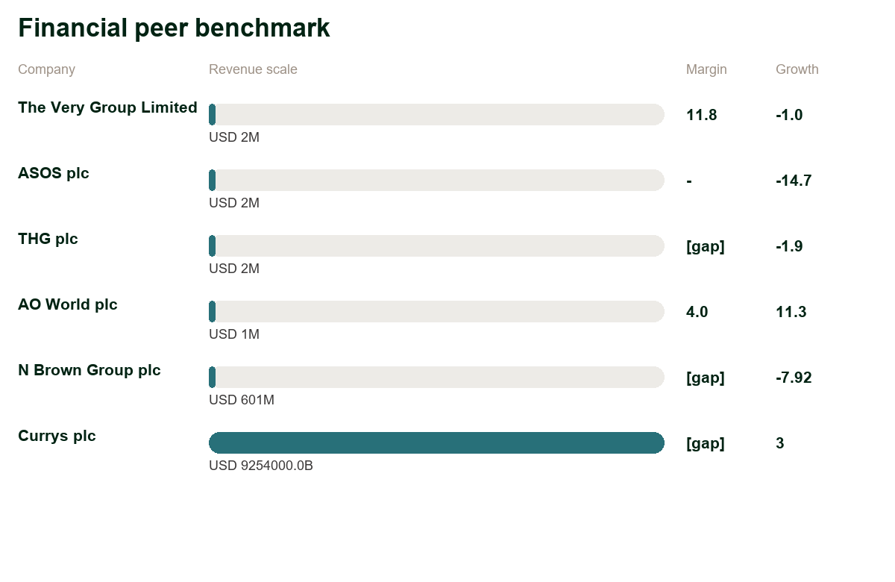
03 PEER BENCHMARK
Peer economics reveal where performance pressure is material
The benchmark turns the discussion into a CFO-relevant value case
Benchmark interpretation
The Very Group Limited: revenue GBP 2.1B, EBITDA margin 11.8
ASOS plc: revenue GBP 2.5B, EBITDA margin -
THG plc: revenue GBP 1.7B, EBITDA margin [DATA GAP]
AO World plc: revenue GBP 1.3B, EBITDA margin 4.0
N Brown Group plc: revenue GBP 600.9M, EBITDA margin [DATA GAP]
kyndryl
Kyndryl & The Very Group Limited confidential
3

Slide 4
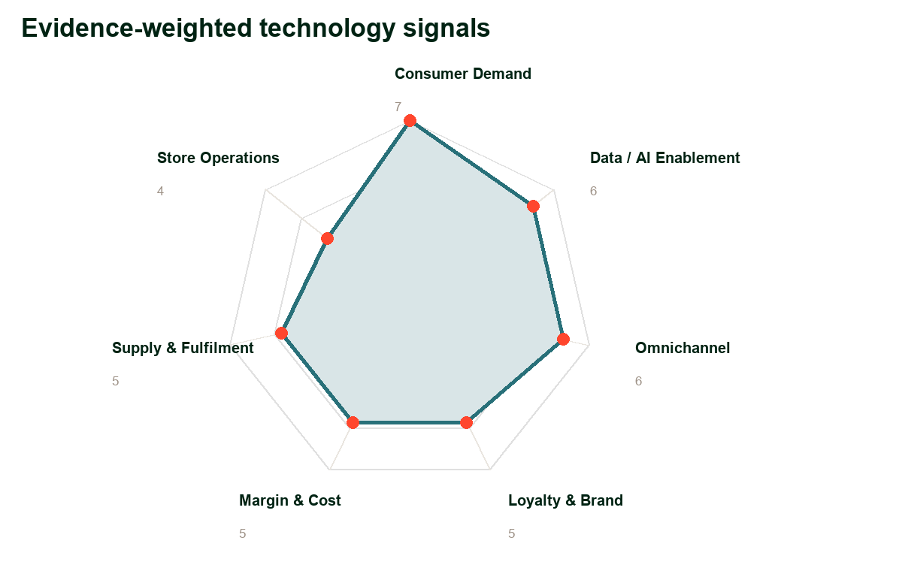
04 TECHNOLOGY LINK
The financial trend points to specific technology levers
Revenue, cost and risk should each have a quantified hypothesis
Revenue
Operating margin
Growth
Technology implications
£2,125.3m for fiscal year ended June...
Test digital growth, conversion, retention and pricing use cases.
[DATA GAP]
Target automation, cloud economics and operating-model simplification.
[DATA GAP]
Prioritise AI use cases that create scalable growth rather than isolated pilots.
Qualify high-value AI use cases, data readiness, governance gaps and measurable business outcomes before platform investment. Evidence signal: Protect customer trust w...
Quantify run cost, resilience, technical debt and migration economics with the CIO, CTO and CFO.
Identify workflow, application and operating-model simplification candidates tied to productivity or service speed. Evidence signal: Create operating leverage from sup...
Connect board-level risk, critical services, identity and resilience evidence to funded control improvement. Evidence signal: Protect customer trust while scaling data...
kyndryl
Kyndryl & The Very Group Limited confidential
4

Slide 5
05 RECOMMENDATIONS
The account should lead with focused executive choices
Each recommendation needs an owner, evidence and next action
AI value discovery and data readiness assessment
Recommended C-suite engagement
Qualify high-value AI use cases, data readiness, governance gaps and measurable business outcomes before platform investment. Evidence signal: Protect customer trust while scaling data-le...
CEO: link transformation to growth choices and customer trust.
CFO: quantify EBITDA, cash and risk-protection logic before solutioning.
CIO/COO: agree the data, platform and delivery constraints that determine pace.
First ask: approve a focused value discovery sprint using the evidence base.
Cloud economics and modernisation assessment
Quantify run cost, resilience, technical debt and migration economics with the CIO, CTO and CFO.
Process automation and platform rationalisation workshop
Identify workflow, application and operating-model simplification candidates tied to productivity or service speed. Evidence signal: Create operating leverage from supply-chain, store and...
Resilience, identity and cyber risk assessment
Connect board-level risk, critical services, identity and resilience evidence to funded control improvement. Evidence signal: Protect customer trust while scaling data-led retailing..
Customer journey and digital adoption workshop
Map revenue, retention and service-friction opportunities across the highest-value customer journeys. Evidence signal: Defend value perception while growing loyalty and basket economics..
kyndryl
Kyndryl & The Very Group Limited confidential
5

Slide 6
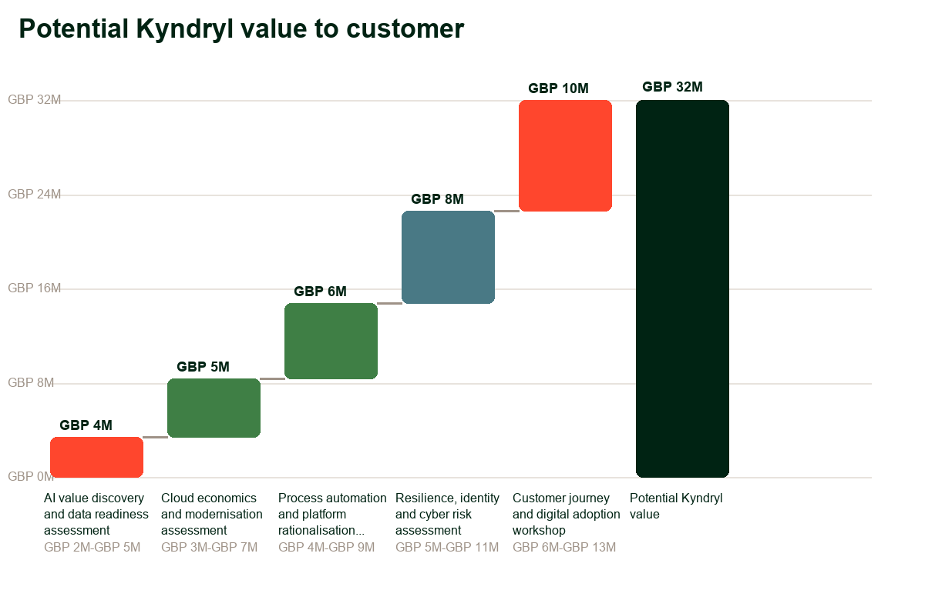
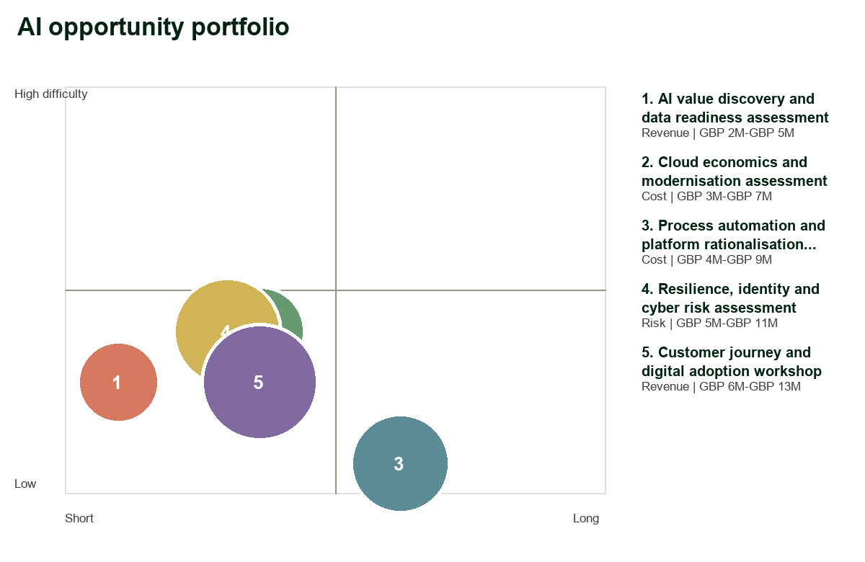
06 AI BUSINESS CASE
AI value should be framed as EBITDA movement
The portfolio must show cost, revenue and risk contribution
Business case logic
Use the waterfall as a directional value hypothesis until validated with customer baselines.
Prioritise use cases that connect to the stored ETS sales angles and peer productivity gaps.
Separate EBITDA uplift from EBITDA protected so risk benefits are not double counted.
kyndryl
Kyndryl & The Very Group Limited confidential
6

Slide 7
07 AI ROADMAP
The roadmap should prove value before scaling ambition
Start narrow, validate economics, then industrialise the model
0-90 days
3-12 months
12-24 months
Prove
Scale
Transform
Value discovery, data readiness, executive value case and two pilots.
Industrialise the highest-confidence use cases and align platform guardrails.
Extend AI into operating-model, customer and risk workflows with benefit tracking.
AI value discovery and data readiness assessment
Cloud economics and modernisation assessment
Process automation and platform rationalisation workshop
Resilience, identity and cyber risk assessment
Customer journey and digital adoption workshop
kyndryl
Kyndryl & The Very Group Limited confidential
7

