Slide 1

Title
Kyndryl Confidential
1

Slide 2
The Industry Is Shifting Towards XYZ Trends
EXECUTIVE THESIS
Evidence from multiple estate data sources and stakeholder validation confirms three structural constraints limiting WPP's ability to simplify, migrate and govern the estate in support of Elevate28.

Slide 3
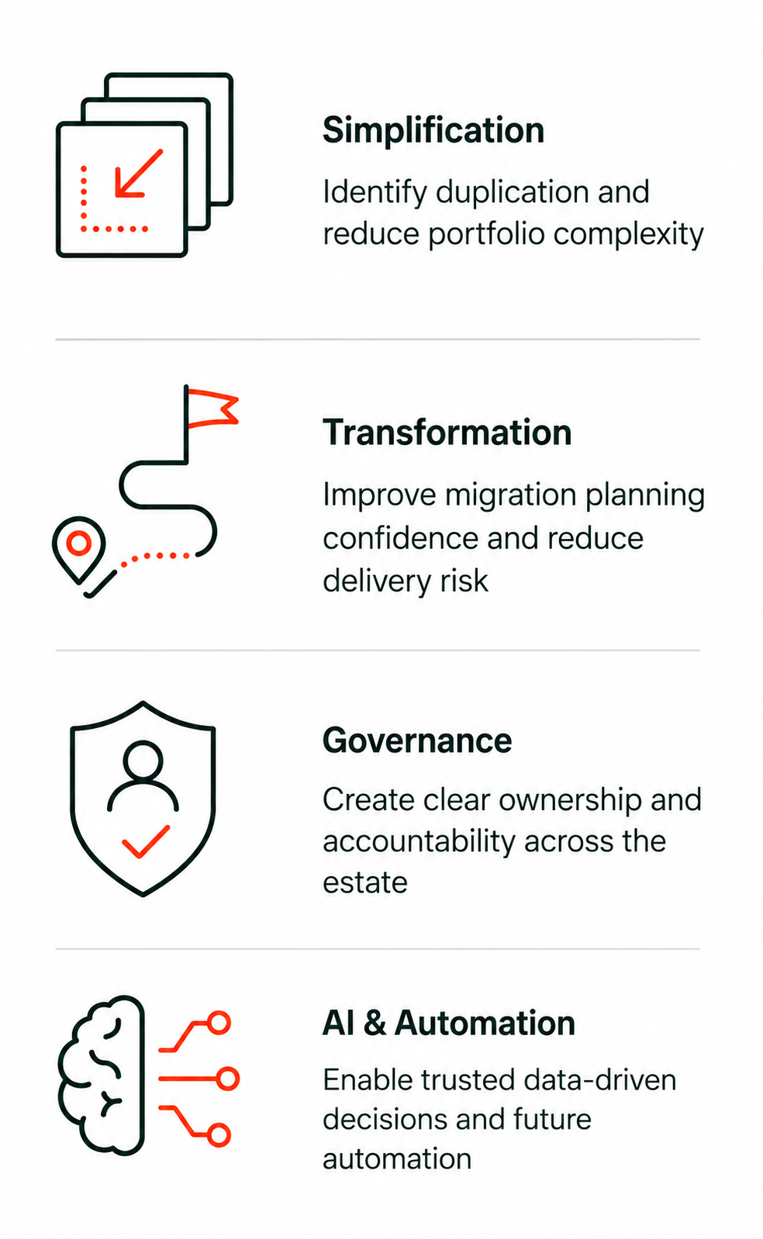
To Address These Company Trends, Company Is Driving The Following Priorities
EXECUTIVE THESIS
ENABLED OUTCOMES
Simplification
Identify duplication and reduce portfolio complexity
Transformation Confidence
Improve migration planning confidence and reduce delivery risk
Governance
Establish trusted estate data through consistent governance and accountability
AI & Automation
Enable trusted data-driven decisions and future automation

Slide 4
Transfo
EXECUTIVE THESIS
ENABLED OUTCOMES
Simplification
Identify duplication and reduce portfolio complexity
Transformation Confidence
Improve migration planning confidence and reduce delivery risk
Governance
Establish trusted estate data through consistent governance and accountability
AI & Automation
Enable trusted data-driven decisions and future automation

Slide 5

Three structural constraints prevent estate data from supporting transformation decisions at enterprise scale
EXECUTIVE SUMMARY
Transformation decisions are constrained by gaps in application visibility, dependency transparency and governance accountability.
THREE STRUCTURAL CONSTRAINTS
WHY THIS MATTERS
No trusted enterprise application portfolio exists.
Application information is fragmented, preventing a single trusted view of the enterprise portfolio.
Application and infrastructure relationships are incomplete.
Service context, dependencies, and impact relationships cannot be consistently traced or relied upon across the estate.
Governance standards and controls are inconsistently applied.
Data standards, stewardship and quality controls vary across OpCo's and projects, creating duplicate, outdated and inconsistent records.
Simplification
Duplication cannot be identified with confidence
01
Application Visibility
02
Dependency Visibility
03
Governance Controls
14 findings
10 findings
39 findings
Transformation Confidence
Transformation planning is constrained by unknown dependencies
Governance
Data quality issues increase rework and reduce confidence in estate decisions
Together, these constraints prevent the estate from being viewed as a connected enterprise portfolio.
AI & Automation
Trusted enterprise data foundations do not yet exist
So What? WPP cannot currently make transformation decisions with sufficient confidence across the enterprise estate.
Notes:
Service Mapping is the stronger objective. Dependencies alone show relationships, such as a computer linked to an operating system or an AWS Lambda function, but they do not show the service delivered. The real value comes when those dependencies reveal the technical service they support and how it is delivered. Dependency discovery should therefore be treated as a step toward Service Mapping.

Slide 6
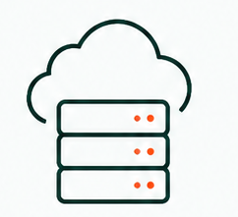
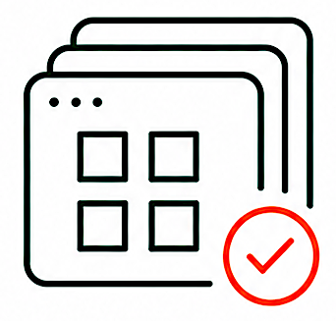
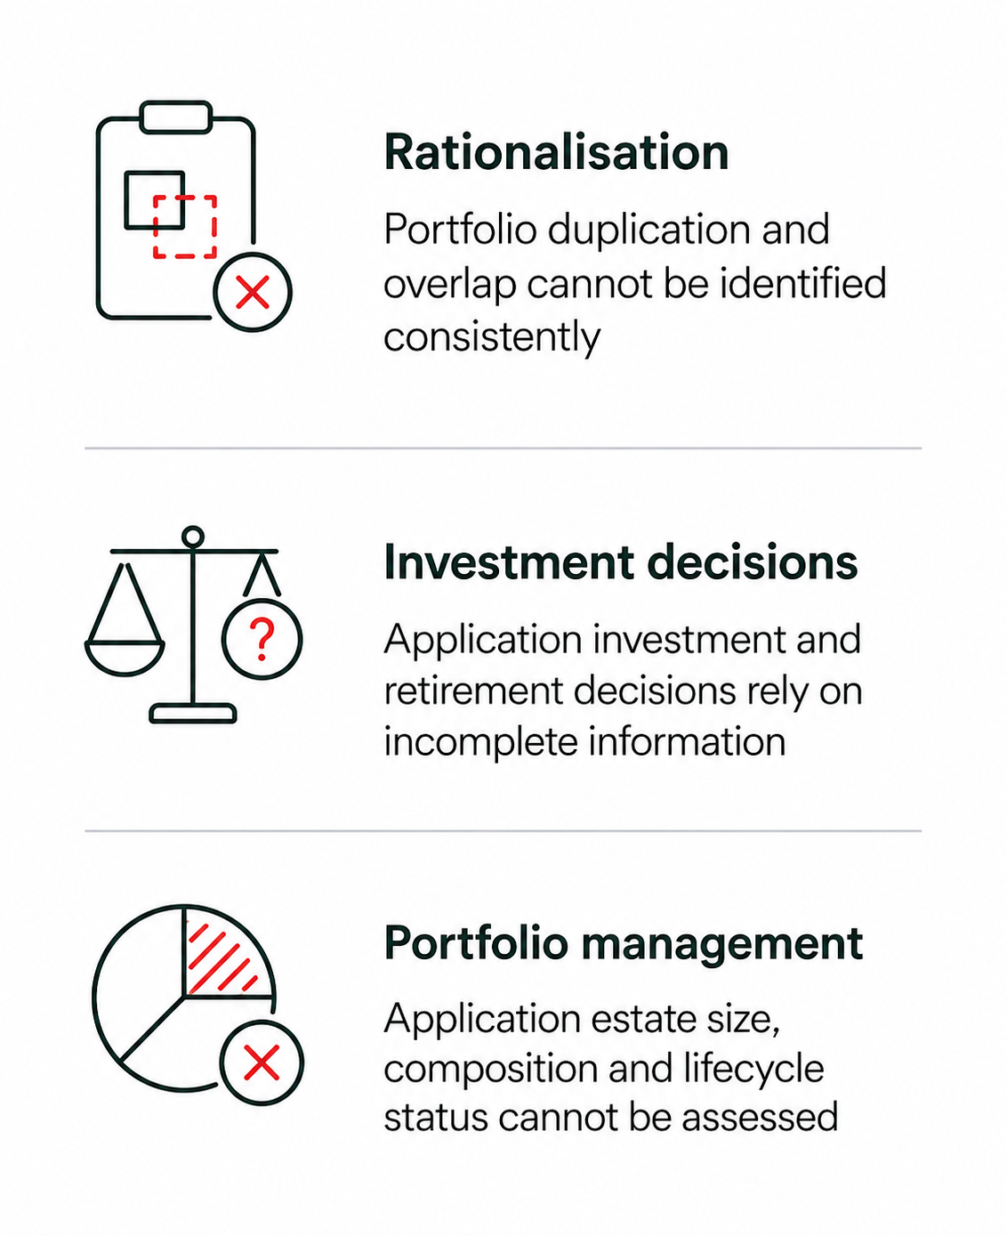
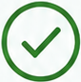

No trusted enterprise application portfolio currently exists for WPP across all OpCo’s
EXECUTIVE SUMMARY
CONSTRAINT 1
Fragmented application data prevents WPP from establishing a trusted view of its application estate, limiting portfolio simplification, investment planning and transformation execution.
Existing Infrastructure Visibility
THE IMPACT
Trusted Application Portfolio
INITIAL
Rationalisation
Portfolio duplication and overlap cannot be identified consistently
DEVELOPING
Portfolio
Lifecycle
Ownership
Business
Context
Why this matters
CMDB contains ~33.9k infrastructure CIs
Investment decisions
Application investment and retirement decisions rely on incomplete information
No single enterprise application inventory
Applications are captured differently across OpCo’s and tools
Operational population reduces to ~8.7k CIs after removing retired/non-operational records
Multiple fragmented repositories
Information is duplicated, inconsistent, and not integrated
Portfolio management
Application estate size, composition and lifecycle status cannot be assessed
Discovery data provides visibility into active infrastructure assets
Ownership and lifecycle data incomplete
Key attributes are missing, outdated, or inconsistently maintained
Business context and value data lacking
Purpose, usage, and criticality are not consistently recorded
Transformation planning
Transformation initiatives require significant manual validation and reconciliation
Total estate size cannot currently be quantified with confidence
So What? Enterprise rationalisation and transformation planning cannot be performed with confidence at scale.

Slide 7
Thank You

