Slide 1

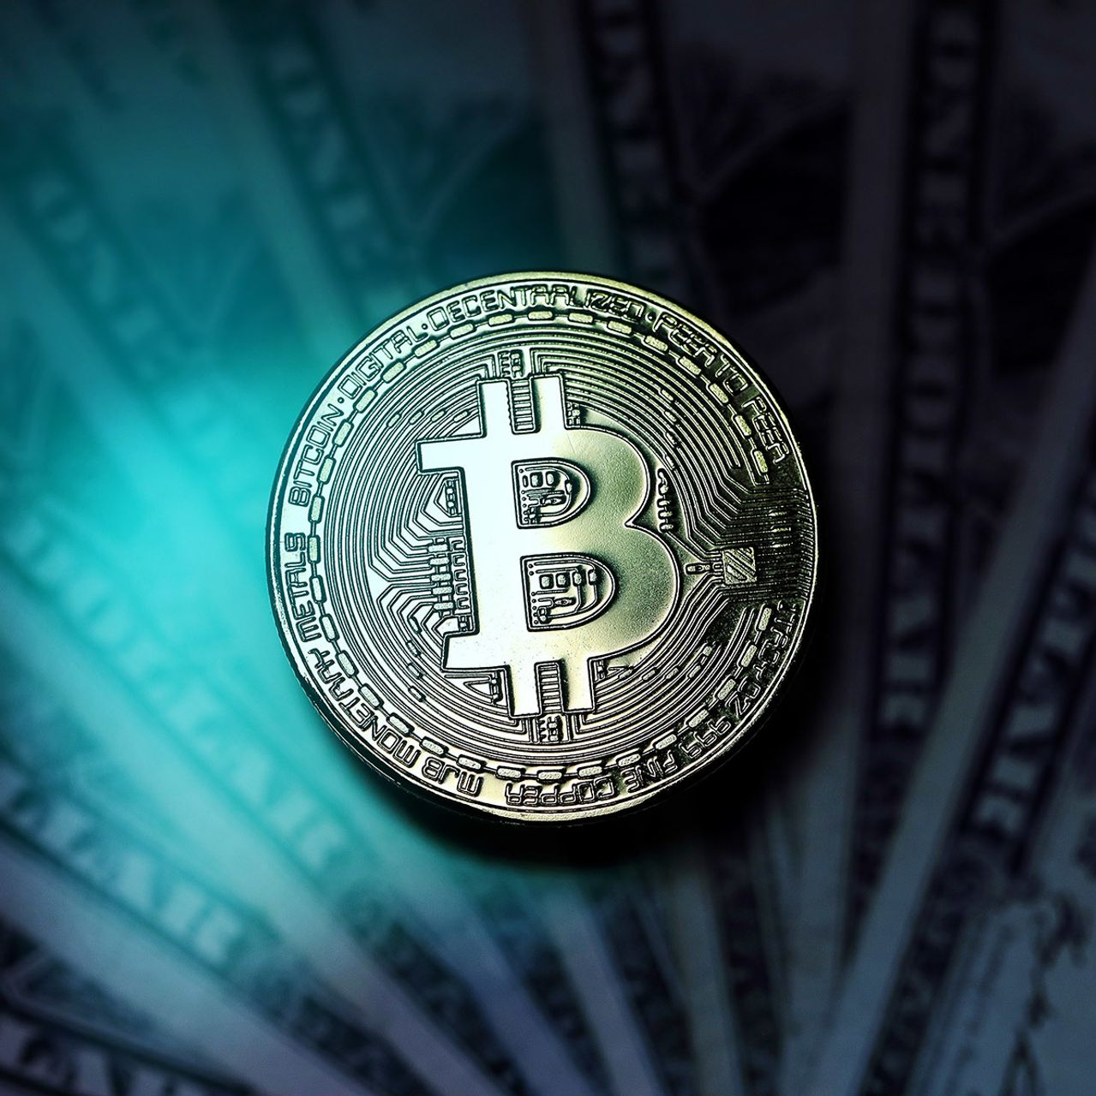
Bitcoin
By: Daniel smith

Slide 2
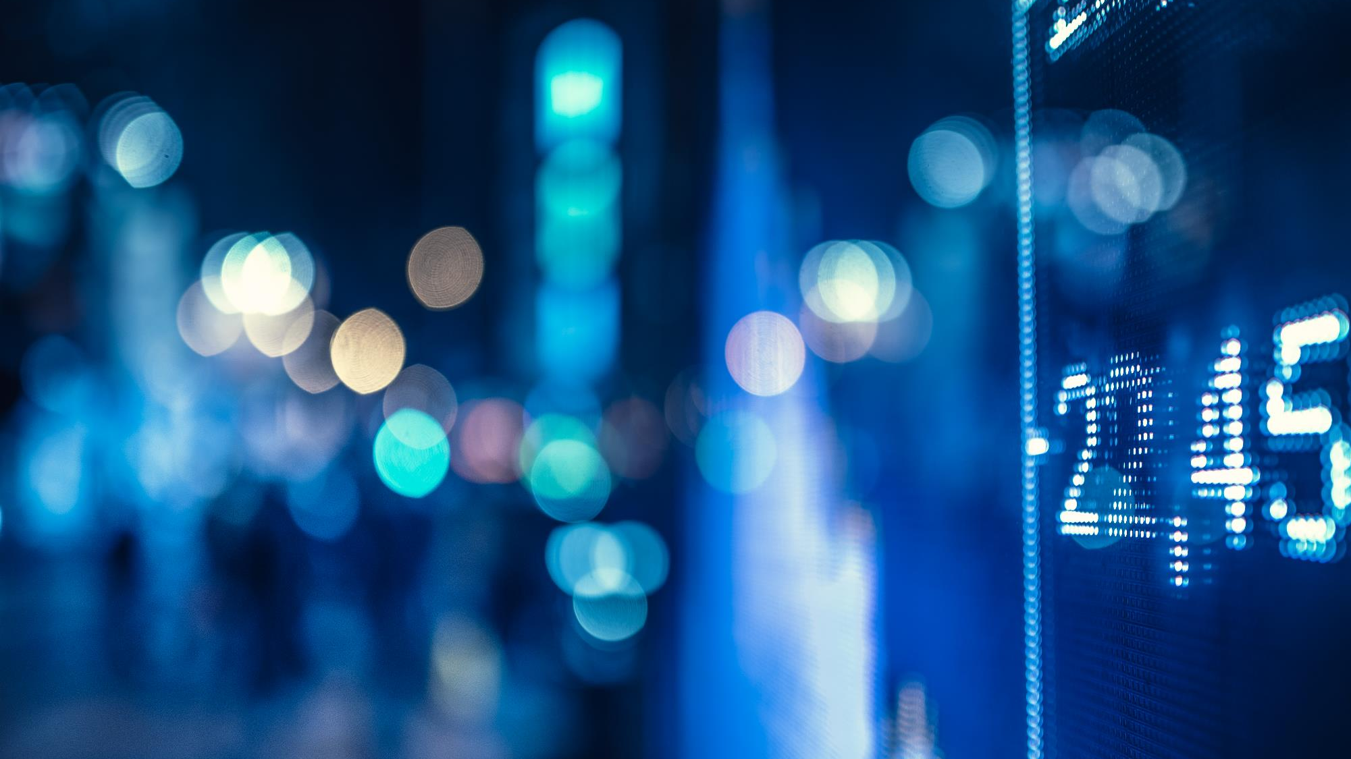
Questions I plan on answering
What is Bitcoin?
What’s the purpose?
Bitcoin transactional Properties
How to acquire Bitcoin?

Slide 3
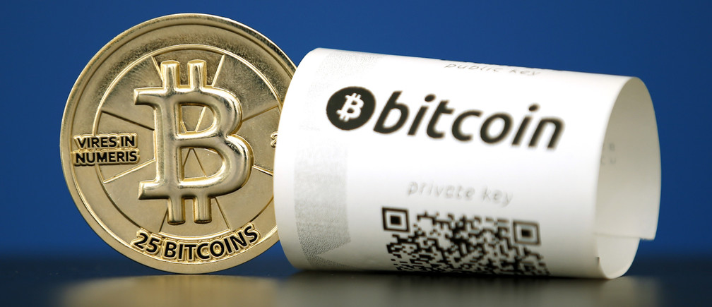
What is Bitcoin?
Cryptocurrency
User-to-User
Satoshi Nakamoto
2008

Slide 4
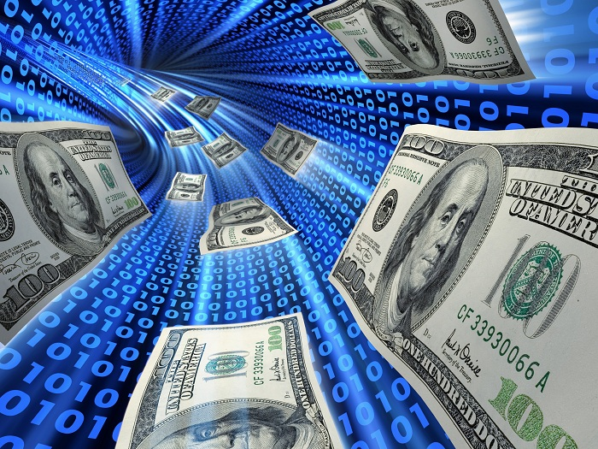
What is Bitcoin?
Wire Transfer
Digital Signature
Encrypted Currency

Slide 5
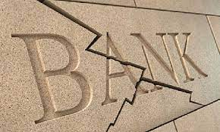
What’s The purpose?
Big Banks
Misuse of Funds
No Middleman
User Controlled System

Slide 6
Bitcoin Transaction properties
Irreversible: After confirmation, a transaction can‘t be reversed. By nobody. And nobody means nobody.
Pseudonymous: Neither transactions or accounts are connected to real-world identities.
Fast and global: Transaction is propagated nearly instantly in the network and are confirmed in a couple of minutes.

Slide 7
Bitcoin Transaction properties
Secure: Bitcoin funds are locked in a public key cryptography system.
Permissionless: You don‘t have to ask anybody to use cryptocurrency.

Slide 8
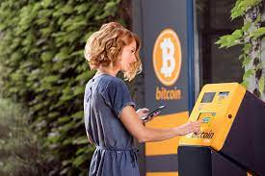
How to acquire bitcoin?
Cryptocurrency Exchange
Bitcoin Atm
Classified Service

Slide 9
Resources
Your best bets are BTER and CoinCorner
https://blockgeeks.com/
www.Youtube.com
www.google.com(images)

Slide 10
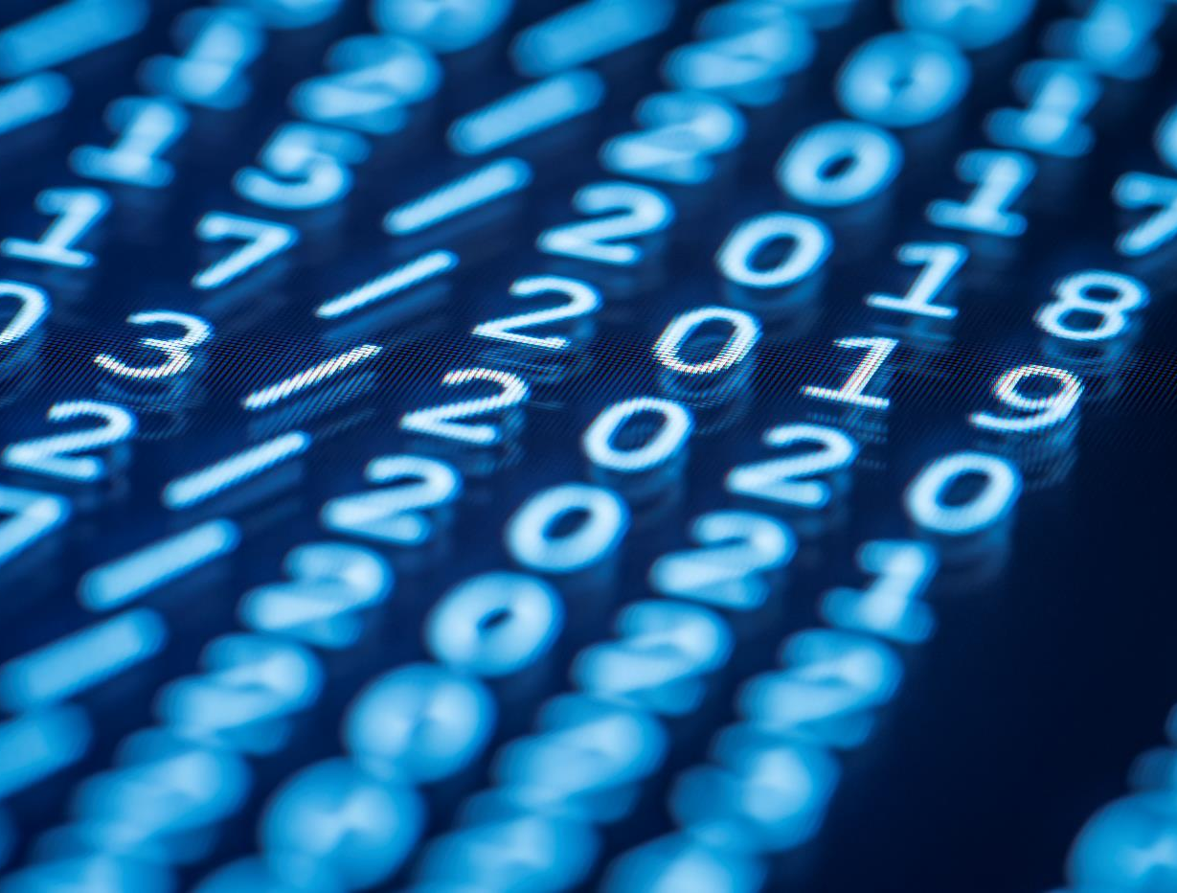
Thank You
The End

