Slide 1
Overview of Project APCA Software Engineering CSE435 Michigan State University Fall 2013
Team GReEN members:
Project Manager: Garret Smith
Facilitator: Eric Austin
Customer Liaison: Nikhil Andrews
Artifacts Manager: Rebecca Collins
Customer:
. Mr. David Agnew,
Continental Automotive Systems
Instructor:
Dr. Betty H.C. Cheng*
.
*Please direct all inquiries to the instructor.

Slide 2
Project Overview
Goals
Avoid collisions with pedestrians
Reduce lost time
Achieve by using breaking & acceleration
Motivation for project
Reduced pedestrian fatalities
Higher efficiency than human drivers
Make driving system more autonomous

Slide 3
Overview of Features
System runs through three pedestrian scenario types
Static
Moving then stopped
Static then moving
Deceleration depends on type of pedestrian detected
System reduces lost time by reaccelerating after passing pedestrian

Slide 4
Domain Research
Investigated in the area of Automated Collision Avoidance Systems
Needed to apply domain knowledge on topic of Automated Pedestrian Collision Avoidance System.
Project Constraints:
- zero collisions
- avoid “lost time”
- “fail safe mode”
- “response time”

Slide 5
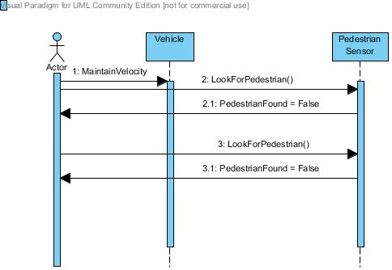
No Pedestrian Present

Slide 6
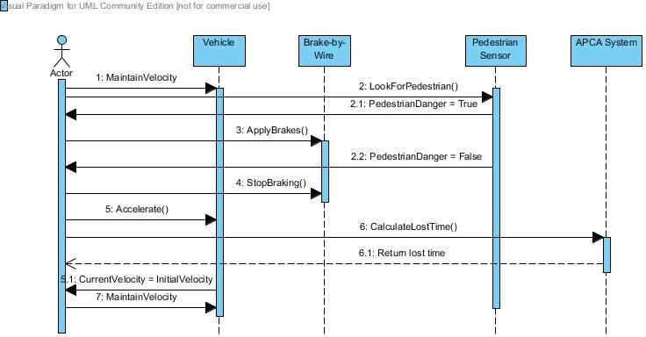
Pedestrian Present

Slide 7
Prototype Demonstration
Types of Scenarios
Moving then stopped
Static then moving
Static
Prototype found at: http://www.cse.msu.edu/~cse435/Projects/F2013/Groups/APCA2/Prototype/prototype2.html

Slide 8
Acknowledgements
We gratefully acknowledge and appreciate the participation of our customer, Mr. David Agnew from Continental Automotive Systems.
We also acknowledge the support of Dr. Betty Cheng and Erik Fredericks.

