Slide 1

Car Rental Management System
Professor:
Manuel
Montrond
Contributors:
Yunhao Yang
Shrivatsa Naragund
Smithi Parthiban
Saurabh Soni
Mridula Prabhakar

Slide 2

Project Overview
A robust database management system for Car Rental Management System is proposed.
This system will streamline all key aspects of the car rental process, including inventory management, reservations, customer interactions, billing, maintenance, insurance.
The goal is to optimize operations, reduce overhead, and provide a seamless, hassle-free rental experience for customers, thereby enhancing service efficiency and business profitability.

Slide 3
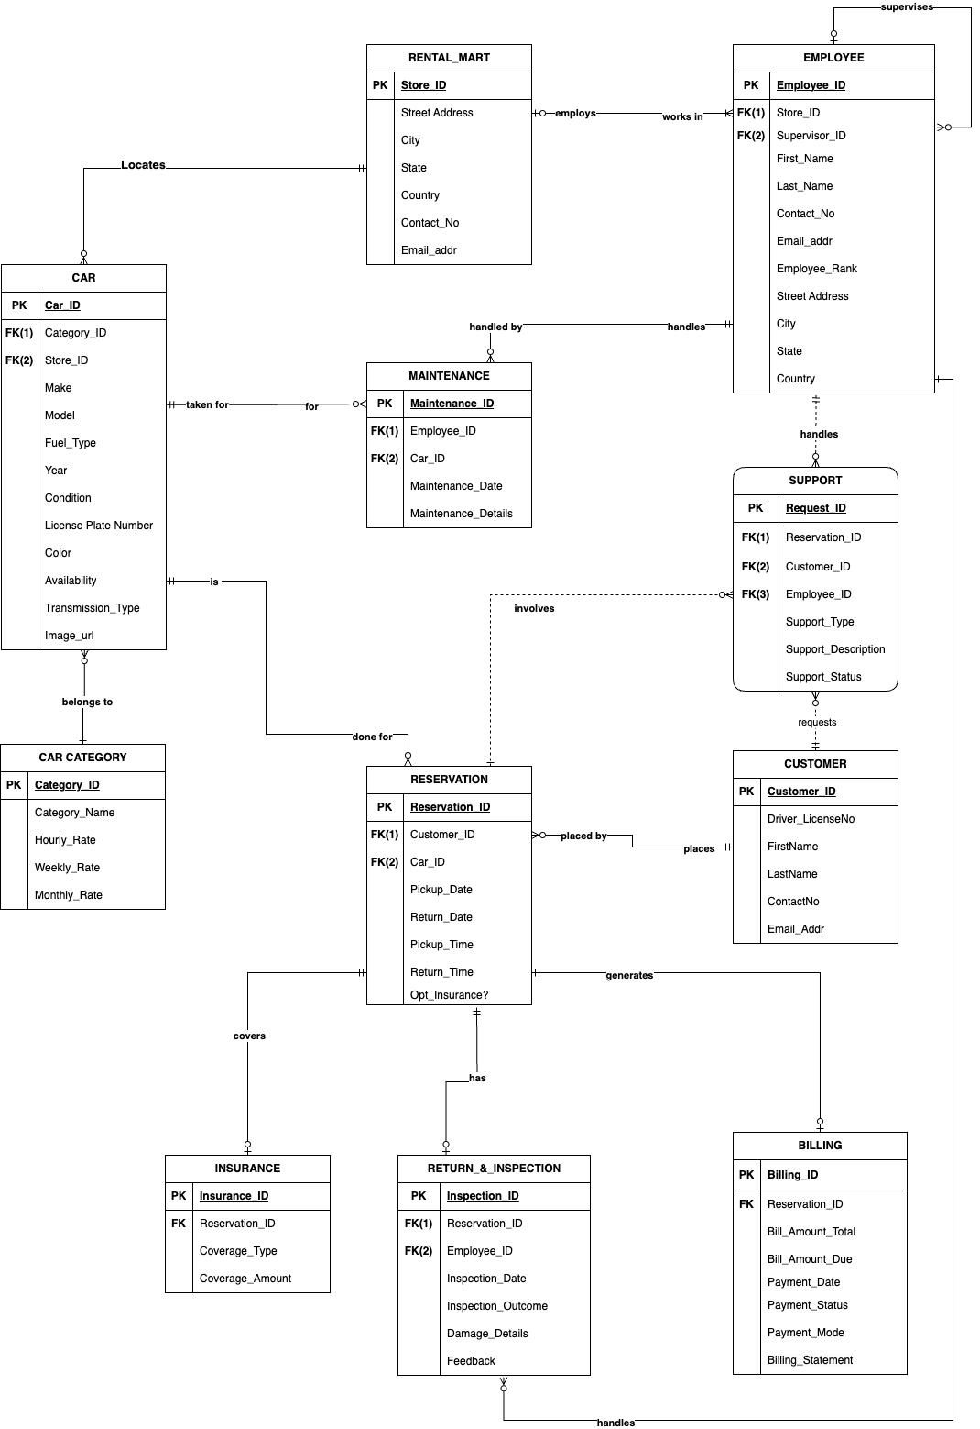
ERD
The ERD for our car rental system maps out the complex network of relationships between various entities that define our operations.

Slide 4
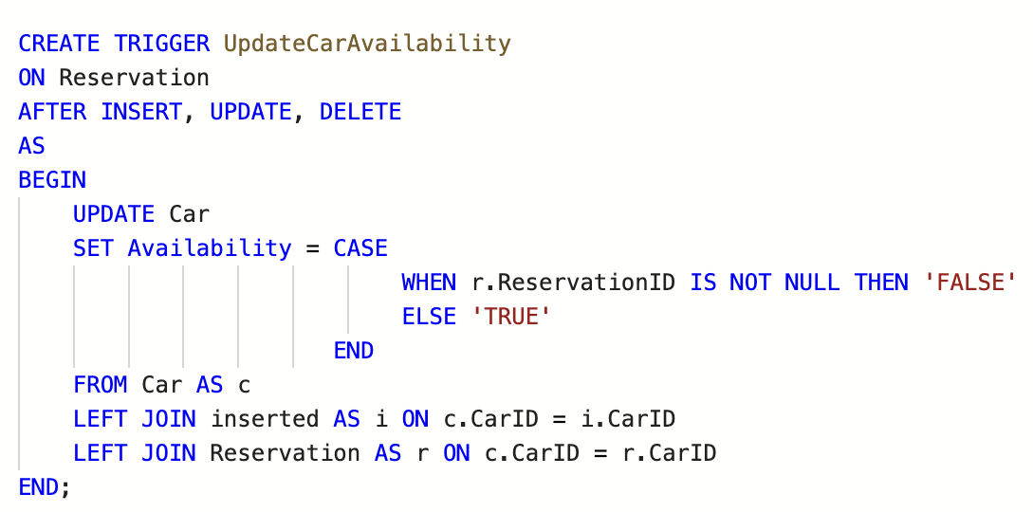
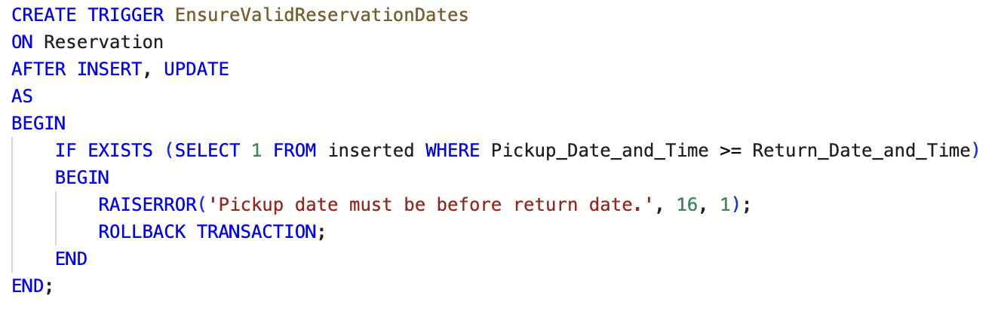
Triggers

Slide 5
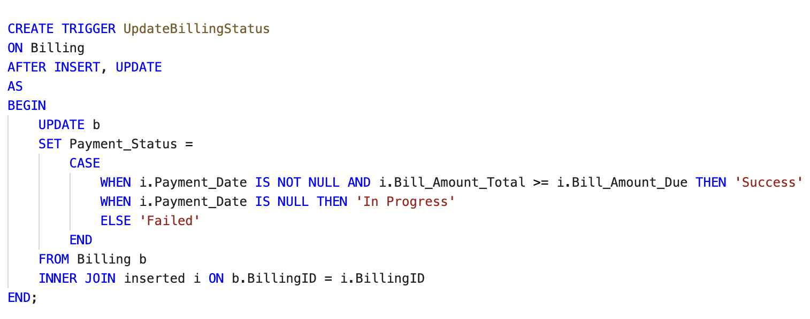
Triggers

Slide 6
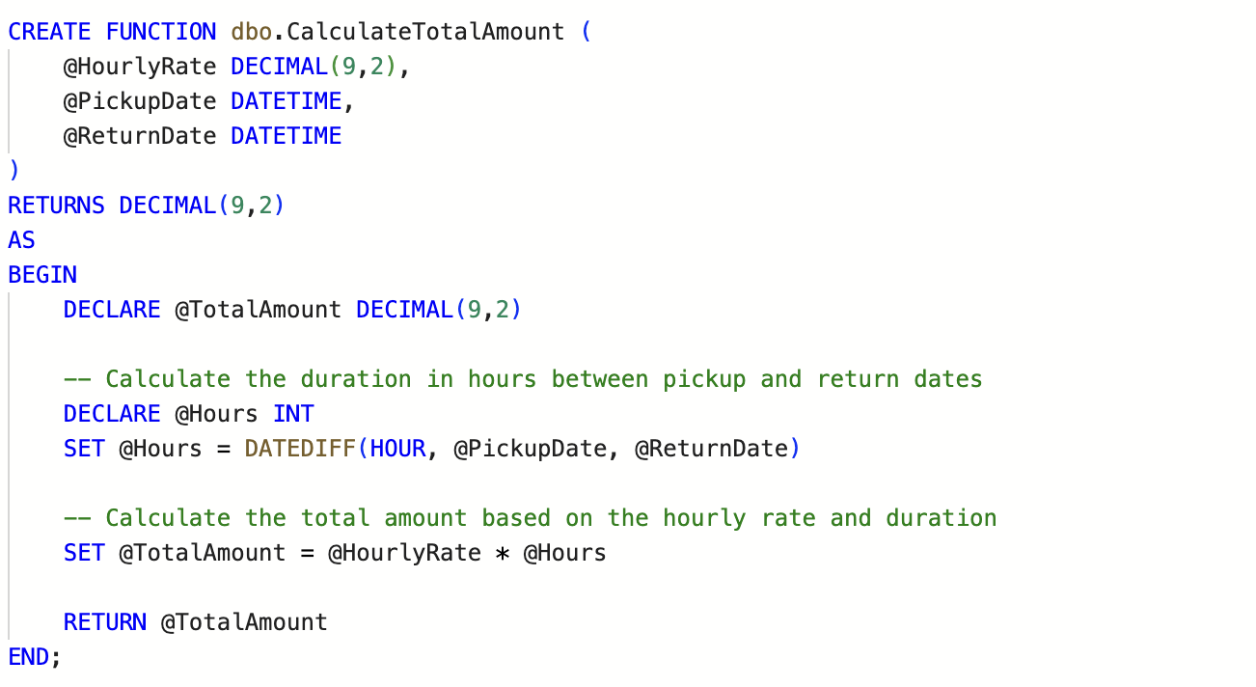
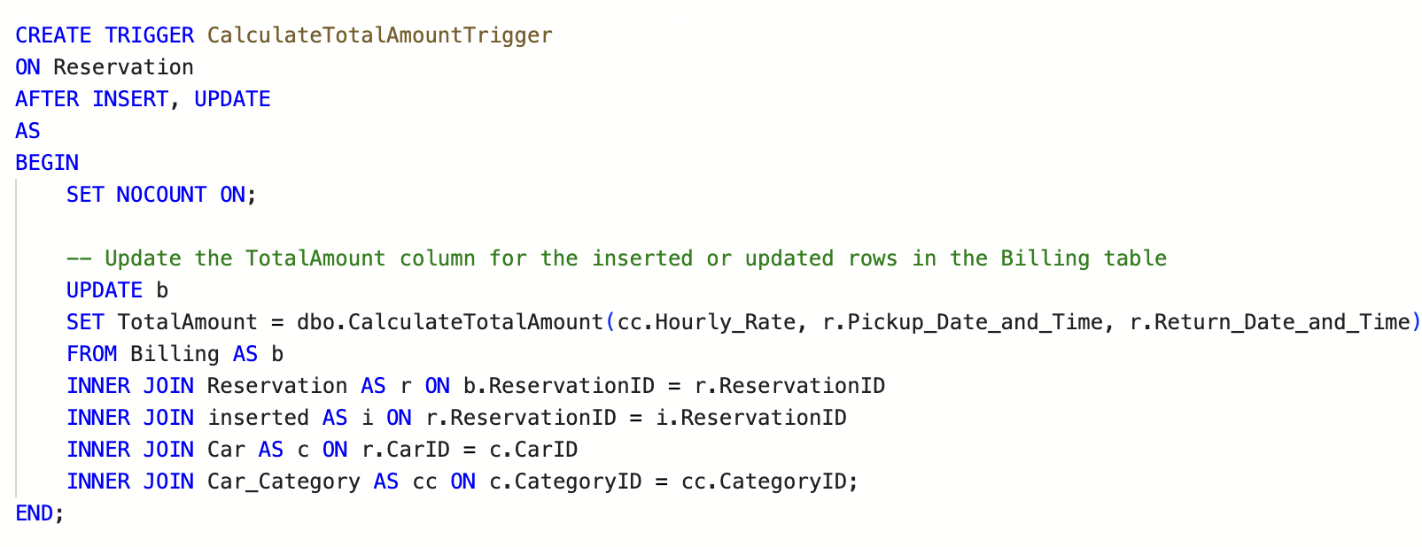
Functions & Triggers
We’re using combination of functions & triggers in our application. As soon as users Insert Value for pickup date & return date it triggers call for calculate total amount function

Slide 7
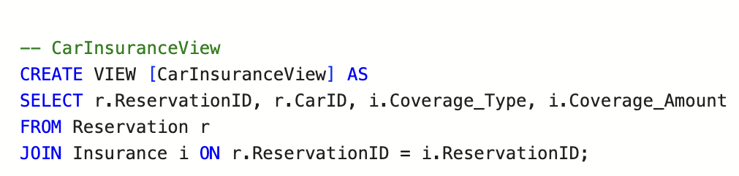
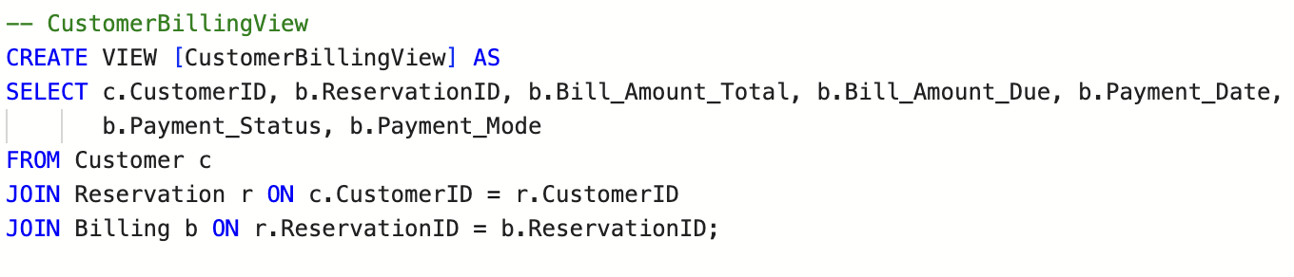
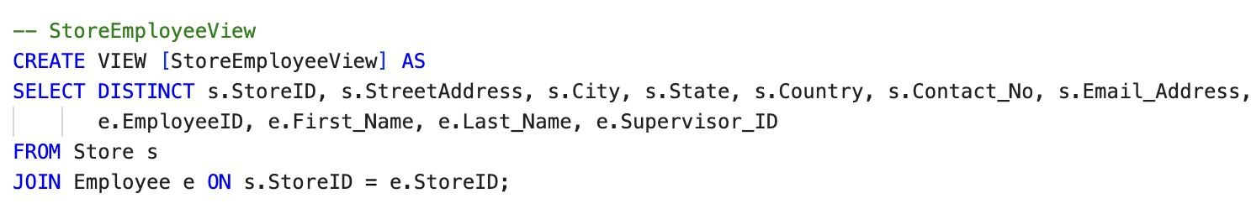
Views

Slide 8
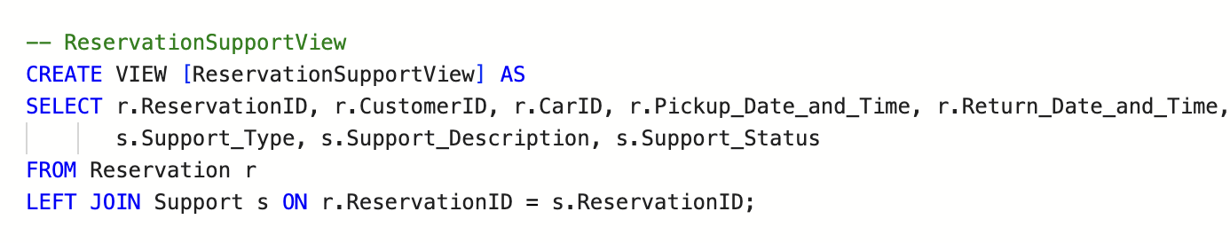
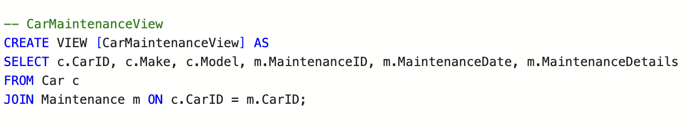
Views

Slide 9
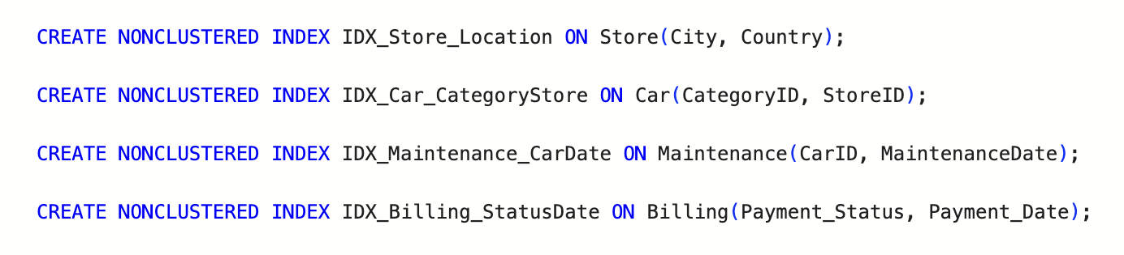
Non-Clustered Index

Slide 10
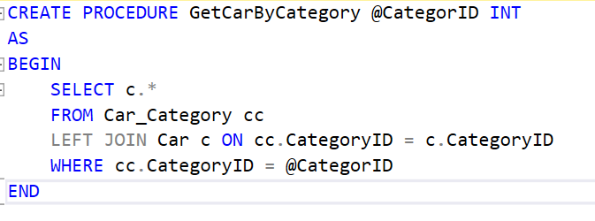
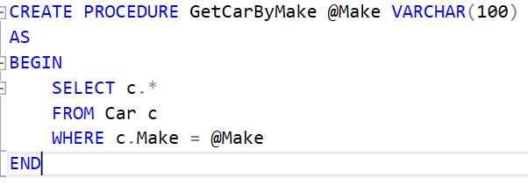
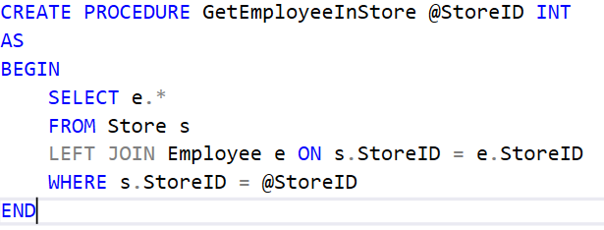
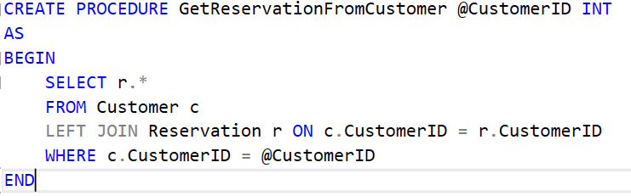
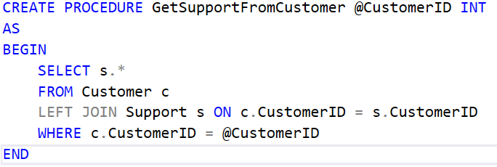
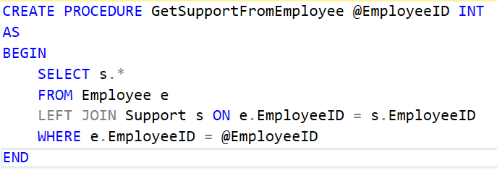
Stored Procedure

Slide 11
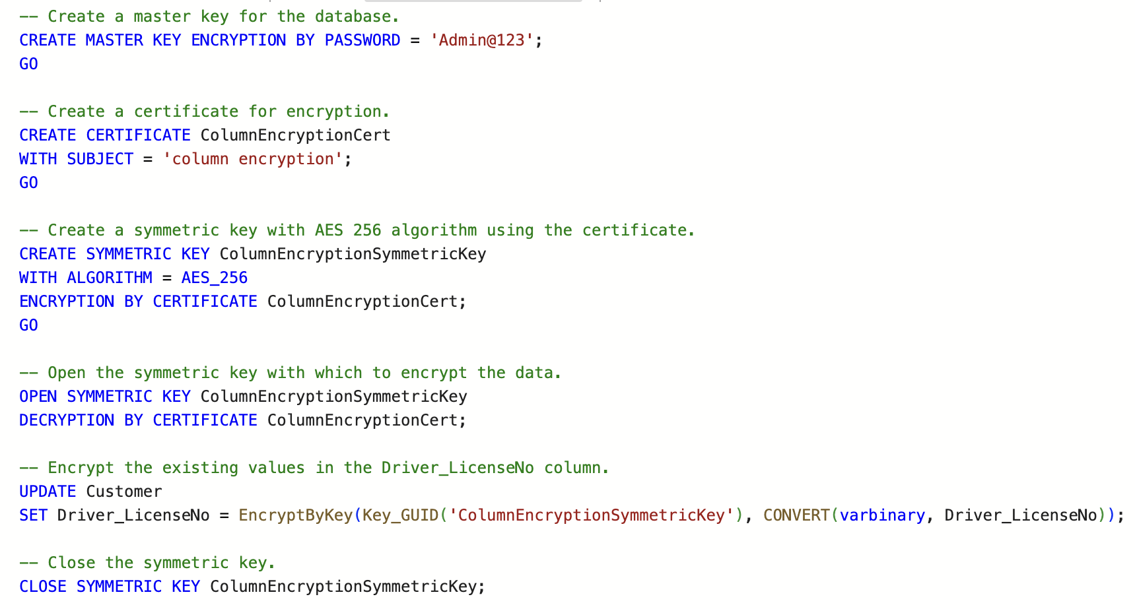
Encryption

Slide 12
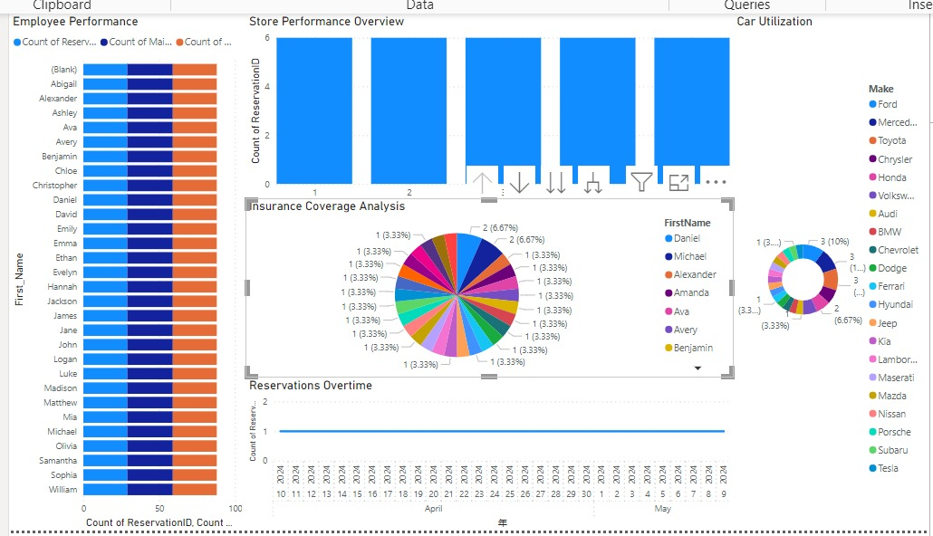
Power BI Dashboard

Slide 13

User Interface

Slide 14

Thank You

