Slide 1
How Computers Learn From Their Mistakes!
“Backpropogation”
Hey everyone! Have you ever wondered how your phone knows your face, or how a computer can learn to play a game? It seems like magic, but today we're going to learn the secret trick. It's a big, fancy word—'Backpropagation'—but the idea is actually super simple. Let's break it down!

Slide 2
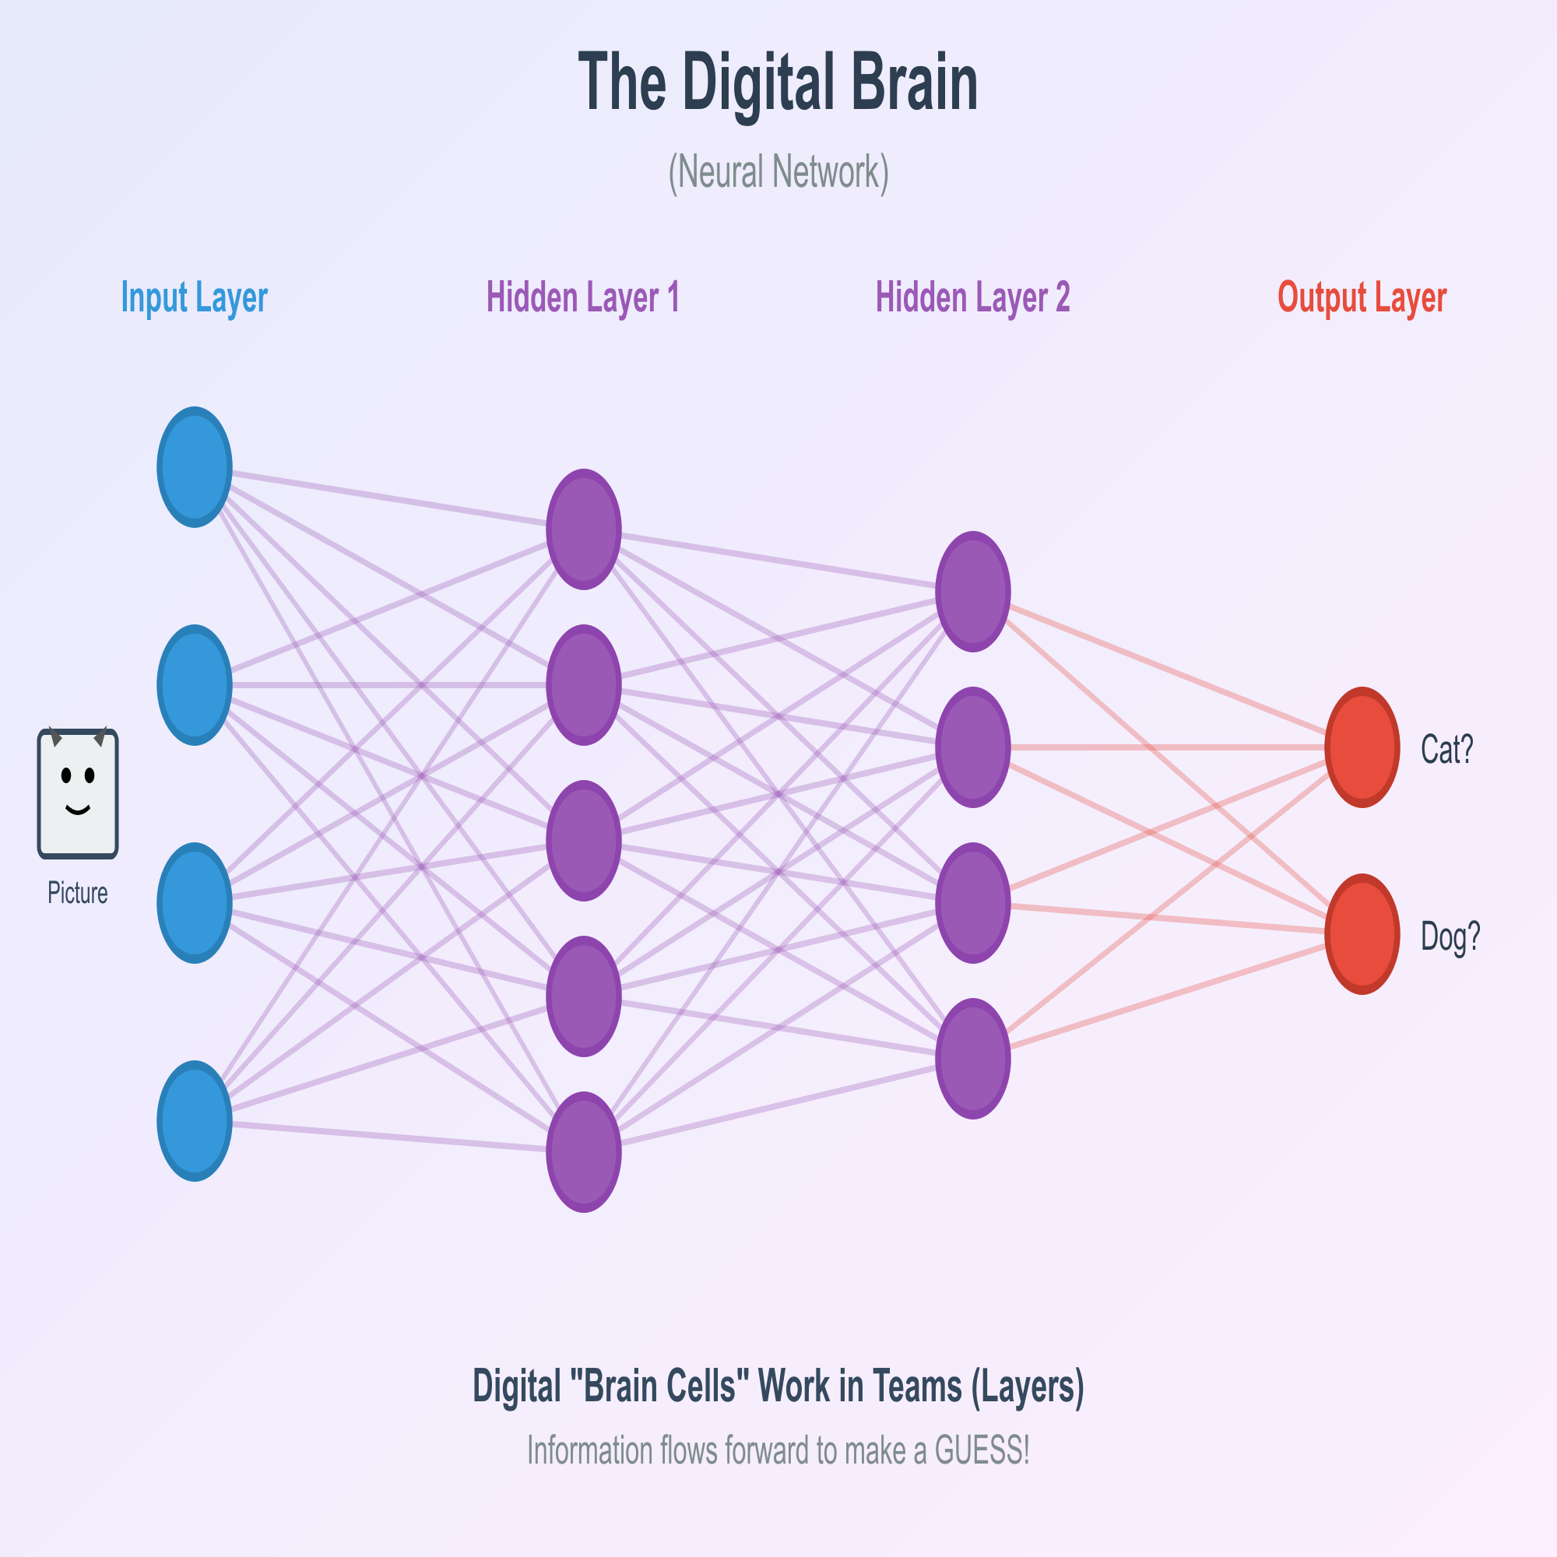
The Digital Brain
What is a 'Digital Brain'?
Scientists call it a Neural Network.
It's made of tiny digital 'brain cells' that work in teams (called layers).
Its job is to look at something (like a picture) and make a GUESS.

Slide 3
So, when we talk about 'Artificial Intelligence' or 'AI,' we're often talking about these 'digital brains.' Think of it like a brand new baby brain. It's connected, but it doesn't know anything yet. Its main job is to guess, guess, guess.

Slide 4
The Big Problem
New Brains Make... Bad Guesses.
When a digital brain first starts, its guesses are terrible.
It might look at a picture of your cat and guess 'Car?' or 'Banana?'
How do we teach it? We have to tell it, 'NOPE! That's a CAT.'
But... how does the whole brain learn from that one 'NOPE'?

Slide 5
This is the big question! If the brain has thousands of 'cells' all working together, how do they all know what they did wrong, just from one final bad answer? Let's use an analogy...

Slide 6
The Analogy: The Whisper Team!
Let's think of the digital brain as a Whisper Team.
Their job: Get a secret message from the start of the line to the end.
Each kid (a 'neuron') can only whisper to the kid in front of them.
They change the message just a little bit as it goes.

Slide 7
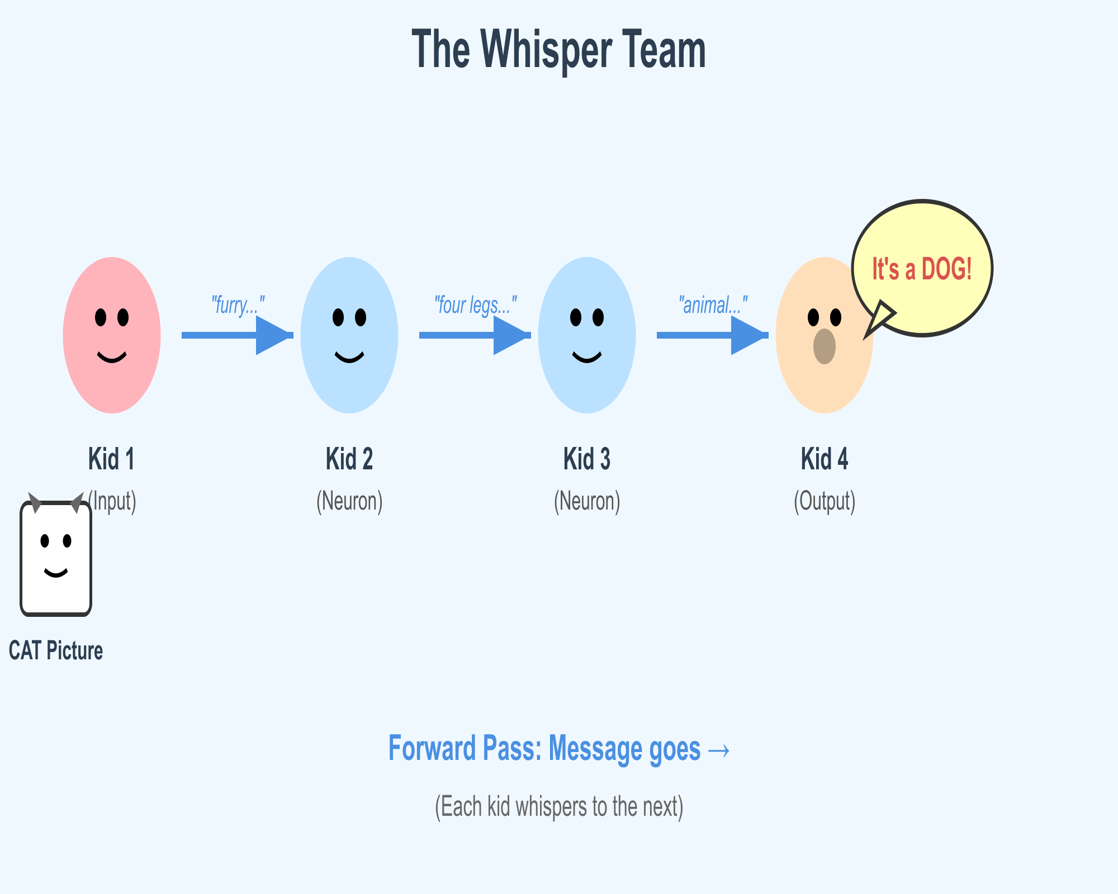
You've all played the 'whisper down the lane' or 'telephone' game, right? Where the message gets all messed up by the end? A digital brain is just like that, but in reverse. They're trying to get the right answer at the end.

Slide 8
Step 1: The First Guess (It's... Bad)
The Whisper Team's First Try
Kid 1 (Input): Sees a picture of a CAT.
Kid 2 (Neuron): Whispers 'furry...'
Kid 3 (Neuron): Whispers '...four legs...'
Kid 4 (Output): Shouts 'It's a DOG!'
This is called the 'Forward Pass' (passing the message forward).
.

Slide 9
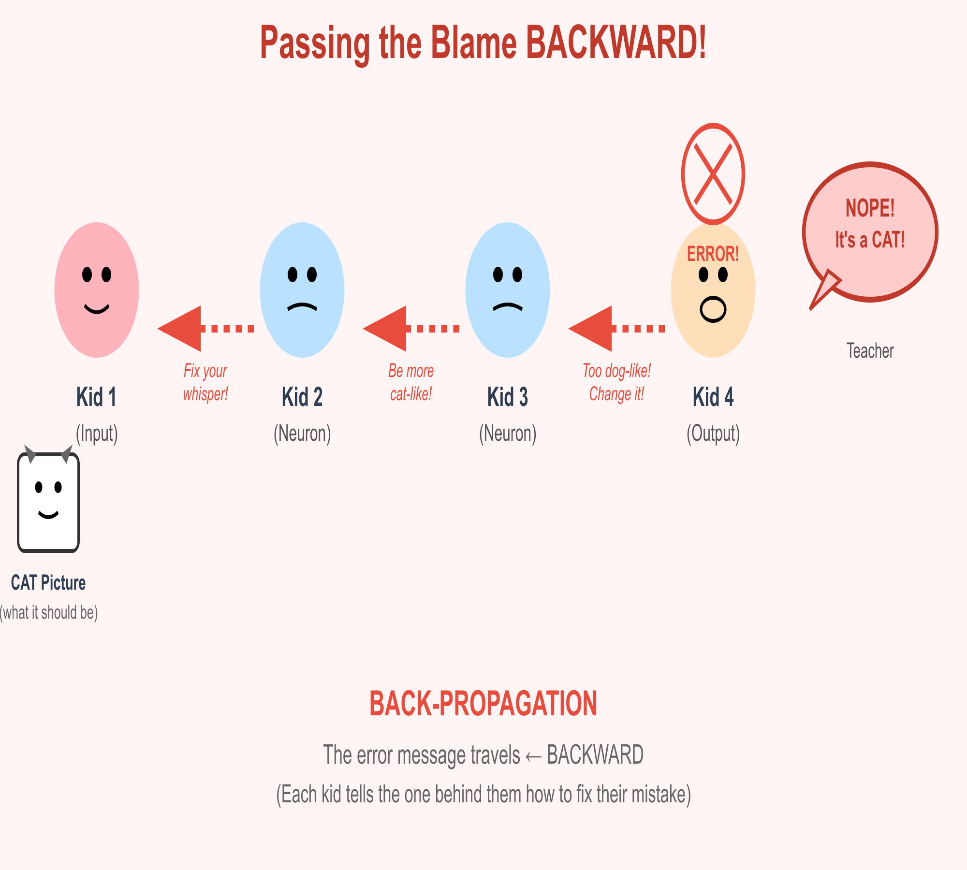
So, the info goes forward through the line. Each kid takes the info they heard, changes it a little, and passes it on. And at the end... Kid 4 gets it wrong. This is the 'forward pass'—just making the guess.

Slide 10
Step 2: The 'Oh No!' Moment
Finding The Mistake
The Teacher (that's us!) says: 'NOPE! It was a CAT.'
This is the 'Mistake' (or 'Error'). The guess 'Dog' is very different from the answer 'Cat.'
Kid 4 (the last kid in the line) is the first one to know they messed up.

Slide 11
This is the most important moment! The team made a mistake, and now they know it. Kid 4 is standing there knowing his answer was wrong. What does he do?

Slide 12
Step 3: Pass the Blame... BACKWARD!
This is BACK-PROPAGATION!
'Back' means backward. They pass the 'blame' back down the line.
Kid 4 (Output): Turns to Kid 3. 'You set me up! Your '...four legs...' whisper was too 'dog'-like. Be more 'cat'-like next time!'
Kid 3 (Neuron): Turns to Kid 2. 'You gave me bad info! Your 'furry...' whisper was too 'dog'-like. Make it sound more 'cat'-like!'

Slide 13
This is the secret! Backpropagation! It's just a fancy word for 'passing the message about the mistake backward.' Each kid tells the kid behind them how they messed up and what they need to fix for next time.

Slide 14
Step 4: Making Tiny Fixes (Learning!)
Learning is Making Tiny Changes.
'Passing the blame' is actually super-smart math.
Each kid (neuron) figures out how much they were to blame.
The kids who made the biggest mistakes get the biggest correction.

Slide 15
They all make a TINY, TINY change to how they'll whisper next time.
(Why tiny? If they make a HUGE change, they might mess up the guess for 'Bird' or 'Fish' later!)
This is the 'learning' part. Each kid in the line doesn't just forget. They adjust. They think, 'Okay, I'll whisper 1% less 'dog-like' and 1% more 'cat-like' next time.' They only make tiny, tiny changes so they don't mess up all the other things they've learned.

Slide 16
Step 5: Try, Try Again!
Let's Go Again!
The Teacher gives them the same 'CAT' picture.
Kid 1 (Input): Sees CAT.
Kid 2 (Adjusted!): Whispers 'furry... meow...'
Kid 3 (Adjusted!): Whispers '...four legs... small...'
Kid 4 (Adjusted!): Shouts 'It's a CAT!'
Teacher: 'YES! Great job, team!'
Speaker Notes:
Now they try again with their new, adjusted whispers. And this time, because of the backward messages and the tiny fixes, the final guess is much better! They got it right!

Slide 17
Now they try again with their new, adjusted whispers. And this time, because of the backward messages and the tiny fixes, the final guess is much better! They got it right!

Slide 18
So, What is Backpropagation?
It's the loop that computers use to learn:
1. Guess (The Forward Pass)
2. Find the Mistake (The Error)
3. Pass the Blame Backward (Backpropagation!)
4. Make Tiny Fixes (Learning!)
...and then they do this MILLIONS of times.

Slide 19
That's all it is! It's just a loop. You guess, you check how wrong you were, you send the 'fix-it' message backward, and everyone makes a tiny change. By doing this millions of times, with millions of pictures, the digital brain gets super, super smart.

Slide 20
Why Is This So Cool?
This 'Whisper Team' Trick is Everywhere!
This is how computers learn to:
- Recognize your face to unlock your phone.
- Understand what you say to Siri or Alexa.
- Drive self-driving cars (by guessing 'Is that a stop sign?').
- Help doctors find diseases in X-rays.

Slide 21
This one simple idea powers almost all the cool AI we see today. From your photo apps to the most advanced science, it's all just a really big 'Whisper Team' learning from its mistakes.

Slide 22
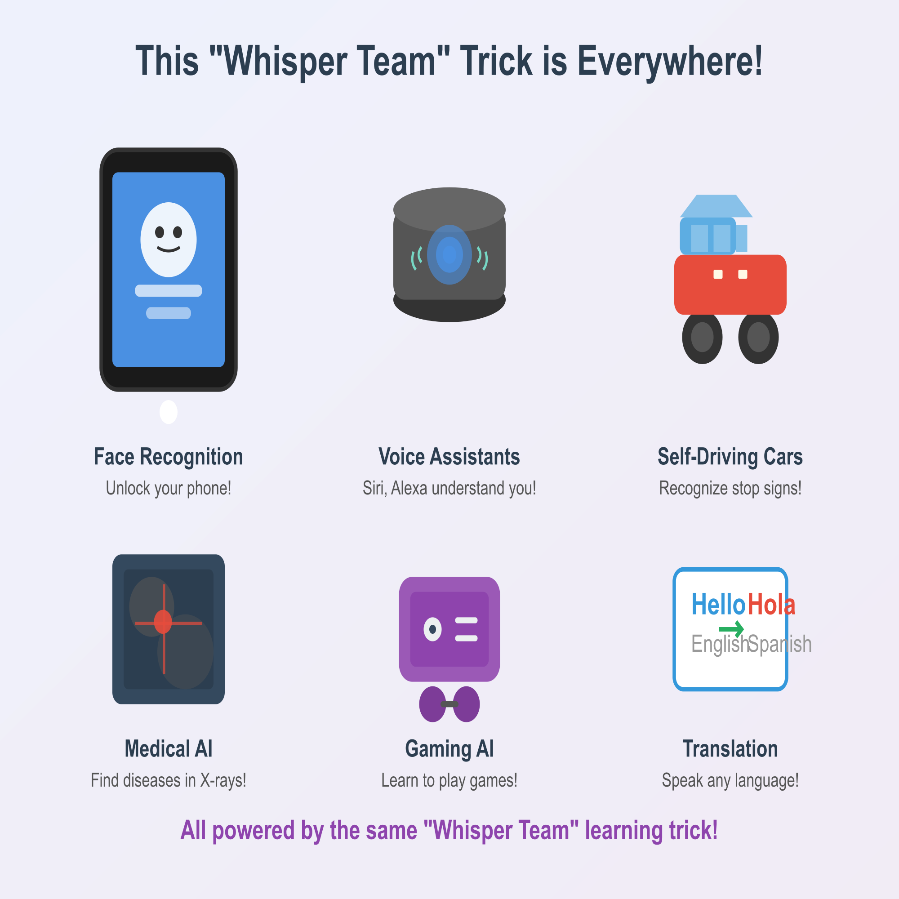

Slide 23
This is how computers learn to:
- Recognize your face to unlock your phone.
- Understand what you say to Siri or Alexa.
- Drive self-driving cars (by guessing 'Is that a stop sign?').
- Help doctors find diseases in X-rays.
This one simple idea powers almost all the cool AI we see today. From your photo apps to the most advanced science, it's all just a really big 'Whisper Team' learning from its mistak

Slide 24
You now understand one of the most important ideas in all of Artificial Intelligence!
So, give yourselves a hand! You just learned a college-level computer science concept. The next time you see a computer do something smart, you know the secret: it's just guessed, messed up, and fixed its mistake millions of time. Any questions?

Slide 25
Works Cited
Brownlee, Jason. "A Gentle Introduction to Backpropagation for Beginners." Machine Learning Mastery, 11 Aug. 2019, https://www.google.com/search?q=machinelearningmastery.com/a-gentle-introduction-to-backpropagation-for-beginners/.
Goodfellow, Ian, et al. Deep Learning. MIT Press, 2016.
Nielsen, Michael A. "How the Backpropagation Algorithm Works." Neural Networks and Deep Learning, Determination Press, 2019, neuralnetworksanddeeplearning.com/chap2.html.

