Slide 1
Tilt Tone
Joshua Smith
ECE 387
Midterm Presentation

Slide 2
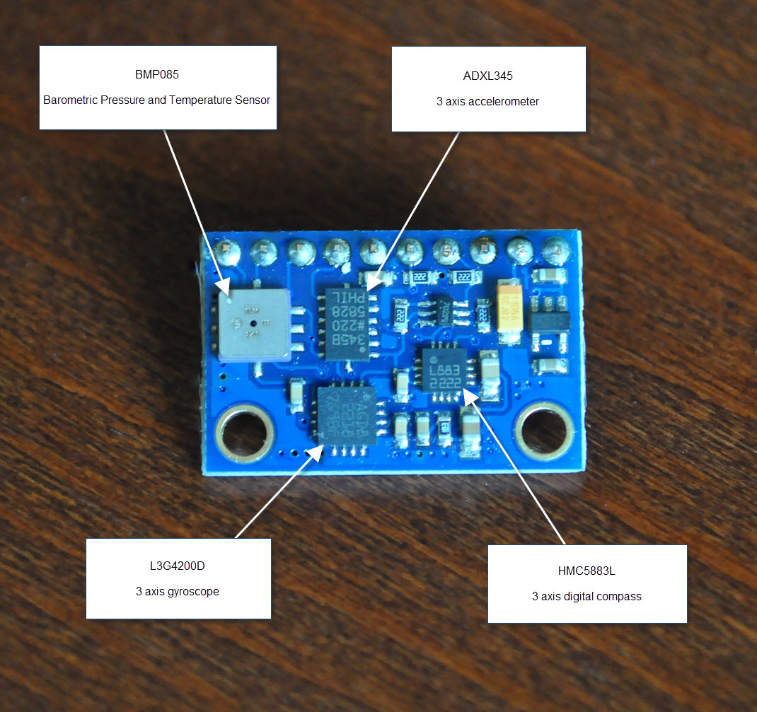
Gy-80 9-Axis Magnetic Acceleration Gyroscope Module
Price: $12.21
3-Axis Magnetic Sensor
3-Axis Accelerometer
3-Axis Gyroscope
Barometer

Slide 3


I2C Serial Protocol
Reads values from all four sensors using I2C protocol:
Vcc Ground SDA (data) SCL (clock)
Only requires two input pins on the Arduino
Arduino Uno is master: can use multiple master devices
GY-80 chip is slave: can support 1008 slave devices

Slide 4
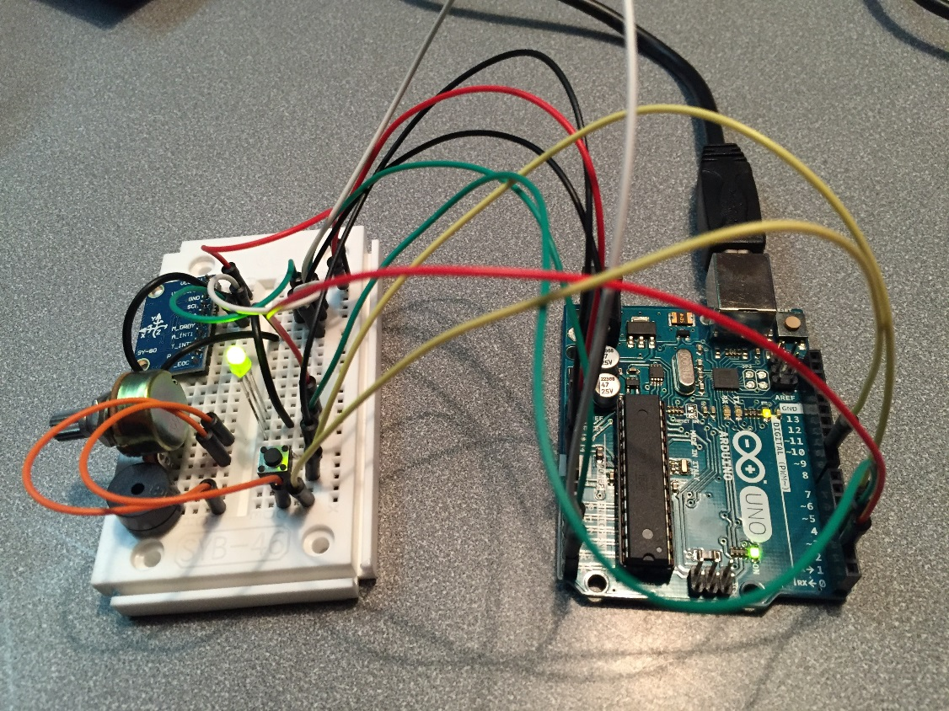
What I Did
Arduino Uno
Variable resistor
Buzzer
Bi-directional LED
Resistor
Push button
GY-80: Gyroscope

Slide 5

Tilt Tone Generator Operation – 2 Modes
Frequency Mode (Green LED):
Tilting gyroscope continuously changes buzzer pitch
Note Mode (Red LED):
Tilting gyroscope discretely changes buzzer pitch
Press push button to switch modes
Turn knob on variable resistor to change volume

Slide 6

It’s Demo Time
https://www.youtube.com/watch?v=S0xSpqv_qrI&feature=youtu.be

Slide 7
Other uses for GY-80 Module
?
Detect tilt: Motion controlled robot?
Detect acceleration: Measure car performance?
Follow magnet in 3D space: 3D magnet stylus?
Compass: Exploration robot?
Altimeter: Fly a plane?
Weather barometer: Predict storms?

Slide 8
References
http://www.control.aau.dk/~jdn/edu/doc/arduino/gy80/gy80.html
http://bildr.org/2011/06/l3g4200d-arduino/
https://learn.sparkfun.com/tutorials/i2c
Questions?

