Slide 1

Interpreting the results of community detection algorithms
Nathan Smith,
Senior Data Scientist

Slide 2
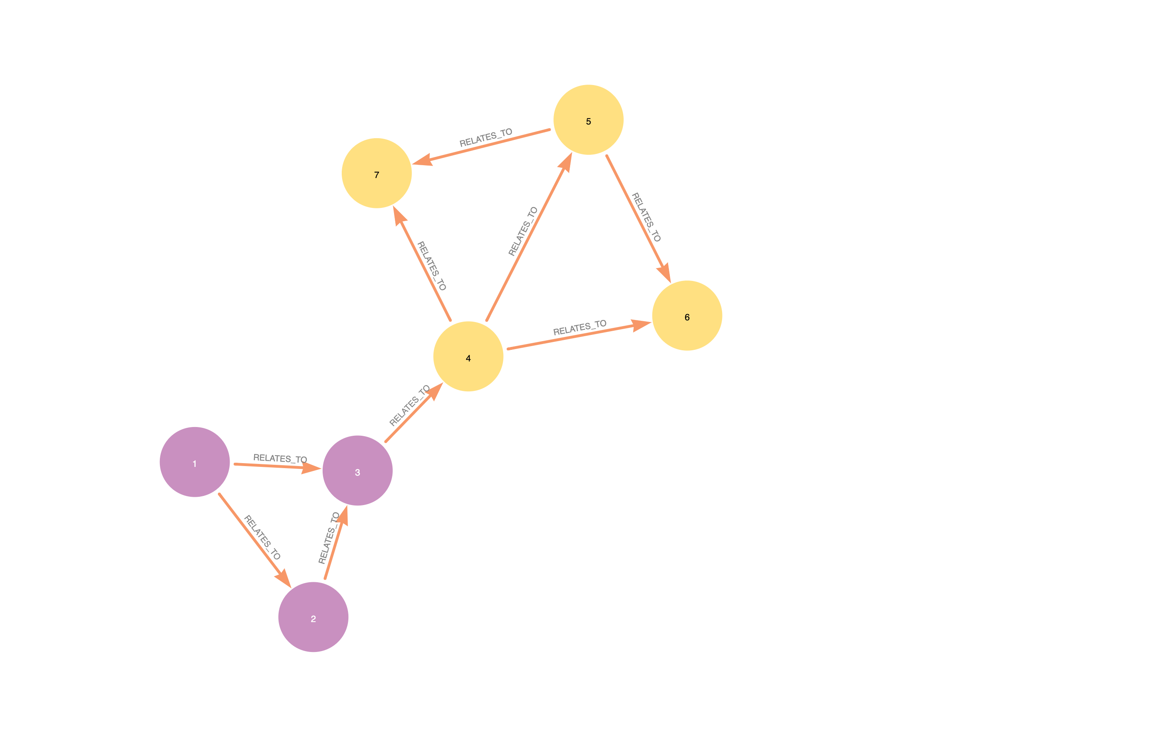
Congratulations!
You have successfully run a community detection algorithm!
But how useful are the results?

Slide 3
What makes a partitioning useful?
Communities are distinct from each other
Conductance
Members of a community are closely related
Modularity and clustering coefficient
We can identify distinctive characteristics of different communities
Centrality

Slide 4
What makes a partitioning useful?
Communities are distinct from each other
Conductance
Members of a community are closely related
Modularity and clustering coefficient
We can identify distinctive characteristics of different communities
Centrality

Slide 5
Demo
https://github

Slide 6
Thank you!
Stay in touch at
nathan.smith@neo4j.com
@nsmith_piano on Twitter

