Slide 1
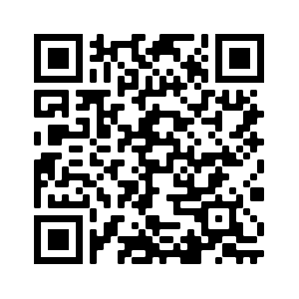

Interpreting the results of community detection algorithms
Nathan Smith,
Senior data scientist
Sample code repo

Slide 2
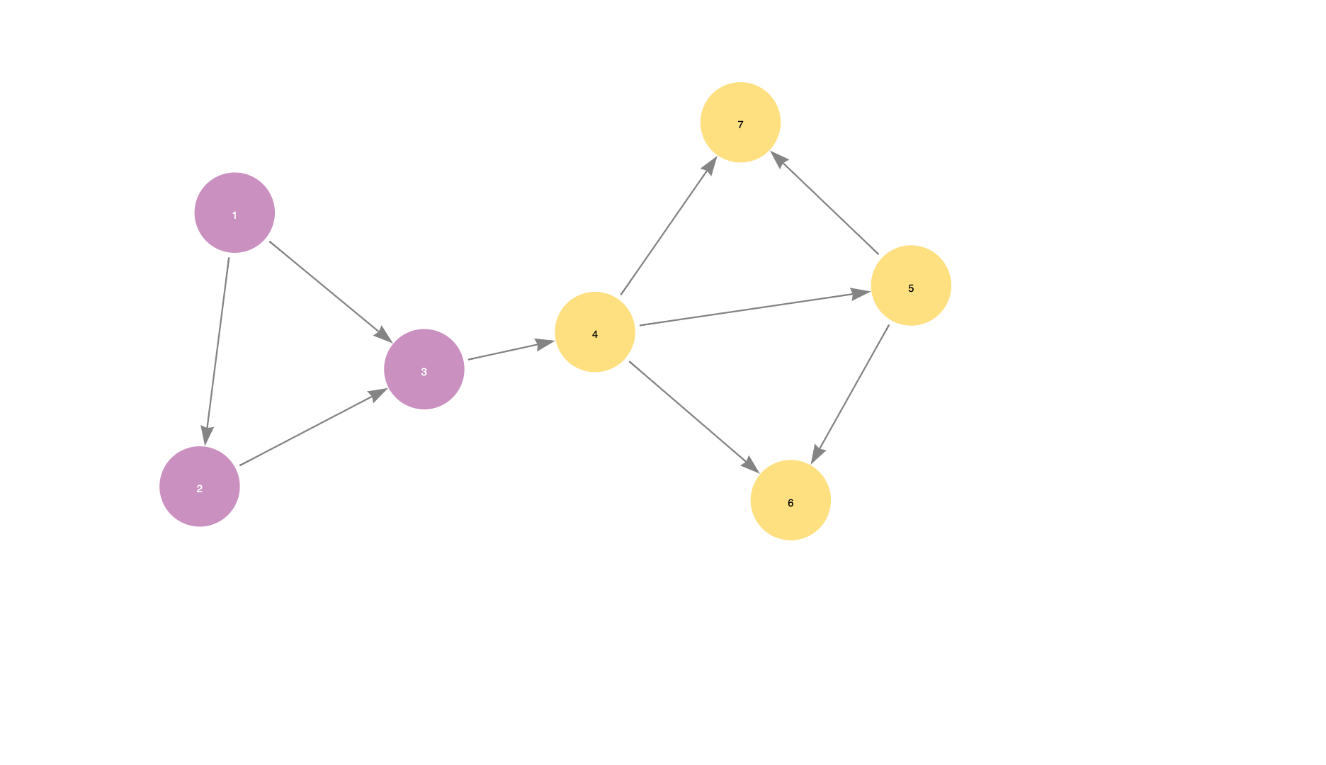
Congratulations!
You have successfully run a community detection algorithm!
But how useful are the results?

Slide 3
What makes a good community?
Weak relationships to other communities
Strong relationships within the community
Identifiable characteristics of community members

Slide 4
We can measure community quality!
Weak relationships to other communities
Strong relationships within the community
Identifiable characteristics of community members
Conductance and Modularity
Clustering coefficient
Centrality

Slide 5
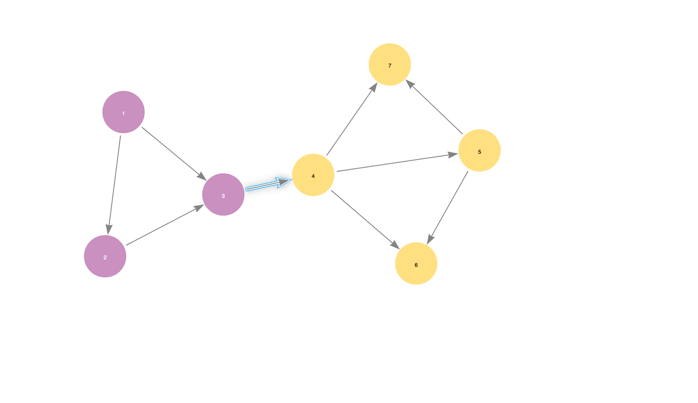
Conductance
What percentage of relationships that start in a community end in the same community?
Lower conductance scores mean more distinct communities.

Slide 6
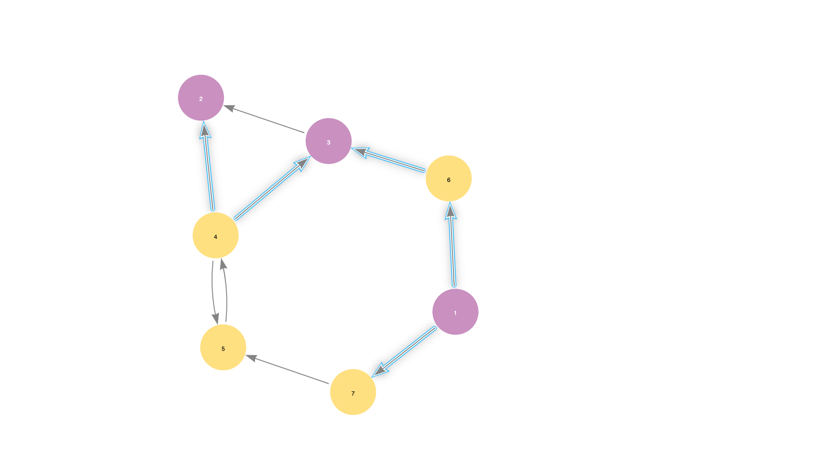
Modularity
What is the difference between the ratio of relationships with both endpoints in the same community compared to what the ratio would be if the relationships were distributed randomly?
Higher modularity scores mean more distinct clusters.
Original relationships
Randomly reassigned relationships

Slide 7
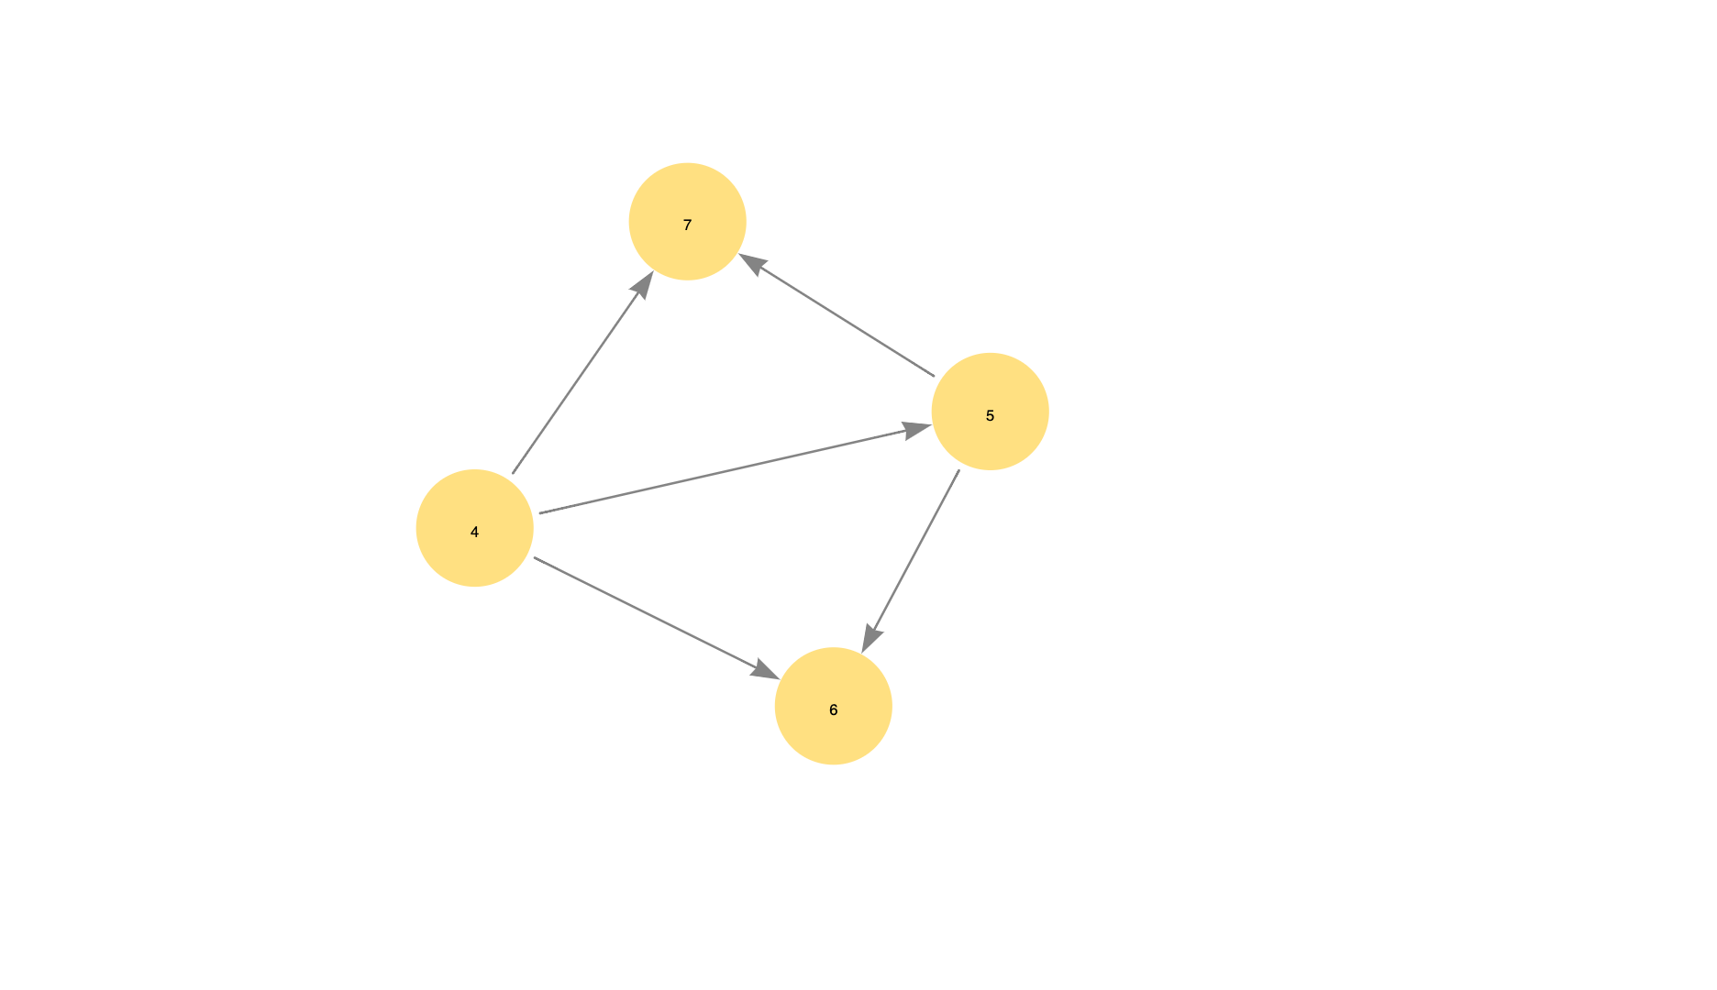
Clustering coefficient
What percentage of the neighbors of a node are related to each other?
Higher scores mean more connected, cohesive clusters

Slide 8
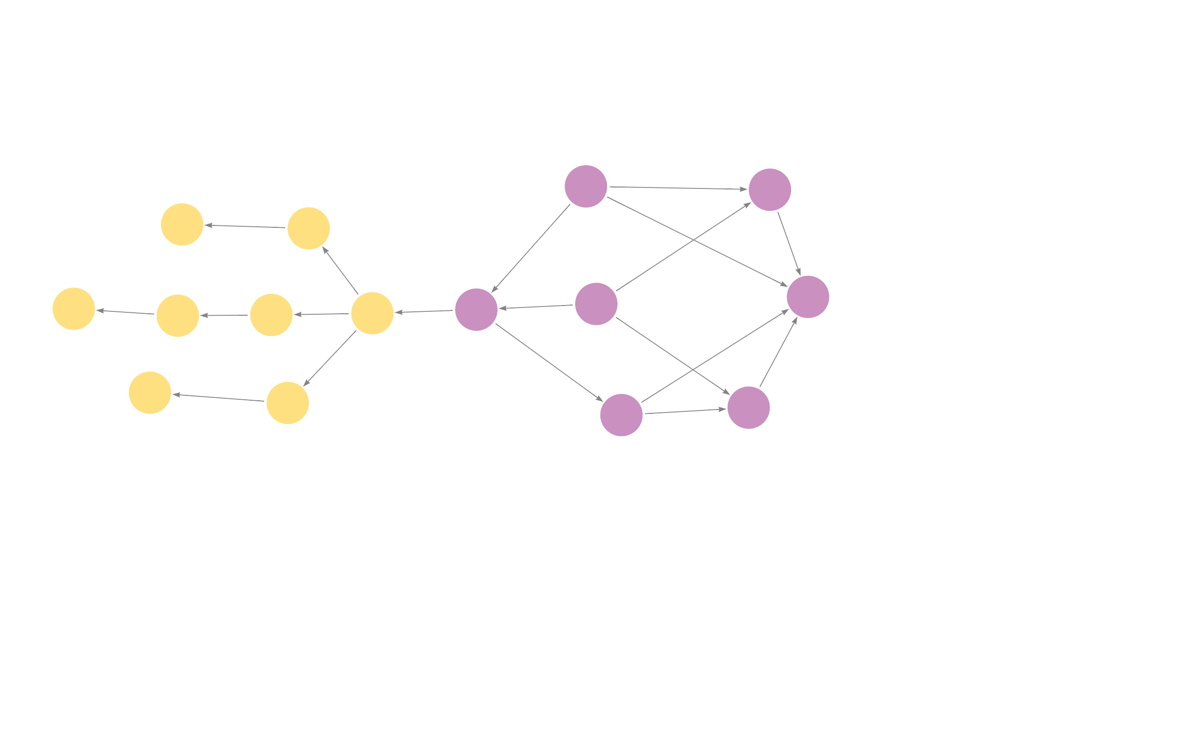
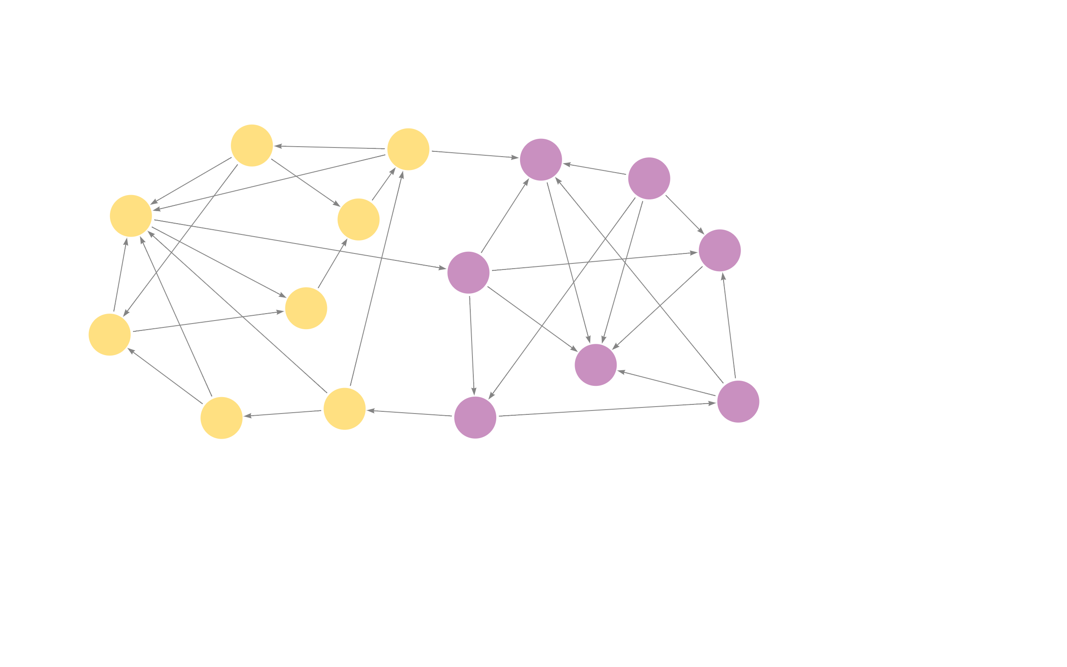
Compare sample graph statistics
Conductance:
Purple: 0.043
Yellow: 0.067
Modularity: 0.425
Clustering Coef:
Purple: 0.238
Yellow: 0.0
Conductance:
Purple: 0.097
Yellow: 0.090
Modularity: 0.406
Clustering Coef:
Purple: 0.371
Yellow: 0.487

Slide 9
Demo
https://github.com/smithna/blogs/tree/main/community_quality

Slide 10
What to tell your boss
Are the communities distinct and cohesive enough to be useful?
Are the community quality statistics changing over time?
What are high centrality examples within each community?
Thank you for sending me to GraphConnect!

Slide 11
Thank you!
Contact us at
nathan.smith@neo4j.com
@nsmith_piano on Twitter

