Slide 1
RAG Has a
Relationship Problem
Nathan Smith · Neo4j · Community Days KC

Slide 2
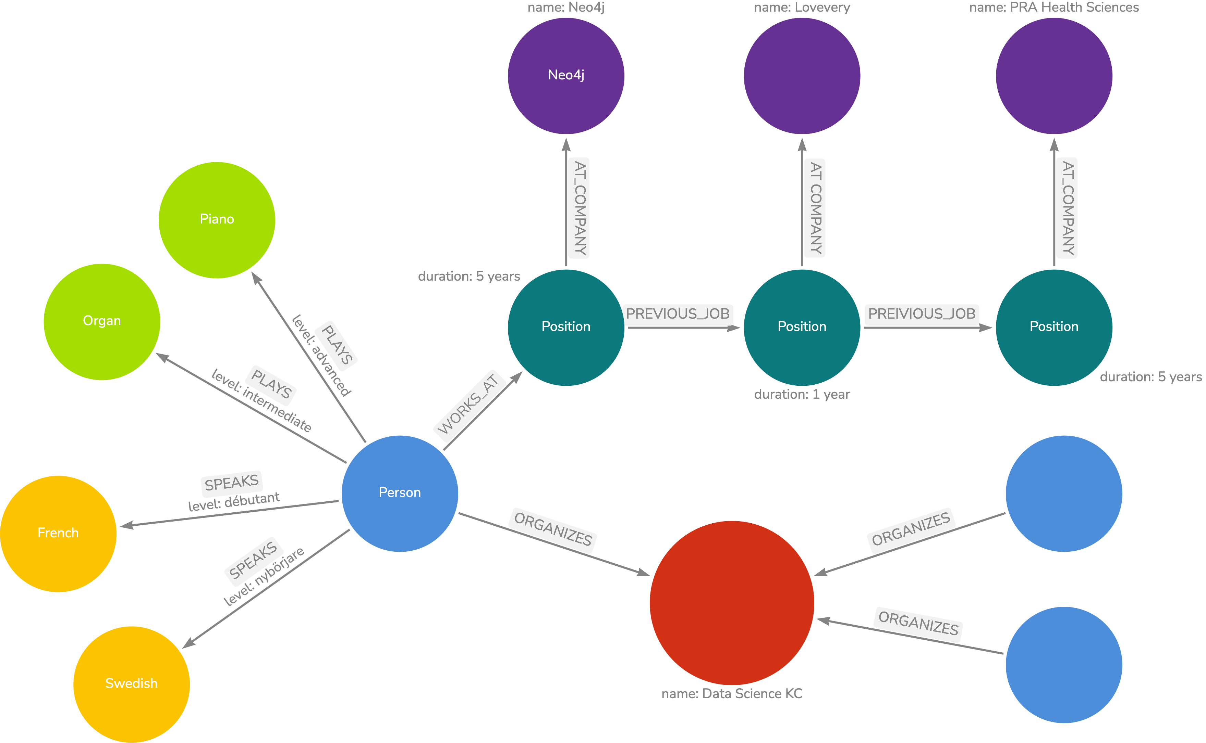



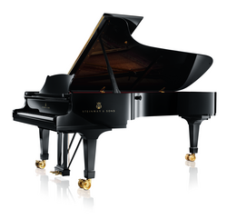
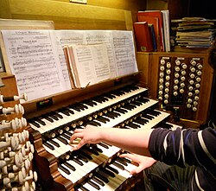



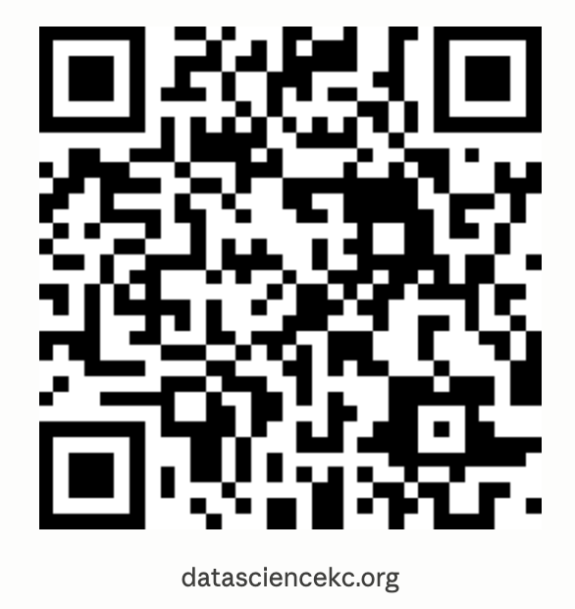



Slide 3
You've built a RAG pipeline.
User Question
Embed
Vector Search
LLM + Context
Answer
Notes:
9:03

Slide 4
You've built a RAG pipeline. It mostly works.
Legal AI
Cites a superseded policy — both versions scored high for the query
Medical chatbot
Finds chunks about Drug A and Drug B separately; misses their interaction
Internal KB
"Michael S." and "Mike Sullivan" are the same person — the system never knew

Slide 5
The problem usually isn't your embeddings
or your model.
Vector search finds things that look similar to your question,
not things that are connected to each other.
Graphs fix the relationship problem
without replacing your existing stack.
Notes:
9:06

Slide 6
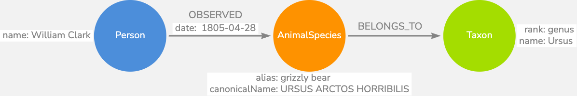
What's a graph?
A graph is a set of nodes (things)
Vector search → finds similar content Graph traversal → follows connections Both are useful. Neither replaces the other.
connected by relationships (how they're connected).

Slide 7
If you know SQL, you have a foundation for graphs
SQL | Graph
Table | Node label
Row | Node
Foreign key | Relationship
JOIN | Traversal
The key difference:
In SQL, relationships are implicit — computed at query time by matching IDs across tables.
In a graph database, relationships are stored explicitly with the data.

Slide 8
The pipeline for a comparison app
User Question
Embed (text-embedding-3-small)
Graph RAG Agent
vector_search · cypher_query · sequence_context
Vector Search — Neo4j
LLM + Context
LLM + Context
Answer
Answer
Vector index and graph live in the same Neo4j database. Both run on every question — answers shown side by side.
Notes:
9:11

Slide 9
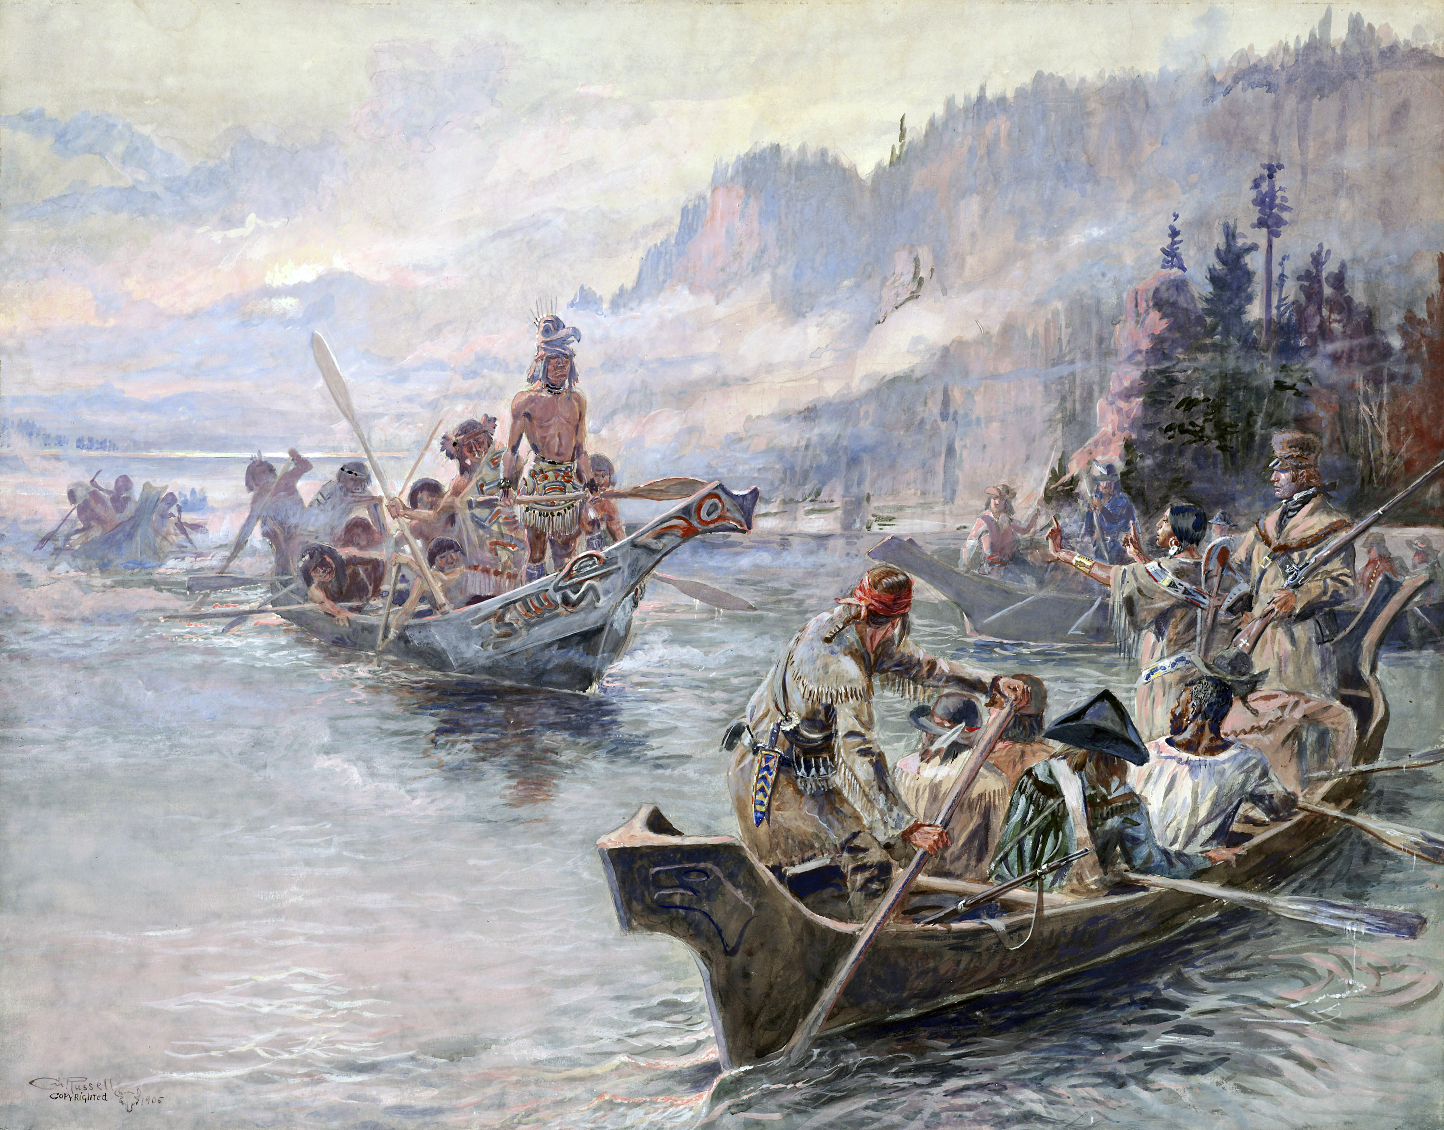
Navigating The Journals of Lewis and Clark

Slide 10
Generating the graph
1
Ingest
Chunk by journal entry, embed, load Chunk nodes
2
Extract
LLM entity + relationship extraction per chunk
3
Disambiguate
Two-pass LLM merge of CLARK / CAPTAIN CLARK / WILLIAM CLARK → one node
4
Enrich
GBIF taxonomy lookups · Sacagawea reference matching
5
Flag
Tag generic place names (:GenericLocation) so queries return real places
Greenfield corpus this size: 2–3 days. Existing chunked+embedded corpus: ~2 days to add the graph layer.

Slide 11
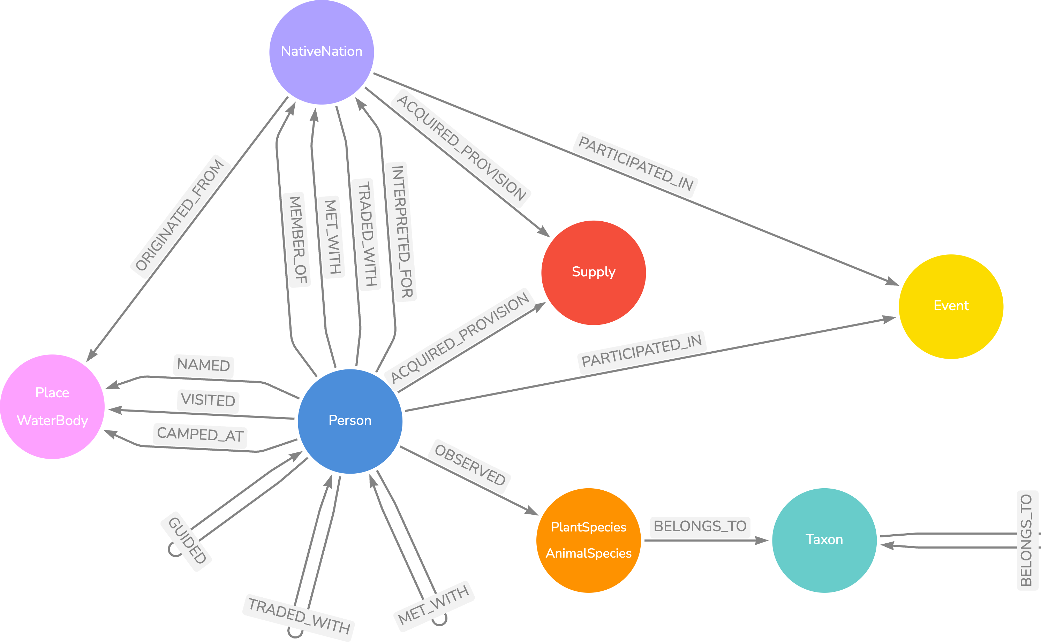
The Lewis & Clark knowledge graph

Slide 12
The graph is an editable artifact
Vector store
Knowledge locked in floating-point vectors
Wrong inference? Re-embed the whole corpus
No correction surface for domain experts
Knowledge graph
Every node and relationship is visible and queryable
Domain experts can validate and patch extracted knowledge
Example: Sacagawea — rarely named directly in the journals
Clark calls her: “Janey” · “the interpreter’s wife” · “the Indian woman” · “Sah-kah-gar-we-a”
A curated annotation list (lewis-clark.org) identifies which passages she appears in, even when unnamed. One canonical Person node links every alias and every relevant chunk. Her INTERPRETED_FOR and GUIDED relationships are extractable. Every query resolves to the same node.
The LLM does the bulk extraction. Domain experts patch what the model can’t know.
Notes:
9:16

Slide 13
Let's look at the graph
Notes:
Start on the entry for 1804-06-26
Show chunk text
Show neighboring chunks
Dismiss neighboring chunks
Expand mentioned in
Expand all but mentioned in for Kansas River
Expand taxonomy for rattle snake
Expand taxonomy for Squamata

Slide 14
Live Demo
Lewis & Clark GraphRAG · localhost:3000
Side-by-side: Vector RAG | Graph RAG — both run on every question

Slide 15
Four things a graph does well that SQL does awkwardly
1
Variable-depth traversal
[:BELONGS_TO*] is one token. SQL needs WITH RECURSIVE — awkward, rarely optimized, requires a known max depth.
2
Schema-free relationships
New relationship type in Neo4j: just write it. In SQL: new junction table, migration, foreign keys everywhere.
3
Multi-hop at scale
Each SQL JOIN compounds in cost. Graph traversal is O(1) per hop — relationships stored as direct pointers.
4
Text-to-query accuracy
(Lewis)-[:OBSERVED]->(Bear) reads like English. A recursive CTE does not. LLMs generate correct Cypher more reliably on complex queries that matter.
Notes:
9:21

Slide 16
Is your use case a good fit?
Strong signal ✓
Probably overkill ✗
Answers require traversal, not just retrieval
Same entity named differently across documents
Hierarchy or sequence is essential
You need completeness, not just similarity
All questions are factual lookups
Corpus is small (< a few hundred docs)
No meaningful entities or relationships
Need a prototype by Friday
"What does my user need to know that isn't in any single document?"
Notes:
9:24

Slide 17
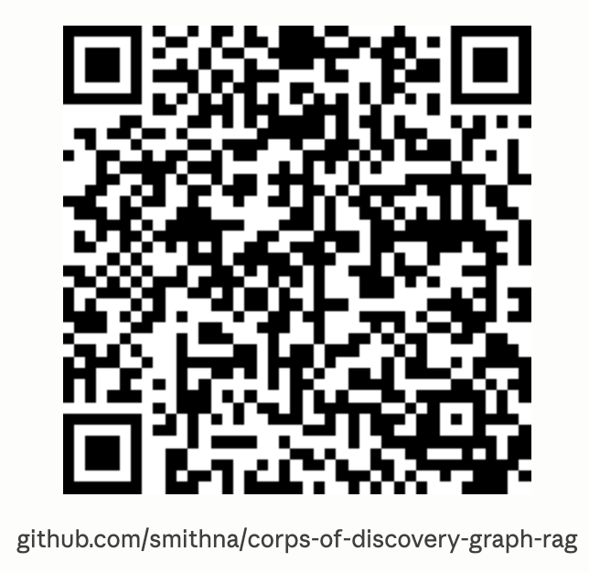
Three things to take home
Mental model
Graphs store connections explicitly. Vectors find similarity. Neither replaces the other.
1
Realistic cost
Adding a graph layer to an existing RAG pipeline is 1–3 days, not a rewrite. The extraction step is the interesting hard problem.
2
Decision signal
If the answer lives in connections between documents rather than in documents themselves, a graph will pay for itself quickly.
3
[ github.com/smithna/corps-of-discovery-graph-rag ]
Notes:
9:25

Slide 18
Appendix
Resources & Further Reading

Slide 19
Where to go next
graphrag.com
arrows.app
Concept guides, how-to walkthroughs, and the full research bibliography.
Free browser-based graph data modeler from Neo4j.
Concepts — What is GraphRAG? What is a knowledge graph?
How-to Guides — data prep through retrieval techniques
Research Appendix — 17+ papers with summaries
Sketch your graph schema before writing any code
Visualize node types, relationship types, and properties
Export your model as Cypher CREATE statements
Share diagrams with your team
Pro tip: model your graph in arrows.app before writing your extraction prompt. A clear schema = better LLM extraction.

Slide 20
Research backing the hybrid approach
HybridRAG
arXiv 2408.04948
Empirically measures the improvement of combining graph and vector retrieval. The closest paper to what this demo shows.
From Local to Global: A Graph RAG Approach to Query-Focused Summarization
arXiv 2404.16130
Microsoft Research. Graph structure enables global summarization queries that vector search fundamentally cannot answer.
Knowledge Graphs on Enterprise SQL Databases
arXiv 2311.07509
Empirical evidence that KGs improve LLM accuracy even when structured SQL data is already available. Direct answer to the Postgres question.
Full bibliography at graphrag.com/appendices/research/

Slide 21
For the curious
Graph RAG: A Survey
arXiv 2408.08921
Map of the whole landscape. Start here to understand the full taxonomy of GraphRAG approaches.
HybGRAG
arXiv 2412.16311
Specifically addresses queries spanning both unstructured text and relational knowledge — the toggle this demo demonstrates.
Customer Service QA with Knowledge Graphs
arXiv 2404.17723
Enterprise use case. Relatable for teams building internal tooling.
Think-on-Graph
arXiv 2307.07697
LLM reasoning over graphs — the next step beyond graph-enriched context.
All links and summaries at graphrag.com/appendices/research/

