Slide 1
Topic Modeling
Natalie Smith

Slide 2
What is topic modeling?

Slide 3
What is topic modeling?
Process of automatically extracting similar word groups and expressions into topics from a large set of text or documents

Slide 4
What is topic modeling?
Process of automatically extracting similar word groups and expressions into topics from a large set of text or documents
Unsupervised learning technique

Slide 5
What is topic modeling?
Process of automatically extracting similar word groups and expressions into topics from a large set of text or documents
Unsupervised learning technique
Does not require knowledge of topics beforehand

Slide 6
What is topic modeling?
Process of automatically extracting similar word groups and expressions into topics from a large set of text or documents
Unsupervised learning technique
Does not require knowledge of topics beforehand
Differs from topic classification, which requires training

Slide 7



How does topic modeling work?
Step 1:
Assemble documents
Step 2:
tokens = [water, flour, salt, sugar, bowl, …]
Clean data and lemmatize words
Step 3:
Dictionary = {‘water’:0,‘flour’:1, ‘salt’:2, ‘sugar’:3,...}
Dictionary
Create dictionary and Bag of Words (BoW)
BoW
Notes:
(step 2): as part of this process, can use the package nltk to filter out “stop words” or extremely common words - in english for example this would be words like “a”, “and”, “the”, and so on
(step 3): here, each token or word is assigned a unique ID -> when added to the Bag of Words, each word is assigned that ID and a frequency
This allows you to filter out extremely low frequency words, for example, keep the first 1000 words, etc.

Slide 8
How does topic modeling work?
Topic 1
Step 4:
BoW
Topic 2
A range of topics are built from the BoW
Topic 3
Topic 1
Topic 2
Topic 3
Step 5:
The words associated with each topic can be printed and visualized

Slide 9
So, how does this work in Python?

Slide 10
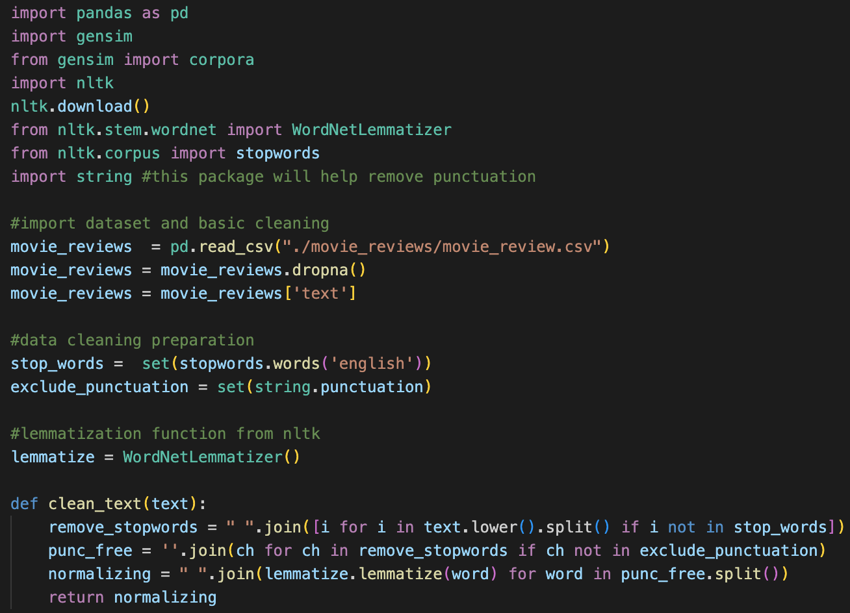
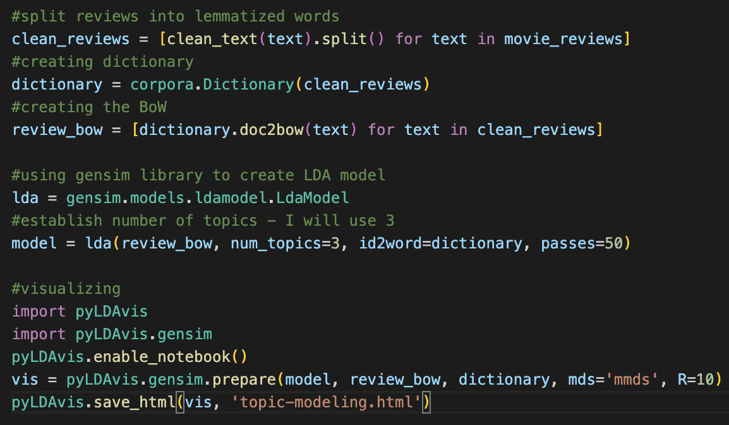
Topic modeling using gensim and pyLDAvis
LDA (Latent Dirichlet Allocation):
Documents considered collections of topics
Topics considered collections of words
Requires number of topics as input
My pyLDAvis Example

Slide 11
Topic modeling resources
NLTK documentation
Gensim documentation
pyLDAvis documentation

