Slide 1


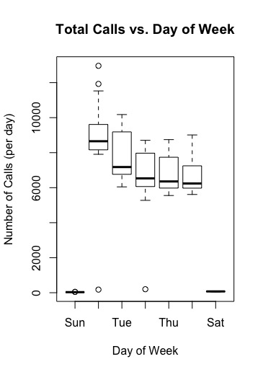
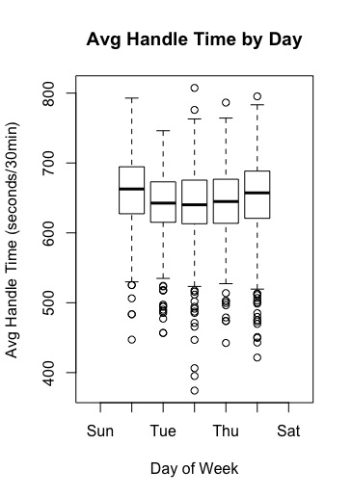
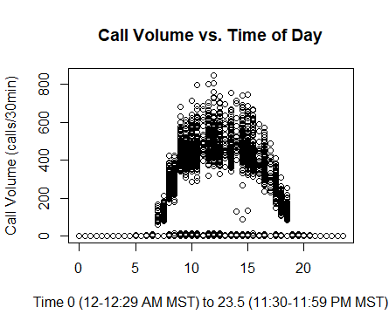
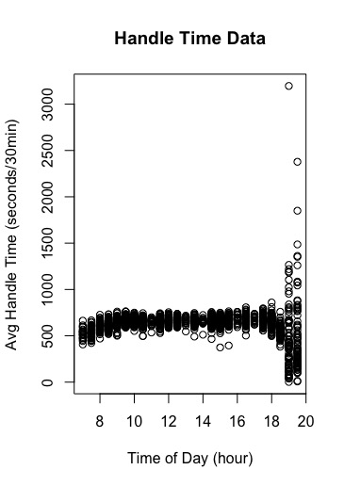
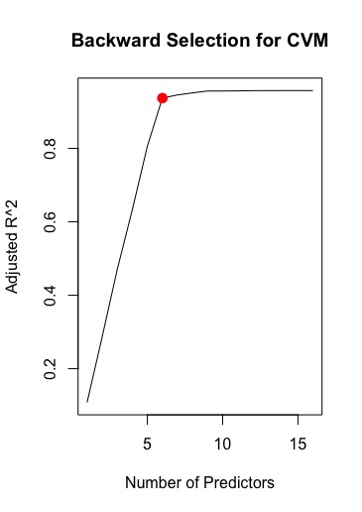
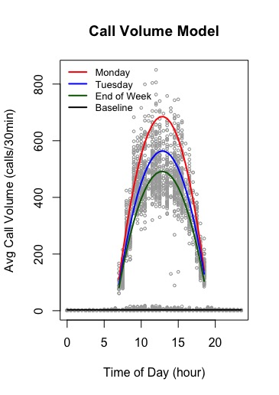
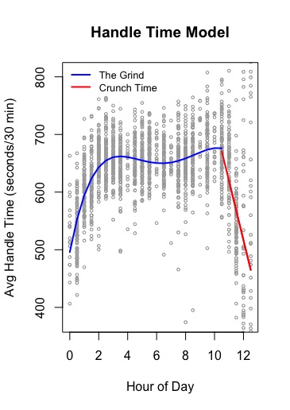
Models for Call Volume and Agent Handling Time in a Call Center to Predict Required Staffing Levels
Nicholas Smith, Jaden Jackson, Weilun Mai
Weber State University, Ogden
Introduction
Data & Results
Discussion
Clearview Live is a company based in Roy, Utah, that creates analytics and dashboard software. The software collects and analyzes data from existing company enterprise wide software such as
Enterprise Resource Planning
Customer relationship management
Call center phone data, etc.
Their goal is to provide data in a digested form to allow businesses to improve their efficiency and customer satisfaction.
The company provided WSU with 4 months of raw data from 2018 for a call center with the request that models be developed for call volume (CVM) and agent handling time (HTM). These models would be used to assist in determining required staffing levels for the call center.
The test error (RMSE) for the CVM was estimated to be ~45, which means that on average the predicted call volume for a given 30 minute interval will only be 45 calls off. Therefore, if we predict 500 calls, then the actual call volume might be something like 545 calls or 455 calls.
The test error (RMSE) for the HTM was estimated to be ~45 seconds (coincidentally), which means that on average the predicted average handle time for a given 30 minute interval will be 45 seconds off. However, this is only when test validation set included data points from “The Grind” (the model has a test error of ~166 seconds when we include test data from “Crunch Time” because the variance is so high in this region.)
Methodology
Fig 1 Monday and Tuesday appear to have a slightly higher call volume, but all other days of the week are essentially equivalent.
Fig 4 The average agent handling time does not appear to significantly vary throughout the week. Agents only answer calls on weekdays.
As with any large data set, the raw data provided were “messy” and needed to be “scrubbed” before analysis.
Using the scrubbed data set the following approach was taken
The number of calls per 30 minute intervals throughout each day was calculated
Time zone is assumed to be MST.
Agent handle time is defined here as seconds agent was actively on line.
Calls not connected to the agent (i.e. of zero seconds length) were included in the CVM, but not in the HTM.
All work was carried out using the open source software ‘R’ and associated libraries.
The scrubbed data were split into a training (70% of the data) and a testing data set.
Best subsets and backward selection was applied to all variables and interactions in order to determine the predictors to use in the models.
A trade off of the model complexity vs the adjusted R squared was made to select the preferred model
Reducing the model complexity improves the interpretability and eliminate unnecessary risk of “over fitting”.
Least squares regression was used to model both the CVM and the HTM.
These models were then used to predict to response values in the testing data set in order to calculate test error.
Conclusions and Future Work
.
Models have been created for both Call Volume (CVM) and Agent Handling Time (HTM).
More information is still needed, such as the exact company needs, nature of the calls, agents schedules (including break times and lunch time), etc.
Why are there outlier data points in the call volume? Can this be explained and discarded?
Why does average handle time ramp up the first two hours? Are the nature of the calls different throughout the day, or does the mindset of the agent change?
Is a typical shift 5-8’s with two breaks and an half hour lunch? Perhaps the two peaks in the HTM could be leveled out if there two large breaks instead of 2 small breaks and a lunch.
In practice, to calculate a needed staffing level other factors such as queue time, service level (ie what % of calls should be answered within a certain amount of time, historical levels of sickness/absenteeism, etc.) are needed.
In addition, data on the end customer satisfaction could be obtained and that used as a response variable to assist in determining the number of agents needed.
If HR practices allow, agent identifiers could be collected and best practices from the most effective agents identified and leveraged to others.
Fig 2 There is a ramp up in the call volume at the start of the day between 7:00am and noon, and a decrease at the end of the day (making a parabolic shape).
Fig 5 Agent handling time is slightly faster at the beginning of the day but is essentially constant throughout the day until near the close of business
Fig 3 There are four statistically significant groups of call volume data. End of week is comprised of Wednesday, Thursday, and Friday.
Fig 6 The HTM included a “dummy” variable that fit least squares to “The Grind” separately to “Crunch Time”. The two groups of agent handle times can be shown to be statistically different.
Notes:
Add parameters for high and low ferritin in the table.
Number of participants in for high and low ferritin groups
Units for figures and results

