Slide 1
Memory Manager (MM) 2.4.1 Tutorial with OCI examples

Slide 2
Introduction
Introduction
Divide and conquer – focus on a small problem to finish in the near future
Three things to consider
We deliver FSW systems, not individual apps/functions/libraries.
We haven’t been taking the time to really learn the reuse software. ←
What you don’t know won’t be used (to troubleshoot problem or implement solution)
Not limited to FSW. CLLC, Filter table tools, STA, ITOS/ASIST/others, FSSE Tools, …
This tutorial assumes MM is being used and the team needs to learn MM:
i.e. knowledgeable about commands & telemetry (some examples included)
i.e. how to configured the platform configuration header file options (OCI values shown)
i.e. implement the “PSP … memory manipulation functions” (in appendix)
Which commands call which functions and short summary of OCI/NICER/MMS.
Examples of actual MM usage are from OCI using MM 2.4.1 (with OCI configurations)
ITOS examples are used for database/STOL

Slide 3
Agenda
Design Charts
Overview
Context Diagram
Memory Manager Commands
Memory Types
Memory Manager Telemetry
File Formats
Examples from OCI
Commands/Telemetry/Pages examples from OCI/ITOS
Configuration Parameters
Proc examples
Summary
Memory Manipulation Functions (in the PSP)
If we have time and interest

Slide 4
Overview
From html user's guide:
“CFS Memory Manager Overview The Memory Manager (MM) component of the Core Flight System (CFS) is responsible for the loading and dumping of flight system memory. MM is basically the operator interface for the PSP (Platform Support Package) and OSAL (Operating System Abstraction Layer) memory manipulation functions. Memory Manager provides the ability to load and dump memory via commands as well as from files. If the operating system supports symbolic addressing, Memory Manager allows specifying the memory address using a symbolic address.”

Slide 5

MM Context Diagram
No wakeup from scheduler
Pends indefinitely for command
Will change so periodically calls
the CFE Run Loop function.
Software
Scheduler
Dump and Load Files
CI, SC
HK
Requests
RAM
MM
Ground or Stored
Commands
PSP/OSAL
Load/Dump
EEPROM
HK, TO,
DS
Memory Mapped Hardware
HK Packets
Event Messages
Memory Manipulation Functions.
File & Symbol Functions.

Slide 6
MM Commands
Command | Description
Noop | Increments the Command Accepted Counter and sends a debug event message
Reset Counters | Initializes housekeeping counters to zero
Memory Peek | Reads 8, 16, or 32 bits of data from any address and reports the data in an event message
Memory Poke | Writes 8, 16, or 32 bits of data to any address
Load Memory With Interrupts Disabled | Loads data into RAM with CPU interrupts disabled during the load
Memory Load From File | Loads memory contents from a file (segmented to prevent CPU hogging)
Memory Dump To File | Dumps memory contents from memory to a file (segmented to prevent CPU hogging)
Dump Memory In Event | Dumps a series of data bytes from memory into telemetry as ASCII characters in an event message. The maximum number of bytes that can be transferred is limited to the maximum event message string length specified in the cFE configuration parameters
Memory Fill | Loads memory with a 32 bit fill pattern. For MEM16 and MEM8 memory types only the least significant word (MEM16) or byte (MEM8) of the fill pattern is used. (segmented to prevent CPU hogging)
Lookup Symbol | Looks up a symbol name in the system symbol table and reports the resolved address in an event message and housekeeping
Save Symbol Table To File | Saves the system symbol table to an onboard file if the operation is supported by the target operating system
EEPROM Write Enable | Enables EEPROM specified bank for writing
EEPROM Write Disable | Disables EEPROM for writing.
Why is there no copy command?

Slide 7
MM Memory Types
No Memory Type
NOMEMTYPE – Used to clear memory type in telemetry for commands that don’t have a memory type
Standard Memory Types
RAM – Directly accessible with no alignment constraints
EEPROM – Any write requirements for EEPROM are handled inside the PSP Memory Manipulation Functions
Special Types (can be conditionally compiled in when needed)
We always include
MEM8 – Forces memory read and writes in 8 bit chunks only. How differs from RAM - Different PSP function
Use case for MEM8 that can’t be done with RAM?
MEM16 – Forces memory read and writes in 16 bit chunks only
MEM32 – Forces memory read and writes in 32 bit chunks only
These are the same as RAM except byte counts and addresses must be properly aligned
Memory mapped I/O is accessed as RAM (or as MEM32/16/8 when special data alignment is required)
NOTE: All writable/readable memory ranges need to be in the PSP memory table.
Addresses are validated.

Slide 8
MM Housekeeping Telemetry Message
Telemetry Point | Description
CmdCounter | Number of accepted ground commands
ErrCounter | Number of rejected ground commands
LastAction | Last command action executed
MemType | Memory type for last command
Address | Fully resolved address used for last command
DataValue | Data value used for last command
BytesProcessed | Bytes processed for last command
FileName[OS MAX PATH LEN] | Name of the data file used for last command, when applicable

Slide 9
MM File Formats
Memory Load File
Binary File
Includes cFE file header with secondary file header containing:
Destination Address Symbolic Name
Destination Address/Offset
Destination Memory Type
Number of Load Bytes
Data Integrity Value (CRC on load data)
Memory Dump File
Binary File
Includes cFE file header with secondary file header containing:
Address Symbolic Name (NUL string)
Source Address (fully resolved, absolute address)
Source Memory Type
Number of Bytes Dumped
Data Integrity Value (CRC on dumped data)
Dump and load files use the same format so dump files can be loaded back into memory if desired
As mentioned, symbolic address not used in dump files.
Address is inside file, so
can’t dump to file from one location and load from
file to another location. i.e. like a copy.
MMS updated MM to allow this.

Slide 10
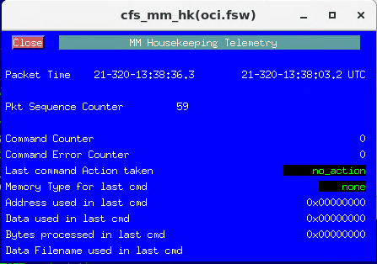
Telemetry at power up
This is how the operators will see your FSW.
Mnemonics.
How displayed on page.
Discrete Conversions.
Decimal verse Hex
Usage in STOL procs.
Etc.

Slide 11
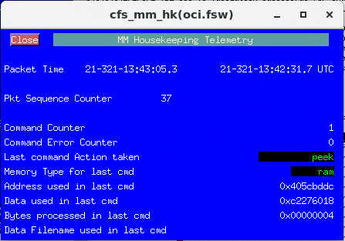
Peek Command
/oci.fsw.mm.peek datasize=32, memtype=ram, offset=0x4c, symname=PS_WakeupProtocol
info MM 9: Peek Command: Addr = 0x405CBDDC Size = 32 bits Data = 0xC2276018
/oci.fsw.mm.peek datasize=32, memtype=ram, offset=0x40000000, symname=""
info MM 9: Peek Command: Addr = 0x40000000 Size = 32 bits Data = 0x00000000
Offset is somewhat misleading.
It’s either:
Offset from symbol, or
Effectively address if symbol is empty/null.
Happen to know these are RAM memory types.
This odd symname and offset are used in an OCI
FDC test.

Slide 12
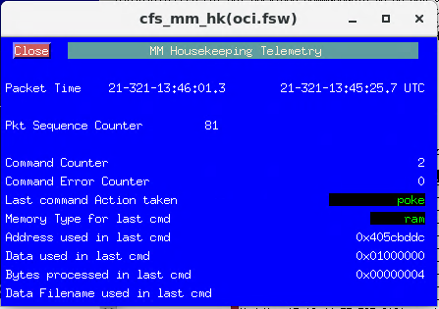
Poke Command
/oci.fsw.mm.poke datasize=32, memtype=ram, data=0x01000000, offset=0x4c, symname=PS_WakeupProtocol
info MM 12: Poke Command: Addr = 0x405CBDDC, Size = 32 bits, Data = 0x01000000
OCI Sparc8 nop
Offset somewhat misleading.
It’s either:
Offset from symbol, or
Effectively address if symbol is empty/null.
I happen to know these are RAM memory types.
This odd symname and offset are used in an OCI
FDC test.

Slide 13

Peek/Poke Command
/oci.fsw.mm.peek datasize=32, memtype=ram, offset=0x4c, symname=PS_WakeupProtocol
/oci.fsw.mm.poke datasize=32, memtype=ram, data=oci.fsw.mm.hk.DataValue, offset=0x4c, symname=PS_WakeupProtocol
info MM 12: Poke Command: Addr = 0x405CBDDC, Size = 32 bits, Data = 0x01000000
This trivial example writes back the value read. The telemetry point can be used in any other command or telemetry check.
oci.fsw.mm.hk.DataValue

Slide 14
Peek/Poke Gotcha Peek/Poke Alignment Constraint
Datasize determines alignment. Rejected if not aligned.
/oci.fsw.mm.peek datasize=32, memtype=eeprom, offset=0x810000, symname=""
info MM 9: Peek Command: Addr = 0x00810000 Size = 32 bits Data = 0x0000ED2A
/oci.fsw.mm.peek datasize=32, memtype=eeprom, offset=0x810002, symname="" Your processor might allow, but MM doesn’t
error MM 23: Data and address not 32 bit aligned: Addr = 0x00810002 Size = 4
/oci.fsw.mm.peek datasize=32, memtype=eeprom, offset=0x810003, symname=""
error MM 23: Data and address not 32 bit aligned: Addr = 0x00810003 Size = 4
Address is validated per memory type, valid RAM address using eeprom memory type. Why can’t MM determine the memory type?
/oci.fsw.mm.peek datasize=32, memtype=eeprom, offset=0x40000000, symname=""
error MM 25: CFE_PSP_MemValidateRange error received: RC = 0xFFFFFFEB Addr = 0x40000000 Size = 4 MemType = 2
So RAM using peek/poke does have alignment constraints!!!!!!
/oci.fsw.mm.peek datasize=32, memtype=ram, offset=0x40000000, symname=""
info MM 9: Peek Command: Addr = 0x40000000 Size = 32 bits Data = 0x00000000
/oci.fsw.mm.peek datasize=32, memtype=ram, offset=0x40000002, symname="" Your processor might allow, but MM doesn’t
error MM 23: Data and address not 32 bit aligned: Addr = 0x40000002 Size = 4
/oci.fsw.mm.peek datasize=16, memtype=ram, offset=0x40000002, symname=""
info MM 8: Peek Command: Addr = 0x40000002 Size = 16 bits Data = 0x0000
/oci.fsw.mm.peek datasize=16, memtype=ram, offset=0x40000004, symname=""
info MM 8: Peek Command: Addr = 0x40000004 Size = 16 bits Data = 0x0000
/oci.fsw.mm.peek datasize=16, memtype=ram, offset=0x40000005, symname="" Your processor might allow, but MM doesn’t
error MM 24: Data and address not 16 bit aligned: Addr = 0x40000005 Size = 2
Peek/Poke datasize in bits.
Other commands it’s bytes.
Bad sub mnemonic,

Slide 15
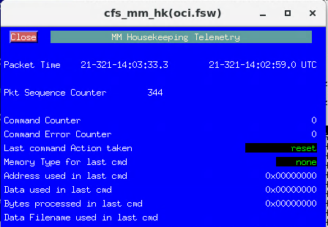
Reset Counters Command
/oci.fsw.evs.AppEnableType Application="MM", EType="debug"
/oci.fsw.mm.resetcntrs
debug MM 3: Reset counters command received
In this case clearing/setting all telemetry points
makes sense. May not be true for all apps.

Slide 16
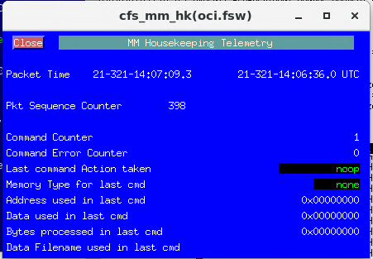
No-Operation Command
/oci.fsw.mm.noop
info MM 2: No-op command. Version 2.4.1.0

Slide 17
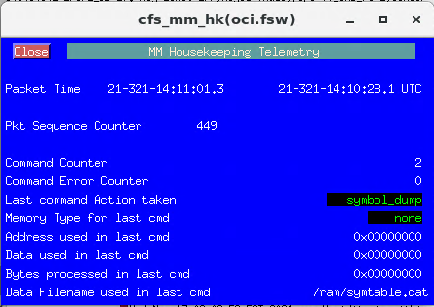
Symbol Table Dump Command
/oci.fsw.mm.symtbl2file filename="/ram/symtable.dat"
error HS 61: CPU Hogging Detected
error CFE_SB 17: Msg Limit Err,MsgId 0xad3,pipe TT_CMD_PIPE,sender SPWR.SPWR_RX_DAUC
Red high violation oci.fsw.sb.hk.MsgLimEC raw = 2 range = 0 at 21-321-14:08:10.131149
error CFE_SB 17: Msg Limit Err,MsgId 0xad3,pipe TT_CMD_PIPE,sender SPWR.SPWR_RX_DAUC
error CFE_SB 17: Msg Limit Err,MsgId 0xad3,pipe TT_CMD_PIPE,sender SPWR.SPWR_RX_DAUC
error CFE_SB 17: Msg Limit Err,MsgId 0xac7,pipe TT_RTA_HAM_PIPE,sender MC.MC_RTA_HAM_TASK
error CFE_SB 17: Msg Limit Err,MsgId 0xad3,pipe TT_CMD_PIPE,sender SPWR.SPWR_RX_DAUC
error CFE_SB 17: Msg Limit Err,MsgId 0x1a9c,pipe MM_CMD_PIPE,sender SCH
tlmStatic: Telemetry packet 'oci.fsw.mm.hk' has gone static.
error CFE_SB 17: Msg Limit Err,MsgId 0xad3,pipe TT_CMD_PIPE,sender SPWR.SPWR_RX_DAUC
error CFE_SB 17: Msg Limit Err,MsgId 0x1a9c,pipe MM_CMD_PIPE,sender SCH
error CFE_SB 17: Msg Limit Err,MsgId 0x1a9c,pipe MM_CMD_PIPE,sender SCH
error CFE_SB 17: Msg Limit Err,MsgId 0xad3,pipe TT_CMD_PIPE,sender SPWR.SPWR_RX_DAUC
error CFE_SB 17: Msg Limit Err,MsgId 0x1a9c,pipe MM_CMD_PIPE,sender SCH
error CFE_SB 17: Msg Limit Err,MsgId 0x1a9c,pipe MM_CMD_PIPE,sender SCH
error CFE_SB 17: Msg Limit Err,MsgId 0x1a9c,pipe MM_CMD_PIPE,sender SCH
error CFE_SB 17: Msg Limit Err,MsgId 0x1a9c,pipe MM_CMD_PIPE,sender SCH
info MM 47: Symbol Table Dump to File Started: Name = '/ram/symtable.dat'
58 seconds to complete
When parsing exception and reset log, may
need addresses.
Perhaps a child task should execute this command.
Hint: You need to dump the symbol table before you need it.
So, if you do something that changes the symbol addresses,
need to dump symbol table so you’ll have in case you need it.
Hint: RAM drive needs to be large enough to handle this file.

Slide 18
Downlink file…..
/oci.fsw.cf.playbackfile class=2, channel=chan_1, priority=1, preserve=keep_file, srcfilename="/ram/symtable.dat", destfilename="symtable.dat“
itos_cfdp__cfdp: (CFDP lib): :::Machine_Allocated trans 2.1_2.
itos_cfdp__cfdp: (CFDP lib): :::MD_Recv trans 2.1_2, class 2, receiving 'symtable.dat' (453832 bytes).
itos_cfdp__cfdp: (CFDP lib): :::EOF_Recv trans 2.1_2.
echo_p1: 1a46c00000101a3908000313020100000002030106400d
echo_p1: 1a46c000000f1a610800021302010000000203010508
echo_p1: 1a46c000000f1a610800021302010000000203010508
info CF 21: Outgoing file successful 2.1_2,src /ram/symtable.dat
itos_cfdp__cfdp: (CFDP lib): :::Trans_Finished trans 2.1_2 successful.
itos_cfdp__cfdp: (CFDP lib): :::Machine_Deallocated trans 2.1_2.

Slide 19
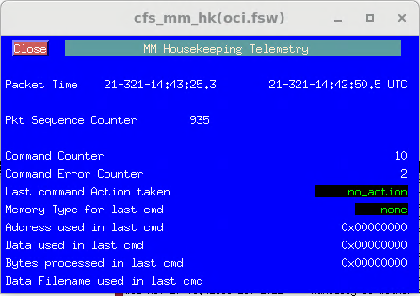
Symbol Table To File Command
/oci.fsw.mm.symtbl2file filename="/ram/symtable12345678901234567890.dat"
error MM 49: Error dumping symbol table, OS_Status= 0xFFFFFF98, File='/ram/symtable12345678901234567890.dat'
This is accepted in open-source release. Change is pending.
OCI updated locally to reject filenames that the rest of the system can’t use/see.
Telemetry nicely cleaned up on error!!!

Slide 20
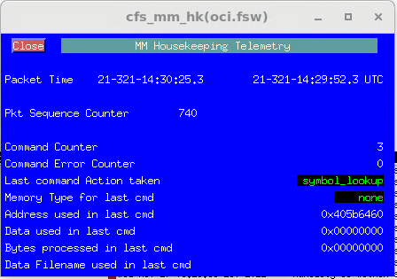
Symbol Lookup Command
/oci.fsw.mm.lookupsymbol symname=MS_TestArea
info MM 45: Symbol Lookup Command: Name = 'MS_TestArea' Addr = 0x405B6460
NOTE: MS test area is an allocated but unused
area of data memory that can be used for test purposes.
Highly recommend having such an area.
Memory loads to “safe area”
Inject memory scrub errors to ‘safe area”
Etc

Slide 21

Fill Command
/oci.fsw.mm.fill memtype=ram, datasize=16, pattern=0xab, offset=0x405B6460, symname=""
info MM 6: Fill Memory Command: Filled 16 bytes at address: 0x405B6460 with pattern: 0x000000AB
Could have (should have) used the symbol instead.
OCI investigating a MRAM write failure problem.
Been testing by first filling MRAM then loading.
i.e. needs to change for success.

Slide 22
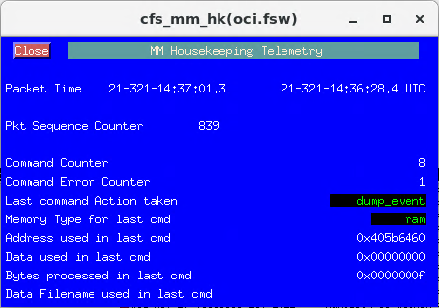
Dump in Event Command
/oci.fsw.mm.dumpinevent memtype=ram, datasize=15, offset=0, symname=MS_TestArea
info MM 14: Memory Dump: 0xAB 0xAB 0xAB 0xAB 0xAB 0xAB 0xAB 0xAB 0xAB 0xAB 0xAB 0xAB 0xAB 0xAB 0xAB from address: 0x405B6460
/oci.fsw.mm.dumpinevent memtype=ram, datasize=15, offset=oci.fsw.mm.hk.Address, symname=""
info MM 14: Memory Dump: 0xAB 0xAB 0xAB 0xAB 0xAB 0xAB 0xAB 0xAB 0xAB 0xAB 0xAB 0xAB 0xAB 0xAB 0xAB from address: 0x405B6460
I used address on previous page.
This command uses symbolic name.
You want the symbolic names.
Could also use oci.fsw.mm.hk.Address
Using symbolic names or mnemonics
allows more automation in STOL procs
Note 15 is max databytes in dump in event
Event limited to 122 characters assuming 64 bit
machine

Slide 23
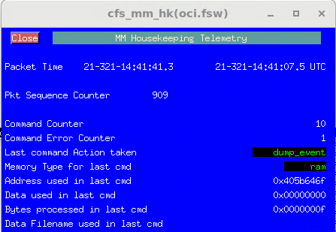
Dump in Event Command
/oci.fsw.mm.dumpinevent memtype=ram, datasize=15, offset=15, symname=MS_TestArea
info MM 14: Memory Dump: 0xAB 0x00 0x00 0x00 0x00 0x00 0x00 0x00 0x00 0x00 0x00 0x00 0x00 0x00 0x00 from address: 0x405B646F
Dump in event is really an interactive
command. Can’t really imagine using
in an automated STOL procedure (would have to parse event string to verify data).

Slide 24
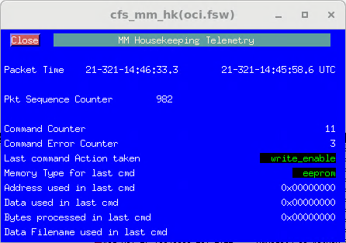
Write Enable EEPROM Bank Command
/oci.fsw.mm.enableeewrite bank=1
error MM 52: Error requesting EEPROM bank 1 write enable, cFE_Status= 0xFFFFFFFF
/oci.fsw.mm.enableeewrite bank=2
info MM 51: EEPROM bank 2 write enabled, cFE_Status= 0x0
OCI Chose to reject bank 1 enables
Have to use secret method to enable bank 1
via ES shell command (or FPGA writes if you
know the secret values to use).
This command is really implemented
in PSP!! Those memory manipulation functions.

Slide 25
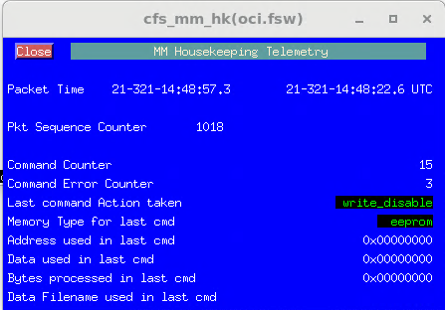
Write Disable EEPROM Bank Command
/oci.fsw.mm.disableeewrite bank=1
info MM 53: EEPROM bank 1 write disabled, cFE_Status= 0x0
/oci.fsw.mm.disableeewrite bank=2
info MM 53: EEPROM bank 2 write disabled, cFE_Status= 0x0
/oci.fsw.mm.disableeewrite bank=3
info MM 53: EEPROM bank 3 write disabled, cFE_Status= 0x0
/oci.fsw.mm.disableeewrite bank=4
info MM 53: EEPROM bank 4 write disabled, cFE_Status= 0x0
OCI Chose to disable (write protect) all
MRAM banks regardless of parameter
This command is really implemented
in PSP!! Those memory manipulation functions.

Slide 26
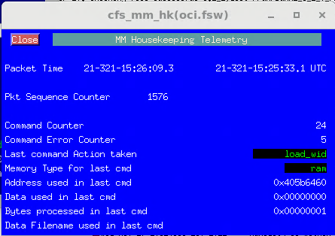
Load With Interrupts Disabled
/oci.fsw.mm.loadwid datasize=1, crc=0x3c0, offset=0, symname=MS_TestArea, data[ 0]=0x05, data[ 1]=0x00, data[ 2]=0x00, data[ 3]=0x00, data[ 4]=0x00, data[ 5]=0x00, data[ 6]=0x00, data[ 7]=0x00, data[ 8]=0x00, data[ 9]=0x00, data[ 10]=0x00, data[ 11]=0x00, data[ 12]=0x00, data[ 13]=0x00, data[ 14]=0x00, data[ 15]=0x00, data[ 16]=0x00, data[ 17]=0x00, data[ 18]=0x00, data[ 19]=0x00, data[ 20]=0x00, data[ 21]=0x00, data[ 22]=0x00, data[ 23]=0x00, data[ 24]=0x00, data[ 25]=0x00, data[ 26]=0x00, data[ 27]=0x00, data[ 28]=0x00, data[ 29]=0x00, data[ 30]=0x00, data[ 31]=0x00, data[ 32]=0x00, data[ 33]=0x00, data[ 34]=0x00, data[ 35]=0x00, data[ 36]=0x00, data[ 37]=0x00, data[ 38]=0x00, data[ 39]=0x00, data[ 40]=0x00, data[ 41]=0x00, data[ 42]=0x00, data[ 43]=0x00, data[ 44]=0x00, data[ 45]=0x00, data[ 46]=0x00, data[ 47]=0x00, data[ 48]=0x00, data[ 49]=0x00, data[ 50]=0x00, data[ 51]=0x00, data[ 52]=0x00, data[ 53]=0x00, data[ 54]=0x00, data[ 55]=0x00, data[ 56]=0x00, data[ 57]=0x00, data[ 58]=0x00, data[ 59]=0x00, data[ 60]=0x00, data[ 61]=0x00, data[ 62]=0x00, data[ 63]=0x00, data[ 64]=0x00, data[ 65]=0x00, data[ 66]=0x00, data[ 67]=0x00, data[ 68]=0x00, data[ 69]=0x00, data[ 70]=0x00, data[ 71]=0x00, data[ 72]=0x00, data[ 73]=0x00, data[ 74]=0x00, data[ 75]=0x00, data[ 76]=0x00, data[ 77]=0x00, data[ 78]=0x00, data[ 79]=0x00, data[ 80]=0x00, data[ 81]=0x00, data[ 82]=0x00, data[ 83]=0x00, data[ 84]=0x00, data[ 85]=0x00, data[ 86]=0x00, data[ 87]=0x00, data[ 88]=0x00, data[ 89]=0x00, data[ 90]=0x00, data[ 91]=0x00, data[ 92]=0x00, data[ 93]=0x00, data[ 94]=0x00, data[ 95]=0x00, data[ 96]=0x00, data[ 97]=0x00, data[ 98]=0x00, data[ 99]=0x00, data[100]=0x00, data[101]=0x00, data[102]=0x00, data[103]=0x00, data[104]=0x00, data[105]=0x00, data[106]=0x00, data[107]=0x00, data[108]=0x00, data[109]=0x00, data[110]=0x00, data[111]=0x00, data[112]=0x00, data[113]=0x00, data[114]=0x00, data[115]=0x00, data[116]=0x00, data[117]=0x00, data[118]=0x00, data[119]=0x00, data[120]=0x00, data[121]=0x00, data[122]=0x00, data[123]=0x00, data[124]=0x00, data[125]=0x00, data[126]=0x00, data[127]=0x00
info MM 4: Load Memory WID Command: Wrote 1 bytes to address: 0x405B6460
/oci.fsw.mm.dumpinevent memtype=ram, datasize=10, offset=0, symname=MS_TestArea
info MM 14: Memory Dump: 0x05 0xAB 0xAB 0xAB 0xAB 0xAB 0xAB 0xAB 0xAB 0xAB from address: 0x405B6460
Drawback - no idea how to compute the CRC. Tool to input hex string and get CRC?
Good news is the error event tells you the expected CRC so could temporarily use that.
Not good practice.
error MM 27: Interrupts Disabled Load CRC failure: Expected = 0x0 Calculated = 0x3C0

Slide 27
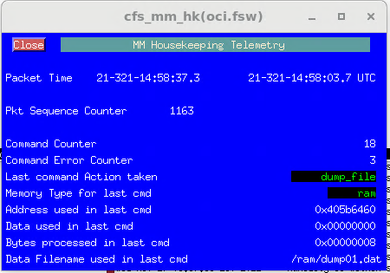
Dump to File Command
/oci.fsw.mm.dump2file memtype=ram, datasize=8, offset=0, symname=MS_TestArea, filename="/ram/dump01.dat"
info MM 13: Dump Memory To File Command: Dumped 8 bytes from address 0x405B6460 to file '/ram/dump01.dat'

Slide 28
Downlink File
/oci.fsw.cf.playbackfile class=2, channel=chan_1, priority=1, preserve=keep_file, srcfilename="/ram/dump01.dat", destfilename="dump01.dat"
itos_cfdp__cfdp: (CFDP lib): :::MD_Recv trans 2.1_3, class 2, receiving 'dump01.dat' (152 bytes).
itos_cfdp__cfdp: (CFDP lib): :::Machine_Allocated trans 2.1_3.
itos_cfdp__cfdp: (CFDP lib): :::EOF_Recv trans 2.1_3.
echo_p1: 1a46c00000101a3808000313020100000003030106400d
echo_p1: 1a46c000000f1a600800021302010000000303010508
echo_p1: 1a46c000000f1a600800021302010000000303010508
info CF 21: Outgoing file successful 2.1_3,src /ram/dump01.dat
itos_cfdp__cfdp: (CFDP lib): :::Machine_Deallocated trans 2.1_3.
itos_cfdp__cfdp: (CFDP lib): :::Trans_Finished trans 2.1_3 successful.

Slide 29
Review Dump File
gsfc580oci@gs580w-ociitos2 (build-3.2-test *) cfdp $ xxd dump01.dat
00000000: 6346 4531 4f43 4946 0000 0040 5041 4345 cFE1OCIF...@PACE
00000010: 0000 0002 0000 0011 7827 7714 0274 4000 ........x'w..t@.
00000020: 4d65 6d6f 7279 204d 616e 6167 6572 2064 Memory Manager d
00000030: 756d 7020 6669 6c65 0000 0000 0000 0000 ump file........
00000040: 405b 6460 0000 0000 0000 0000 0000 0000 @[d`............
00000050: 0000 0000 0000 0000 0000 0000 0000 0000 ................
00000060: 0000 0000 0000 0000 0000 0000 0000 0000 ................
00000070: 0000 0000 0000 0000 0000 0000 0000 0000 ................
00000080: 0000 0000 0000 0008 0000 4902 0100 0000 ..........I.....
00000090: abab abab abab abab ........
gsfc580oci@gs580w-ociitos2 (build-3.2-test *) cfdp $
File was dumped prior
to previous load WID.
Type is “cFE1” which is hard coded in CFE_FS_WriteHeader (comments in function say ‘cfe1’.
OCI configured file subtype to be “OCIF” changed default.
OCI used default for header description. Don’t think anybody has ever changed.
S/C ID is “PACE”. OCI CPU ID is 2. I guess MM appID is 17.
Dumps do not put symbol name in file. Why? Could if they wanted. But might not make sense.
Recall I previously loaded with 0xab (load WID command was added to charts later).

Slide 30
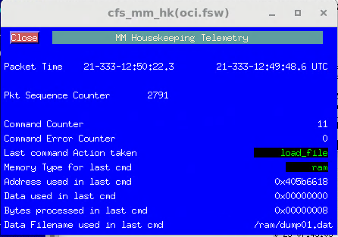
Load from File Command
/oci.fsw.mm.loadfile filename="/ram/dump01.dat"
info MM 5: Load Memory From File Command: Loaded 8 bytes to address 0x405B6618 from file '/ram/dump01.dat'
I “cheated” here and just loaded the previously dumped file. Obviously, the file would need to contain the contents necessary for whatever objective you’re trying achieve. Do you know what tools exist to help generate load files?
A FSSE tutorial on tools and generating load files
would be useful.
Ignore address change from previous charts,
new build was loaded

Slide 31
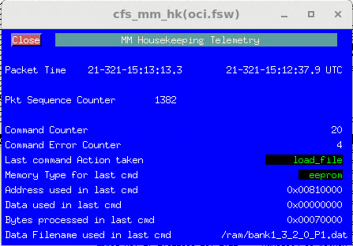
Upload and then load really big file
/oci.fsw.fm.DeleteAllFiles Directory="/ram/" ; delete giant symbol table file…..
write(77) "cfdp put loads/bank1-3_2_0_P1.dat 2.1 /ram/bank1_3_2_0_P1.dat“
info CF 20: Incoming file successful 3.1_2,dest /ram/bank1_3_2_0_P1.dat
Generated with FSSE tools for converting srec files to binary MM load files.
/oci.fsw.es.Shell cmdstring="CFE_PSP_MramEnableWrites(1)", filename="/ram/cmd.out“
info CFE_ES 5: Invoked shell command: 'CFE_PSP_MramEnableWrites(1)'
/oci.fsw.mm.LoadFile FileName="/ram/bank1_3_2_0_P1.dat“
info CFE_TIME 20: Start FLYWHEEL
error HS 61: CPU Hogging Detected
info CFE_TIME 21: Stop FLYWHEEL
Red high violation oci.fsw.sch.hk.MissedMajorFrameCount raw = 6 range = 0 at 21-321-15:12:21.990997
info MM 5: Load Memory From File Command: Loaded 458752 bytes
to address 0x00810000 from file '/ram/bank1_3_2_0_P1.dat'
I thought segmented so this
shouldn’t happen.

Slide 32
MM Platform Configurations OCI
Been making unique for mission
#define MM_CFE_HDR_SUBTYPE 0x4F434946 /* "OCIF" */
Always used default. Not sure it needs to ever be changed
#define MM_CFE_HDR_DESCRIPTION "Memory Manager dump file"
Load files need to be half size of RAM drive, or less. OCI RAM drive is 1 MB.
Since CFE file header and MM secondary file header take space, should be even less. 144 bytes less.
For big loads we’ve been using 7*64K. Maybe RAM drive should have been 1.1 MB. Have seen CPU hogging with large loads.
CFDP loads to temporary file then copies to final file then deletes temporary file. Hence half RAM drive is maximum.
Technically it’s half of the free RAM drive.
Always have the same. Any reason to have different?
#define MM_MAX_LOAD_FILE_DATA_RAM (512u * 1024u)
#define MM_MAX_LOAD_FILE_DATA_EEPROM (512u * 1024u)
#define MM_MAX_LOAD_FILE_DATA_MEM32 (512u * 1024u)
#define MM_MAX_LOAD_FILE_DATA_MEM16 (512u * 1024u)
#define MM_MAX_LOAD_FILE_DATA_MEM8 (512u * 1024u)

Slide 33
MM Platform Configurations OCI
Set according to max command size. 256 for OCI. So, default (200) was too large.
#define MM_MAX_UNINTERRUPTABLE_DATA (128u)
Is there a better number?
Always have the same. Any reason to have different?
#define MM_MAX_LOAD_DATA_SEG 200
#define MM_MAX_DUMP_DATA_SEG 200
#define MM_MAX_FILL_DATA_SEG 200
Always used true. i.e. include the feature
#define MM_OPT_CODE_MEM32_MEMTYPE TRUE
#define MM_OPT_CODE_MEM16_MEMTYPE TRUE
#define MM_OPT_CODE_MEM8_MEMTYPE TRUE
Always used 0.
#define MM_PROCESSOR_CYCLE 0

Slide 34
MM Platform Configurations OCI
Set like max load file size but shouldn’t be limited to that. Limit is RAM drive size (free space).
But if want to dump/download/uplink/load then need to limit dump files to load file size.
Always have the same. Any reason to have different?
#define MM_MAX_DUMP_FILE_DATA_RAM (512u * 1024u)
#define MM_MAX_DUMP_FILE_DATA_EEPROM (512u * 1024u)
#define MM_MAX_DUMP_FILE_DATA_MEM32 (512u * 1024u)
#define MM_MAX_DUMP_FILE_DATA_MEM16 (512u * 1024u)
#define MM_MAX_DUMP_FILE_DATA_MEM8 (512u * 1024u)
OCI set like dump file. Never loading so really can be size of RAM drive. Default 128K was too small for OCI
NOTE: Make sure symbol table isn’t larger than this parameter
#define MM_MAX_DUMP_FILE_DATA_SYMTBL (512u * 1024u)

Slide 35
MM Platform Configurations OCI
Set like max load/dump file size but not limited to that. CPU utilization/duration.
Never seen errors with 7*64K fills on OCI.
Always have the same. Any reason to have different?
#define MM_MAX_FILL_DATA_RAM (512u * 1024u)
#define MM_MAX_FILL_DATA_EEPROM (512u * 1024u)
#define MM_MAX_FILL_DATA_MEM32 (512u * 1024u)
#define MM_MAX_FILL_DATA_MEM16 (512u * 1024u)
#define MM_MAX_FILL_DATA_MEM8 (512u * 1024u)
Ideally have no reason to update, but OCI did modify the symtable command.
#define MM_MISSION_REV 0

Slide 36
Peek/Poke Examples
Exception (mmexample1.proc)
Cause exceptions on embedded system
CDS corruption (mmexample2.proc)
Two second CDS overview
No CDS usage – Nothing restored
App CDS or 1 critical table – All restored or nothing restored
(App CDS and (1 or more critical tables)) OR (2 or more critical tables)
Have case when part of CDS could be restored and part of CDS not restored
Is app in valid state if some CDS items restored and some not?
If given start address of CDS then ES & MM peek/poke can be used to corrupt an entry or entries for testing.
MRAM write protection test (mmexample3.proc)
Really an FPGA test

Slide 37
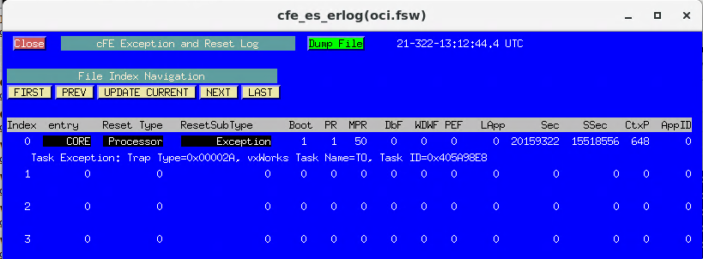
Exception ERLog page snap
Cause unsigned integer divide by 0.
Overwrite No-Operation command (a function that is only called upon ground command)
Overwrite first instruction then send no-operation command
Yes, this required sparc8 inside knowledge.
Instruction 0x80780000 is R0 = R0 / R0. NOTE: R0 has value 0 (non-writable register).
Trap 42 (0x2A) is divide by zero.
No error writing to non-writable register 0.
Apparently, the divide by zero exception happens prior to invalid/undefined exception.
0/0 is undefined.

Slide 38

Corrupt Critical Data Store
On OCI we put the base address of the CDS in routine HK telemetry.
Would recommend doing things like this that make your life easier.
Offset to selected table is in ES CDS registry information.
With base address and offset the selected CDS can be “corrupted”
NOTE: I didn’t automate finding events, see below for UART log.
Could have dumped and parsed EVS log.

Slide 39
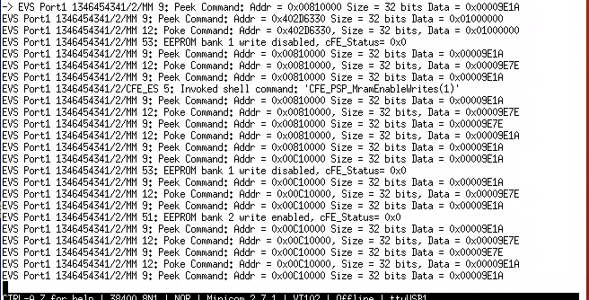
MRAM Write Protection Test (FPGA test)
FSW prevents writes to write disabled MRAM.
Need to bypass this feature. See next page.
NOTE: On OCI a write disable to any bank disables writes to all banks.
Save value
Bypass FSW (ran previously so already bypassed)
Bank 1 write while disabled
Bank 1write while enabled & restore
Save value
Bank 2 write while disabled
Bank 2 write while enabled & restore

Slide 40
FSW EEPROM Write 32
67 CFE_PSP_EepromWrite32:
68 00a0 9DE3BFA0 save %sp, -96, %sp
69 00a4 808E2003 andcc %i0, 3, %g0
70 00a8 1280000A bne .L12
71 00ac 01000000 nop
72 00b0 40000000 call CFE_PSP_IsAddressInWriteableEepromBank, 0
73 00b4 90100018 mov %i0, %o0
74 00b8 80A22000 cmp %o0, 0
75 00bc 02800007 be .L13
76 00c0 01000000 nop
77 00c4 F2260000 st %i1, [%i0]
78 00c8 81C7E008 jmp %i7+8
79 00cc 91E82000 restore %g0, 0, %o0
80 .L12:
81 00d0 81C7E008 jmp %i7+8
82 00d4 91E83FFD restore %g0, -3, %o0
83 .L13:
84 00d8 81C7E008 jmp %i7+8
85 00dc 91E83FEB restore %g0, -21, %o0
int32 CFE_PSP_EepromWrite32( cpuaddr MemoryAddress, uint32 uint32Value )
{
int32 ret_value = CFE_PSP_SUCCESS;
/* check 32 bit alignment */
if( MemoryAddress & 0x00000003)
{
return(CFE_PSP_ERROR_ADDRESS_MISALIGNED) ;
}
if (! CFE_PSP_IsAddressInWriteableEepromBank(MemoryAddress))
{
return(CFE_PSP_INVALID_MEM_ADDR) ;
}
/* make the Write */
*((uint32 *)MemoryAddress) = uint32Value;
return(ret_value) ;
}
Replace branch with “nop” allows write to happen
regardless of return status from
CFE_PSP_IsAddressInWriteableEepromBank
Other options exist, write with interrupts disabled.

Slide 41
Summary
Other examples?
Better examples?
More insights to be added?
Any thing else to add (or remove) for better tutorial?
Troubleshooting problem?
Implementing solution?
Testing FSW, FPGA, or something else?
Memory Manager CAN HELP!!!

Slide 42
Memory Manipulation Functions
Memory Manipulation Functions
CFE_PSP_MemRead8/16/32
Used in Peek command all memory types (size in bits forces to 8/16/32 aligned).
Used in Dump in Events command for MEM8/16/32
Used in Dump To File command for MEM8/16/32
OCI - Direct read from address (MRAM is directly accessible).
32 – Allows shared SRAM reads/writes, converts to FPGA address.
MMS - Direct read from RAM, follows EEPROM read protocol for EEPROM.
NICER - Direct read from address. Non-writable bootstrap is directly accessible.
CFE_PSP_MemWrite8/16/32
Used in Poke command for RAM/MEM8/16/32 memory types (size in bits forces to 8/16/32 aligned).
Used in Load From File command for MEM8/16/32 memory types.
Used in Fill command for MEM8/16/32 memory types.
OCI - Direct write to address with alignment verification
32 – Allows shared SRAM reads/writes, converts to FPGA address.
MMS - Direct write to address with alignment verification
NICER - Direct write to address with alignment verification

Slide 43
Memory Manipulation Functions
Memory Manipulation Functions
CFE_PSP_EepromWrite8/16/32
Used in Poke command for EEPROM memory type (size in bits can force EEPROM to 8/16/32 aligned).
OCI:
32 - Does 32 bit direct write to MRAM. Verifies alignment and address is in writable enabled bank.
16 – Does read/modify/write using above 32 function.
8 –Does read/modify/write using above 16 function
MMS - 32/16/8 – Follows specific EEPROM write protocol that surprisingly auto powers up and auto write enables/disables EEPROM.
NICER - 32/16/8 – Returns error. No writable non-volatile memory (has flash accessed via different application and bootstrap is non-writable – H/W protected via jumper).
CFE_PSP_EepromWriteEnable
Enables writing to EEPROM. If necessary, verify power status.
OCI enables only a single bank at any given time.
MMS enables all EEPROM banks.
NICER returns an error.
CFE_PSP_EepromWriteDisable
Disables writing to EEPROM. If necessary, verify power status.
OCI/MMS disables writing to all banks.
NICER returns an error.

Slide 44
Memory Manipulation Functions
Memory Manipulation Functions
CFE_PSP_MemSet
Used my MM as utility function for local buffer. Dump in event uses to clear buffer. Dump Mem to file uses to zero file headers.
OCI - Uses memset library function
MMS – Uses memset library function for RAM, EEPROM write protocol for EEPROM.
NICER - Uses memset library function
CFE_PSP_MemCpy
Used in Dump in Events command for RAM/EEPROM
Used in Dump Memory To File command for RAM/EEPROM memory type.
Used in Load With Interrupts Disabled command for RAM memory type only.
Used in Load Memory From File command for RAM/EEPROM memory types.
Used in Fill Memory command for RAM/EEPROM memory types
OCI - Uses memcpy library function
MMS - Has to handle many cases, RAM to RAM, FPGA DMA, RAM to EEPROM, EEPROM to RAM, EEPROM to EEPROM
NICER - Uses memcpy library function

Slide 45
Memory Manipulation Functions
Memory Manipulation Functions
CFE_PSP_MemValidateRange
File dump validation specific to memory type. But MEM8/16/32 is RAM.
Dump In Event validation specific to memory type. But MEM8/16/32 is RAM.
Load With Interrupts Disabled is RAM.
Fill validation specific to memory type. But MEM8/16/32 is RAM.
Validates the command supplied address and memory type match an entry in the on-board memory table (don’t forget to populate memory table).
Don’t assume other missions PSP is correct for your mission.
OCI/MMS/NICER have shown each mission is unique.
Need to handle the cache.
If EEPROM chip can be powered down, need to handle.

