Slide 1
Core Flight System Software Bus Networking Application Design As Built
Christopher.D.Knight@nasa.gov
(650) 604-3471
NASA Ames Research Center
Intelligent Systems Division (Code TI)

Slide 2
Design (1/2)
SBN is a cFS application that:
connects the software bus to the software bus of one or more other cFS nodes (who are also running SBN).
ensures that all messages published by an application on one bus will be received by a subscribing application on another bus.
has a modular network architecture (TCP, UDP, Serial, SpaceWire, etc.) to connect peers and supports mixed-mode peer networks.
remaps and filters outgoing messages (as configured in a remap table.)

Slide 3
Design (2/2)
subscribes to the CFE_SB_ALLSUBS_TLM_MID and sends a CFE_SB_SEND_PREV_SUBS_CC to receive all existing subscriptions at startup.
subscribes to the CFE_SB_ONESUB_TLM_MID message that informs SBN when a local application has (un)subscribed.
receives messages from peers (either via “select” polling or per-peer task [table-configurable]) and publishes the messages locally.
gets messages for peers from the SB (either via “polling” or per-peer task [table-configurable]) and sends the messages to peers.
ensures all SBN and CCSDS headers are big-endian and packed before sending over the wire.

Slide 4
History (1/3)
SBN 1.0 – UDP-only monolithic application.
SBN 1.1 – Added a modular network layer for Spacewire, Serial.
SBN 1.2 @ce1b3ca – TCP module. Merged protocol and data traffic into the same connections/sockets. Heartbeats only sent if no other traffic sent in the last number of seconds. Bug-fix to ensure SBN ignores messages it publishes on the SB, ensures all network messages are big-endian and aligned, removes windowing/retransmit logic.
SBN 1.3 @15f3754 – Removed sync word. Simplified module API, added MID remapping/filtering. Added the (compile-time) option of per-peer tasks for watching pipes and net.
SBN 1.4 @2b6556a – DTN module. Pushed protocol handling (announce/heartbeat) down into the modules that need it (UDP.)

Slide 5
History (2/3)
SBN 1.5 @b5cb3d7 – When sending all subs, send them in one message.
SBN 1.6 @b0d0027 – Added “unload” method to modules.
SBN 1.7 @eff7047 – Peer identified by ID not name, remapping rearchitecture.
SBN 1.8 @cdb841 – Utilizes table services for runtime config. Rearchitected housekeeping.
SBN 1.9 @063ebf2 – Protocol handshake message type.
SBN 1.10 @59b598 – Text configs for remap and protocol module replaced with tables.
SBN 1.11 @e046721 – Command secondary headers always big-endian on local bus.
SBN 1.12 @ c61d830 – Task/poll logic table-configured.

Slide 6
History (3/3)
SBN 1.13 – typedefs instead of int32/uint32/etc.

Slide 7
Concerns/Future Developments
Issue | Fix
CCSDS v2 extended headers, custom headers, etc. | cFE’s handling of message headers being rearchitected, how SBN interacts to be discussed.
SBN “star network” only, lacks any forwarding/routing capability. | Develop forwarding/routing architecture, or develop/integrate separate app (CI/TO?)
cFS SB limits the total number of MIDs to 256. Large SBN networks will need significantly more. | Leverage remapping/filtering. Increase SB limits. Investigate impacts.
SBN subscribes to all MIDs of all other subs, plus subs for all peers. | Increase limits, leverage filtering to limit subs for peers.
SBN provides no guarantee of delivery. | Use TCP or DTN.
SBN connections defined at start time. | Allow for command-driven network configuration?

Slide 8
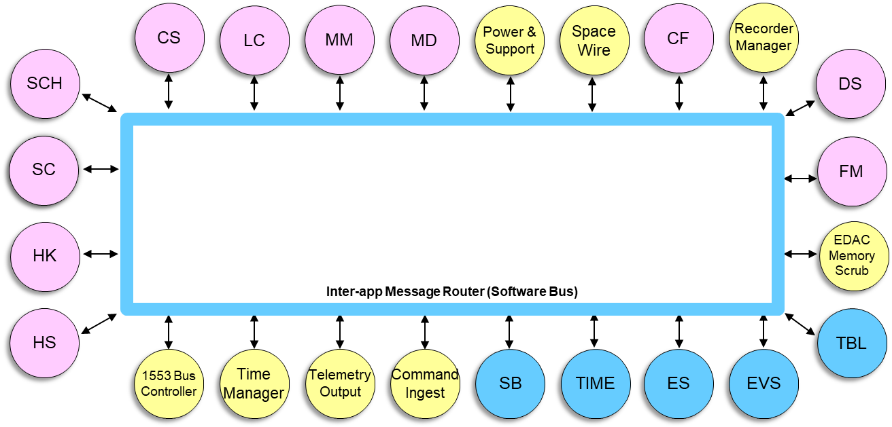
Context Diagram
ProcessorID 1
ProcessorID 2
SBN
SBN
SB
SB
NetNum 0
NetNum 1
ProcessorID 3
ProcessorID 4
SBN
SBN
SB
SB
8
Notes:
testnotes

Slide 9
Sequence: Multi-task
Peer
cFS Apps
SB
SBN
cFS Apps
<send task>
Subscribe()
<recv task>
RcvMsg()
SendMsg()
SendMsg()

Slide 10
Sequence: Polling
SBN
Peer
SB
Master loop
sendloop
Recv ()
SendMsg()
rcvloop
RcvMsg()
Send()

Slide 11
Sequence: Polling
cFS Apps
SBN
Peer
cFS Apps
SB
RcvMsg()
Recv ()
SendMsg()
RcvMsg()
SendMsg()
Send()
Recv ()
RcvMsg()
RcvMsg()
Send()
RcvMsg()
Send()
Send()
Recv ()
SendMsg()

Slide 12
Sequence: Packet Exchange
Peer
cFS Apps
SB
cFS Apps
SBN
Subscribe()
“connection” msg
…
“enable sub reporting”
“subs”
SendMsg()
SendMsg()
“subs” from peer
SubscribeLocal()
<SB messages>
SendMsg()
Unsubscribe()

Slide 13
Configuration Table: Module Data
Field | Type | Description
Name | char[SBN_MAX_MOD_NAME_LEN] | The name of this protocol.
LibFileName | char[OS_MAX_PATH_LEN] | The filename (and path) for the module’s symbol.
LibSymbol | char[OS_MAX_API_NAME] | The symbol in the module’s symbol table containing the methods the module provides.
{
{“UDP”, “/cf/sbn_udp_module.so”, “SBN_UDP_Ops”},
{“TCP”, “/cf/sbn_tcp_module.so”, “SBN_TCP_Ops”},
{“Serial”, “/cf/sbn_serial_module.so”,
“SBN_Serial_Ops”}
}

Slide 14
Configuration Table: Peer Data
Parameter | Type | Description
ProcessorID | uint32 | The ID of the peer (must match CFE_CPU_ID for that node.)
SpacecraftID | uint32 | The Spacecraft ID of the peer.
NetNum | uint16 | All nodes on the same net number are inter-connected.
ModIdx | uint16 | The index of the protocol to use to connect to this peer/net.
Address | char[SBN_ADDR_SZ] | The protocol-specific address (e.g. hostname/port #, serial dev filename, etc.)
TaskFlags | SBN_Task_Flag_t | Bit fields for whether to create a task for sending and/or receiving messages to/from this peer.
{
{1, 42, 1, 2, “/dev/ttyS0”, SBN_POLL},
{3, 42, 0, 0, “localhost:5000”, SBN_TASKS},
{4, 42, 0, 0, “localhost:5001”, SBN_TASKS}
}

Slide 15
Commands
Command (#defined as SBN_<cmd>_CC) | Parameters | Description
NOOP | (none) | General app aliveness test – verifies command handler and event generation.
RESET | (none) | Reset application housekeeping telemetry counters.
RESET_PEER | uint8 PeerNum | Resets the task, stopping and clearing config.
SEND_HK | (none) | SBN sends telemetry containing the current status of the SBN network.
SEND_HK_NET | uint8 NetIdx | Send telemetry about a network.
SEND_HK_PEER | uint8 NetIdx, uint8 PeerIdx | Send telemetry about a peer.
MYSUBS | (none) | SBN sends telemetry containing the local subscriptions that SBN is subscribed to.
PEERSUBS | uint8 NetIdx, uint8 PeerIdx | SBN sends telemetry containing the subscriptions the local SBN is aware of for that peer.
SCH_WAKEUP | (none) | SBN waits on wakeup messages from the scheduler and also has a built-in timeout in case SCH is not running.
Housekeeping requests are sent as commands with housekeeping-specific command codes. Responses all are sent as telemetry with the same message ID but the first byte of the response is the command code that made the request.

Slide 16
Housekeeping (1)
SBN_HkPacket_t
Telemetry Point | Data Type | Description
TlmHeader | uint8[CFE_SB_TLM_HDR_SIZE] | The CCSDS header.
CC | uint8 | The command code that requested this housekeeping.
CmdCount | uint8 | Number of successful ground commands (includes commands from on board sources).
CmdErrCount | uint8 | Number of commands with process errors.
SubCount | uint16 | Number of subscriptions for local apps.
NetCount | uint16 | Total number of entries (hosts and peers.)
SBN_NetStatus_t
Telemetry Point | Data Type | Description
TlmHeader | uint8[CFE_SB_TLM_HDR_SIZE] | The CCSDS header.
CC | uint8 | The command code that requested this housekeeping.
Name | char[SBN_MAX_NET_NAME_LENGTH] | Name of this network.
ProtocolID | uint8 | ID of the protocol of this network.
PeerCount | uint8 | Number of peers in this net.
16
Notes:
testnotes

Slide 17
Housekeeping (2)
SBN_PeerStatus_t
Telemetry Point | Data Type | Description
QoS | uint8 | The CCSDS quality of service.
State | uint8 | Whether this node is connected (heartbeating) or disconnected (announcing.)
Name | char * SBN_MAX_PEERNAME_LENGTH | The name of the peer.
ProcessorID | uint32 | The cFS processor ID of the peer.
LastSend | OS_time_t | Last time I sent this peer a message.
LastRecv | OS_time_t | Last time I received a message from this peer.
LastConnect | OS_time_t | Last time I
SendCount | uint16 | Number of messages sent to this peer since last reset.
RecvCount | uint16 | Number of messages received from this peer since last reset.
SendErrCount | uint16 | Number of errors raised when sending to this peer.
RecvErrCount | uint16 | Number of errors raised when trying to receive from this peer.
SubCount | uint16 | Number of subscriptions sent to me by this peer.
IFData | uint8 * 32 | IF-specific private data block.
17
Notes:
testnotes

Slide 18
Housekeeping (3)
SBN_HkSubsPacket_t
Telemetry Point | Data Type | Description
TlmHeader | uint8[CFE_SB_TLM_HDR_SIZE] | The CCSDS header.
CC | uint8 | The command code that requested this housekeeping.
PeerIdx | uint8 | The index of the peer this is a subscription list for.
SubCount | uint16 | The number of subscriptions for this peer.
Subs | CFE_SB_MsgId_t * SBN_MAX_SUBS_PER_PEER | Subscriptions for this peer.
18
Notes:
testnotes

Slide 19
Event IDs
Event ID #define SBN_..._EID | Description
SB | Local software bus
INIT | Application initialization
MSG | SB message
FILE | Configuration (module and peer) file
PEER | Local peer resources (pipes, memory)
PROTO | Network protocol
CMD | Commanding
SUB | Subscriptions

Slide 20
Network Protocol
Field | Type | Description
MsgSize | uint16 | Size of the payload.
Type | uint8 | Announce/Sub/Unsub/App
CpuId | uint32 | CPU ID of the sender. (Needed for UDP).
(Un)Subscription Message
Field | Type | Description
VersionHash | char[SBN_IDENT_LEN] | GIT-generated version hash.
SubCnt | uint16 | Number of entries in the Subs table.
Subs | SBN_PackedSubs_t
Field | Type
MsgId | uint16
Qos | uint8 + uint8

Slide 21
Network Module API
SBN_Status_t Load(const char **, int, void *);
SBN_Status_t InitHost(SBN_HostInterface_t *Host);
SBN_Status_t InitPeer(SBN_PeerInterface_t *Peer);
SBN_Status_t PollPeer(SBN_PeerInterface_t *Peer);
SBN_MsgSz_t Send(SBN_PeerInterface_t *Peer, SBN_MsgType_t MsgType,
SBN_MsgSz_t MsgSz, SBN_Payload_t *Payload);
SBN_Status_t RecvFromPeer(SBN_PeerInterface_t *Peer,
SBN_MsgType_t *MsgTypePtr,
SBN_MsgSize_t *MsgSizePtr, SBN_CpuId_t *CpuIdPtr,
SBN_Payload_t *PayloadBuffer);
SBN_Status_t RecvFromNet(SBN_NetInterface_t *Net, SBN_PeerInterface_t *Peer,
SBN_MsgType_t *MsgTypePtr, SBN_MsgSize_t *MsgSizePtr,
SBN_CpuId_t *CpuIdPtr, SBN_Payload_t *PayloadBuffer);
SBN_Status_t ReportModuleStatus(SBN_ModuleStatusPacket_t *Buffer);
SBN_Status_t ResetPeer(SBN_PeerInterface_t *Peer);
Used in “mesh” point-to-point networks (e.g. TCP, serial)
Used in star networks (UDP, DTN)

