Slide 1
A Scala PokeDex Presentation & Demo
Group 9: Arash Yazdidoost, Jessica Davis, Tanner Smith
Notes:
Technology, Issues, Who Did What, Development process(?), reductions/increases in scope (look for final slide presentation sample)

Slide 2

Table of Contents
Overview and Objective
Software Development Life Cycle
Team Roles
Technology Stack
Demo
Issues
Future Works

Slide 3
Overview
ScalaDex is a PokeDex and Battle Simulator built with Scala
Players can submit a Pokemon and ScalaDex will return the Pokemon’s PokeDex entry
Players can submit two Pokemon, and ScalaDex will determine which Pokemon is the winner
Notes:
Create a web application that can be used by Pokémon “main” (e.g. Pokémon Sword and Shield) and Pokémon Go players to get important information related to a chosen Pokémon and simulate battles between Pokémon of their choosing based on their type (e.g. Fire, Water) and overall strength

Slide 4
Software Development Life Cycle (SDLC)
first
second
third
last
Meet & Plan
Implement
Integrate
Test & Refactor
Define each person’s assignments, and stay in constant communication
Independently code and carry out assignment
Using Git, push for all the latest changes, commit any local changes, and send a pull request
Verify that code works as expected, and refactor as needed
Notes:
Jess

Slide 5
Team Roles
Jessica D.
Front-End
Deciding the “look” of the ScalaDex web application, creating initial HTML/CSS files, implementing JavaScript autocomplete function
Tanner S.
Integration & Back-End
Converting HTML files to scala.html files, creating back-end PokeAPI calls for the PokeDex function and battle simulator
Arash Y.
Back-End
Creating code for battle simulator and assisting Tanner with back-end.
Notes:
Jess

Slide 6
Technology Stack
Play Framework
Web framework used to build our project. Handles routing and integration of logical code with front end design code..
PokeAPI
REST API used to query Pokemon information.
Returns JSON objects to the back end Scala code.
Javascript/jQuery
Used for the autocomplete function on the test inputs, and to bind parameter values to HTML elements..
HTML/CSS
Used to build and stylize the webpages for the application.
Scala
Back end programming language used to develop models and logic of application.
JSON
Information queried from REST API is delivered as JSON.
Parsed and utilized by the back end code.
Notes:
Tanner

Slide 7
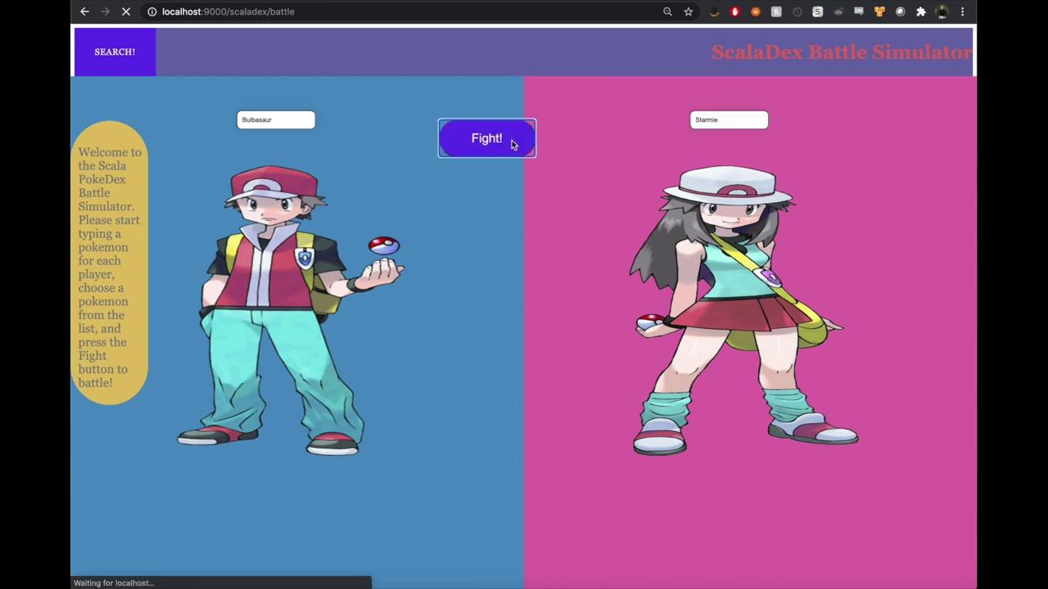
Demo
Notes:
Youtube Link To Demo: https://www.youtube.com/watch?v=ZKP8wFKbaao

Slide 8
Issues
Battle logic
Pokemon Type
Stats
PokeAPI Limitations
Pokemon Generation
Frontend/Backend Integration
Ex: Passing in Pokemon name
Notes:
Arash

Slide 9
Future Works
Bug Fixes
Small CSS issues
“Mr. Mime”-gate
Pokemon Description
Additional Pages
Previous Battles
Species Pages (with links from Details Page)
Additional Details on Search Results page
Upgrades
3D Models
Add Pokemon Images in Battle Selector page.
Improved Battle logic with descriptive results
Notes:
Tanner

Slide 10
Thanks!
Any questions?

Slide 11
Credits
Special thanks to all the people who made and released these awesome resources for free:
Presentation template by SlidesCarnival
Photographs by Unsplash

