Slide 1

Multiwan and routing in MikroTik ROS v7
MUoM
Mikrotik User Online Meeting

Slide 2
Об авторе
Владимир Кузнецов
Сетевой инженер
Yandex
Telegram @smithy1208
v.kuznetsov48@ya.ru
С сетями с 2008 года
12 лет в провайдере
Строил сети и в аутсорсе, там и настиг меня MikroTik
MTCRE
MUoM
Mikrotik User online Meeting

Slide 3

01
Routing tables
Multiwan - несколько провайдеров с помощью таблиц маршрутизации
MUoM
Mikrotik User Online Meeting

Slide 4
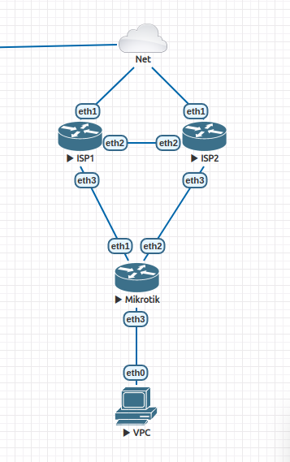
Схема
Dualwan
MUoM
Mikrotik User online Meeting

Slide 5
Стартовые настройки
# Базовые настройки:
/interface ethernet
set [ find default-name=ether1 ] comment=ISP1
set [ find default-name=ether2 ] comment=ISP2
/interface list
add name=WAN
/interface list member
add interface=ether1 list=WAN
add interface=ether2 list=WAN
/ip address
add address=198.51.100.6/29 interface=ether1
add address=203.0.113.6/29 interface=ether2
add address=192.168.88.254/24 interface=br-lan
/ip firewall nat
add action=masquerade chain=srcnat out-interface-list=WAN
Интерфейсы в провайдеров добавлены в интерфейс лист WAN
Развешаны IP
Включен masquerading для WAN
MUoM
Mikrotik User online Meeting

Slide 6
Routing tables
# Создать дополнительные роутинг таблицы
[admin@MikroTik] > /routing/table/export terse
# dec/11/2021 00:50:35 by RouterOS 7.1
# software id =
#
/routing table add disabled=no fib name=rtab-1
/routing table add disabled=no fib name=rtab-2
MUoM
Mikrotik User online Meeting

Slide 7
# Добавить дефолты в новые таблицы
[admin@MikroTik] /ip/route> export terse
# dec/11/2021 00:59:52 by RouterOS 7.1
# software id =
#
/ip route add distance=251 gateway=198.51.100.1
/ip route add distance=252 gateway=203.0.113.1
/ip route add gateway=198.51.100.1 routing-table=rtab-1
/ip route add gateway=203.0.113.1 routing-table=rtab-2
Route
defaults
MUoM
Mikrotik User online Meeting

Slide 8
Маркировки (mangle)
# Добавить маркировки
[admin@MikroTik] /ip/firewall/mangle> export
# dec/11/2021 01:07:11 by RouterOS 7.1
# software id =
#
/ip firewall mangle
add action=mark-connection chain=prerouting connection-mark=no-mark in-interface=ether1 new-connection-mark=con-isp1 passthrough=yes
add action=mark-connection chain=prerouting connection-mark=no-mark in-interface=ether2 new-connection-mark=con-isp2 passthrough=yes
add action=mark-routing chain=prerouting connection-mark=con-isp1 in-interface-list=!WAN new-routing-mark=rtab-1 passthrough=yes
add action=mark-routing chain=prerouting connection-mark=con-isp2 in-interface-list=!WAN new-routing-mark=rtab-2 passthrough=yes
add action=mark-routing chain=output connection-mark=con-isp1 new-routing-mark=rtab-1 passthrough=yes
add action=mark-routing chain=output connection-mark=con-isp2 new-routing-mark=rtab-2 passthrough=yes
# При таких маркировках будут работать оба провайдера.
# DST-NAT так же будет работать.
MUoM
Mikrotik User online Meeting

Slide 9
# Отказоустойчивость через рекурсивные маршруты
[admin@MikroTik] /ip/route> export
# dec/11/2021 01:28:53 by RouterOS 7.1
# software id =
#
/ip route
add distance=251 gateway=198.51.100.1
add distance=252 gateway=203.0.113.1
add gateway=198.51.100.1 routing-table=rtab-1
add gateway=203.0.113.1 routing-table=rtab-2
add dst-address=4.2.2.1/32 gateway=198.51.100.1 scope=11
add dst-address=4.2.2.2/32 gateway=203.0.113.1 scope=11
add check-gateway=ping distance=10 gateway=4.2.2.1 target-scope=11
add check-gateway=ping distance=20 gateway=4.2.2.2 target-scope=11
Route
Recursive
failover
MUoM
Mikrotik User online Meeting

Slide 10
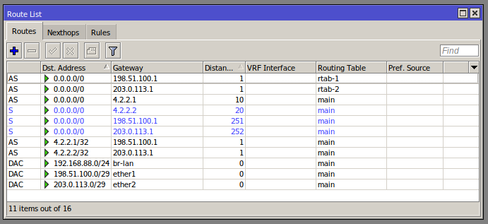
Route recursive
MUoM
Mikrotik User online Meeting

Slide 11
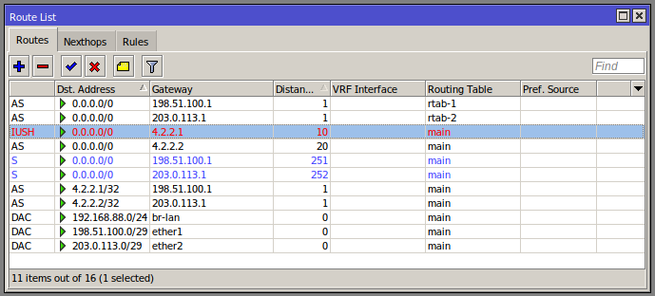
Route recursive. Fail ISP1
MUoM
Mikrotik User online Meeting

Slide 12
Check gateway
## log check gateway ISP1
10:29:41 forward: proto ICMP (type 8, code 0), 198.51.100.6->4.2.2.1,
10:29:51 forward: proto ICMP (type 8, code 0), 198.51.100.6->4.2.2.1,
10:30:01 forward: proto ICMP (type 8, code 0), 198.51.100.6->4.2.2.1,
10:30:11 forward: proto ICMP (type 8, code 0), 198.51.100.6->4.2.2.1,
10:30:21 forward: proto ICMP (type 8, code 0), 198.51.100.6->4.2.2.1,
10:30:31 forward: proto ICMP (type 8, code 0), 198.51.100.6->4.2.2.1,
MUoM
Mikrotik User online Meeting

Slide 13

02
VRF изолированный!
Закрою гештальт с MUM 2019 https://clck.ru/ZRYyM
слайды 17-21
MUoM
Mikrotik User Online Meeting

Slide 14
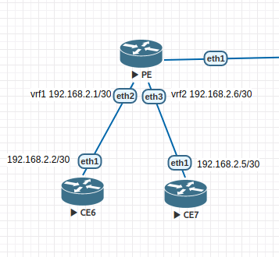
Схема VRF
MUoM
Mikrotik User online Meeting

Slide 15
PE
Provider Edge router — граничный маршрутизатор провайдера
[admin@PE] > export
# dec/13/2021 11:18:15 by RouterOS 7.1
# software id =
#
/ip vrf
add interfaces=ether3 name=vrf2
add interfaces=ether2 name=vrf1
/ip address
add address=192.168.2.1/30 interface=ether2 network=192.168.2.0
add address=192.168.2.6/30 interface=ether3 network=192.168.2.4
/ip dhcp-client
add interface=ether1
/system identity
set name=PE
MUoM
Mikrotik User online Meeting

Slide 16
[admin@CE6] > export
# dec/13/2021 11:15:17 by RouterOS 6.46.8
# software id =
#
#
#
/ip address
add address=192.168.2.2/30 interface=ether1 network=192.168.2.0
/ip route
add distance=1 gateway=192.168.2.1
/system identity
set name=CE6
[admin@CE6] >
[admin@CE6] > ping count=2 192.168.2.1
SEQ HOST SIZE TTL TIME STATUS
0 192.168.2.1 56 64 5ms
1 192.168.2.1 56 64 3ms
sent=2 received=2 packet-loss=0% min-rtt=3ms avg-rtt=4ms max-rtt=5ms
[admin@CE6] > ping count=2 192.168.2.6
SEQ HOST SIZE TTL TIME STATUS
0 192.168.2.1 84 64 3ms net unreachable
1 192.168.2.1 84 64 3ms net unreachable
sent=2 received=0 packet-loss=100%
[admin@CE6] > ping count=2 192.168.2.5
SEQ HOST SIZE TTL TIME STATUS
0 192.168.2.1 84 64 3ms net unreachable
1 192.168.2.1 84 64 3ms net unreachable
sent=2 received=0 packet-loss=100%
CE6
Customer Edge router — граничный маршрутизатор клиента, который
подключен в сеть
провайдера.
MUoM
Mikrotik User online Meeting

Slide 17
[admin@CE7] > /export
# dec/13/2021 10:59:34 by RouterOS 6.46.8
# software id =
#
#
#
/ip address
add address=192.168.2.5/30 interface=ether1 network=192.168.2.4
/ip route
add distance=1 gateway=192.168.2.6
/system identity
set name=CE7
[admin@CE7] > /ping count=2 192.168.2.6
SEQ HOST SIZE TTL TIME STATUS
0 192.168.2.6 56 64 2ms
1 192.168.2.6 56 64 2ms
sent=2 received=2 packet-loss=0% min-rtt=2ms avg-rtt=2ms max-rtt=2ms
[admin@CE7] > /ping count=2 192.168.2.1
SEQ HOST SIZE TTL TIME STATUS
0 192.168.2.6 84 64 2ms net unreachable
1 192.168.2.6 84 64 2ms net unreachable
sent=2 received=0 packet-loss=100%
[admin@CE7] > /ping count=2 192.168.2.2
SEQ HOST SIZE TTL TIME STATUS
0 192.168.2.6 84 64 2ms net unreachable
1 192.168.2.6 84 64 5ms net unreachable
sent=2 received=0 packet-loss=100%
CE7
Customer Edge router — граничный маршрутизатор клиента, который
подключен в сеть
провайдера.
MUoM
Mikrotik User online Meeting

Slide 18
03
VRF "route leaking"
vrf-lite and "route leaking"
MUoM
Mikrotik User Online Meeting

Slide 19
[admin@PE] > /export
# dec/13/2021 11:29:48 by RouterOS 7.1
# software id =
#
/ip vrf
add interfaces=ether2 name=vrf1
add interfaces=ether3 name=vrf2
/ip address
add address=192.168.2.1/30 interface=ether2 network=192.168.2.0
add address=192.168.2.6/30 interface=ether3 network=192.168.2.4
/ip dhcp-client
add interface=ether1
/ip route
add distance=1 dst-address=192.168.2.4/30 gateway=ether3@vrf2 routing-table=vrf1
add distance=1 dst-address=192.168.2.0/30 gateway=ether2@vrf1 routing-table=vrf2
/system identity
set name=PE
PE
"route leaking"
MUoM
Mikrotik User online Meeting

Slide 20
[admin@CE6] > /export
# dec/13/2021 11:37:58 by RouterOS 6.46.8
# software id =
#
#
#
/ip address
add address=192.168.2.2/30 interface=ether1 network=192.168.2.0
/ip route
add distance=1 gateway=192.168.2.1
/system identity
set name=CE6
[admin@CE6] > ping count=2 192.168.2.1
SEQ HOST SIZE TTL TIME STATUS
0 192.168.2.1 56 64 4ms
1 192.168.2.1 56 64 2ms
sent=2 received=2 packet-loss=0% min-rtt=2ms avg-rtt=3ms max-rtt=4ms
[admin@CE6] > ping count=2 192.168.2.6
SEQ HOST SIZE TTL TIME STATUS
0 192.168.2.6 timeout
1 192.168.2.6 timeout
sent=2 received=0 packet-loss=100%
[admin@CE6] > ping count=2 192.168.2.5
SEQ HOST SIZE TTL TIME STATUS
0 192.168.2.5 56 63 8ms
1 192.168.2.5 56 63 7ms
sent=2 received=2 packet-loss=0% min-rtt=7ms avg-rtt=7ms max-rtt=8ms
CE6
"route leaking"
MUoM
Mikrotik User online Meeting

Slide 21
04
VRF management
MUoM
Mikrotik User Online Meeting

Slide 22
PE
vrf management
[admin@PE] /ip/service> set ssh vrf=vrf1
[admin@PE] /ip/service> pri
Flags: X, I - INVALID
Columns: NAME, PORT, CERTIFICATE, VRF
# NAME PORT CERTIFICATE VRF
0 X telnet 23 main
1 X ftp 21
2 X www 80 main
3 ssh 22 vrf1
4 X www-ssl 443 none main
5 X api 8728 main
6 winbox 8291 main
7 X api-ssl 8729 none main
MUoM
Mikrotik User online Meeting

Slide 23
[admin@CE6] > sys ssh 192.168.2.1
password:
MMM MMM KKK TTTTTTTTTTT KKK
MMMM MMMM KKK TTTTTTTTTTT KKK
MMM MMMM MMM III KKK KKK RRRRRR OOOOOO TTT III KKK KKK
MMM MM MMM III KKKKK RRR RRR OOO OOO TTT III KKKKK
MMM MMM III KKK KKK RRRRRR OOO OOO TTT III KKK KKK
MMM MMM III KKK KKK RRR RRR OOOOOO TTT III KKK KKK
MikroTik RouterOS 7.1 (c) 1999-2021 https://www.mikrotik.com/
Press F1 for help
[admin@PE] >
[admin@CE7] > sys ssh 192.168.2.6
connectHandler: Connection refused
Welcome back!
# Route leaks не помогли.
vrf management
Route leaks не помогли
MUoM
Mikrotik User online Meeting

Slide 24
05
VRF vpn
MUoM
Mikrotik User Online Meeting

Slide 25
VRF
RD & RT
####################
# vrf vpn
####################
[admin@PE] /routing/bgp/vpn> add
copy-from export-route-targets label-allocation-policy vrf
disabled import-filter redistribute
export-filter import-route-targets route-distinguisher
MUoM
Mikrotik User online Meeting

Slide 26
06
VRF internet
MUoM
Mikrotik User Online Meeting

Slide 27
Схема
Dualwan
MUoM
Mikrotik User online Meeting

Slide 28
VRF internet
/ip vrf
add interfaces=ether1 name=vrf1
add interfaces=ether2 name=vrf2
/ip address
add address=10.51.100.6/29 interface=ether1
add address=10.51.100.6/29 interface=ether2
/ip route
add check-gateway=ping distance=251 dst-address=0.0.0.0/0 gateway=10.51.100.1@vrf1 routing-table=main
add check-gateway=ping distance=252 dst-address=0.0.0.0/0 gateway=10.51.100.1@vrf2 routing-table=main
add dst-address=192.168.88.0/24 gateway=br-lan routing-table=vrf1
add dst-address=192.168.88.0/24 gateway=br-lan routing-table=vrf2
Без маркировок
MUoM
Mikrotik User online Meeting

Slide 29
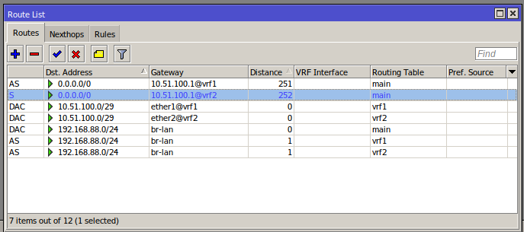
VRF internet
MUoM
Mikrotik User online Meeting

Slide 30

Ссылки
- https://habr.com/ru/post/463813/
- СДСМ MPLS L3VPN
https://habr.com/post/273679/
- MUM 2019 (mikrotik mpls)
https://clck.ru/ZRYyM
MUoM
Mikrotik User online Meeting

Slide 31
Спасибо за внимание!
Буду рад ответить на все ваши вопросы сейчас или свяжитесь со мной в будущем:
Telegram @smithy1208
v.kuznetsov48@ya.ru
MUoM
Mikrotik User Online Meeting

