Slide 1
Digital Image Processing
Components of an IP System
Visual Preliminaries

Slide 2
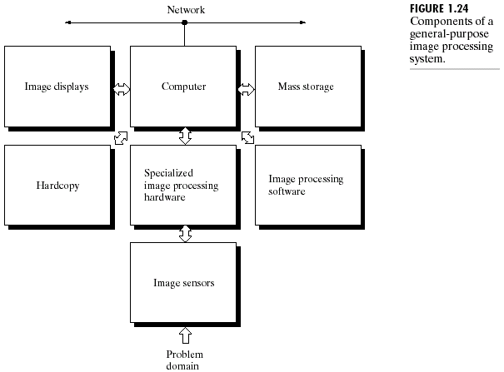
RECAP: Components of a General
Purpose IP System

Slide 3
Image Sensors
An image sensor is a physical device that is sensitive to the energy radiated by the object we wish to image.
Two different technologies:
  Photochemical
  Photoelectronic

Slide 4
Contd…
Photochemical: methods have the advantage of combining image formation and recording on a single entity called ‘photographic film’.
Photoelectronic: methods separate the recording process from image formation and detection. Three types of sensor arrangements are used to transform illumination energy into digital images.

Slide 5
Specialized IP Hardware
Specialized IP hardware consists of:
Digitizer
Front-end system

Slide 6
Digitizer
Is a device for converting the output of the physical sensing device (sensor) into digital form.
For instance, in digital video camera, the sensors produce an electrical output proportional to light intensity. The digitizer converts these outputs to digital data.

Slide 7
Front-end Subsystem
This unit performs functions that require fast data throughputs e.g. averaging video images as quickly as they are digitized, for the purpose of noise reduction.
Functions involve arithmetic and logical operations in parallel on entire image.
Done at 30 frames/s that the typical main computer cannot handle.

Slide 8
Computer
Can range from a PC to a super- computer.
Depending on the requirement, various processor architectures are available in market (von Neumann, MIMD, Pipelined, SIMD etc.)
Machines for scientific research are different from commercial ones.

Slide 9
Software
Specialized modules that perform specific tasks.
Also includes capability for the user to write code.
For example: ERDAS Imagine Professional and PCI Geomatica softwares for Geospatial Image Processing.

Slide 10
Mass Storage
Large storage requirements
Categories of digital storage for IP Appls.
  Short term storage (Computer memory or specialized boards called frame buffers)
  Online storage for relatively fast recall (magnetic disks or optical-media storage)
  Archival storage for infrequent need for access (magnetic tapes and optical disks housed in “jukeboxes”).

Slide 11
Image Displays
A display device produces and shows a visual form of numerical values in a computer as an image array.
Principal display devices are printer, TV monitors and CRTs.
Entire image is kept in a memory commonly called frame buffer.
This memory is scanned and displayed at the video rate (30 frames/s) by special H/W.

Slide 12
Visual Preliminaries

Slide 13
Overview
Structure of Human Eye
Image Formation in the Eye
Brightness Adaptation
Intensity Discrimination
Characteristics of Human Visual System

Slide 14
Motivation
The aim of the IP and Analysis techniques is to build a system that has similar capabilities as the human vision system.
To achieve it, one must know about the formation of image in the eye, brightness adaptation and discrimination, and perceptual mechanism, and should incorporate such knowledge in the processing algorithms.

Slide 15
Structure of Human Eye
Spherical in shape with average diameter approximately 20 mm
Three membranes enclose the eye
Cornea and sclera as outermost cover
Choroid as middle layer
Retina as innermost layer
Iris (pupil) varies in diameter approximately 2 to 8 mm
Lens

Slide 16
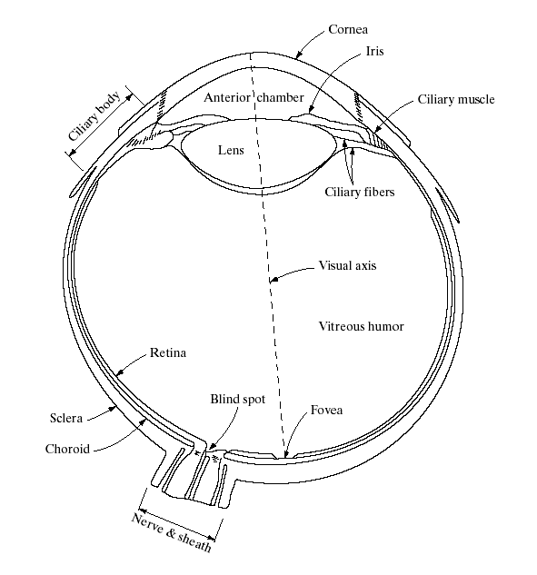
Cross section of the human eye

Slide 17
Light Receptors over Retina
2 photosensitive cell types in retina
  RODS: sensitive to brightness/luminance
  CONES: sensitive to color/ frequency
Cellular distribution not uniform
  cones predominate at the fovea
  rods dominate at periphery of vision
  Color vision best at the fovea, poor in peripheral vision
  Luminance detection poorer at fovea

Slide 18
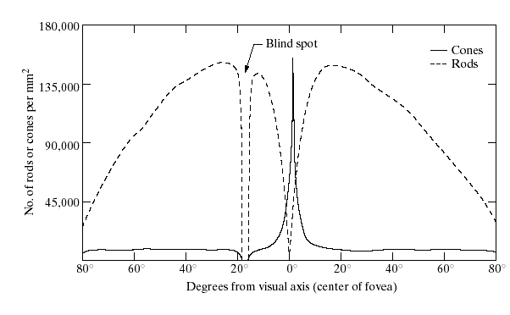
Distribution of Light Receptors over Retina

Slide 19
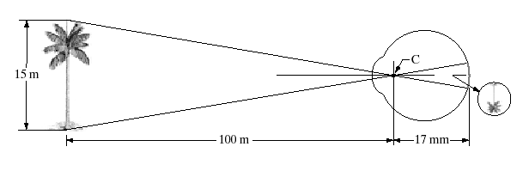
Image Formation in the Eye
What is the height of retinal image?
Note: Focal length varies from approx. 17 mm to about 14 mm

Slide 20
Summary: Image Sensing by Human Eye
The photoreceptors convert light energy into electrical pulses through some photochemical reaction.
These pulses are transmitted to the visual cortex through the optical nerve.
The information reaching the visual cortex are finally decoded by the brain.

Slide 21
Brightness Adaptation and Discrimination
Because digital images are displayed as a discrete set of intensities, the eye’s ability to discriminate between different intensity levels is an important consideration in presenting image processing results.

Slide 22
Relationship between Intensity and Brightness
Intensity and brightness are two different phenomenon.
Intensity of a light source depends on the total amount of light emitted and the solid angle from which it is emitted.
Thus, intensity is a physical property and can be measured.

Slide 23
Contd…
On the other hand, brightness is a psycho-visual concept and can be described as the sensation to the light intensity.
The subjective brightness perceived by human visual system is a logarithmic function of intensity incident on the eye.

Slide 24
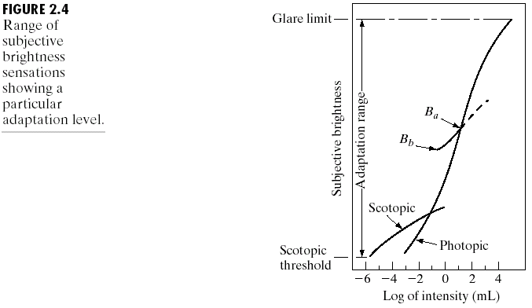
Brightness Adaptation Contd…
Human eye can not operate over the entire dynamic range simultaneously.
Rather, it rooms around the complex intensity pattern over a small neighborhood.
The small intersecting curve shows the range of intensity level that eye can discriminate simultaneously around a said level of brightness adaptation (B_{a}).

Slide 25
Intensity Discrimination
The ability of the eye to discriminate between changes in light intensity at any specific adaptation level is also of considerable interest.
Consider a sharp-edged circular target of brightness I₁ on uniform brightness I.
I₁
I

Slide 26
Contd…
The ratio δI/I, known as ‘Weber Ratio’, has approx. a constant value 0.02 over a wide range of brightness I.
Small value of δI/I → “good” brightness
discrimination
Large value of δI/I → “poor” brightness
discrimination

Slide 27
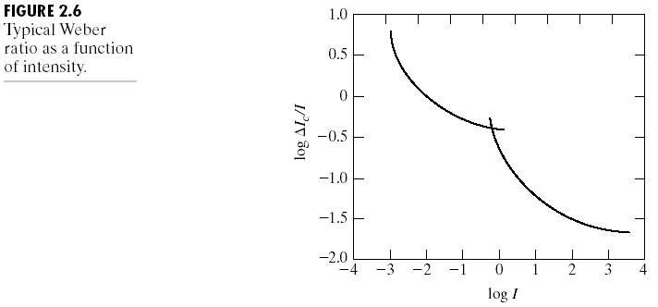
Contd…
function of rods
function of cones

Slide 28
Effect on Human Perception
It has been shown that perceived brightness is not a simple function of intensity.
Example of simultaneous contrast:
All the inner squares have the same intensity, but they appear progressively darker as the background becomes lighter.

Slide 29
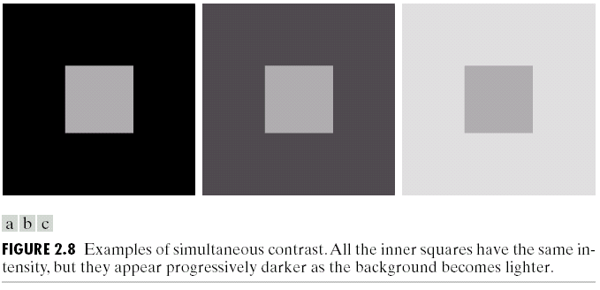
Simultaneous contrast Contd…

Slide 30
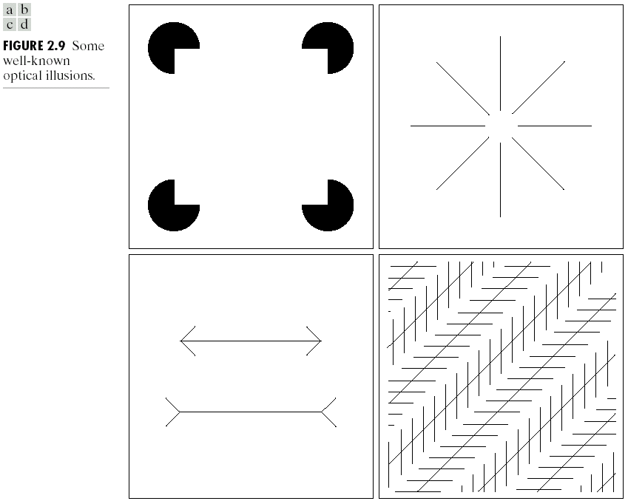
Other Characteristics of Human Visual System
Phenomenon of Optical Illusion:
One important characteristic of HVS is it seems to fill in the interior of a region with apparent brightness at the edge.

