Slide 1
Digital Image Processing
Imaging Sensors

Slide 2
Overview
Image Formation in the Eye
Brightness Adaptation and Discrimination
Imaging Sensors and Image Acquisition Modalities
Acquisition of Remote Sensing and Medical Images

Slide 3
Image Sensing and Acquisition
Images are generated by the combination of “illumination” source and the reflection or absorption or transmission of energy from that source by the elements of the “scene” being imaged.
Sources of illumination: electromagnetic energy such as radar, infrared or X-ray energy. Other sources - ultrasound

Slide 4
Image Sensing and Acquisition
or even a computer-generated illumination pattern.
Scene elements: familiar objects or molecules or buried rock formations, or a human brain.

Slide 5
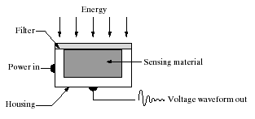
Imaging Sensors
Sensors are used to transform illumination energy into digital images. Sensors are of three types:
Single Imaging Sensor
Strip Sensors
Array Sensors
Figure: A single imaging sensor

Slide 6
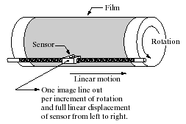
Image Acquisition using Single Sensor
To generate a 2-D image using a single sensor, there has to be relative displacements in both the x- and y-directions between the sensor and the area to be imaged.

Slide 7
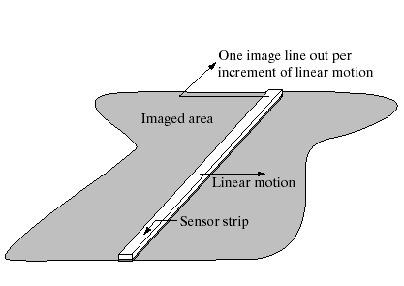
Image Acquisition using Sensor Strip
The strip provides imaging elements in one direction.
Motion perpendicular to the strip provides imaging in the other direction.
Lenses or other focusing schemes are used to project the area to be scanned onto the sensors.

Slide 8
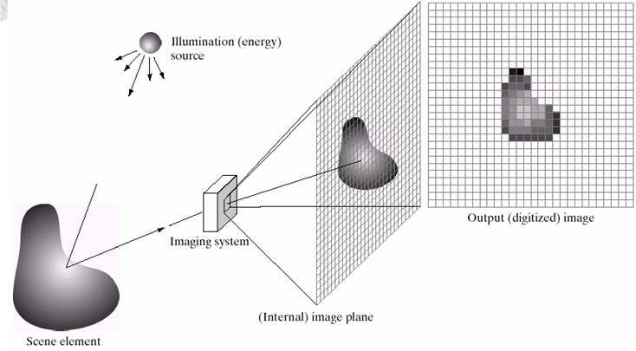
Image Acquisition using Sensor Arrays

Slide 9
Sensor arrays contd…
The first function performed by the imaging system is to collect the incoming reflected energy and focus it onto an image plane.
If the illumination is light, the front end of the imaging system is a lens, which projects the viewed scene onto the lens focal plane.
The sensor array, which is coincident with the focal plane, produces outputs proportional to the integral of the light received at each sensor.

Slide 10
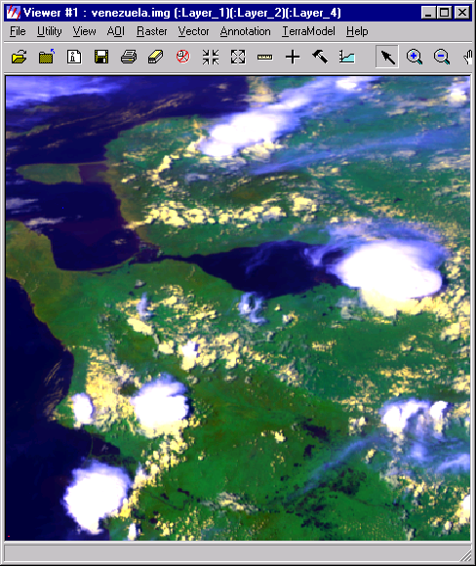
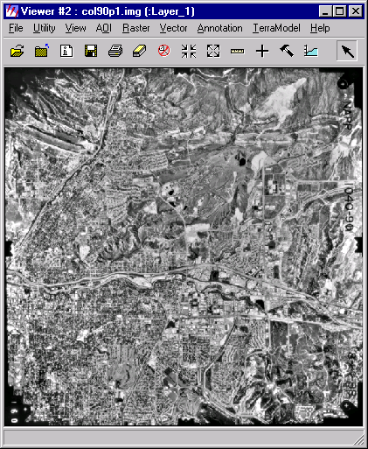
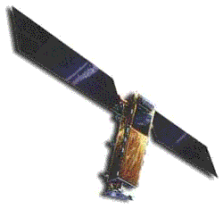


The Process of RS Image Acquisition
12
65
C
28
33
76
E
A
D
A
B
A. Radiation and the atmosphere
C. Energy recorded and converted by sensor
B. Interaction with target
E. Interpretation and analysis
D. Reception and processing

Slide 11
Different Imaging Modalities used in Remote Sensing
Categories:
  Cameras and Aerial Photography
  Multispectral Scanning
  Thermal Imaging
  Microwave Imaging

Slide 12
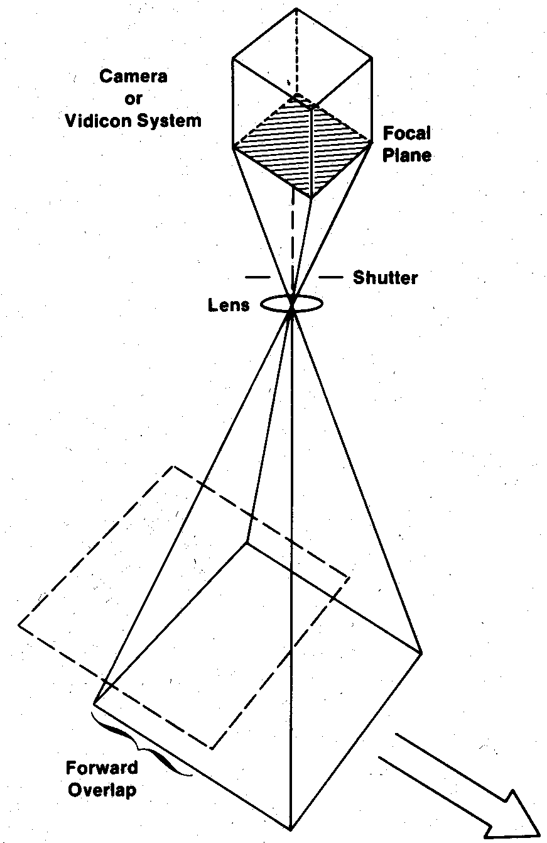
Cameras and Aerial Photography
Cameras are framing systems which instantaneously acquire an image of an area on the terrain.
The longer the focal length of lens, the smaller the area covered on the ground, but with greater detail (also depends on the altitude of the platform).

Slide 13
Contd…
Aerial photographs are most useful when fine spatial detail is more critical than spectral information.
Multiband photography uses multi-lens systems with different film-filter combinations to acquire photos simultaneously in a number of different spectral ranges.
Digital cameras record EM radiation electronically instead of using film.

Slide 14
Multispectral Scanning
A scanning system employs a sensor with a narrow filed of view that is swept across the terrain to produce an image.
A scanning system used to collect data over a variety of different wavelength ranges is called a Multispectral Scanner (MSS).
There are two common scanning modes: across-track scanning and along-track scanning.

Slide 15
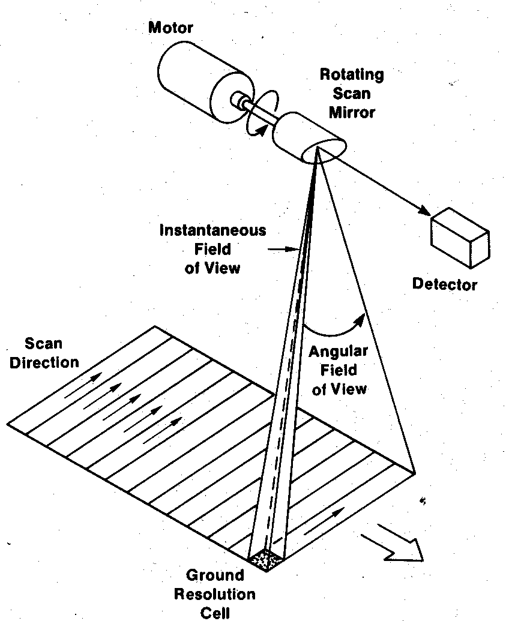
Cross-Track Scanners
A rotating mirror sweeps across the terrain in a pattern of parallel scan-lines oriented normal to the flight direction.
The length of time the IFOV “sees” a ground resolution cell as rotating mirror scans is called the dwell time.

Slide 16
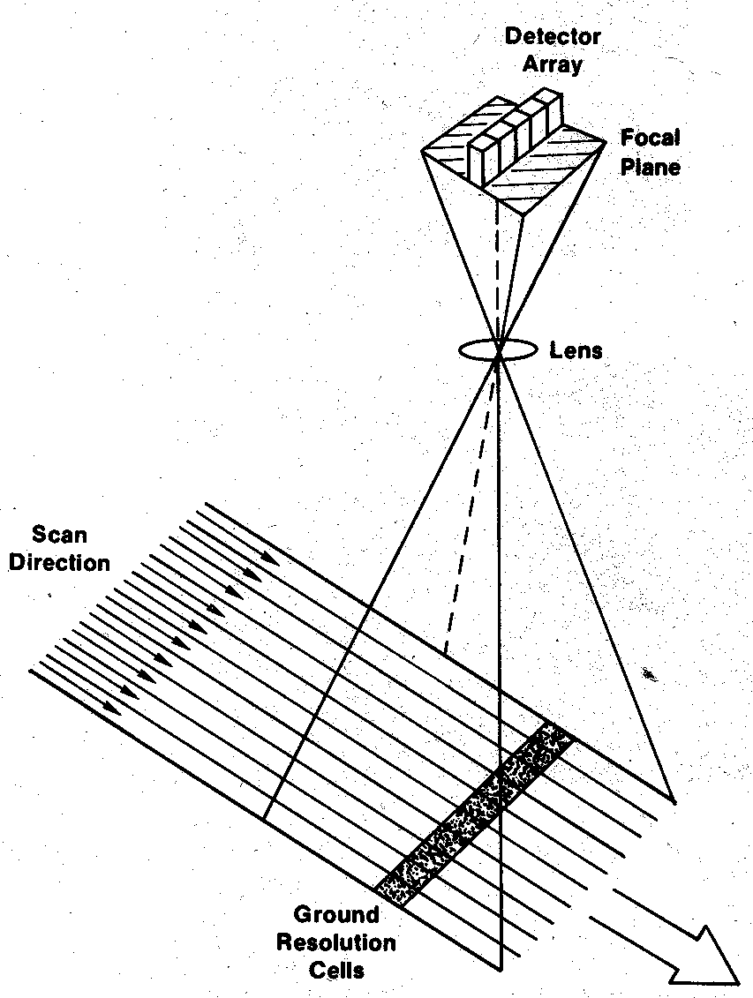
Along-Track Scanners
Along-track scanners use a linear array of detectors in the focal plane of the image formed by a lens system.
These systems are also referred as pushbroom scanners.
They have higher dwell time for each GRC, and hence finer spatial and spectral resolution.

Slide 17
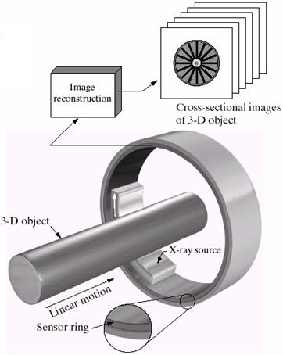
Process of CAT Imaging
Sensor strips mounted in a ring configuration are used to obtain cross-sectional images of 3-D objects.
A rotating X-ray source provides illumination and the portion of the sensors opposite the source collect the energy that pass through the object.

Slide 18
Next…
Image Sampling and Quantization
Spatial and Gray-Level Resolution
Zooming and Shrinking Digital Images
Some Basic Relationships between Pixels
Problem Solving

