Slide 1
Digital Image Fundamentals

Slide 2
Overview
Image Digitization
Image Sampling and Quantization
Spatial Resolution
Gray-Level or Radiometric Resolution
Effects of varying number of samples and gray levels on image quality
Spectral Resolution
Basic Relationships between Pixels
Simple Operations on Digital Images

Slide 3
What is Image Digitization?
An image g(x,y) that is detected and recorded by a sensor is primarily a continuous tone intensity pattern formed on 2-D plane.
The image must be converted into a form which is suitable for computer processing.
The method of converting an image,

Slide 4
What is Image Digitization?
Contd…
which is continuous in space as well as in its value, into a discrete numerical form is called image digitization.

Slide 5
Steps involved in Image Digitization
Two Steps for
taking measurements at regularly spaced intervals, called sampling, and
mapping the measured intensity (or value) to one of finite number of discrete levels, called quantization.

Slide 6
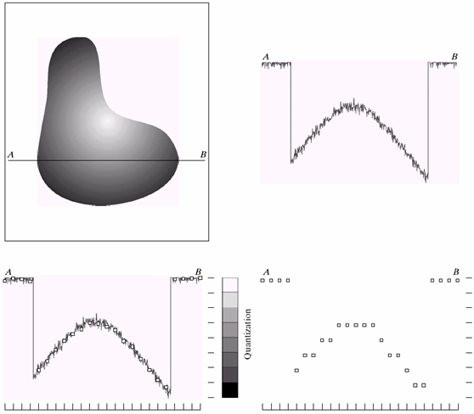
Figure: Generating a Digital Image (a) Continuous image. (b) a scan line from A to B in the continuous image,
used to illustrate the concept of sampling and quantization. (c) sampling and quantization. (d) Digital scan line
(b)
Gray level scale is divided
into 8 discrete levels
(a)
Samples shown as
white squares
(c)
Sampling
(d)

Slide 7
Controlling Image Sampling
The method of sampling is determined by the sensor arrangement used to generate the image.
In case of Image generation by single sensor element, ‘sampling’ is accomplished by selecting the number of mechanical increments at which we activate the sensor to collect data.

Slide 8
Image Sampling Contd…
Case of Sensor Strip: the number of sensors in the strip establishes the sampling limitations in one image direction.
Mechanical motion is the other direction is controlled accordingly.
Case of Sensor Array: number of sensors in the array establishes the limit of sampling in both directions.

Slide 9
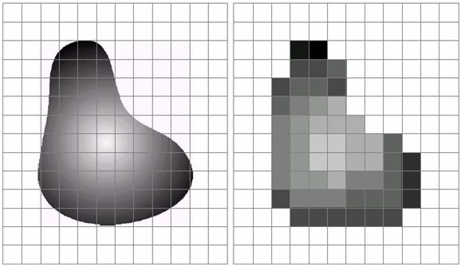
Image Quantization
The continuous gray levels are quantized simply by assigning one of the eight discrete gray levels to each sample.

Slide 10
Spatial Resolution
Basically, the spatial resolution is the smallest discernible detail in an image.
‘Sampling’ is the principal factor determining the spatial resolution of an image.
Explanation: Consider a chart with vertical lines of width W, with the space between the lines also having width W.

Slide 11
Spatial Resolution Contd…
A line pair consists of one such line and its adjacent space. Thus the width of a line pair is 2W.
⇒ there are 1/2W line pairs per unit dist.
We may define ‘spatial resolution’ as the smallest number of discernible line pairs per unit distance (e.g. 100 lines per mm).

Slide 12
Calculating Spatial Resolution of RS Satellite/Aerial Images
Spatial resolution is simply the dimension in meters of the ground projected Instantaneous Field Of View (IFOV).
The IFOV of any detector is the solid angle through which a detector is sensitive to radiation.
IFOV = D/F radiance
where D = Detector dimension
F = Focal length

Slide 13
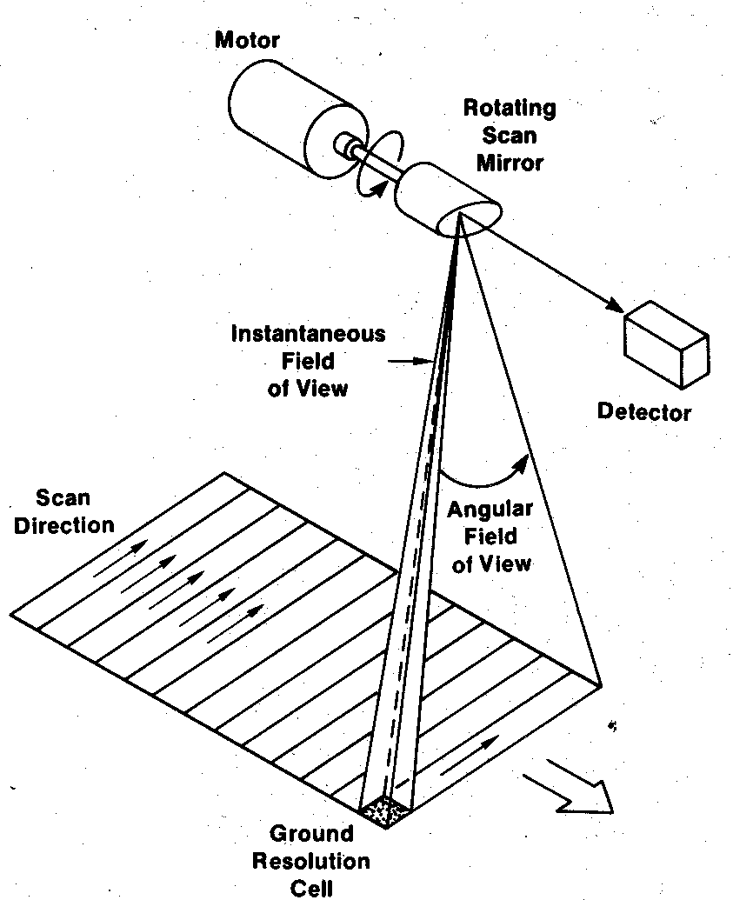
Spatial Resolution Contd…
Fig: Cross-Track Scanner
Ground Resolution Element (GRE) is defined as
GRE = H * IFOV
where H = Flying height of spacecraft

Slide 14
Spatial Resolution Contd…
It is important to distinguish between pixel size and spatial resolution - they are not interchangeable.
If a sensor has a spatial resolution of 20 meters and an image from that sensor is displayed at full resolution, each pixel represents an area of 20m x 20m on the ground. In this case the pixel size and resolution are the same.
However, it is possible to display an image with a pixel size different than the resolution.

Slide 15
Gray level or Radiometric Resolution
It refers to the smallest discernible change in gray level.
Radiometric resolution defines the sensitivity of a detector to differences in signal strength as it records the radiant flux reflected or emitted from the target of interest.
The finer the radiometric resolution of a

Slide 16
Gray level Resolution Contd…
sensor, the more sensitive it is to detecting small differences in reflected or emitted energy.
The maximum number of brightness levels available depends on the number of bits used in representing the energy recorded.
Due to processing, storage and sampling hardware considerations, the no. of gray levels is usually an integer power 2.

Slide 17
Image Size
The size of M*N image with discrete gray levels in the interval [0, L-1], where L=2^{k} (k is the number of bits required to represent a gray value), is given by
b = M * N * k
b= no. of bits required to store a digitized image
For square image M=N ⇒ b= N*N*k

Slide 18
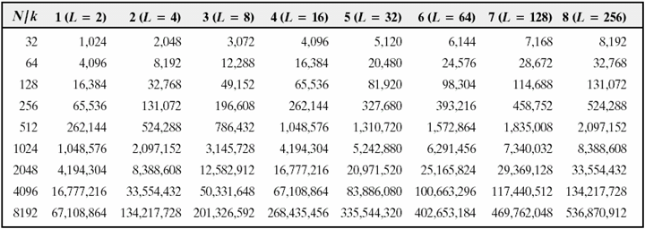
Number of storage bits for various values of N and k

Slide 19
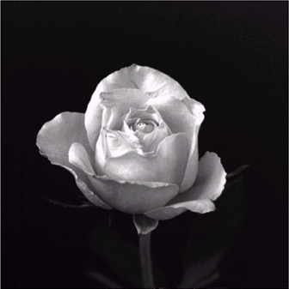
Effects of varying the number of samples on image quality
1024*1024 pixels size
image with 256 gray levels

Slide 20
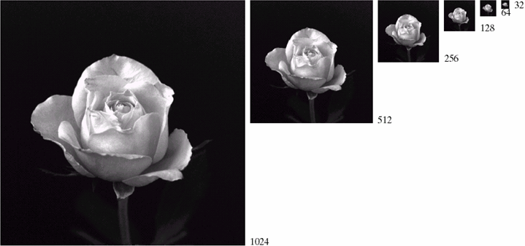
Fig: A 1024*1024, 8-bit image subsampled down to size 32*32
pixels. The number of allowable gray levels was kept at 256.
NOTE: Size differences make it difficult to
see the effects resulting from a reduction
in the number of samples.

Slide 21
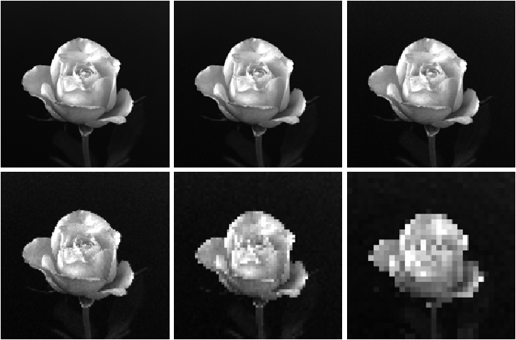
1024*1024, 8-bit image. (b) 512*512 image resampled into 1024*1024 pixels by row and
column duplication. (c) through (f) 256*256, 128*128, 64*64, and 32*32 images resampled
into 1024*1024 pixels.

Slide 22
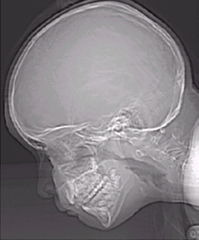
Effects of varying number of gray levels on image quality
452*374, 256-gray levels
CAT projection image
(k=8)

Slide 23
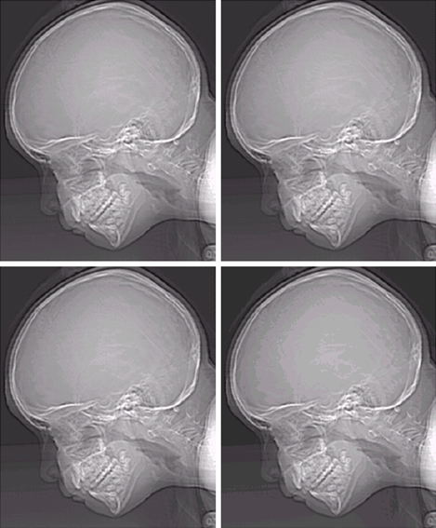
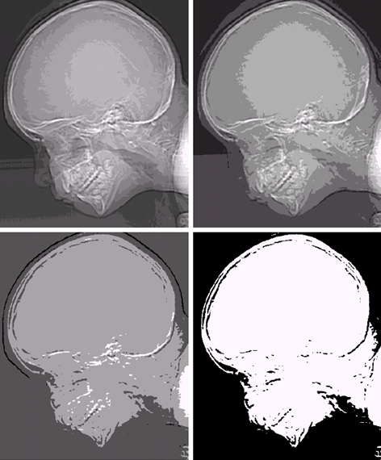
Effects of varying number of gray levels on image quality
(a) 452*374, 256-level image (b)–(d) Image displayed in 128, 64, and 32 gray levels,
(e)–(h) Image displayed in 16, 8, 4 and 2 gray levels, while keeping the spatial resolution constant.

Slide 24
Basic Relationship between pixels
Neighbors of a pixel
Adjacency, Connectivity, Regions and Boundaries
Distance measures

Slide 25
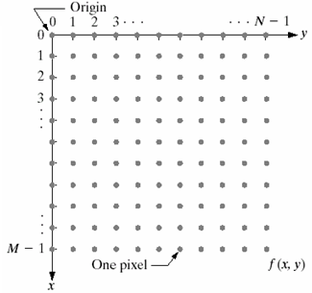
Neighbors of a pixel
.
.
.
f(x-1,y-1)
f(x-1,y)
f(x-1,y+1)
. . .
f(x,y-1)
f(x,y)
f(x,y+1)
. . .
f(x+1,y-1)
f(x+1,y)
f(x+1,y+1)
.
.
.
4-neighbors - N₄(p)
  (x+1, y), (x-1, y), (x, y+1), (x, y-1)

Slide 26
Neighbors of a pixel
Contd…
Diagonal-neighbors - N_{D}(p)
  (x+1, y+1), (x+1, y-1), (x-1, y+1), (x-1, y-1)
8-neighbors – N₈(p)
  N₈(p) = N₄(p) ∪ N_{D}(p)

Slide 27
Adjacency of Pixels
Let V be the set of gray-level values used to define adjacency.
4-adjacency:
  Two pixels p and q with values from V are 4-adjacent if q is in the set N₄(p).
8-adjacency:
  Two pixels p and q with values from V are 8-adjacent if q is in the set N₈(p).

Slide 28

Adjacency of Pixels
Contd…
m-adjacency:
  Two pixels p and q with values from V are m-adjacent if
    q is in N₄(p) or
    q is in N_{D}(p) and the set N₄(p) ∩ N₄(q) has no pixels whose values are from V.
Example:
8-adjacent pixels
m-adjacent pixels

Slide 29
Connectivity
Used for defining path, connected pixels and connected components
Path:
  A path from pixel p(x,y) to pixel q(s,t) is a sequence of distinct pixels with coordinates:
  (x₀,y₀), (x₁,y₁),…, (x_{n},y_{n})
  where (x₀,y₀)=(x,y), (x_{n},y_{n}) =(s,t) and pixels (x_{i},y_{i}) and (x_{i-1},y_{i-1}) are adjacent for 1 ≤i ≤n.

Slide 30
Connectivity
Contd…
Let S represents a subset of pixels in an image.
Two pixels p and q are said to be connected in S if there exists a path between them consisting entirely of pixels in S.
For any pixel p in S, the set of pixels that are connected to it in S is called a connected component of S.
If S only has one connected component then set S is called a connected set.

Slide 31
Region of an Image
Let R be a subset of pixels in an image.
We call R a region of the image if R is a connected set.

Slide 32
Boundary of a Region
The boundary of (border or contour) of a region R is the set of pixels in the region that have one or more neighbors that are not in R.
The boundary of a finite region forms a closed path.

Slide 33
Distance Measures
For pixels p, q and z with coordinates (x,y), (s,t) and (u,v) respectively, D is a distance function or metric if
  D(p, q) ≥ 0 (D(p, q) =0 iff p=q)
  D(p, q) = D(q, p) and
  D(p, z) ≤ D(p, q) + D(q, z)
Different Measures
  Euclidean distance
  City Block distance
  Chessboard distance
  M-adjacency D_{m} distance

Slide 34
Euclidean distance (D_{e})
D_{e}(p,q) = [(x-s)² + (y-t)²]^{1/2}
Note: The pixels having a distance less than or equal to some value r from (x,y) are the points contained in a disk of radius r centered at (x,y).

Slide 35
City Block distance (D₄)
D₄(p,q) = |x-s| + |y-t|
Note: The pixels having a D₄ distance from (x, y) less than or equal to some value r forms a diamond centered at (x,y). E.g. for pixels with D₄ ≤ 2 from (x,y)
2
2 1 2
2 1 0 1 2
2 1 2
2

Slide 36
Chessboard distance (D₈)
D₈(p,q) = max (|x-s| , |y-t|)
2 2 2 2 2
2 1 1 1 2
2 1 0 1 2
2 1 1 1 2
2 2 2 2 2
Note: The pixels with D₈ ≤ r forms a square centered at (x, y).

Slide 37
m-adjacency D_{m} distance
D_{m} distance between two pints is defined as the shortest m-path between the points.
In this case, the distance between two points will depend on the values of the pixels along the path, as well as the values of their neighbors.

Slide 38
Operations on Digital Images:
Zooming and Shrinking
Zooming can be viewed as oversampling
Steps
  creation of new pixel locations
  assignment of gray levels to those new locations.
Example
Input image size: 500*500 pixels
Enlarged image size: 750*750 pixels (1.5 times)

Slide 39
Zooming operation Contd…
Creation of new pixel locations
  Assume an imaginary grid of size 750*750 pixels laying over the original image.
  Here spacing in the grid would be less than one pixel.
Assigning gray-value to new locations
  Nearest neighbor interpolation
  Bilinear interpolation
  Cubic interpolation

Slide 40
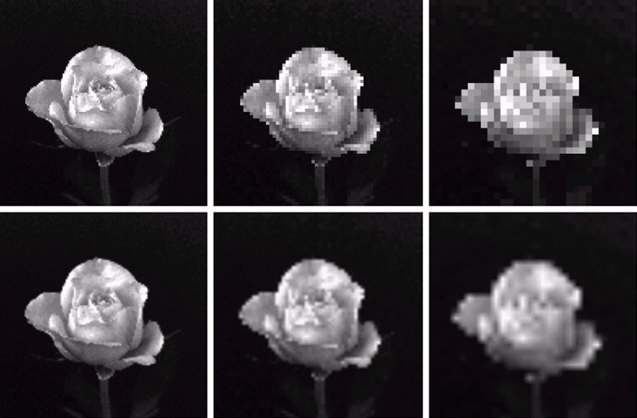
Top row: images zoomed from 128*128, 64*64, and 32*32 pixels to 1024*1024 pixels,
using nearest neighbor gray-level interpolation. Bottom row: using Bilinear interpolation.

Slide 41
Arithmetic/Logic Operations
Logic operations apply to binary images, while the arithmetic operations apply to multivalued pixels.
Arithmetic operations between two pixels p and q:
  Addition : p+q
  Subtraction: p-q
  Multiplication: p*q
  Division: p/q

Slide 42
Contd…
Principal logic operations:
  AND: p AND q
  OR: p OR q
  COMPLEMENT: NOT q
The above two operations are used for IP in basically two ways:
  on a pixel-by-pixel basis (e.g. addition of two images)
  in neighborhood-oriented operations

Slide 43
Neighborhood-oriented (or mask) operations
The idea behind mask operations is to let the value assigned to a pixel be a function of it and its neighbors.
Useful in applications such as:
  Noise reduction
  Region thinning
  Feature detection

Slide 44
Contd…
.
.
.
a
b
c
w₁
w₂
w₃
. . .
d
e
f
. . .
w₄
w₅
w₆
g
h
i
w₇
w₈
w₉
.
.
A 3*3 mask
.
Sub-area of an image
p = w₁a + w₂b + w₃c + w₄d + w₅e + w₆f + w₇g + w₈h + w₉i

Slide 45
Linear and Non-linear Operations
Test for linear operator
Let H be an operator whose input and output are images. H is said to be linear operator if, for any two images f and g and any two scalars a and b,
H(af + bg) = aH(f) + bH(g)
Non-linear operator fails the above test

