Slide 1
Image Enhancement in the Spatial Domain

Slide 2
Principle Objective of Enhancement
Process an image so that the result will be more suitable than the original image for a specific application.
The suitableness is up to each application.
A method which is quite useful for enhancing an image may not necessarily be the best approach for enhancing another images.

Slide 3
Categories of Image Enhancements
Spatial Domain : (image plane)
  Techniques are based on direct manipulation of pixels in an image
Frequency Domain :
  Techniques are based on modifying the Fourier transform of an image
There are some enhancement techniques based on various combinations of methods from these two categories.

Slide 4
Good images
For human visual
  The visual evaluation of image quality is a highly subjective process.
  It is hard to standardize the definition of a good image.
For machine perception
  The evaluation task is easier.
  A good image is one which gives the best machine recognition results.
A certain amount of trial and error usually is required before a particular image enhancement approach is selected.

Slide 5
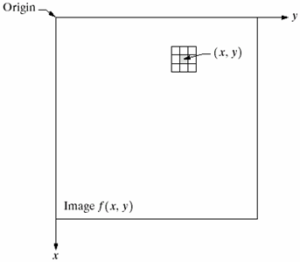
Spatial Domain
Procedures that operate directly on pixels.
g(x,y) = T[f(x,y)]
  where
  f(x,y) is the input image
  g(x,y) is the processed image
  T is an operator on f defined over some neighborhood of (x,y)

Slide 6
Point Processing
Neighborhood size = 1x1 pixel
g depends on only the value of f at (x,y)
T = gray level (or intensity or mapping) transformation function
s = T(r)
Where
  r = gray level of f(x,y)
  s = gray level of g(x,y)

Slide 7
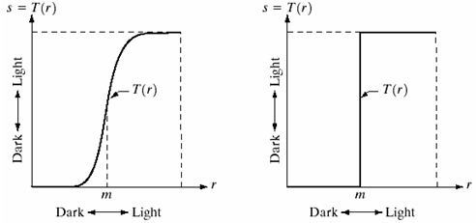
Thresholding
In above figure, transformation function T(r) produces a two-level (binary) image.
The function T assigns value 0 (black) to values of r below m and 255 (white) to values of r above m.

Slide 8
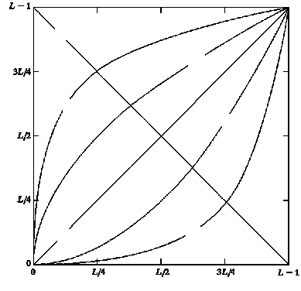
3 Basic Gray Level Transformations
Linear function
  Negative and identity transformations
Logarithm function
  Log and inverse-log transformation
Power-law function
  n^{th} power and n^{th} root transformations
Negative
n^{th} root
Log
n^{th} power
Output gray level, s
Identity
Inverse Log
Input gray level, r

Slide 9
Identity Function
Output intensities are identical to input intensities.
Is included in the graph only for completeness.
Negative
n^{th} root
Log
n^{th} power
Output gray level, s
Identity
Inverse Log
Input gray level, r

Slide 10
Image Negatives
An image with gray level in the range [0, L-1]
where L = 2^{n} ; n = 1, 2…
Negative transformation :
s = L – 1 –r
Output equivalent of a photographic negative.
Suitable for enhancing white or gray detail embedded in dark regions of an image, especially when the black areas are dominant in size.
Negative
n^{th} root
Log
n^{th} power
Output gray level, s
Identity
Inverse Log
Input gray level, r

Slide 11
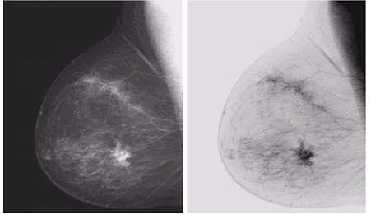
Example of Negative Image
Original image
Negative Image : gives a better vision to analyze the image

Slide 12
Log Transformations
s = c log (1+r)
c is a constant and r ≥ 0
Log curve maps a narrow range of low gray-level values in the input image into a wider range of output levels.
Used to expand the values of dark pixels in an image while compressing the higher-level values.
Negative
nth root
Log
nth power
Output gray level, s
Identity
Inverse Log
Input gray level, r

Slide 13
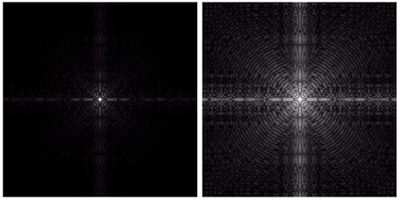
Example: Image after Log transformation
Fourier Spectrum with range = 0 to 1.5 x 10⁶
Result after apply the log transformation with c = 1, range = 0 to 6.2

Slide 14
Inverse Log Transformation
Do opposite to the Log Transformations
Used to expand the values of high pixels in an image while compressing the darker-level values.

Slide 15
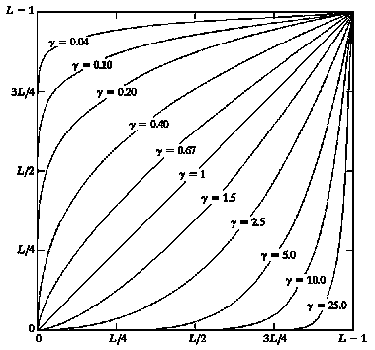
Power-Law Transformations
s = cr^{γ}
c and γ are positive constants
Power-law curves with fractional values of γ map a narrow range of dark input values into a wider range of output values, with the opposite being true for higher values of input levels.
It is more versatile than Log transformations.
Output gray level, s
Input gray level, r
Plots of s = cr^{γ} for various values of γ
(c = 1 in all cases)

Slide 16
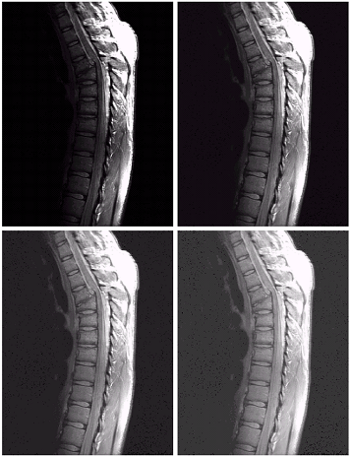
Example : MR Image
(a) a Magnetic Resonance image of a fractured human spine
  The picture is predominately dark
  An expansion of gray levels are desirable  needs γ < 1
(b) result after power-law
transformation with γ = 0.6,
(c) transformation with γ = 0.4
(best result)
(d) transformation with γ = 0.3
(under acceptable level)
Here c=1 in all cases.
a
b
c
d

Slide 17
Effect of decreasing gamma
When the γ is reduced too much, the image begins to reduce contrast to the point where the image started to have very slight “wash-out” look, especially in the background.

Slide 18
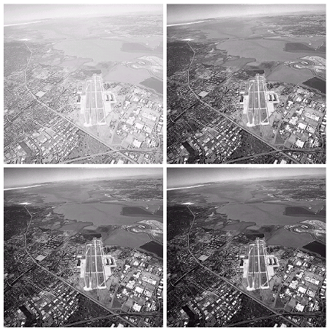
Another Example
a | b
c | d
(a) image has a washed-out appearance, it needs a compression of gray levels  needs γ > 1
(b) result after power-law
transformation with γ = 3.0 (suitable)
(c) transformation with γ = 4.0
(suitable, high contrast)
(d) transformation with γ = 5.0
(the image has areas that are too dark, some detail is lost)

Slide 19
Piecewise-Linear Transformation Functions
Advantage:
  The form of piecewise functions can be arbitrarily complex.
Disadvantage:
  Their specification requires considerably more user input.

Slide 20
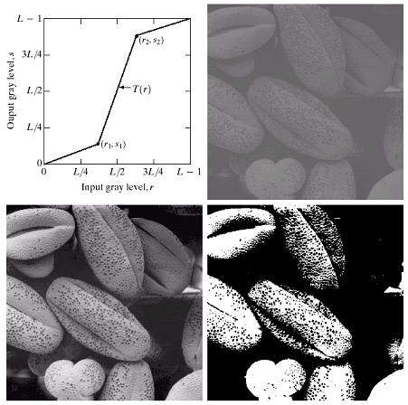
Contrast Stretching
a | b
c | d
Increase the dynamic range of the gray levels in the image.
(b) a low-contrast image : result from poor illumination, lack of dynamic range in the imaging sensor, or even wrong setting of a lens aperture of image acquisition
(c) result of contrast stretching: (r₁,s₁) = (r_{min},0) and (r₂,s₂) = (r_{max},L-1)
(d) result of thresholding

Slide 21
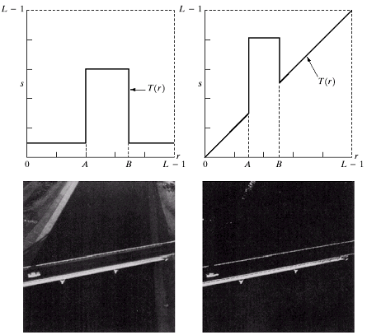
Gray-level slicing
a | b
c | d
Highlighting a specific range of gray levels in an image
(a) transformation highlights range [A,B] of gray level and reduces all others to a constant level
(b) transformation highlights range [A,B] but preserves all other levels
(c) An image
(d) Result of using transformation (a).

Slide 22
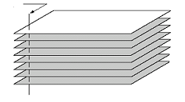
Bit-plane slicing
Highlighting the contribution made to total image appearance by specific bits.
Suppose each pixel is represented by 8 bits.
Higher-order bits contain the majority of the visually significant data.
Useful for analyzing the relative importance played by each bit of the image.
One 8-bit byte
Bit-plane 7
(most significant)
Bit-plane 0
(least significant)

Slide 23
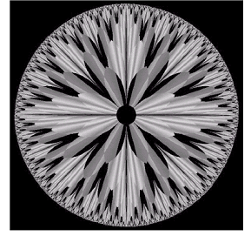
Example
The (binary) image for bit-plane 7 can be obtained by processing the input image with a thresholding gray-level transformation function:
  Map all levels between 0 and 127 to 0
  Map all levels between 129 and 255 to 255
An 8-bit fractal image

Slide 24
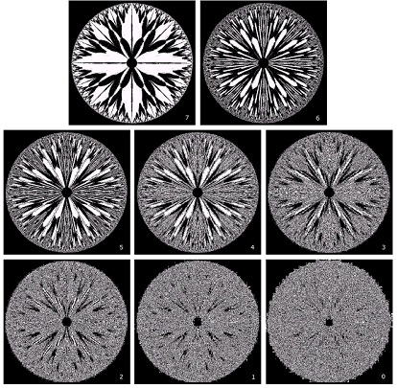
8 bit planes
Bit-plane 7 |  | Bit-plane 6
Bit-plane 5 | Bit-plane 4 |  | Bit-plane 3
Bit-plane 2 | Bit-plane 1 |  | Bit-plane 0

