Slide 1
Image Enhancement in the Spatial Domain
Histogram Techniques

Slide 2
RECAP
Categories of Image Enhancements
Spatial Domain Techniques
Basic Gray Level Transformations
  Linear function
  Logarithm function
  Power-law function
  Piecewise-Linear Transformation Functions
Histogram-based Techniques

Slide 3
Image Enhancement by Histogram-Modification Techniques
The shape of gray level histogram gives an idea about the overall appearance of an image.
Histogram of a digital image with gray levels in the range [0,L-1] is a discrete function
h(r_{k}) = n_{k}
where
  r_{k} : the k^{th} gray level
  n_{k} : the number of pixels in the image having gray level r_{k}

Slide 4
Example
No. of pixels
6
2 | 3 | 3 | 2
4 | 2 | 4 | 3
3 | 2 | 3 | 5
2 | 4 | 2 | 4
5
4
3
2
1
Gray level
4x4 image
0
1
2
3
4
5
6
7
8
9
Gray scale = [0,9]
histogram

Slide 5
Normalized Histogram
Computed by dividing each of histogram value at gray level r_{k} by the total number of pixels in the image, n
p(r_{k}) = n_{k} / n
for k = 0,1,…,L-1
p(r_{k}) gives an estimate of the probability of occurrence of gray level r_{k} .
The sum of all components of a normalized histogram is equal to 1.

Slide 6
Purpose of Histogram Processing
Basis for numerous spatial domain processing techniques.
Used effectively for image enhancement.
Information inherent in histograms also is useful in image compression and segmentation.

Slide 7
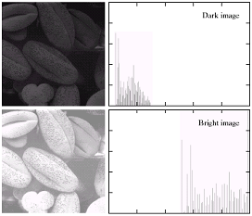
h(r_{k}) or p(r_{k})
Example
r_{k}
Dark image
Components of histogram are concentrated on the low side of the gray scale.
Bright image
Components of histogram are biased towards the high side of the gray scale.

Slide 8
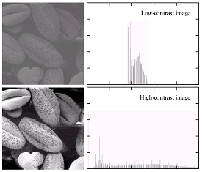
Example Contd…
Low-contrast image
histogram is narrow and is centered toward the middle of the gray scale.
High-contrast image
histogram covers a broad range of the gray scale and the distribution of pixels is not too far from uniform, with very few vertical lines being much higher than the others.

Slide 9
Histogram Equalization
As the low-contrast image’s histogram is narrow and centered toward the middle of the gray scale, if we distribute the histogram to a wider range the quality of the image will be improved.
We can do it by adjusting the probability density function (pdf) of the original histogram of the image so that the probability spreads equally.
It produces an output image that has a uniform histogram.

Slide 10
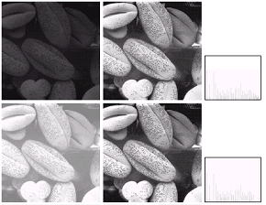
Example
before
after
Histogram
equalization

Slide 11
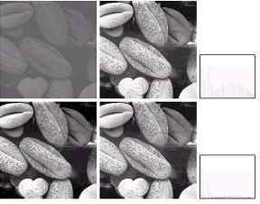
Example Contd…
before
after
Histogram
equalization
The quality is not improved much because the original image already has a broaden gray-level scale.

Slide 12
Procedure
The gray levels in an image may be viewed as random variables in the interval [0,1].
The probability of occurrence of gray level r_{k} in an image is approximated by
  p_{r}(r_{k}) = n_{k}/n, k=0,1,2,…, L-1 ---(1)
Continuous version of gray level transformation function
  s = T(r) = ∫ p_{r}(w) dw ---(2)
r
0

Slide 13
Contd…
Discrete version of the transformation function given in equation (2) is
  s_{k} = T(r_{k}) = ∑ p_{r} (r_{j}) ---(3)
  = ∑ n_{j}/n
The output image is obtained by mapping each pixel with level r_{k} in the input image into a corresponding pixel s_{k} in the output image via equation (3).
k
j=0
k
j=0

Slide 14
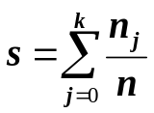
Example
Gray Level (r_{k}) | 0 | 1 | 2 | 3 | 4 | 5 | 6 | 7
No. of pixels (n_{k}) | 790 | 1023 | 850 | 656 | 329 | 245 | 122 | 81
Normalization L_{i} =r_{k}/7 | 0 | 0.14 | 0.28 | 0.42 | 0.57 | 0.71 | 0.85 | 1.0
Probability: n_{k}/(total pixels) | 790/4096= 0.19 | 1023/4096= 0.25 | 850/4096= 0.21 | 656/4096= 0.16 | 329/4096= 0.08 | 245/4096= 0.06 | 122/4096= 0.03 | 81/4096= 0.02
 | 0.19 | 0.44 | 0.65 | 0.81 | 0.89 | 0.95 | 0.98 | 1.0
Assign original class to the new class it is closest in value | 1 | 3 | 5 | 6 | 6 | 7 | 7 | 7
Image size: 64*64, Gray levels: 8

Slide 15
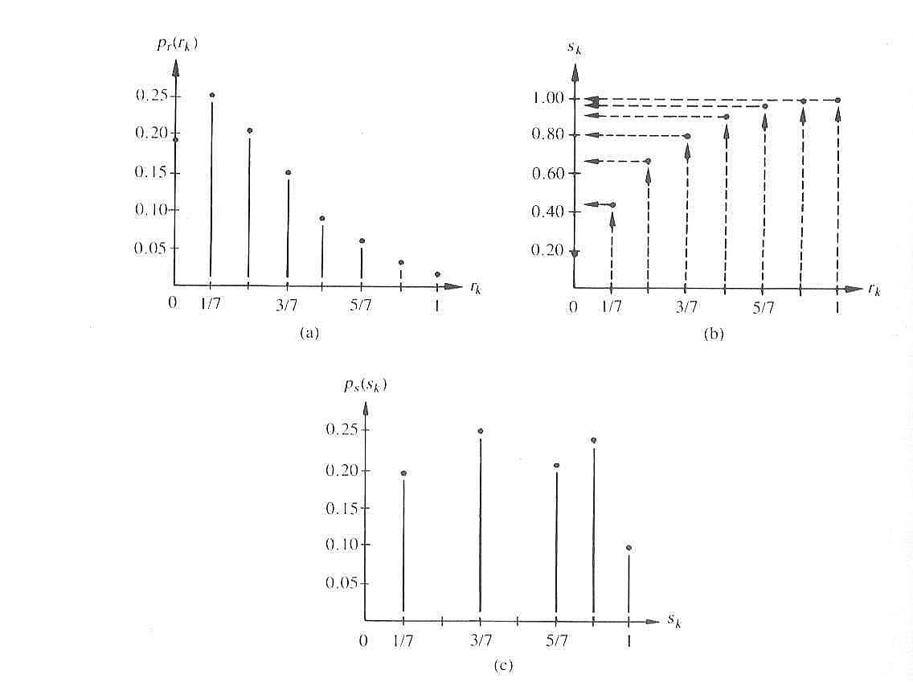
Example Contd…
(a) Original histogram. (b) Transformation function. (c) Equalized histogram

Slide 16
Histogram Matching
(Specification)
Histogram equalization has a disadvantage which is that it can generate only one type of output image.
With Histogram Specification, we can specify the shape of the histogram that we wish the output image to have.
It does not have to be a uniform histogram.

Slide 17
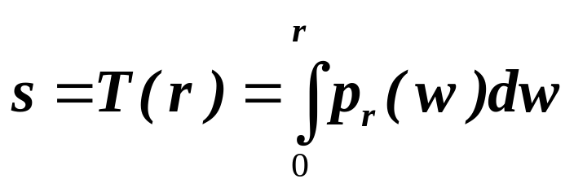
Consider the continuous domain
Let p_{r}(r) denote continuous probability density function of gray-level of input image, r
Let p_{z}(z) denote desired (specified) continuous probability density function of gray-level of output image, z
Let s be a random variable with the property
Histogram equalization
where w is a dummy variable of integration

Slide 18
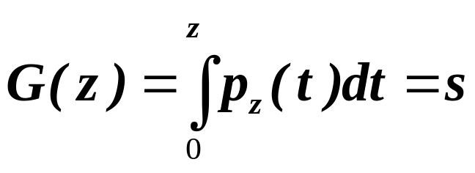
Next, we define a random variable z with the property
Histogram equalization
where t is a dummy variable of integration
thus
s = T(r) = G(z)
Therefore, z must satisfy the condition
z = G⁻¹(s) = G⁻¹[T(r)]
Assume G⁻¹ exists and satisfies required conditions, then
we can map an input gray level r to output gray level z.

Slide 19
Procedure Summary (Histogram Matching)
Obtain the transformation function T(r) by calculating the histogram equalization of the input image
Obtain the transformation function G(z) by calculating histogram equalization of the desired density function

Slide 20
Procedure Summary Contd…
Obtain the inversed transformation function G⁻¹
Obtain the output image by applying the processed gray-level from the inversed transformation function to all the pixels in the input image.
z = G⁻¹(s) = G⁻¹[T(r)]

Slide 21
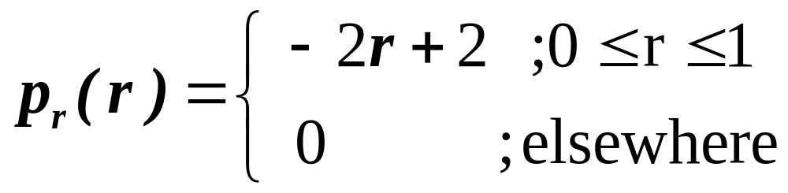
Example (Histogram Matching)
Q 3.10, pp. 144 (G&W)
Assume an image has a gray level probability density function p_{r}(r) as shown below:
P_{r}(r)
2
1
0
1
2
r

Slide 22
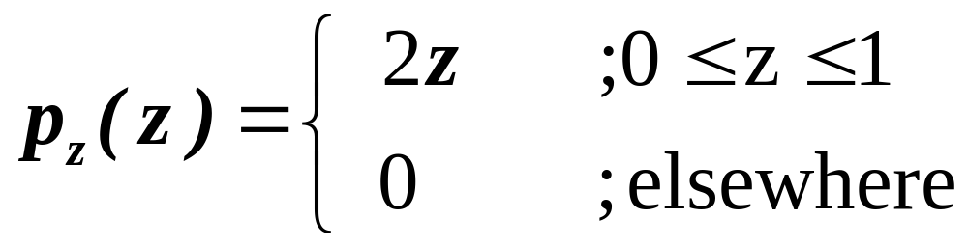
Example Contd…
We would like to apply the histogram specification with the desired probability density function p_{z}(z) as shown below:
P_{z}(z)
2
1
Assume continuous quantities, and
find the transformations (in terms of
r and z) that will accomplish this.
z
0
1
2

Slide 23
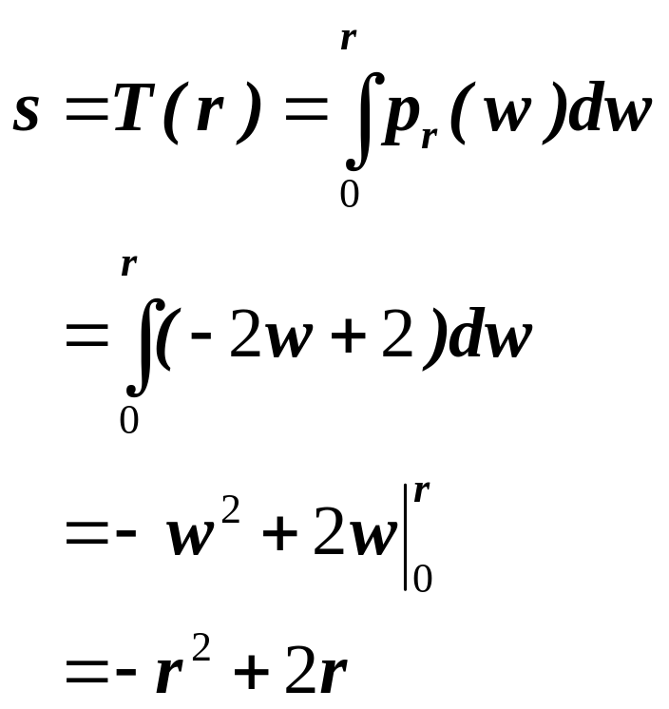
Step 1
Obtain the transformation function T(r)
s=T(r)
1
One to one mapping function
r
0
1

Slide 24
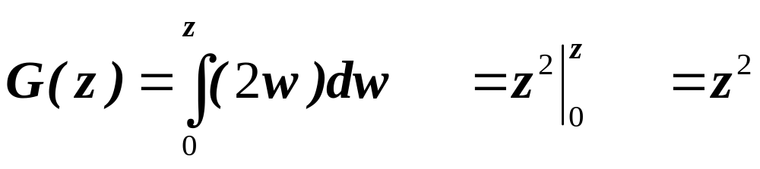
Step 2
Obtain the transformation function G(z)

Slide 25
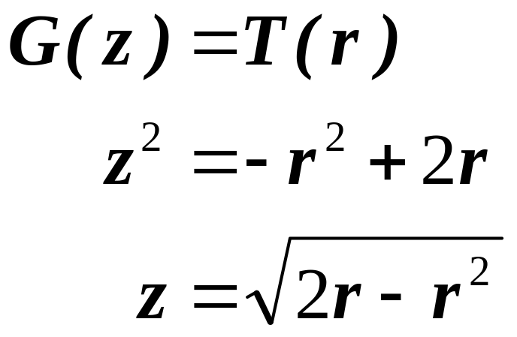
Step 3
Obtain the inversed transformation function G⁻¹
We can guarantee that 0 ≤ z ≤1 when 0 ≤ r ≤1

Slide 26
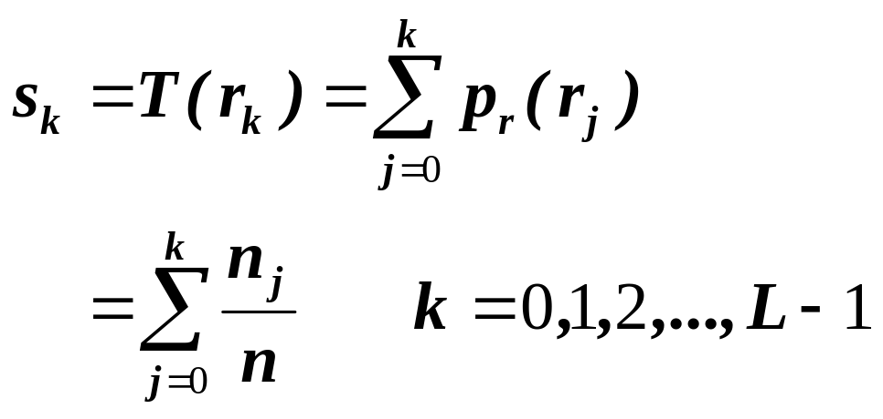
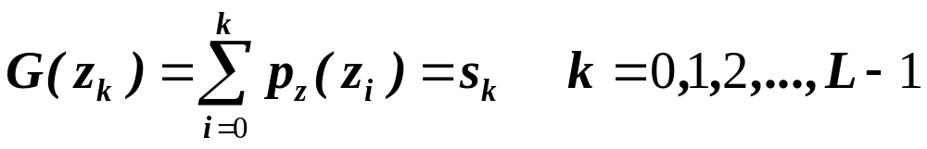
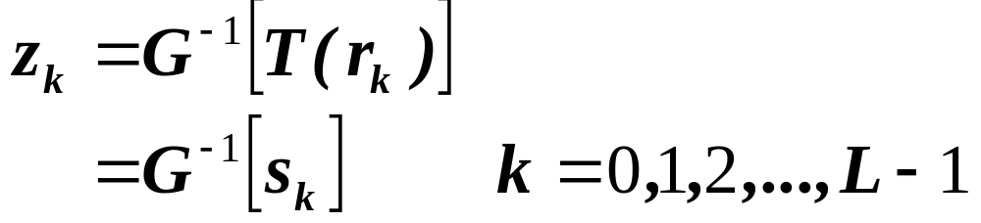
Discrete formulation

Slide 27
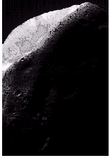
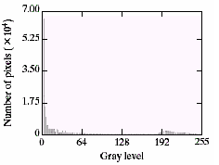
Example (Histogram Specification)
Image is dominated by large, dark areas, resulting in a histogram characterized by a large concentration of pixels in the dark end of the gray scale.
Image of Mars moon (Phobos)

Slide 28
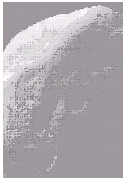
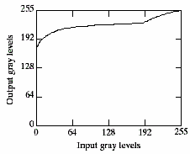
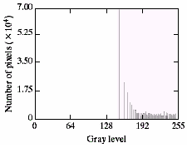
Example Contd…
Result image after histogram equalization
Transformation function for histogram equalization
Histogram of the result image
The histogram equalization doesn’t make the result image look better than the original image. Consider the histogram of the result image, the net effect of this method is to map a very narrow interval of dark pixels into the upper end of the gray scale of the output image. As a consequence, the output image is light and has a washed-out appearance.

Slide 29
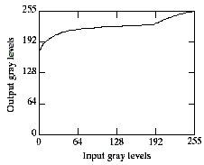
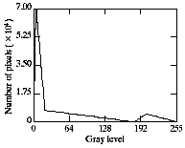
Example Contd…
Solving the problem:
Histogram Equalization
Since the problem with the transformation function of the histogram equalization was caused by a large concentration of pixels in the original image with levels near 0,
a reasonable approach is to modify the histogram of that image so that it does not have this property.
Histogram Specification

Slide 30
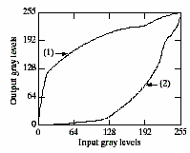
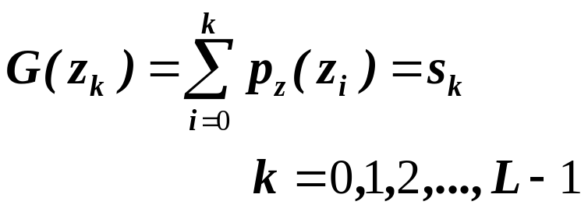
Histogram Specification Example Contd…
(1)→the transformation function G(z) obtained from
(2)→the inverse transformation G⁻¹(s) obtained using an iterative technique.

Slide 31
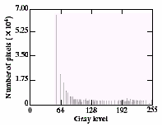
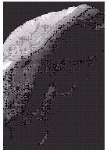
Result image and its histogram
The output image’s histogram
Notice that the output histogram’s low end has shifted right toward the lighter region of the gray scale, as desired.
After applying the histogram specification
Original image

Slide 32
Note regarding Histogram Matching
Histogram specification is a trial-and-error process.
There are no rules for specifying histograms, and one must resort to analysis on a case-by-case basis for any given enhancement task.

