Slide 1
Image Enhancement in the Spatial Domain
Enhancement using Arithmetic/ Logic
Operations
Spatial Filtering

Slide 2
RECAP
Spatial Domain Techniques
Basic Gray Level Transformations
  Linear function
  Logarithm function
  Power-law function
  Piecewise-Linear Transformation Functions
Histogram-based Techniques
Enhancement using Arithmetic/ Logic Operations
Spatial Filtering (smoothing Linear Filters)

Slide 3
Enhancement using Arithmetic/Logic Operations
Arithmetic/Logic operations perform on pixel by pixel basis between two or more images,
except NOT operation which is performed only on a single image.
Logic Operations: AND, OR and NOT
Arithmetic Operations: Addition, Subtraction, Multiplication, Division.

Slide 4
Logic Operations
In Logic operations performed on gray-scale images, the pixel values are processed as string of binary numbers,
light represents a binary 1, and dark represents a binary 0,
NOT operation ≅ negative transformation.

Slide 5
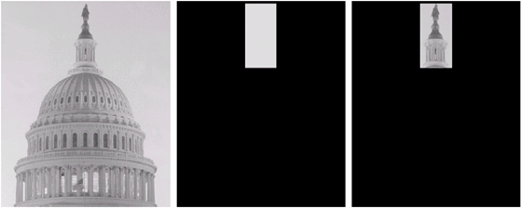
Example of AND Operation
Logical Operations Contd…
original image
AND image
mask
result of AND operation

Slide 6
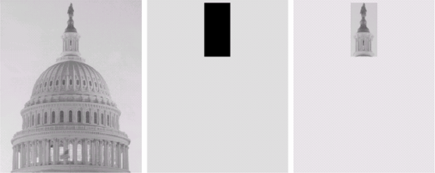
Example of OR Operation
Logical Operations Contd…
original image
OR image
mask
result of AND operation

Slide 7
Image Subtraction
Arithmetic Operations Contd…
The difference between two images f(x,y) & h(x,y):
g(x,y) = f(x,y) – h(x,y)
May be used for enhancement of the differences between images.

Slide 8
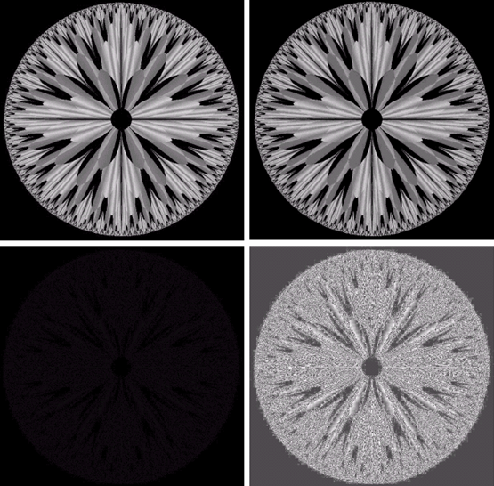
a | b
c | d
Example 1: Image Subtraction
a) original fractal image
b) result of setting the four lower-order bit planes to zero
  refer to the bit-plane slicing
  the higher planes contribute significant visual detail
  the lower planes contribute more to fine detail
  image b) is nearly identical visually to image a), with a very slightly drop in overall contrast due to less variability of the gray-level values in the image.
c) difference between a) and b) (nearly black)
d) result of histogram equalization of c)
(or use power-law transformation)

Slide 9
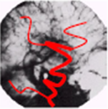
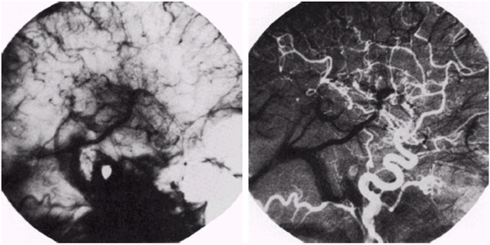
Example 2: Image Subtraction
Change Detection
f(x,y) – h(x,y) = g(x,y)
Arteries appear bright
Mask
Result

Slide 10
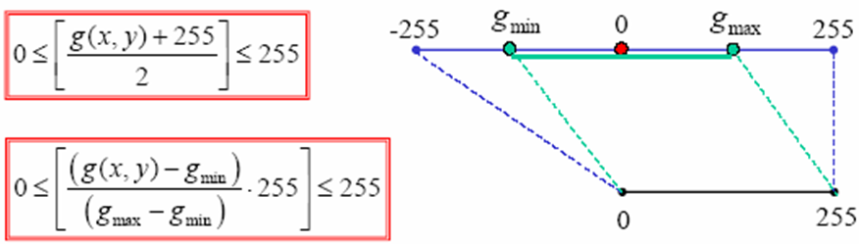
Image Subtraction Contd…
Displaying
  g(x,y) = f(x,y) – h(x,y)
  ⇒ -255 ≤ g(x,y) ≤ 255
0 ≤ f(x,y) ≤ 255
0 ≤ h(x,y) ≤ 255

Slide 11
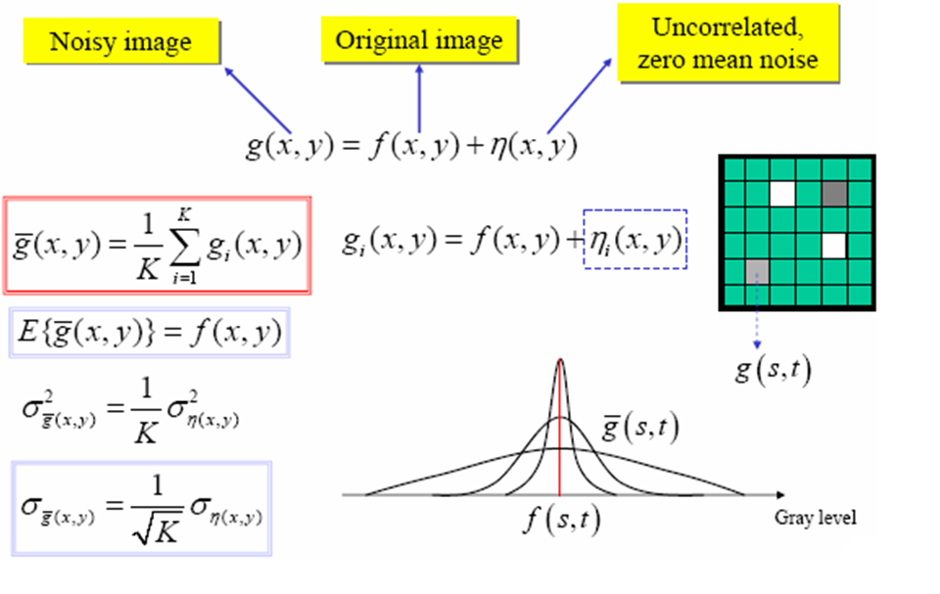
Image Averaging
Note: Here mean and SD of the difference images decrease as K increases.

Slide 12
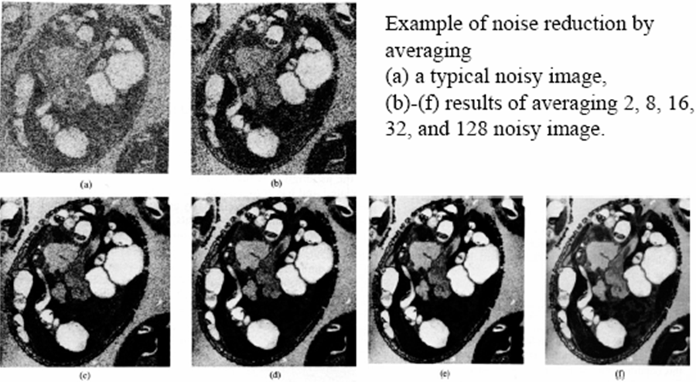
Example: Image Averaging

Slide 13
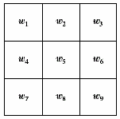
Spatial Filtering
use filter (can also be called as mask/kernel/template or window)
the values in a filter subimage are referred to as coefficients, rather than pixels.
our focus will be on masks of odd sizes, e.g. 3x3, 5x5,…

Slide 14
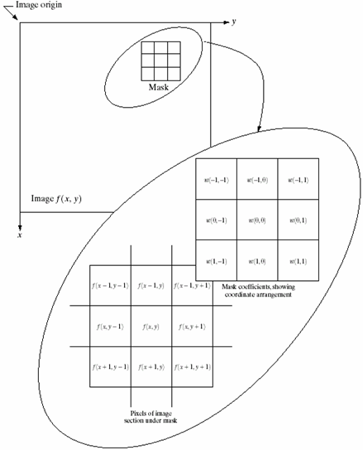
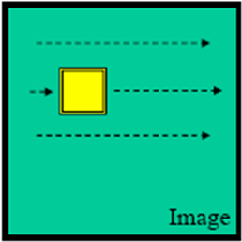
Basis of Spatial Filtering
R = w(-1,-1)f(x-1,y-1) + w(-1,0)f(x-1,y) + …
+ w(0,0)f(x,y) + …+ w(1,0)f(x+1,y) + w(1,1)f(x+1,y+1)

Slide 15
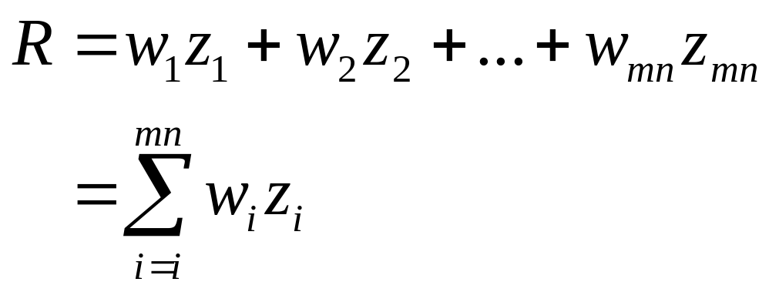
Spatial Filtering Process
Simply move the filter mask from point to point in an image.
At each point (x,y), the response of the filter at that point is calculated using a predefined relationship.

Slide 16
Smoothing Spatial Filters
Used for blurring and for noise reduction
Blurring is used in preprocessing steps, such as
  removal of small details from an image prior to (large) object extraction, and
  bridging of small gaps in lines or curves.
Noise reduction can be accomplished by blurring with a linear filter and also by a nonlinear filter

Slide 17
Smoothing Linear Filters Contd…
Replacing the value of every pixel in an image by the average of the gray levels in the neighborhood will reduce the “sharp” transitions in gray levels.
Sharp transitions are due to
  random noise in the image
  edges of objects in the image
Thus, smoothing can reduce noises (desirable) and blur edges (undesirable).

Slide 18
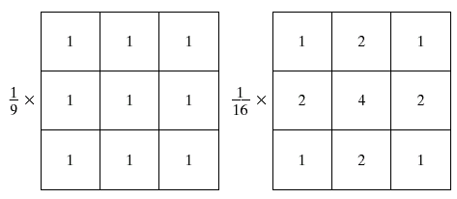
3x3 Smoothing Linear Filters
box filter
weighted average
the center is the most important and other pixels are inversely weighted as a function of their distance from the center of the mask.

Slide 19
Smoothing Linear Filters Contd…
Weighted average filter
The basic strategy behind weighting the center point the highest and then reducing the value of the coefficients as a function of increasing distance from the origin is simply an attempt to reduce blurring in the smoothing process.

Slide 20
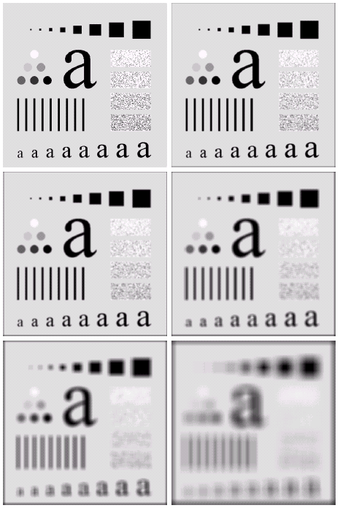
a | b
c | d
e | f
Example: Smoothing Linear Filter
a) original image 500x500 pixel
b) - f) results of smoothing with square averaging filter masks of size n = 3, 5, 9, 15 and 35, respectively.
Note:
  big mask is used to eliminate small objects from an image.
  the size of the mask establishes the relative size of the objects that will be blended with the background.

Slide 21
Order-Statistics Filters
Non-linear filters whose response is based on ordering (ranking) the pixels contained in the image area encompassed by the filter.
Example
  median filter : R = median{z_{k} |k = 1,2,…,n x n}
  max filter : R = max{z_{k} |k = 1,2,…,n x n}
  min filter : R = min{z_{k} |k = 1,2,…,n x n}
Note: n x n is the size of the mask.

Slide 22
Median Filters
Replaces the value of a pixel by the median of the gray levels in the neighborhood of that pixel (the original value of the pixel is included in the computation of the median).
Quite popular because for certain types of random noise (impulse noise  salt and pepper noise) , they provide excellent noise-reduction capabilities, with considering less blurring than linear smoothing filters of similar size.

Slide 23
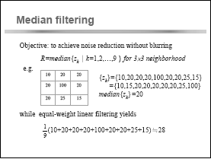

Slide 24

Example : Median Filters

