Slide 1
Image Enhancement in the Spatial Domain
Sharpening Spatial Filters

Slide 2
RECAP
Spatial Domain Techniques
Basic Gray Level Transformations
Histogram-based Techniques
Enhancement using Arithmetic/ Logic Operations
Spatial Filtering (smoothing Linear/Non-Linear Filters)
Sharpening Spatial Filters

Slide 3
Sharpening Spatial Filters
To highlight fine detail in an image,
or to enhance detail that has been blurred, either in error or as a natural effect of a particular method of image acquisition.

Slide 4
Blurring vs. Sharpening
We know that blurring can be done in spatial domain by pixel averaging in a neighborhood.
Since averaging is analogous to integration thus, we can guess that the sharpening could be accomplished by spatial differentiation.

Slide 5
Derivative operator
The strength of the response of a derivative operator is proportional to the degree of discontinuity of the image at the point at which the operator is applied.
Thus, image differentiation
  enhances edges and other discontinuities (noise)
  deemphasizes area with slowly varying gray-level values.

Slide 6
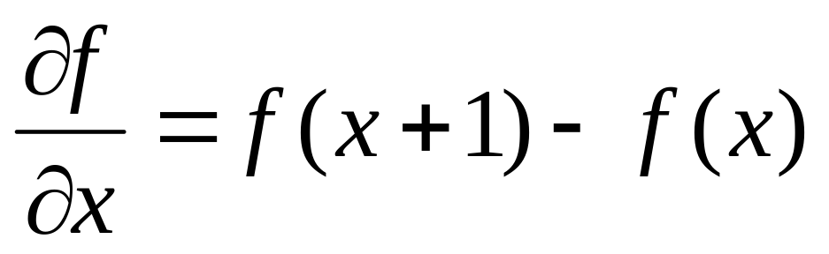
First-order Derivative
A basic definition of the first-order derivative of a one-dimensional function f(x) is the difference

Slide 7
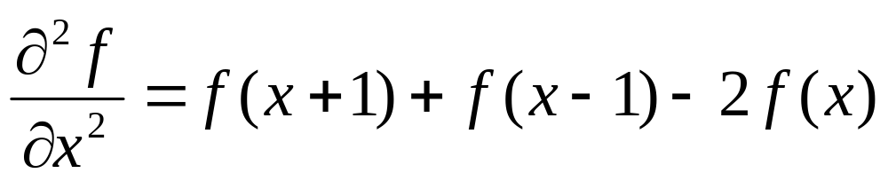
Second-order derivative
Similarly, we define the second-order derivative of a one-dimensional function f(x) as the difference

Slide 8
Response of First- and Second- Order Derivatives
Response of first-order derivative is:
zero in flat segments (area of constant grey values)
Nonzero at the onset of a grey-level step or ramp
Nonzero along ramps of constant slope.
Response of second-order derivative is:
Zero in flat areas
Nonzero at the onset and end of a grey-level step or ramp
Zero along ramps of constant slope.

Slide 9

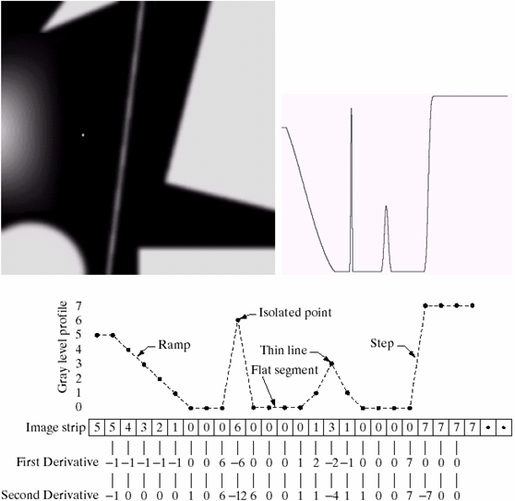
Contd…
(a) a simple image
(b) 1-D horizontal gray-level profile along the centre of the image
(c) Simplified profile

Slide 10
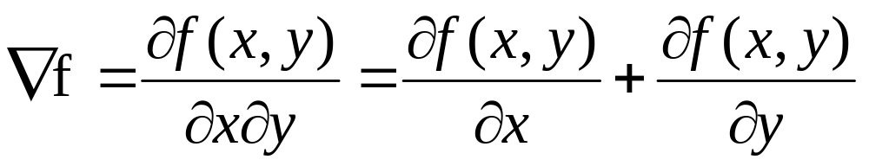
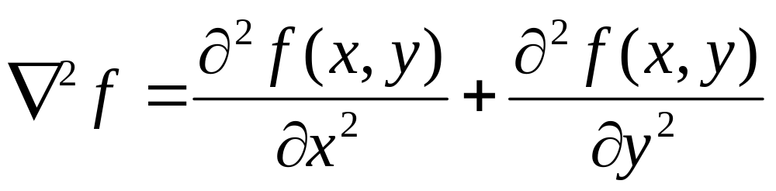
First- and Second-order derivative of f(x,y)
When we consider an image function of two variables, f(x,y), at which time we shall be dealing with partial derivatives along the two spatial axes.
Gradient operator
Laplacian operator
(linear operator)

Slide 11
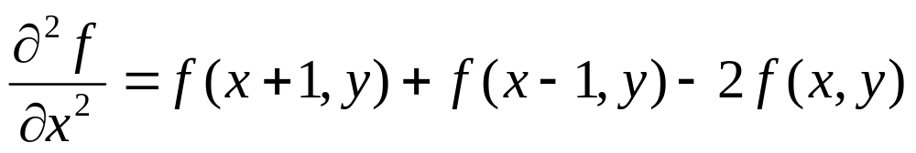
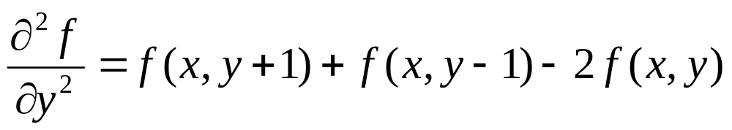
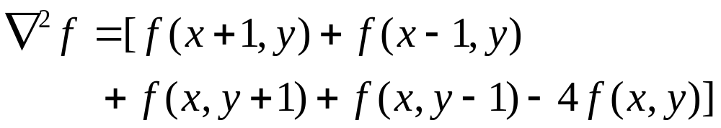
Discrete Form of Laplacian
from
yield,

Slide 12
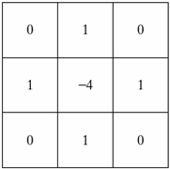
Resulting Laplacian mask
Note: It produces isotropic result for
rotations in increments of 90⁰
Isotropic→ whose response is independent
of the direction of the discontinuities
in the image.

Slide 13
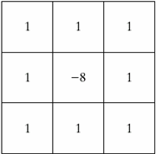
Laplacian mask including the diagonal neighbors
Note: It produces isotropic result for
rotations in increments of 45⁰

Slide 14
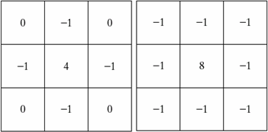
Other implementations of Laplacian masks
Give the same result, but we have to keep in mind the form when combining (add / subtract) a Laplacian-filtered image with the original image.

Slide 15
Effect of Laplacian Operator
As it is a derivative operator,
  it highlights gray-level discontinuities in an image
  it deemphasizes regions with slowly varying gray levels
Tends to produce images that have
  grayish edge lines and other discontinuities, all superimposed on a dark,
  featureless background.

Slide 16
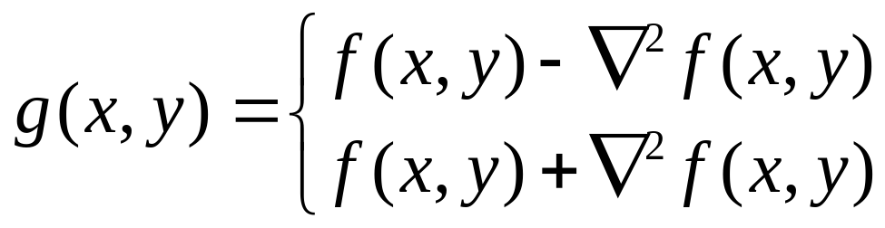
Correct the effect of featureless background
Done easily by adding the original and Laplacian image.
Be careful with the Laplacian filter used.
if the center coefficient of the Laplacian mask is negative.
if the center coefficient of the Laplacian mask is positive.

Slide 17
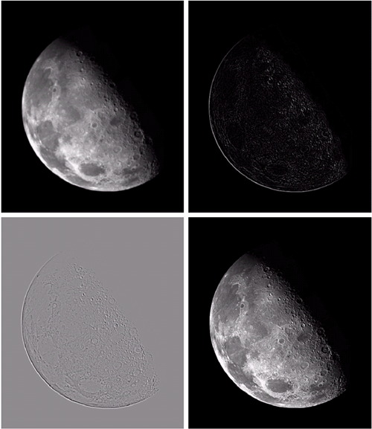
Example (Laplacian Operator)
a) image of the North pole of the moon
b) Laplacian-filtered image with
c) Laplacian image scaled for display purposes
d) image enhanced by subtracting it from original image.
1 | 1 | 1
1 | -8 | 1
1 | 1 | 1

Slide 18

Masks of Combined Operation
0 | -1 | 0
-1 | 5 | -1
0 | -1 | 0
0 | 0 | 0
0 | 1 | 0
0 | 0 | 0
0 | 1 | 0
1 | -4 | 1
0 | 1 | 0
=
-
-1 | -1 | -1
-1 | 9 | -1
-1 | -1 | -1
0 | 0 | 0
0 | 1 | 0
0 | 0 | 0
1 | 1 | 1
1 | -8 | 1
1 | 1 | 1
=
-

Slide 19
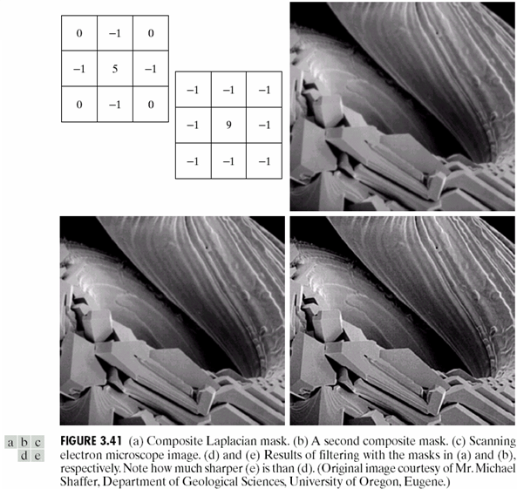
Example

Slide 20
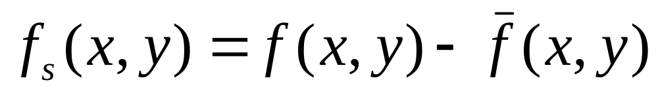
Unsharp masking
sharpened image = original image – blurred image
Subtracting a blurred version of an image produces sharpening output image.

Slide 21
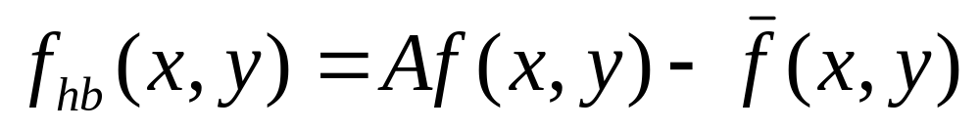
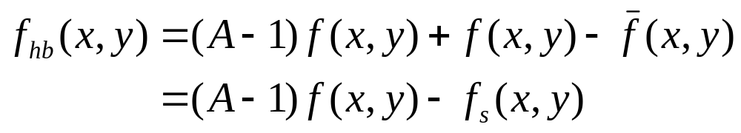
High-boost filtering
generalized form of Unsharp masking
A ≥ 1

Slide 22
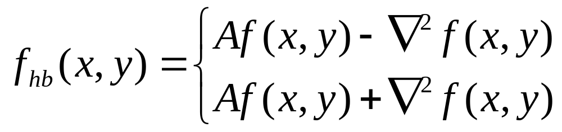
Alternate form of High-boost filtering
if the center coefficient of the Laplacian mask is negative
if the center coefficient of the Laplacian mask is positive

Slide 23
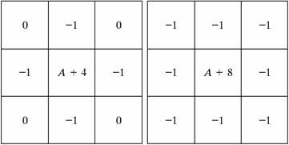
High-boost Masks
A ≥ 1
if A = 1, it becomes “standard” Laplacian sharpening.

Slide 24
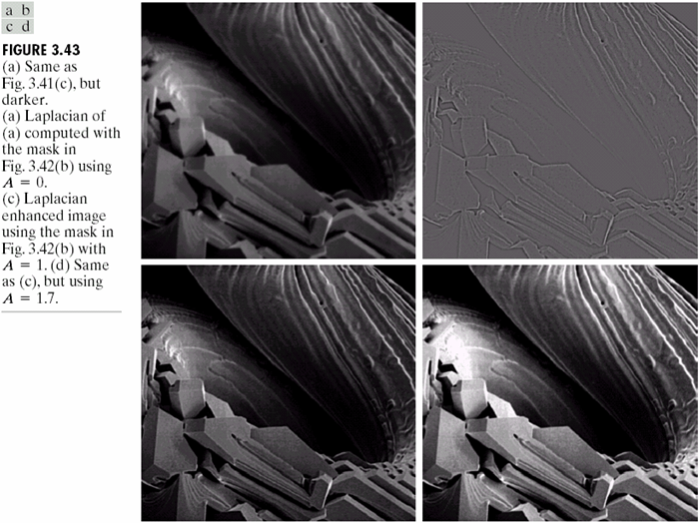
Example

Slide 25
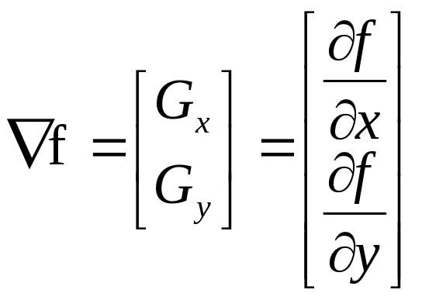
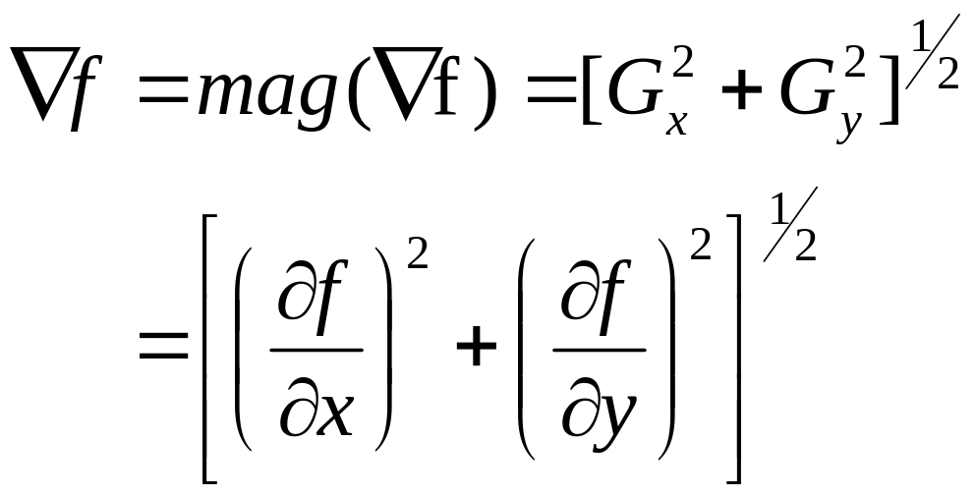
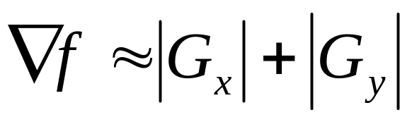
Gradient Operator
gradient of f
first derivatives are implemented using the magnitude of the gradient.
magnitude of gradient vector
commonly approx.
the magnitude becomes nonlinear

Slide 26
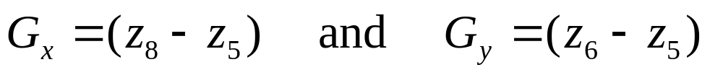
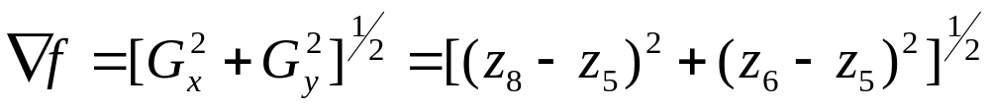
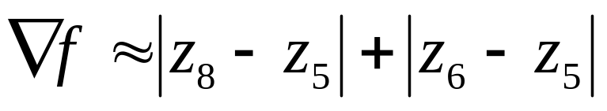
z₁ | z₂ | z₃
z₄ | z₅ | z₆
z₇ | z₈ | z₉
Gradient Mask
Simplest approximation, 2x2
-1 | 0
0 | 1
0 | -1
1 | 0
Cross differences → Roberts gradient

Slide 27
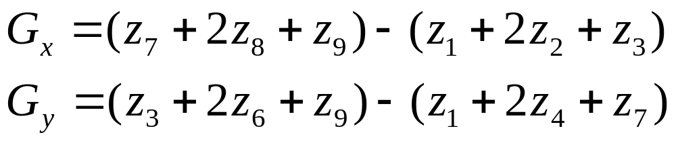

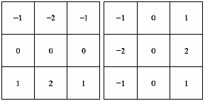
Gradient Mask
z₁ | z₂ | z₃
z₄ | z₅ | z₆
z₇ | z₈ | z₉
Sobel operators, 3x3
the weight value 2 is to achieve smoothing by giving more importance to the center point

Slide 28
Note
The summation of coefficients in all masks equals 0, indicating that they would give a response of 0 in an area of constant gray level.

Slide 29
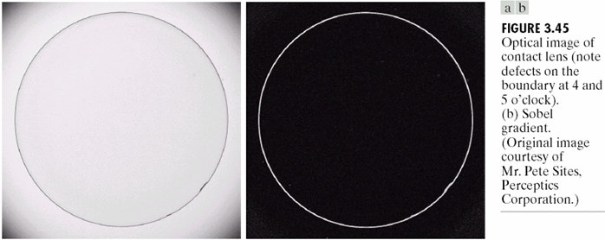
Example

Slide 30
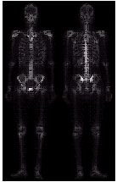
Example of Combining Spatial Enhancement Methods
Want to sharpen the original image and bring out more skeletal detail.
Problems: narrow dynamic range of gray level and high noise content makes the image difficult to enhance.

Slide 31
Example of Combining Spatial Enhancement Methods
Contd…
Steps:
  Laplacian to highlight fine detail
  Gradient to enhance prominent edges
  Gray-level transformation to increase the dynamic range of gray levels

Slide 32
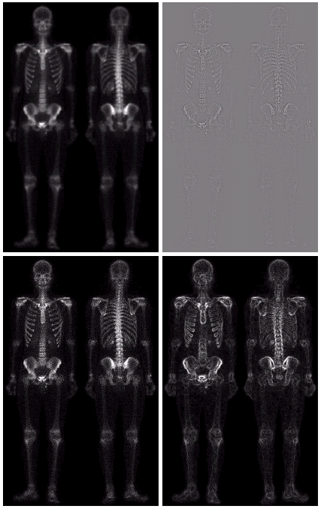
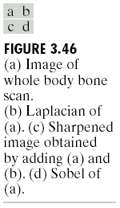

Slide 33
