Slide 1
Multi-valued Image Processing
Color Fundamentals & Models

Slide 2
Introduction
So far we are familiar with grayscale image where a pixel value at any image point can be represented by a single-valued function within a range of 0 to 255 in an 8-bit system.
In the black and white intensity image, the visual stimulus covers the entire bandwidth of the visible spectrum ranging from 0.4 μm to 0.7 μm.

Slide 3
Contd…
The intensity distribution in an image depends on the properties of sensors and measuring devices used in imaging the object where different physical properties of the object contribute differently while generating intensity map of the object.
Such images are usually represented by a multi-valued function that means that more than one measurements are made at the object point.

Slide 4
Categories of Multi-valued images
These can be grouped into following two major areas:
Multi-spectral
  Measurements correspond to different spectral bands of frequencies of EM waves. Color IP is the most common example of Multi-spectral images.
Multi-modal
  Measuring different physical properties of an object using different sensors. For example, CT scan, MRI, Ultrasonography, PET, single photon emission computed tomography (SPECT), etc.

Slide 5
Color Fundamentals
‘Cones’ are the sensors in the eye responsible for color vision.
Out of 6 to 7 millions cones in the human eye, approx. 65% are sensitive to red light, 33% are sensitive to green light, and only about 2% are sensitive to blue (but the blue cones are the most sensitive).
It is experimentally estimated that the human eye can distinguish about 350,000 different colors.

Slide 6
Additive Primary Colors
The visible region is divided into the blue, green and red bands (or colors):
0.4
0.5
0.6
0.7 μm
Blue
Green
Red
Fig: Color Light Sources
These are called additive primary colors because the white light is formed when equal amounts of Blue, Green and Red (RGB) light are added.

Slide 7
Contd…
Digital images are typically displayed as additive color composites using these additive primary colors.

Slide 8
Subtractive Primary Colors
Yellow, Magenta and Cyan are called subtractive primary colors (or secondary colors).
Suitable for film-based printers, which mix colors by superposition of films.
A subtractive primary filter absorbs one-third of the visible spectrum and transmit the remaining two-third.

Slide 9
B
G
R
Fig: Filters for additive primary colors
B
G
R
Yellow
Magenta
Cyan
Fig: Filters for subtractive primary colors
Filter Transmission
Filter Absorption

Slide 10
Color Triangle Showing Relationship of Additive (+) and Subtractive (-) Filters
Red+
Magenta-
Yellow-
White+
Black-
Blue+
Green+
Cyan-

Slide 11
Contd…
Each subtractive primary absorbs the additive primary at the opposite corner and transmits the additive primaries at the adjacent corners.
When any two different subtractive primary filters are superimposed and illuminated with white light, color transmitted will be the additive color located at their common corner on the triangle.
Complementary colors are pairs of colors that produce white light when added together, such as Magenta and Green.

Slide 12
Color Models
A systematic way of representing and describing colors is a color model.
In essence, a color model is a specification of a coordinate system and a subspace within that system where each color is represented by a single point.
Categorization of Color Models
Hardware oriented
User oriented

Slide 13
Categorization of Color Models
Hardware oriented
  RGB (is used in color TV monitor & Camera)
  CMY (is suitable for color printing devices)
  YIQ (widely used in commercial TV broadcasting – for transmission efficiency and for downward compatibility with B/W TV)
User oriented
  IHS Model (is directly related to the intuitive color notion of human being).

Slide 14
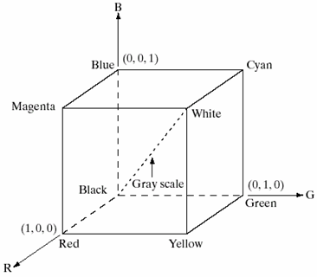
RGB Color Model
The RGB color cube can be used to show the interaction among the RGB components of a typical color display device (e.g. color monitor).
Image represented in the RGB model consists of three component images, one for each primary color.

Slide 15
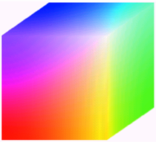
RGB Color Model
Contd…
Every pixel in a composite display (16,777,216 color combinations) may be represented by a 3D coordinate position inside the color cube.
All DNs that lie on the gray line have equal components of RGB.
Pixel depth: 24 bits

Slide 16
The CMY and CMYK Color Models
In image processing, this color model is used in connection with generating hardcopy output.
Most devices that deposit colored pigments on paper, such as color printers and copiers, require CMY data input or perform an RGB to CMY conversion internally.

Slide 17
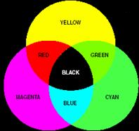
Contd…
  C 1 R
  M = 1 - G
  Y 1 B
(Note: All color values have been normalized to the range [0, 1].
Combining equal amount of pigment primaries produces (a muddy-looking) black.
So publishers use “four-color printing” – CMYK model with fourth color ‘black’.
Mixture of Pigments
(Subtractive primaries)

Slide 18
The IHS Color Model
When humans view a color object, we describe it by its hue, saturation and brightness.
We do not think of color images as being composed of three primary images that combine to form that single image.
Any perceived color is described by a unique set of IHS values; in the RGB system, however, different combinations of additive primaries can produce the same color.

Slide 19
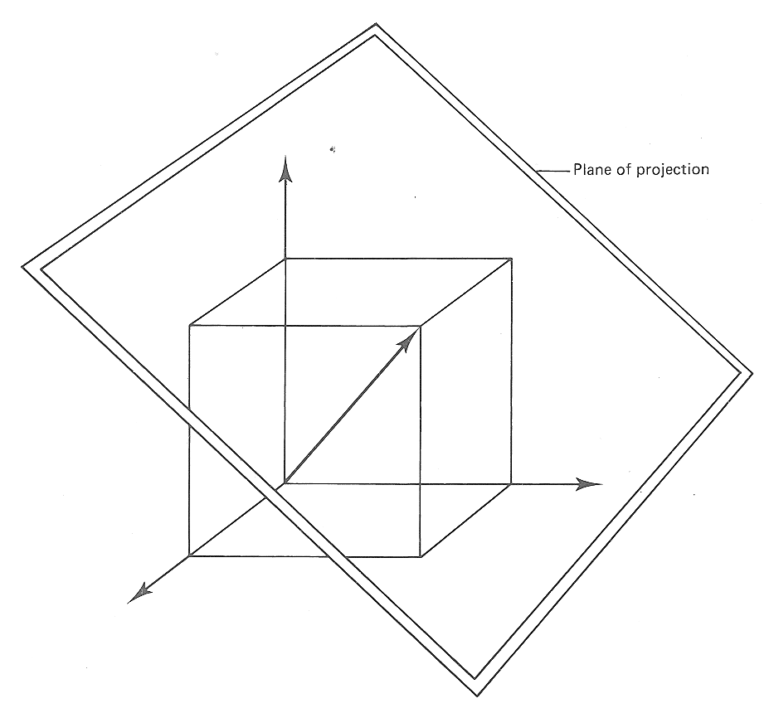
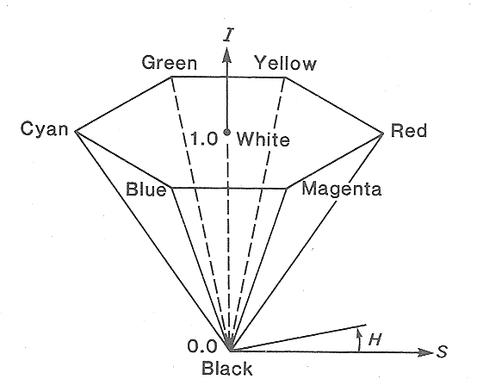
Transforming RGB Components into IHS Components
Project the RGB color cube onto a plane that is perpendicular to the gray line and tangent to the cube at the corner farthest from the origin.
IHS Hexcone

Slide 20
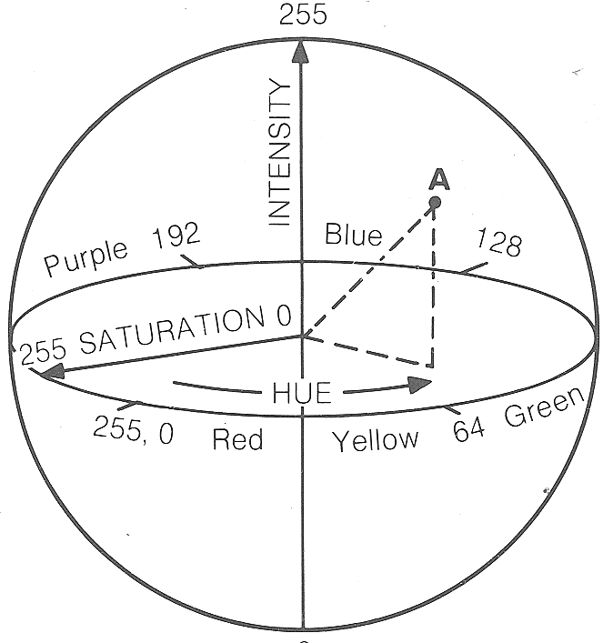
The IHS Color Model
Contd…
Hue represents dominant color as perceived by an observer.
Thus when we call an object red, orange or yellow, we are specifying its hue.
Hue is represented by the angle around the hexagon with red at 0⁰, green at 120⁰ and blue at 240⁰.
Coordinate system for IHS transformation

Slide 21
The IHS Color Model
Contd…
Saturation refers to the relative purity or the amount of white light mixed with hue (varies from 0 to 1 - normalized).
The degree of saturation is inversely proportional to the amount of white light added.

Slide 22
The IHS Color Model
Contd…
The pure spectrum colors are fully saturated whereas colors such as pink (red & white) and lavender (violet & white) are less saturated.
Intensity is the overall brightness of the scene and varies from black (0) to white (1) - normalized.

Slide 23
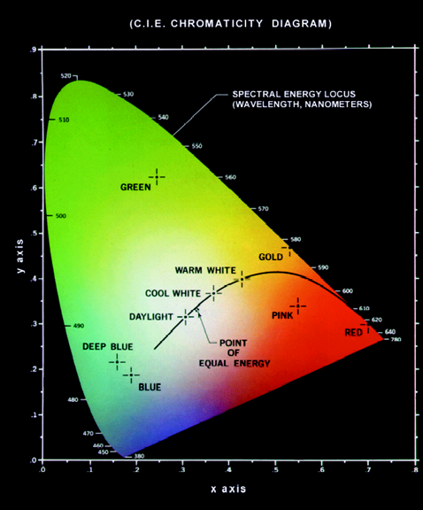
Chromaticity Diagram
Hue and Saturation taken together are called chromaticity, and therefore, a color may be characterized by its brightness and chromaticity.
The chromaticity diagram provides an approach for specifying colors and is useful for color mixing.

Slide 24
Chromaticity Diagram
Contd…
The diagram shows color composition as a function of red (x) and green (y).
For any value of x and y, the corresponding value of blue (z) is obtained by the following equation:
  z = 1 – (x + y)
The point marked green has approx. 62% green and 25% red content (⇒13% blue).

Slide 25
Chromaticity Diagram
Contd…
Any point located on the boundary of the chromaticity chart is fully saturated.
As a point leaves the boundary and approaches the point of equal energy, more white light is added to the color and it becomes less saturated.

Slide 26
IHS Model: Important Observations
All the shades of gray lying on the vertical axis between the black and white points have no hue and also zero saturation.
The IHS model is an ideal tool for developing image processing algorithms based on color descriptions that are natural and intuitive to humans
(whereas RGB is ideal for image color generation – as in image captured by a color camera or image display in a monitor screen.)

Slide 27
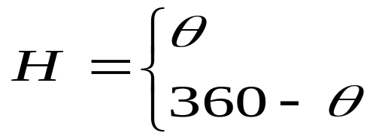

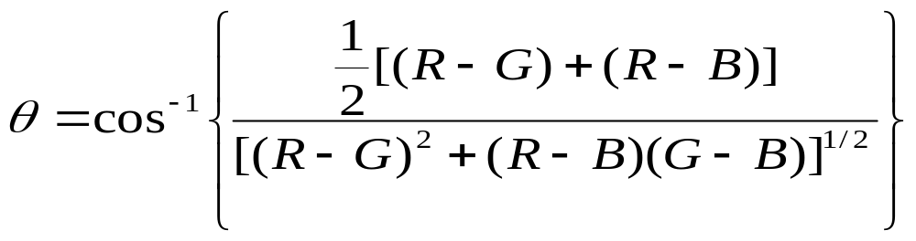
Converting Colors from RGB to IHS
Computing H component of each (normalized) RGB pixel
if
if
with

Slide 28
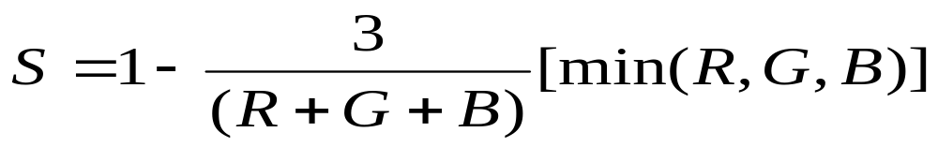
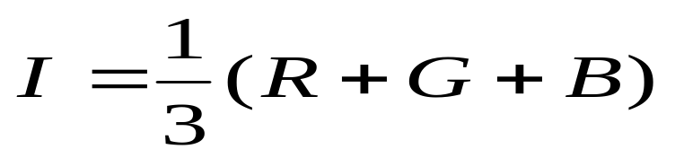
Converting Colors from RGB to IHS
Contd…
The saturation component is given by
The intensity component is given by

Slide 29
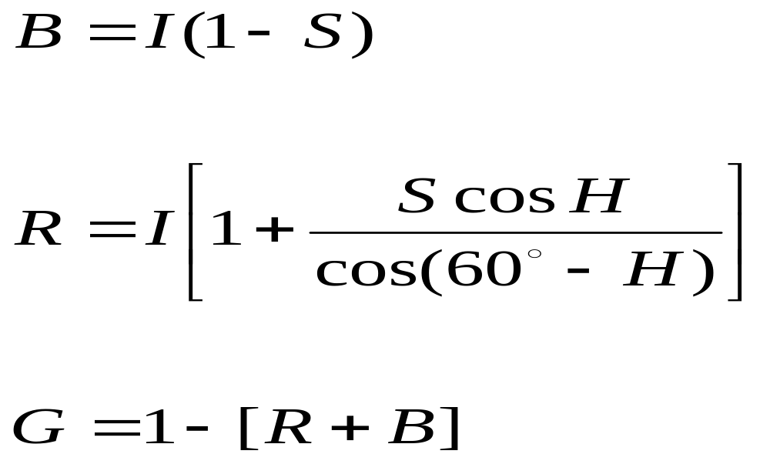
Converting Colors from IHS to RGB
Finding (normalized) RGB values from given values of IHS in the interval [0, 1].
Based on the value of H:
RG sector (0⁰ ≤ H < 120⁰)
and

Slide 30


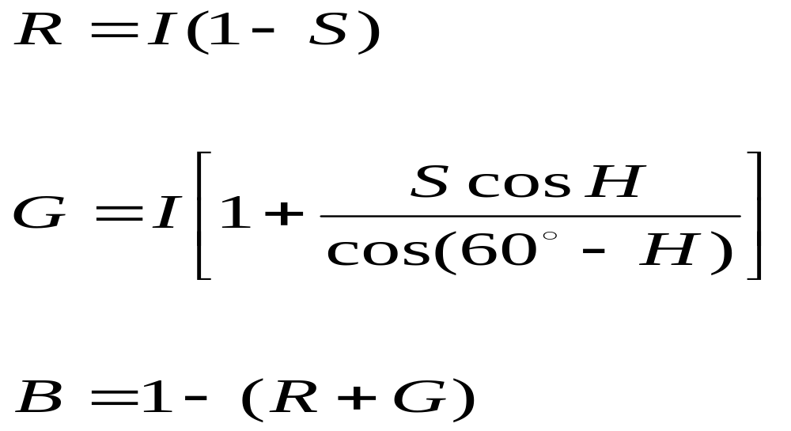
Converting Colors from IHS to RGB
Contd…
GB sector : if the given values of H is in this sector, we first subtract 120° form it:
Then the RGB component are
and

Slide 31



Converting Colors from IHS to RGB
Contd…
BR sector : finally, if H is in this range, we subtract 240⁰ from it:
Then the RGB component are
and

Slide 32
Next…
Spectral Enhancements & Dimensionality Reduction (multi-valued image processing)

