Slide 1
Image and Video Processing
Overview and Introduction

Slide 2
Motivation
AI research: Can we incorporate human capability of processing non-numerical information received from the environment as well as society, of reasoning and decision making, in the machine with equal or more efficiency?
A major portion of information received by a human from environment is VISUAL.

Slide 3
Contd…
Hence, processing visual information by computer has been drawing a very significant attention over the last few decades.

Slide 4
Stages of Image Processing & Analysis
The entire process of Image Processing and Analysis starting from receiving of visual information to the giving out of description of the scene, may be divided into THREE major stages:
  Discretization and Representation
  Processing
  Analysis

Slide 5
1. Discretization and Representation
Converting visual information into a discrete form, suitable for computer processing.
Approximating visual information to save storage space as well as time requirement in subsequent processing.
The input is a scene/visual info, and the output is corresponding digital image.

Slide 6
2. Processing
Improving image quality by filtering etc.,
Compressing data to save storage and channel capacity during transmission,
The output is an improved version of the input image.

Slide 7
3. Analysis
Extracting image features, quantifying shapes, registration and recognition.
Input is still an image but output is a description of the content of that image.

Slide 8
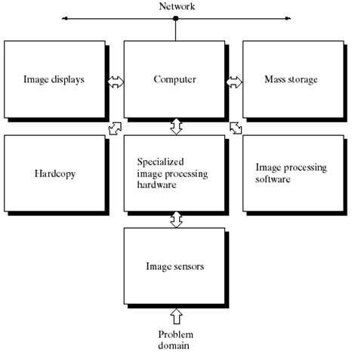
Components of a general-purpose Image Processing System

Slide 9
Relationship between Image Processing & Computer Vision
The ultimate goal of Computer Vision research is to use computers to emulate human vision including –
learning and being able to make inferences and take actions based on visual inputs.
The area of Image Analysis (or image understanding) is in between IP & CV.

Slide 10
Contd…
There are no clear-cut boundaries in the continuum from IP at one end and to CV at the other.
However, one useful paradigm is to consider three types of processes in this continuum:
  Low-level processing
  Mid-level processing
  High-level processing

Slide 11
Low-level Image Processing
Involves primitive operations such as image preprocessing to reduce noise, contrast enhancement, and image sharpening.
In this stage, both inputs and outputs are images.

Slide 12
Mid-level Image Processing
Involves tasks such as segmentation (partitioning an image into regions or objects), description of those objects to reduce them to a form suitable for computer processing, and classification (recognition) of individual objects.
Inputs are images, but its outputs are attributes (e.g. edges, contours etc.) extracted from those images.

Slide 13
High-level Image Processing
“making sense” of an ensemble of recognized objects,
and, at the far end of the continuum, performing the cognitive functions normally associated with VISION.

Slide 14
History of Image Processing: Important Events
1920s
  One of the first application of digital images was in the newspaper industry.
  Images were coded (in 5 gray levels), sent by submarine cable between London and New York and then reconstructed at the receiving end by a specialized printing device.
  Attention was concentrated on improving visual quality of transmitted images.

Slide 15
Contd…
1960s
  The potentials of IP techniques came into focus with the advancement of large-scale digital computers and with the journey to the moon.
  Improving image quality using computers, started at Jet Propulsion Lab, California in 1964, and the images of moon transmitted by Ranger 7 were processed.

Slide 16
Contd…
Late 1960s and 1970s
  In parallel with space applications, DIP techniques began to be used in medical imagery, remote earth resources observations and astronomy.
  The invention in the early 1970s of the Computerized Axial Tomography (CAT) is one of the most important events of IP in medical diagnosis.
(In above examples, most of the IP results were intended for
human interpretation.)

Slide 17
Current Trends
The second major area of application of DIP techniques is in problems dealing with machine perception such as automatic character recognition, industrial machine vision for product assembly and inspection, military recognizance, automatic processing of finger prints, screening of X-rays and blood samples, and machine processing of aerial and satellite images for natural resource management, weather prediction and environment assessment.

Slide 18
Contd…
In this case, interest focuses on procedures for extracting from an image information in a form suitable for computer processing.
Types of info used in machine perception includes statistical movements, Fourier transform coefficients & multi-dimensional distance measures.

Slide 19
References
“Digital Image Processing, 2nd Ed.”, by R.C. Gonzalez and R.E. Woods, Pub: Pearson Education.
“Digital Image Processing (3rd Edition)” – by William K. Pratt, Pub: John Willey & Sons.
“Digital Image Processing & Analysis”, - by B. Chanda & D. Dutta Majumdar, Pub: PHI.

