Slide 1

PASSIVE CAPTCHA FOR WEB BOT DETECTION
CAPSTONE PROJECT
AIDS 2
SMIT PATIL
TANAY KOLI
ARYAN KHATU
SAP: 70562200058
SAP: 70562200062
SAP: 70562200066
SVKM’S NMIMS, STME, NAVI MUMBAI
SVKM’S NMIMS, STME, NAVI MUMBAI
SVKM’S NMIMS, STME, NAVI MUMBAI

Slide 2
OUTLINE OF PRESENTATION
Problem Statement
Supporting Literature
Strategy
Tools
Plan to Execute

Slide 3
PROBLEM STATEMENT
The challenge is to develop a solution that passively collects environmental and behavioral data from a user's browser and uses an AI/ML model on the backend to analyze this data. The solution must be able to accurately identify bots and protect UIDAI's backend APIs from DoS/DDoS vulnerabilities without significant human interaction. The goal is to detect web bots that have a browser-like fingerprint and exhibit human-like behavior, as these are particularly difficult to detect.
Core Idea
The core idea is to replace disruptive CAPTCHAs with a passive, multi-layered solution that distinguishes between human users and bots.

Slide 4
SUPPORTING LITERATURE (thematic)
The Evolving Landscape of Web Bots and the Cybersecurity
The digital realm is increasingly dominated by web bots, which, while serving many benign functions like web indexing, are also extensively exploited for malicious activities such as data theft, fraud, and denial-of-service attacks. This has ignited a persistent "arms race" in cybersecurity, where advancements in bot detection are met with increasingly sophisticated evasion tactics, particularly through the mimicry of human-like behavior and browser fingerprints
AI-Powered Human-Like Behavior Generation
Diffusion Models, such as the DMTG framework, represent an even more advanced approach, generating trajectories with "controllable randomness" that mimic subtle physical properties of human operations, like slow initiation and varying applied force . Evaluations show that these AI-generated behaviors can significantly reduce the performance of bot detection systems and achieve near-human-level pass rates on commercial CAPTCHA systems

Slide 5
SUPPORTING LITERATURE (thematic)
From Static CAPTCHAs to Dynamic Behavioral Biometrics
Historically, CAPTCHA technologies were the primary defense against automated abuse, relying on puzzles to distinguish humans from machines. However, rapid advancements in AI, including Convolutional Neural Networks and Large Language Models, have rendered traditional CAPTCHAs easily bypassable, with AI achieving near-perfect accuracy against even complex text-based challenges.
Persistent Challenges and the Path Forward in Bot Detection
Despite advancements, achieving truly undetectable human-like behavior remains challenging due to the inherent complexity and non-repeatability of human actions. The threat of replay attacks, where recorded human behavior is replayed by bots, also remains. Future defense strategies must be multi-layered, continuously adaptive, and incorporate advanced features like keystroke dynamics, while meticulously balancing security needs with user privacy and ensuring ethical data management .

Slide 6
SUPPORTING LITERATURE (thematic)
Multi-Modal Detection: Combining Web Logs and Behavioral Signals
To counter sophisticated bots, modern detection frameworks integrate multiple data sources, primarily web logs and behavioral biometrics. Web log analysis, while effective against simpler bots, struggles with advanced bots that mimic browser signatures and human-like browsing patterns. This limitation is addressed by incorporating mouse behavioral biometrics, which measures unique patterns in user interaction that are inherently difficult for machines to replicate . Integrated frameworks intelligently fuse scores from both web log and mouse movement modules, prioritizing mouse movement data due to its complexity, significantly enhancing detection accuracy against even advanced bots. Unsupervised learning approaches are also gaining traction to identify intrinsic patterns and user profiles without relying on potentially mislabeled historical data

Slide 7
STRATERGY
Frontend: Passive Data Capture
Environmental & Browser Parameters
The frontend will capture data similar to what is found in web logs, which can include the type of web content accessed and HTTP errors produced.
Behavioral Biometrics (Mouse Movements)
The system will constantly collect mouse movements along with timestamps. The data will be collected as a sequence of points with coordinates and timestamps, sent back to the server on a mouse click or periodically. Mouse movements are considered a very effective method for detecting bots because human mouse movements are difficult to simulate.
Minimal Interactive Data (if needed)
If passive analysis is inconclusive, the system can provide the user with minimal/gamified captcha to differentiate between a bot and a human.
Honeypot Trap
This involves placing hidden elements (such as links or form fields) on a web page that are invisible to human users but accessible to bots. If a user interacts with these hidden elements, they are flagged as a bot.

Slide 8
STRATERGY
Backend: AI/ML Analysis & Fusion
Web Log Module
This module uses features extracted from web logs, such as access frequency, content type, access patterns, and HTTP errors, to train a classifier. We will use an ensemble of classifiers, such as Support Vector Machines and Random Forests, to provide a more robust detection framework.
Mouse Movement Module
This module uses mouse movements to identify whether a visitor is a human or a bot. The mouse movement data is represented as a two-dimensional matrix and used to train a Convolutional Neural Network (CNN) classifier, a method that has proven to be effective.
Fusion of Detection Modules
The framework performs a decision-level fusion of the scores from both modules to make a final determination. The framework prioritizes the mouse movement score when it is very high or very low, as simulating human mouse movements is more difficult than simulating human Browse behavior. This combined approach is more robust than using either method alone.

Slide 9






TOOLS
FRONTEND
JavaScript Framework: React, TypeScript, JavaScript File (embedded to collect data)
BACKEND
Python Framework with libraries such as sckit-learning, torch, keras.
MACHINE LEARNING MODELS
For Weblogs, the frameworks includes Support Vector Machines, Random Forest, Adaboost, and Multi-layer Perceptron classifiers
For Mouse Movements, the module uses a Deep Neural Network architecture with Convolutional Neural Networks (CNNs) to detect web bots based on their mouse trajectories

Slide 10
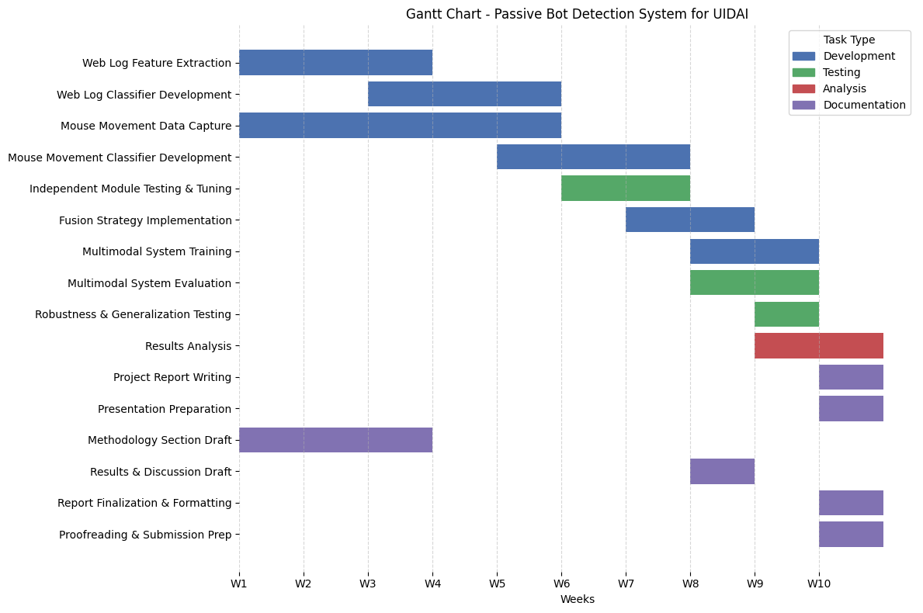
PLANS TO EXECUTE

Slide 11
THANK
YOU

