Slide 1

Analysis of Customer Behaviour in Automobile Insurance Industry
An analytical CRM project
By- Smit Jain
x18135340

Slide 2
About the project
This project aims to find a relationship in the patterns of the customer behavior in response to the marketing campaigns in the automobile industry.
In this project, using the visualization techniques, the behavior pattern of the customers has been analyzed.

Slide 3
Why the visualization technique?
Because it is the most effective way of visualizing trends and patterns in the data sets.
The information can be easily analyzed in the form of charts and meaningful decisions can be made.
Recent acquisition of Tableau by Salesforce is also a sign that CRM and visualization go hand in hand.

Slide 4
What does CRM do?
records customer contact information
automatically pull in other information
organizes this information to give a complete record of individuals and companies
improves customer relationship management by creating a 360° view of the customer

Slide 5

Why is CRM important in Automobile Insurance Industry?
enables a business to deepen its relationships with customers
keeping track of prospects and customers for customer acquisition and retention
You can see everything in one place
For forward-thinking businesses, CRM is the framework for that strategy.

Slide 6

The visualizations

Slide 7
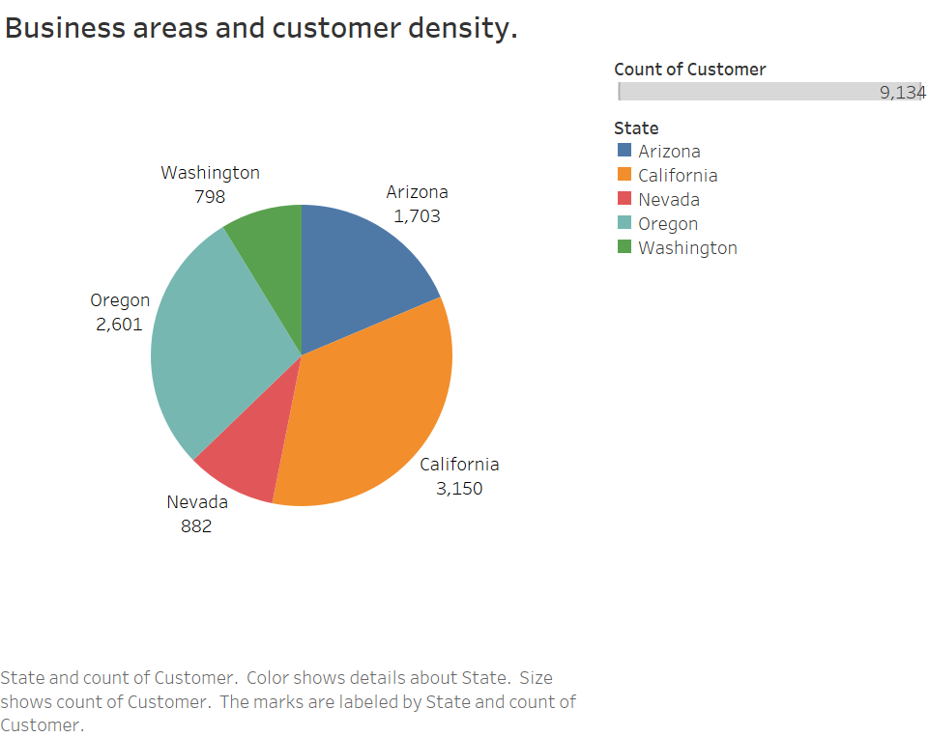
This visualization tells us:
Which area is having maximum number of its customer.
Based on this marketing campaign decisions can be made.
Here, it is evident that the maximum number of customers are from California.

Slide 8
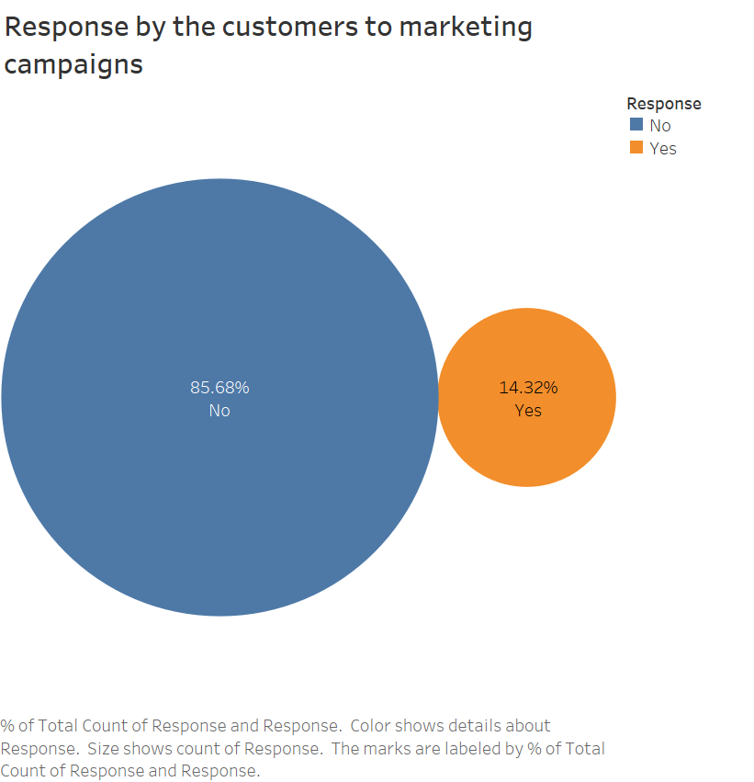
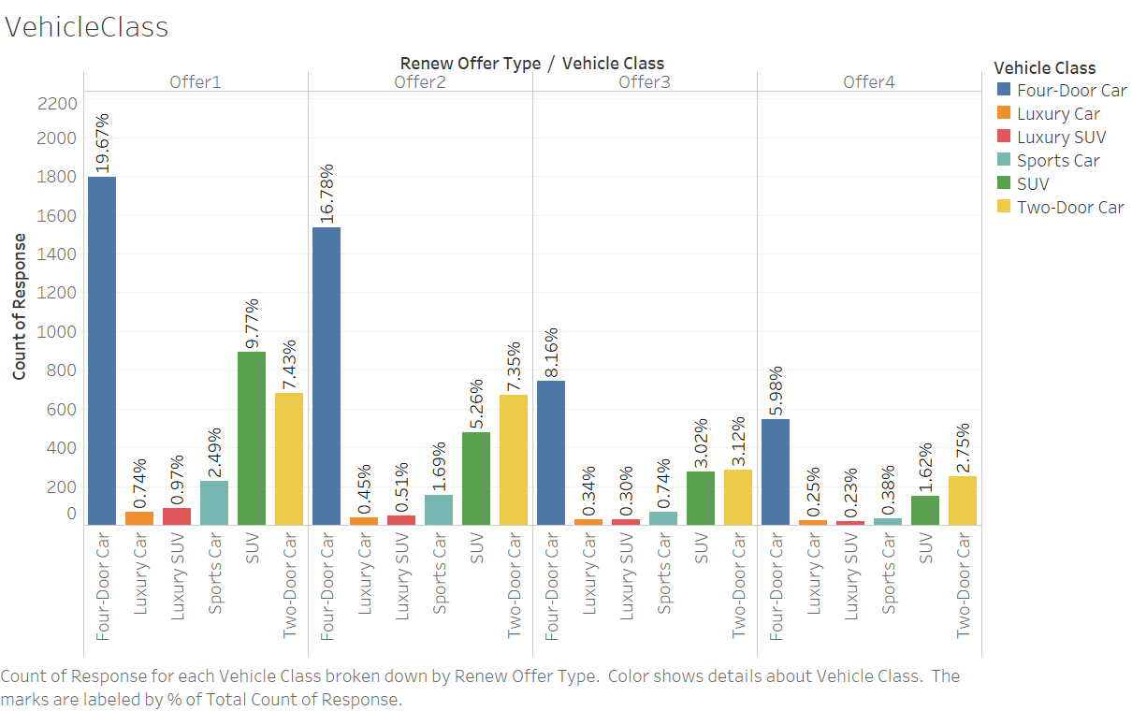
Notes:
It is evitable that the customers with four door vehicles were more responsive as compared to others. If the difference in the response by the customers is significant, the business can amend and make changes in the offers to suit the customers.

Slide 9
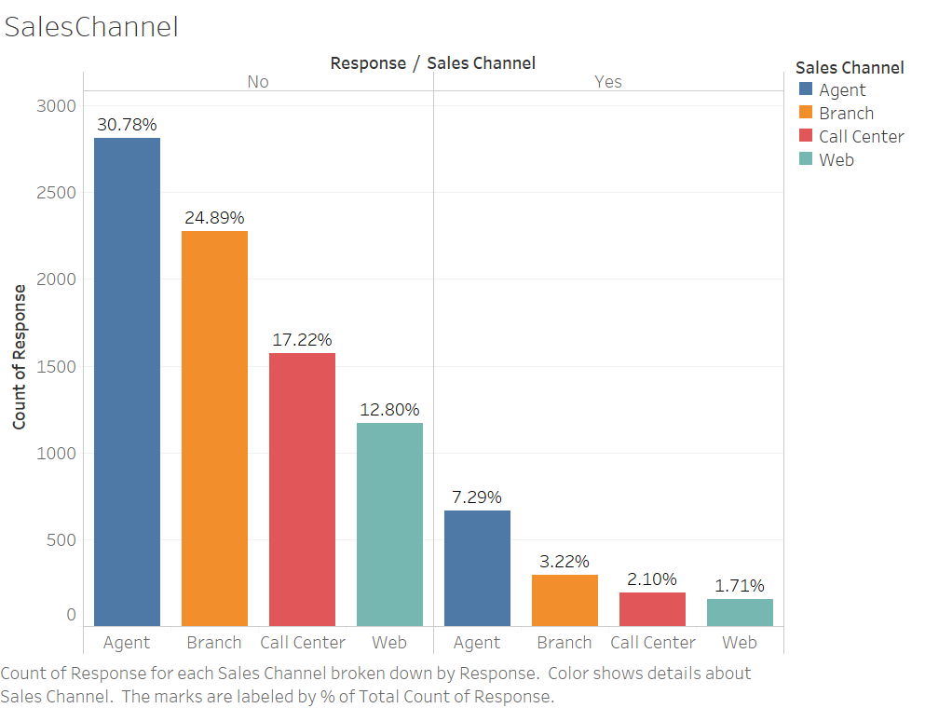
Notes:
visualization talks about the channel using which the customer is communicated with. It shows that the most number of responses are from the agents. This will give the company a brief idea about where to channelize the strength and also to train the staff for a better result.

Slide 10
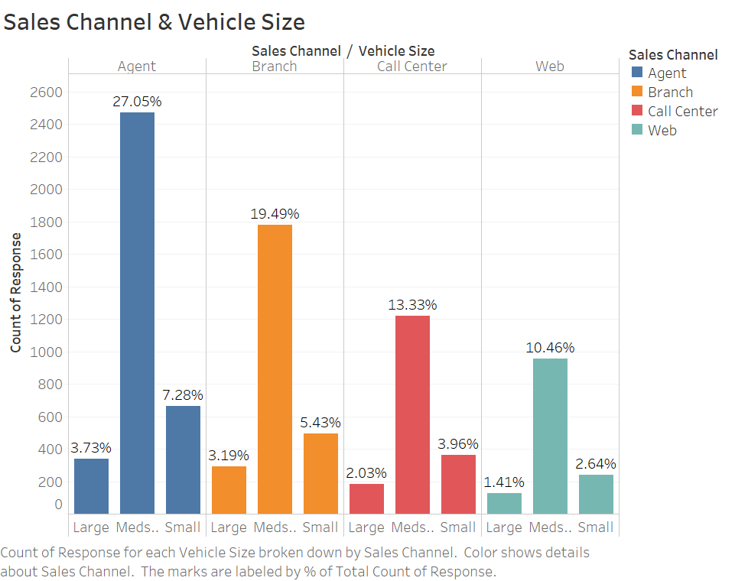
Notes:
The visualization below shows that the customers who are having medium sized vehicles have responded the best as compared to others. The agents have got the maximum responses in comparison to all other sales channel and of those responses, maximum are from the medium size vehicle owners.

Slide 11
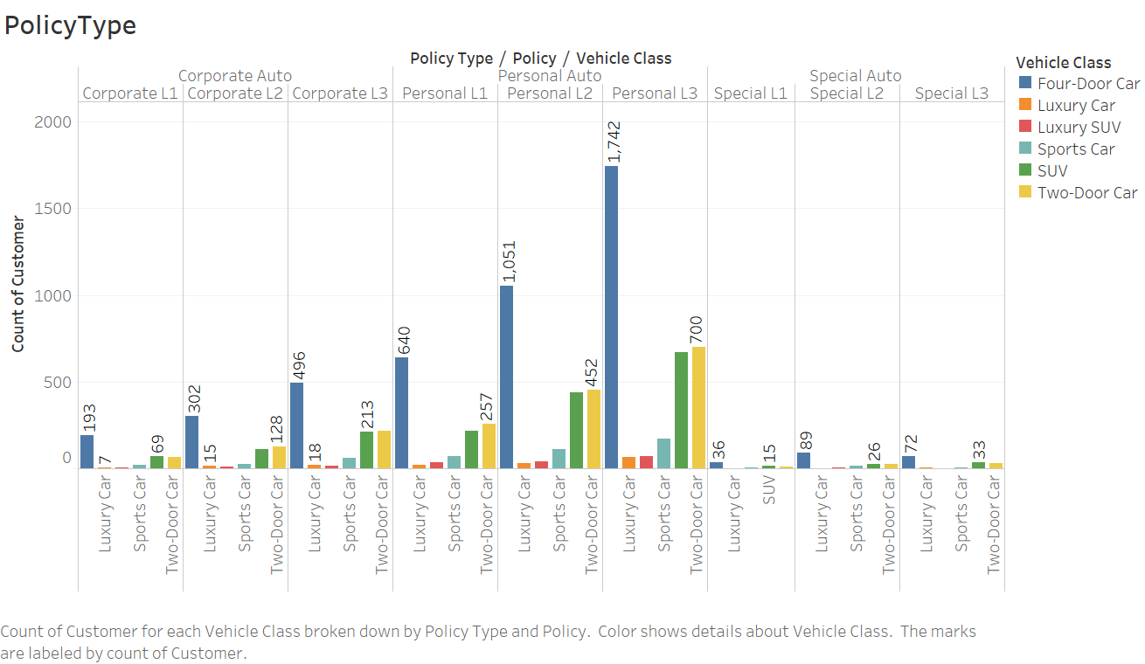
Notes:
Another interesting fact that can be captured from the visualization below is that the maximum number of people who responded are having four door car are having personal auto policy type and the specific policy is Personal L3.

Slide 12

Conclusion
To conclude, after carefully analyzing the visualizations made from the customers response, the response of the customers is different based on the type of policy and the class of the car.
Using the visualization techniques the business can shape their policies better and make the marketing campaigns aligned with the business goals. In this way, the organizations can make better offers and make better relationships with the customers.

Slide 13

Thank you

