Slide 1
Fixly
Convenience at Your Doorstep
A web-based service marketplace connecting customers with skilled professionals for household and commercial needs. Designed for simplicity, efficiency, and trust.
Group 13 | IT644: Web Services & SOA
Team Members
202412031 - Kachhadiya Smit - Team Lead & Project Manager
202412036 - Kathrotiya Harsh - BackEnd Developer & Product Owner
202412052 - Navadiya Krishn - Backend Developer
202412030 - Kachhadiya Princy - FrontEnd Developer
202412043 - Lakkad Vishva - UI/UX Designer & Business Analyst
202412044 - Limbachiya Parth - QA Tester & Solution Architecture
202412104 - Shekhda Miraj - FrontEnd Developer
202412010 - Asodariya Gaurav - QA Tester & Technical Writer

Slide 2

Verification, Validation & System Robustness
Fixly Platform: Testing Strategy, Coverage & Quality Assurance

Slide 3





Test Coverage
Home
Services
Login/Signup
Main landing page and initial user experience.
Browsing, selection, and details of available services.
Secure user authentication and registration processes.
User/Provider Dashboards
Admin Panel
Personalized interfaces for users
and service providers.
Backend management and operational control.

Slide 4
Comprehensive Testing Strategy & Coverage
1
2
Unit Testing
Testing Code
111 suites with 573 individual tests passed, focusing on isolated code components.
Backend
Frontend
3
4
System Testing
UI/UX Testing
End-to-end testing of complete modules and features, mimicking user scenarios.
Functional UI, cross-browser compatibility, responsiveness, and aesthetic reviews.
Our multi-faceted approach guarantees all critical aspects of the Fixly platform are thoroughly examined for quality.

Slide 5
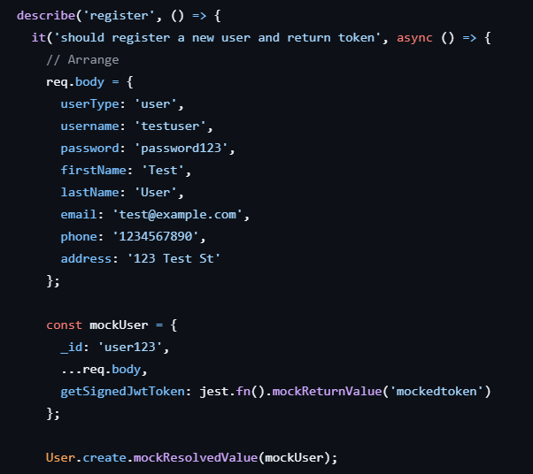
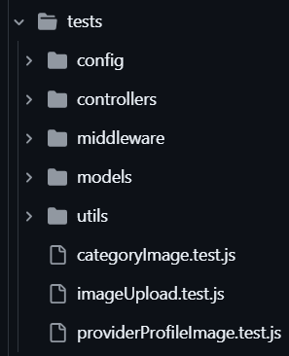
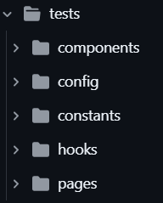
Mock Data and Tree Structure
1
2
Mock Data Example
Testing Tree Structure

Slide 6


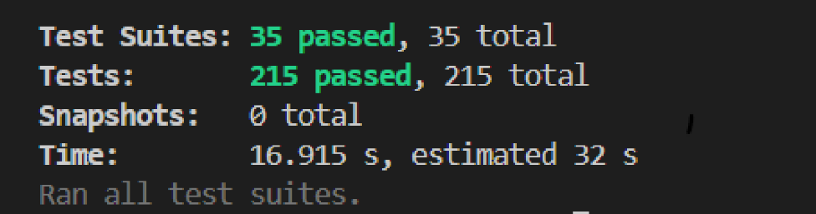
System Robustness: The Foundation of Reliability
Test Strength
A total of 215 backend unit and integration tests and 358 Frontend unit tests have been successfully passed, demonstrating the core stability and reliability of the Fixly platform's server-side logic and database interactions.
Frontend Testing Result
Backend Testing Result

Slide 7

Outstanding Test Results: Functional, Cross-Browser & Responsiveness
19/ 19
4/ 4
10/ 10
Functional Tests Passed
Cross-Browser Compatibility
Responsiveness Score
All core functionalities, including login, booking, profile management, and admin tasks, are validated and working flawlessly.
Fixly performs consistently across Chrome, Edge, Firefox, and Safari, ensuring a broad reach for all users. Only minor visual differences observed.
Tested across 6 different screen sizes, the platform adapts perfectly to mobile, tablet, and desktop views, providing an optimal experience regardless of device.

Slide 8
Comprehensive Testing Artifacts
Our rigorous testing process has generated a suite of detailed documentation:
Strategic Documentation
Detailed Reports
Supporting Files
Test Plan (Strategy & Coverage)
Functional UI Report
UI Review Checklist
UI/UX Improvement Log
Cross-Browser Report
Backend Jest Test Summary
Responsiveness Report
Sample Test Data
These artifacts serve as a transparent record of our quality assurance efforts.

Slide 9
Fixly Platform: Ready for Launch!
All Major Categories Passed
100% Functional Success
No High-Severity Issues
Every aspect of the platform has been thoroughly tested and approved.
Core features are fully operational, delivering on user expectations.
The platform is stable and free from critical bugs.
Robust & Adaptive
Optimized for Future
Consistent performance across browsers, devices, and modules.
Ready for deployment and continuous enhancement.

Slide 10
Github:
https://github.com/smitkachhadiya/Fixly.git
Thank You

