Slide 1
Fixly
Convenience at Your Doorstep
A web-based service marketplace connecting customers with skilled professionals for household and commercial needs. Designed for simplicity, efficiency, and trust.
Group 13 | IT644: Web Services & SOA
Team Members
202412031 - Kachhadiya Smit - Team Lead & Project Manager
202412036 - Kathrotiya Harsh - BackEnd Developer & Product Owner
202412052 - Navadiya Krishn - Backend Developer
202412030 - Kachhadiya Princy - FrontEnd Developer
202412043 - Lakkad Vishva - UI/UX Designer & Business Analyst
202412044 - Limbachiya Parth - QA Tester & Solution Architecture
202412104 - Shekhda Miraj - FrontEnd Developer
202412010 - Asodariya Gaurav - QA Tester & Technical Writer

Slide 2

Fixly: Deployment & User Experience Readiness
A demonstration of the Fixly functional prototype, highlighting operational readiness and a polished user experience.

Slide 3





What This Section Covers: Our Objectives
Live Platform Demo
Deployment Workflow
UI/UX Showcase
Experience the Fixly platform in a live, deployed environment.
Understand our CI/CD, Docker, and hosting infrastructure.
Explore customer, provider, and admin portals' intuitive design.
Performance & Security
User-Centric Readiness
Review the measures ensuring a fast and secure platform.
Confirm Fixly's readiness for real-world user engagement.

Slide 4
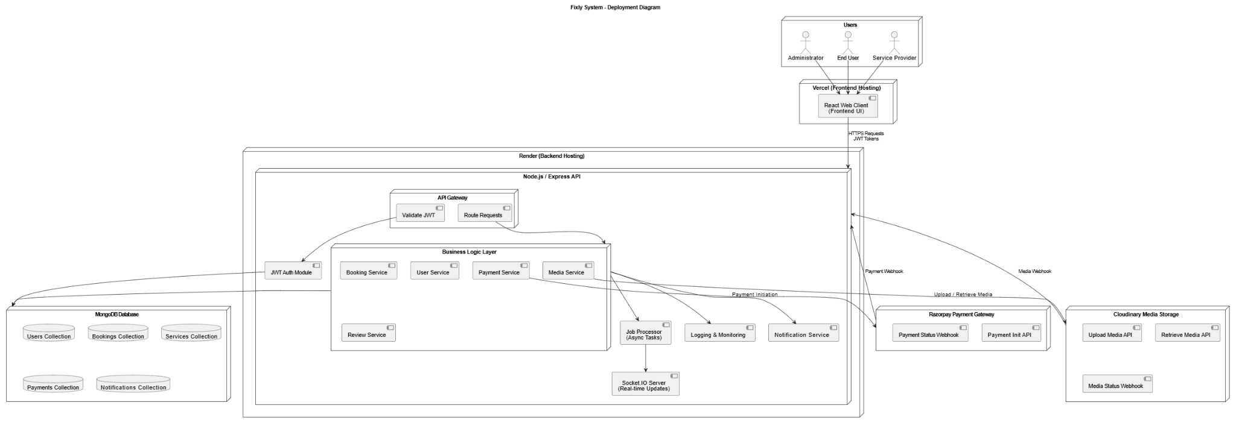
Deployment Diagram

Slide 5
Robust Deployment Environment
Core Technology Stack
Containerization
Backend: Node.js (Express), MongoDB (Mongoose), Cloudinary for media management.
Containerized backend services using Docker for isolated environments.
Frontend: React , Tailwind CSS.
Docker Compose for streamlined multi-service orchestration.
Authentication: JWT-based secure authentication for all user roles.
Hosting & CI/CD Pipeline
Seamless integration from GitHub to automated build and cloud deployment (Vercel/Render).
Dynamic environment variable configuration for flexibility.
CORS & API Gateway setup ensuring secure and efficient communication.

Slide 6
Deployment Process: Step-by-Step
01
02
Build & Configuration
CI/CD Pipeline Automation
Dependency installation, environment variable setup (DB URI, JWT secret, Cloudinary keys), and optimized production build via Vite.
Automated testing, lint checks, and continuous deployment triggered by Git pushes, ensuring zero-downtime releases.
03
04
API + Frontend Deployment
Database Setup
Backend deployment with HTTPS-enabled endpoints and frontend as an optimized static build, securely connected via environment configurations.
MongoDB Atlas cluster for scalable data storage, with collections automatically generated through Mongoose models.

Slide 7
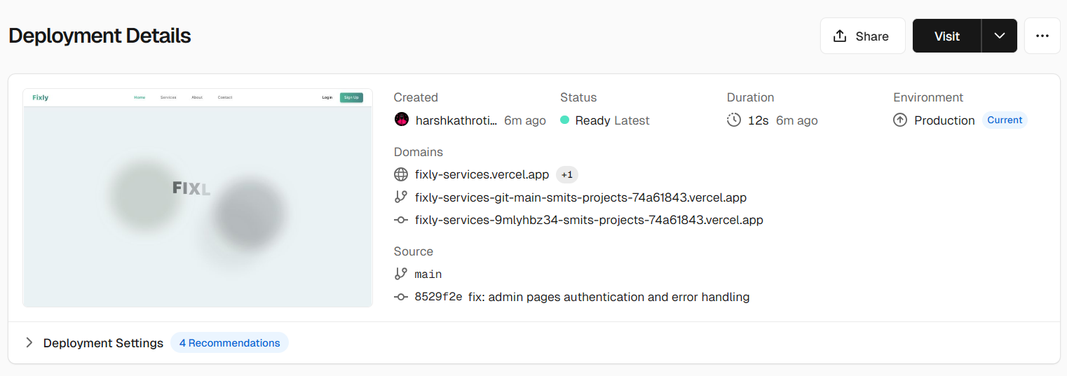
Deployment Images : Vercel
Link : https://fixly-services.vercel.app/

Slide 8
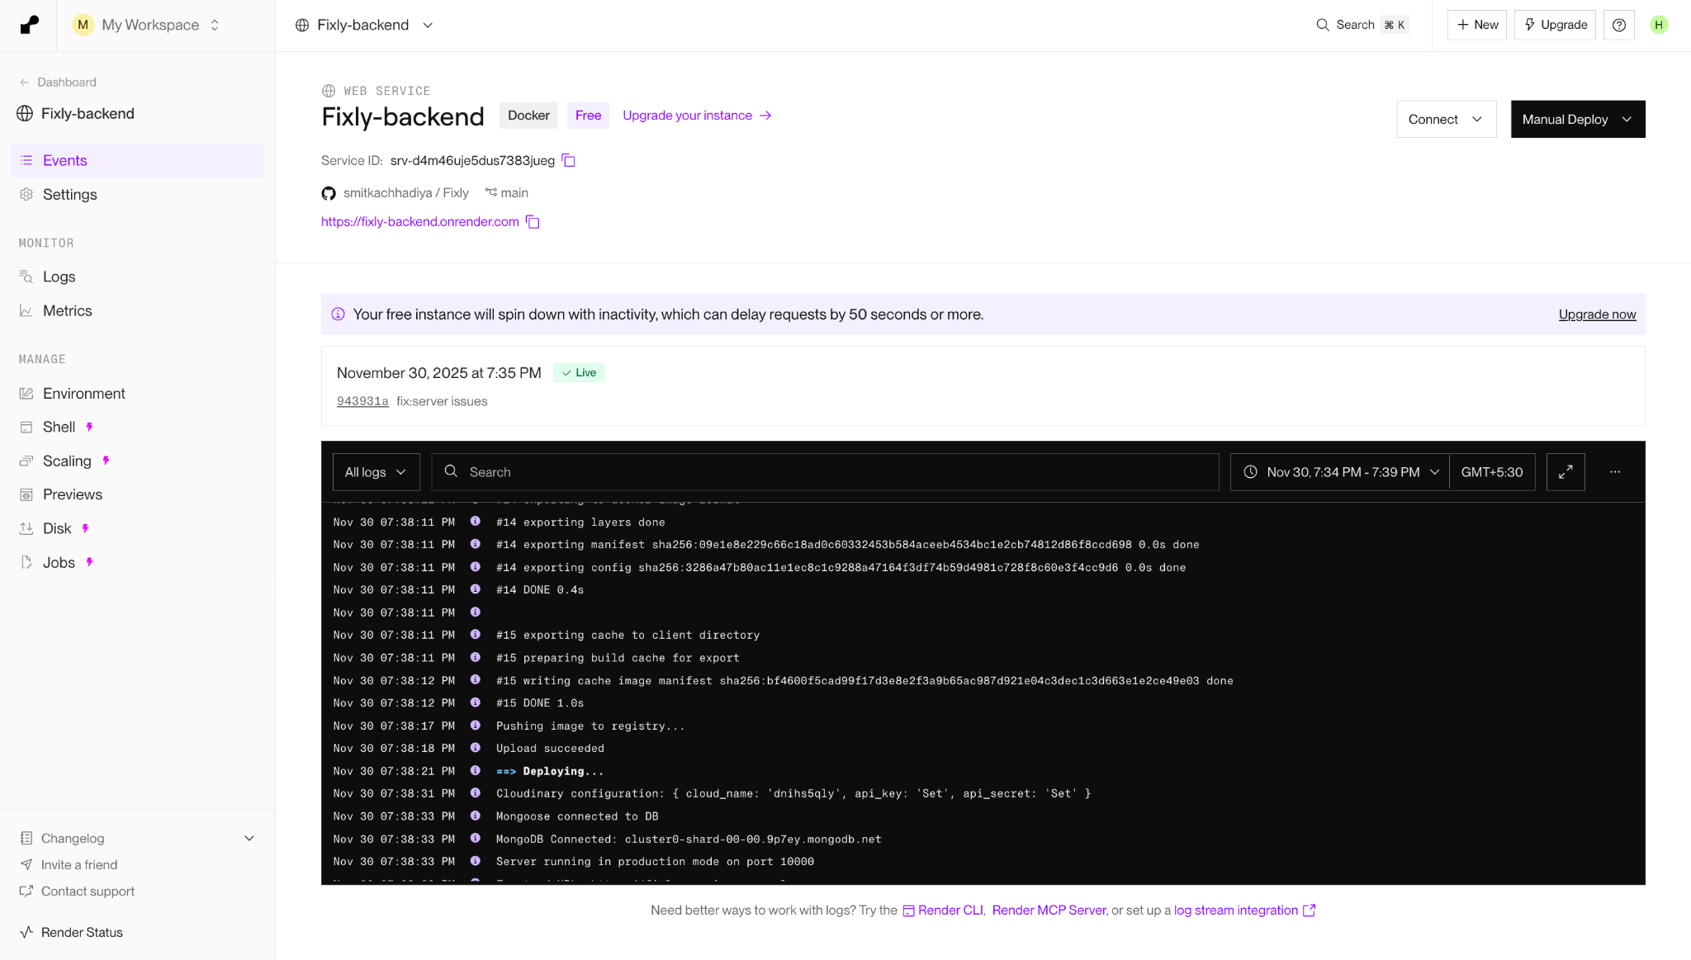
Deployment Images : Render

Slide 9



Intuitive UI/UX: A Seamless Experience
Customer Portal
Service Provider Portal
Admin Interface
A clean homepage for browsing categories and searching services, featuring a smooth booking flow with real-time availability and intuitive payment options.
Effortless listing creation with image uploads via Cloudinary, coupled with a comprehensive booking management dashboard and clear overviews of profiles and earnings.
Minimalist and efficient dashboards for approvals, insightful analytics, and robust user management, ensuring streamlined operations.

Slide 10

Optimized for Peak Performance
<3
<500
Page Load Time (Seconds)
API Response Time (ms)
Ensuring rapid access and a smooth user journey.
Fast data retrieval for dynamic content updates.
Our commitment to speed extends to every element:
Optimized Images: Efficiently served via Cloudinary.
Lazy Loading: For heavy UI sections, improving initial load times.
Efficient Database Queries: With strategic indexing for quick data access.
Scalable Backend: Engineered to handle increasing load and user traffic seamlessly.

Slide 11

Fortified Security Measures
Authentication & Access
JWT-based secure login and session management.
Role-based access control (Customer, Provider, Admin) to ensure data integrity.
Data & Network Protection
HTTPS enforced across all communications.
Rigorous input validation & sanitization.
Rate limiting on sensitive endpoints to prevent abuse.
Secure image handling with signed URLs and Cloudinary access rules.
Proactive defense against common vulnerabilities:
Robust error monitoring and logging for quick issue resolution.
Automated session expiration and token invalidation.

Slide 12

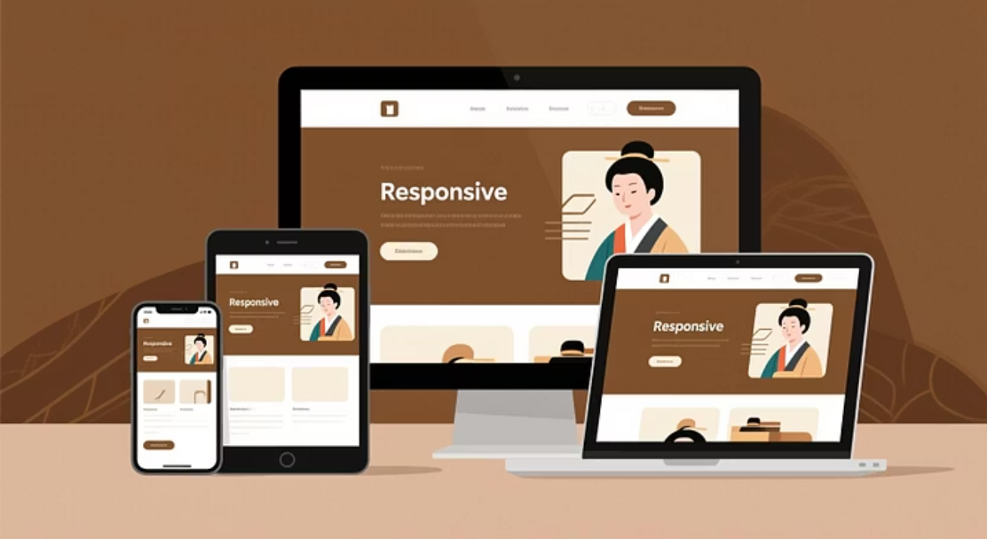

Exceptional User Experience Strengths
Fixly is designed with the user at its core, offering an intuitive and highly responsive experience across all touchpoints.
Intuitive Navigation: Consistent and easy-to-understand pathways.
Clear Feedback: Instant visual and textual cues (toast messages, loaders).
Responsive Design: Seamless experience on desktops, tablets, and mobile devices.
Accessibility Focused: Optimal contrast, readable fonts, and ARIA tags for inclusivity.
Smooth Animations: Engaging transitions that enhance usability without hindering performance.

Slide 13
Key Artifacts Provided
To ensure a comprehensive understanding and facilitate future collaboration, we are providing the following essential documentation:
1
2
Deployment Guide
User Manual
Detailed steps for environment setup, configuration, and successful deployment.
Comprehensive instructions for Customer, Provider, and Admin portals, covering all functionalities.
3
4
Demo Slides
Live Link
This presentation deck, summarizing our progress and key features.
Access to the deployed prototype for hands-on experience and evaluation.

Slide 14





Conclusion & Next Steps: Fixly is Ready!
Stable Deployment
Our robust infrastructure ensures reliable performance.
Mature UI/UX
Intuitive design for all user types is complete.
Secure Environment
Comprehensive measures protect data and users.
Performance Optimized
Fast and responsive, even under load.

