Slide 1
Fixly
Convenience at Your Doorstep
A web-based service marketplace connecting customers with skilled professionals for household and commercial needs. Designed for simplicity, efficiency, and trust.
Group 13 | IT644: Web Services & SOA
Team Members
202412031 - Kachhadiya Smit - Team Lead & Project Manager
202412036 - Kathrotiya Harsh - BackEnd Developer & Product Owner
202412052 - Navadiya Krishn - Backend Developer
202412030 - Kachhadiya Princy - FrontEnd Developer
202412043 - Lakkad Vishva - UI/UX Designer & Business Analyst
202412044 - Limbachiya Parth - QA Tester & Solution Architecture
202412104 - Shekhda Miraj - FrontEnd Developer
202412010 - Asodariya Gaurav - Technical Writer

Slide 2
Repository Overview: A Client-Server Architecture
The Fixly repository is meticulously organized to support a robust client-server architecture. This structure ensures clear separation of concerns, facilitating independent development and deployment of frontend and backend components. Comprehensive documentation and planning materials are integrated directly into the repository, providing a single source of truth for all project-related information.
Client-Server Model
Integrated Documentation
Modular Design
Dedicated directories for frontend and backend codebases.
All project documents, from proposals to code docs, are version-controlled.
Enables scalable development and easier maintenance.

Slide 3
Fixly Codebase Structure
Repository Overview
The Fixly repository uses a client-server architecture, supported by extensive documentation and planning materials.
1
2
Documentation
Product Details
Includes UI/UX, project proposals, requirements, system design, timelines, and testing.
Covers acceptance criteria, product backlog, roadmap, sprint planning, and user stories.
3
4
Client
Server
Frontend application with components, pages, services, and state management.
Backend API with controllers, models, routes, and middleware.

Slide 4
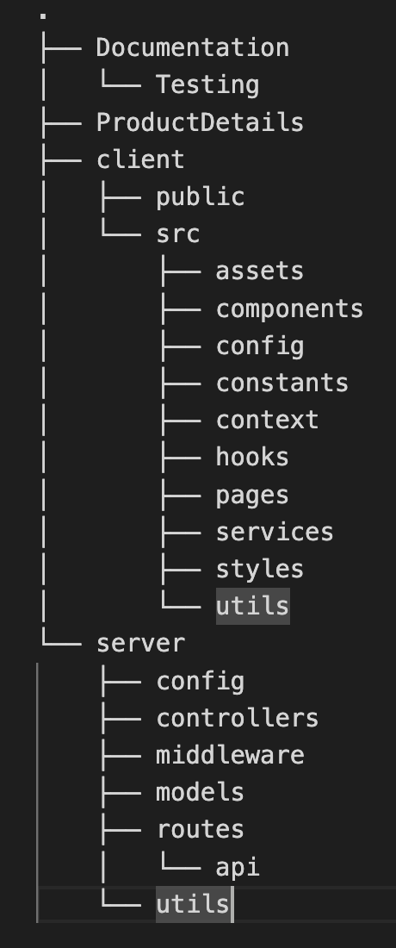
Fixly Directory Structure: The Blueprint
The `Fixly/` root directory is systematically divided to ensure logical grouping of all project artifacts. This detailed structure allows developers to quickly locate relevant files, understand the project's scope, and contribute effectively.
Documentation/: All project planning, design, and progress reports.
ProductDetails/: Documents related to product management, including roadmaps and sprint planning.
README.md: Project overview and setup instructions.
client/: The entire frontend React application.
server/: The backend Node.js application and its components.

Slide 5
Backend Architecture: Server-Side Components
The `server/` directory embodies a well-defined controller-based architecture, promoting modularity and maintainability. Each core entity within the Fixly platform has its dedicated components, ensuring clear responsibilities and easy navigation for backend developers.
Controllers: Business Logic Orchestrators
Models: Database Schemas
adminController.js: Admin functionality
AdminEarnings.js: Admin revenue tracking
authController.js: User authentication & authorization
Booking.js: Records for service bookings
bookingController.js: Booking management
Commission.js: Commission rate settings
paymentController.js: Payment processing
Payment.js: Detailed payment transaction records
reviewController.js: Review and rating system
Review.js: User-submitted service reviews
userController.js: Comprehensive user management
User.js: Core user account definitions
Routes: API Endpoints
Middleware: Reusable Functionality
Configuration: Environment Settings
Structured API routes for efficient request handling (e.g., api/admin.js, api/auth.js).
Custom middleware like auth.js for authentication and errorHandler.js for global error handling.
Dedicated files for external service integrations like cloudinary.js and database connections db.js.

Slide 6
Frontend Architecture: Client-Side Experience
The `client/` directory hosts the React application, structured for maintainability and a seamless user experience. This organization promotes reusable components, clear state management, and efficient communication with the backend services.
Components
Services
Utilities & Configuration
Reusable UI elements (e.g., Authentication, Booking, Profile Management).
API communication layer (e.g., Authentication services, Payment services).
Helper functions and frontend-specific configurations.
Pages
Context
Styling
Top-level views (e.g., Home, Login, Service Browsing, Admin Dashboard).
React Context for global state management (e.g., Authentication context, User context).
Centralized styling definitions using Tailwind CSS for a consistent look and feel.
This client-side structure ensures that the user interface is modular, scalable, and easy to develop, integrating modern React practices for optimal performance.

Slide 7
Fixly Key Modules: Authentication & User Management
The authentication and user management system is the bedrock of the Fixly platform, ensuring secure access and personalized experiences for all users. It supports distinct roles: customers, service providers, and administrators, each with specific permissions.
1
2
Role-Based Access Control (RBAC)
Secure Authentication Flow
Distinguishes permissions for Customers, Service Providers, and Admins based on their assigned roles in the User.js model.
Utilizes authController.js for registration, login, logout, and password resets, with bcrypt for password hashing and JWT for token-based authentication, secured with HttpOnly cookies.
3
4
Protected Routes
Comprehensive User Features
auth.js middleware safeguards API endpoints, verifying JWT tokens and ensuring users have the necessary authorization before access is granted.
Includes email/password validation, secure password hashing, JWT token generation, and robust password reset functionality with email verification.

Slide 8
Service Lifecycle: Listings, Bookings & Payments
The core functionality of Fixly revolves around service offerings, customer bookings, and secure payment processing. These modules are intricately linked, providing a comprehensive marketplace experience.
1
2
3
Service Listings
Dynamic Bookings
Secure Payments
Providers create and manage detailed service listings (ServiceListing.js) with descriptions, pricing, category association, availability, and images via Cloudinary integration.
Customers schedule appointments using the bookingController.js with real-time availability checks, status tracking (Pending, Confirmed, Cancelled), and automatic conflict prevention.
The paymentController.js handles secure transactions, integrating with a payment gateway, performing automatic commission calculations (10-15%), and tracking payment statuses.
This integrated flow ensures that from service offering to booking completion and payment, all aspects are managed efficiently and securely.

Slide 9
Trust & Transparency: Reviews & Admin Dashboard
Building trust and ensuring platform integrity are paramount for Fixly. The review system provides valuable feedback, while the robust Admin Dashboard empowers administrators to manage and monitor the entire ecosystem effectively.
Review & Rating System
Admin Dashboard
The reviewController.js and Review.js model enable customers to submit post-service ratings (1-5 stars) and textual reviews. This feedback loop is crucial for:
The adminController.js and related models (AdminEarnings.js, Commission.js) power a comprehensive dashboard, offering administrators control over:
Building credibility for service providers.
User account activation/deactivation and management.
Allowing average rating calculation for providers and listings.
Approval and rejection of new service listings.
Providing review moderation capabilities for quality control.
Configuration of commission rates and platform settings.
Publicly displaying reviews to inform future customers.
Financial reporting, dispute resolution, and platform analytics.
Together, these systems foster a transparent environment for users and provide administrators with the tools needed for efficient platform governance.

Slide 10




Cloudinary Integration: Advanced Image Management
Fixly leverages Cloudinary for all image storage and processing needs, ensuring optimal performance, scalability, and security for visual content across the platform. This integration streamlines image handling from upload to display.
Automated Uploads
Optimized Transformations
Seamless image upload for service listings, profiles, and categories with specific configurations (cloudinary.js).
Automatic resizing (e.g., 500x500px for services), cropping, and format conversion for various use cases, reducing load times.
Organized Storage
Validation & Security
Images are categorized into dedicated Cloudinary folders (`services/`, `categories/`, `profiles/`) for better management.
Strict file validation (JPG, JPEG, PNG, size limits) and secure deletion ensure data integrity and platform security.
This robust image management system ensures that all visual assets are delivered efficiently and maintain high quality, enhancing the overall user experience.

Slide 11
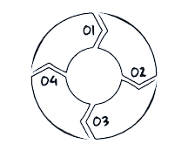
Collaborative Version Control Workflow: GitFlow Model
Fixly adheres to a structured GitFlow branching strategy to ensure organized, collaborative development, efficient code reviews, and reliable releases. This systematic approach minimizes conflicts and maintains code quality throughout the project lifecycle.
Feature Development
Code Review & Merge
Developers create feature/* branches from develop, implement functionality, and submit Pull Requests for review.
All PRs undergo rigorous code review, automated CI checks, and merge into the develop branch upon approval.
Hotfix Management
Production Deployment
Urgent fixes for production issues are handled via hotfix/* branches, branched from main, and merged back to main and develop.
Once a release is stable, it's merged into both main (production) and develop, then tagged for version control.
This workflow, combined with strict commit message guidelines and continuous integration, fosters a highly efficient and quality-driven development environment.

Slide 12
THANK YOU

