Slide 1
Fixly
Convenience at Your Doorstep
A web-based service marketplace connecting customers with skilled professionals for household and commercial needs. Designed for simplicity, efficiency, and trust.
Group 13 | IT644: Web Services & SOA
Team Members
202412031 - Kachhadiya Smit - Team Lead & Project Manager
202412036 - Kathrotiya Harsh - BackEnd Developer & Product Owner
202412052 - Navadiya Krishn - Backend Developer
202412030 - Kachhadiya Princy - FrontEnd Developer
202412043 - Lakkad Vishva - UI/UX Designer & Business Analyst
202412044 - Limbachiya Parth - QA Tester & Solution Architecture
202412104 - Shekhda Miraj - FrontEnd Developer
202412010 - Asodariya Gaurav - Technical Writer

Slide 2

About Fixly
Fixly is more than just a service provider platform; it's a bridge connecting customers with skilled professionals for various household and commercial needs. Its intuitive interface simplifies the process of discovering, booking, and managing services. With seamless appointment scheduling and integrated communication features, Fixly aims to make professional services accessible, trustworthy, and hassle-free for everyone.
As a web-based platform, Fixly acts as a virtual marketplace, offering key features such as comprehensive service listings, secure transaction processing, real-time communication tools, service analytics, robust customer feedback mechanisms, and an engaging rewards program.

Slide 3
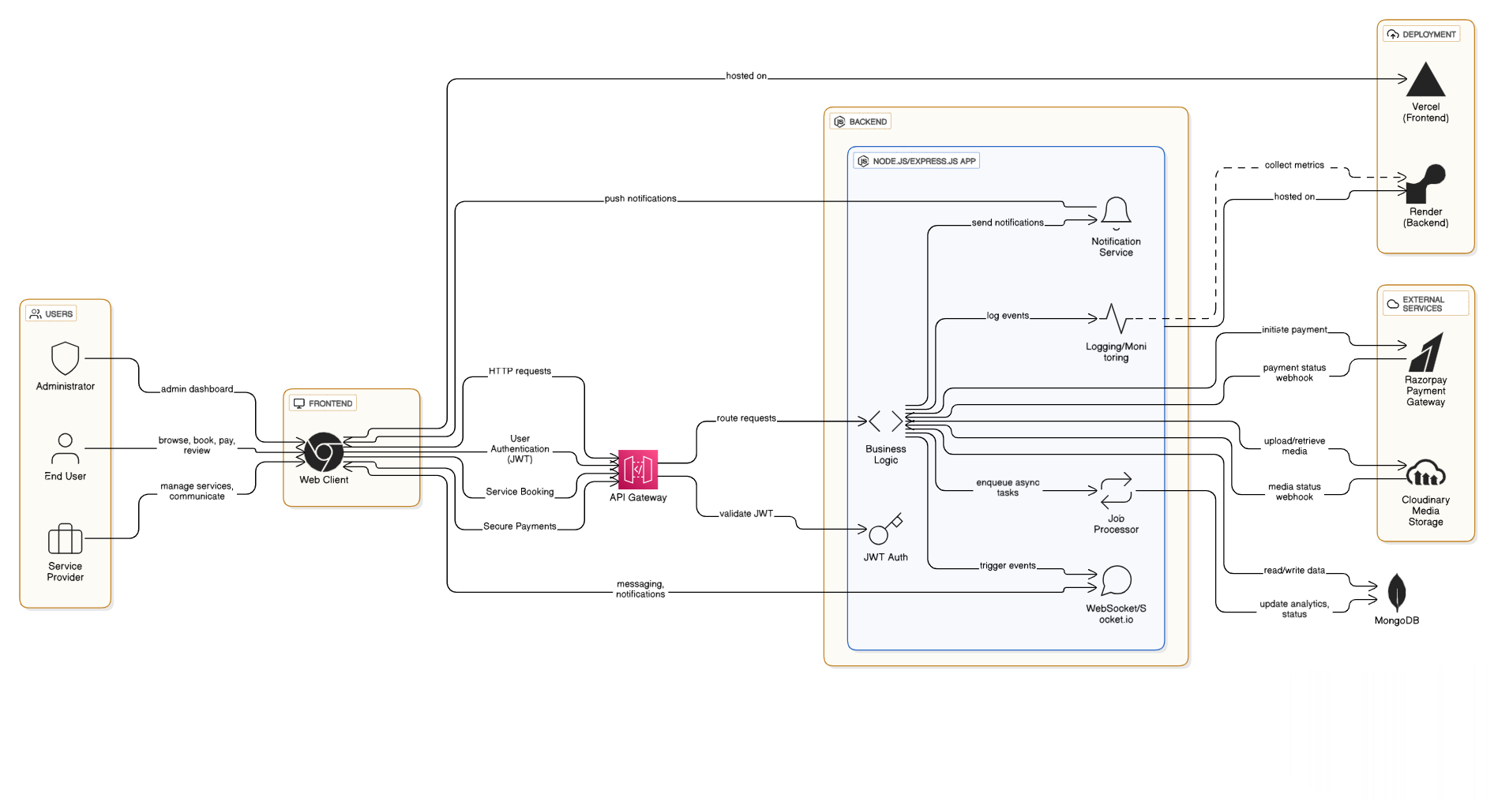
System Architecture

Slide 4
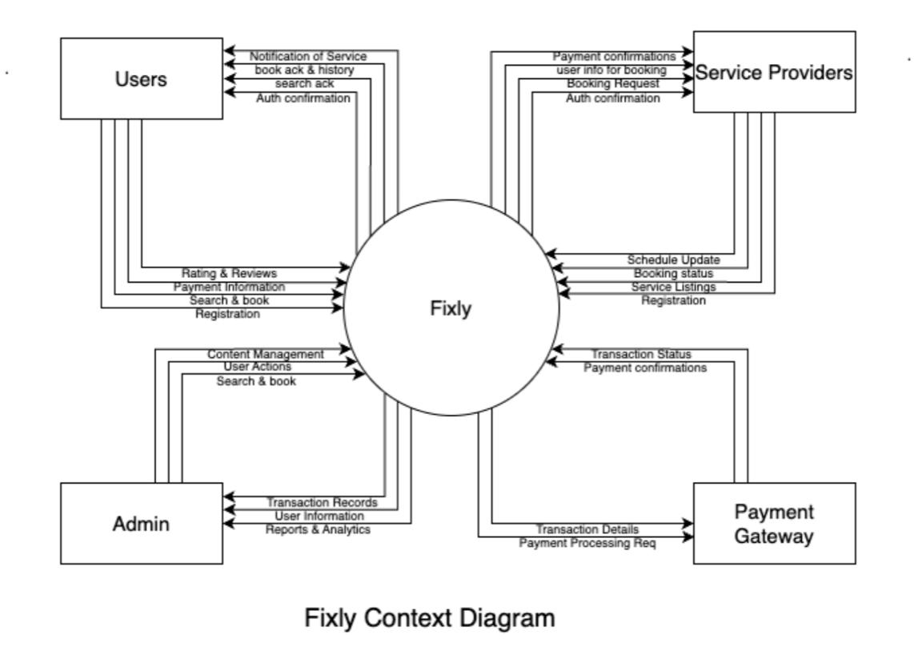
DFD - 0

Slide 5
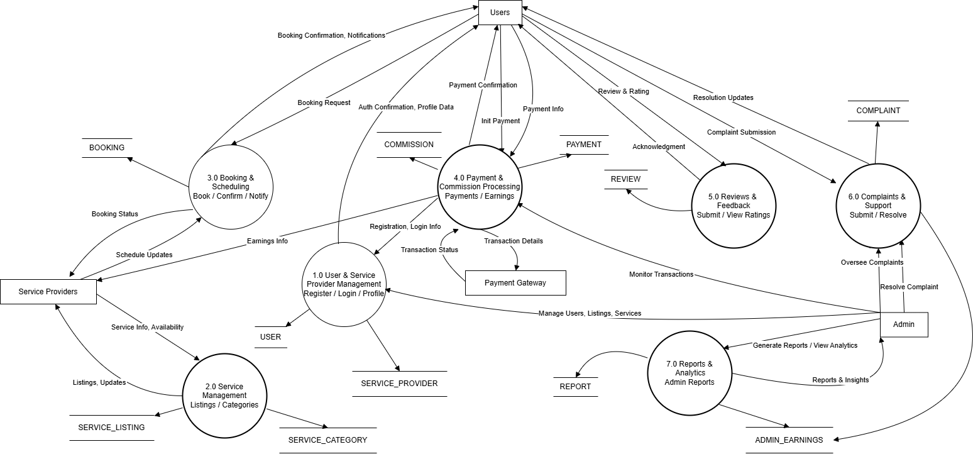
DFD - 1

Slide 6
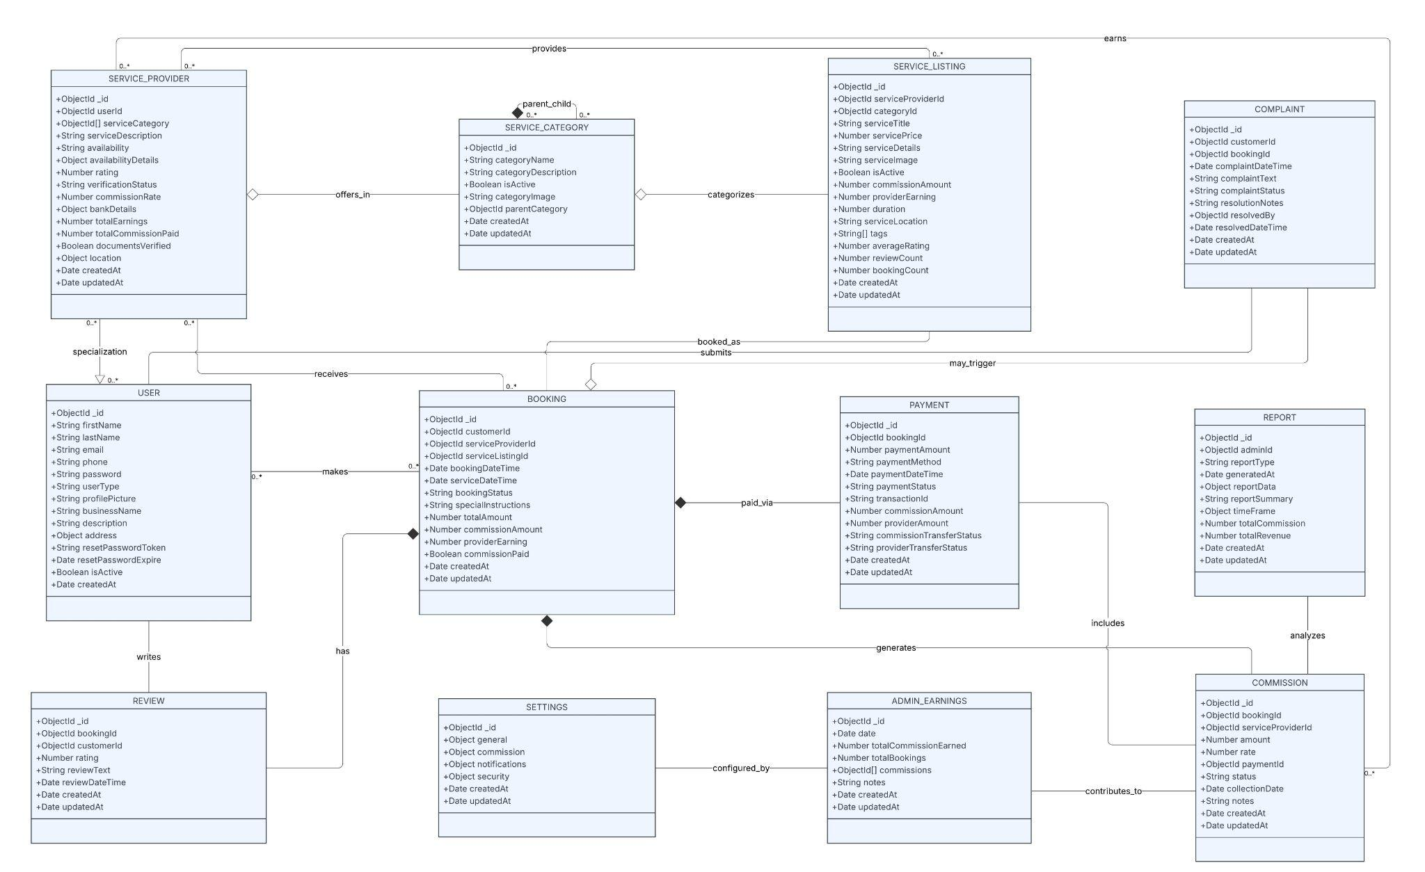
Class
Diagram

Slide 7
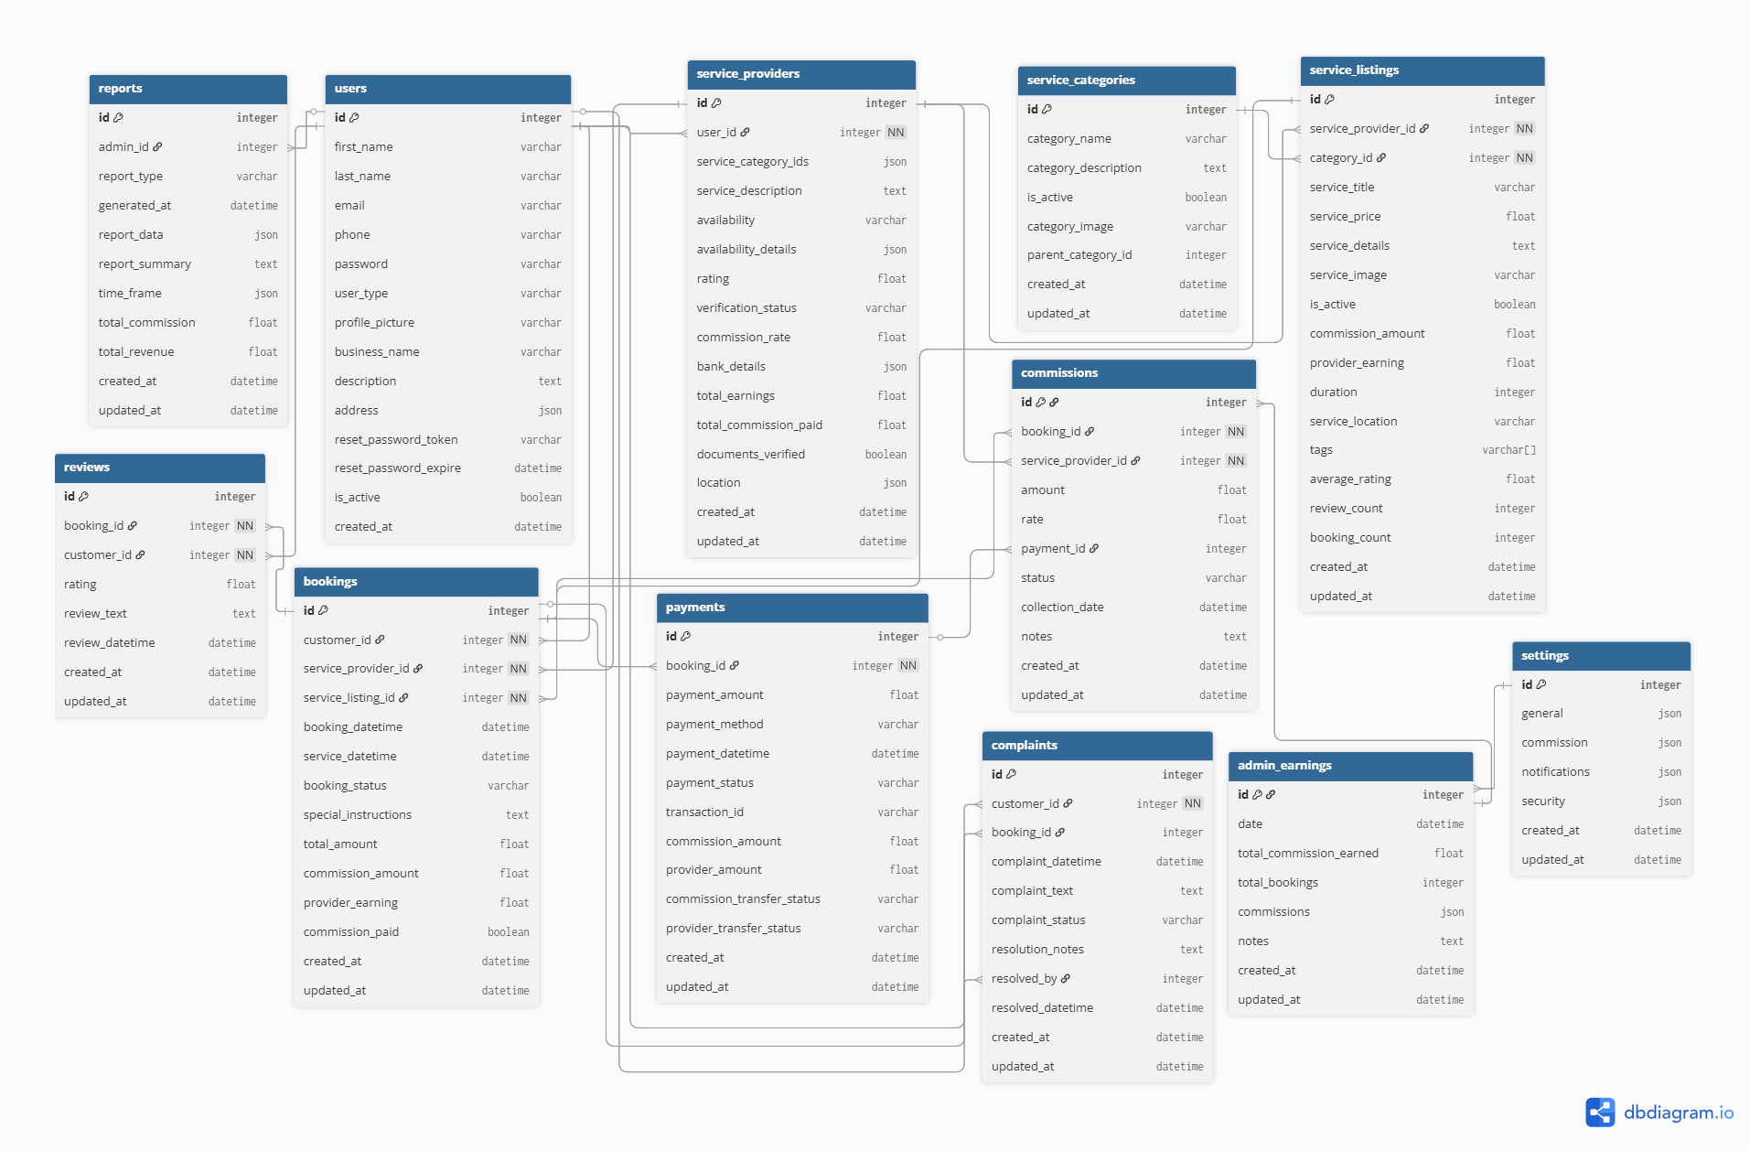
ER Diagram

Slide 8
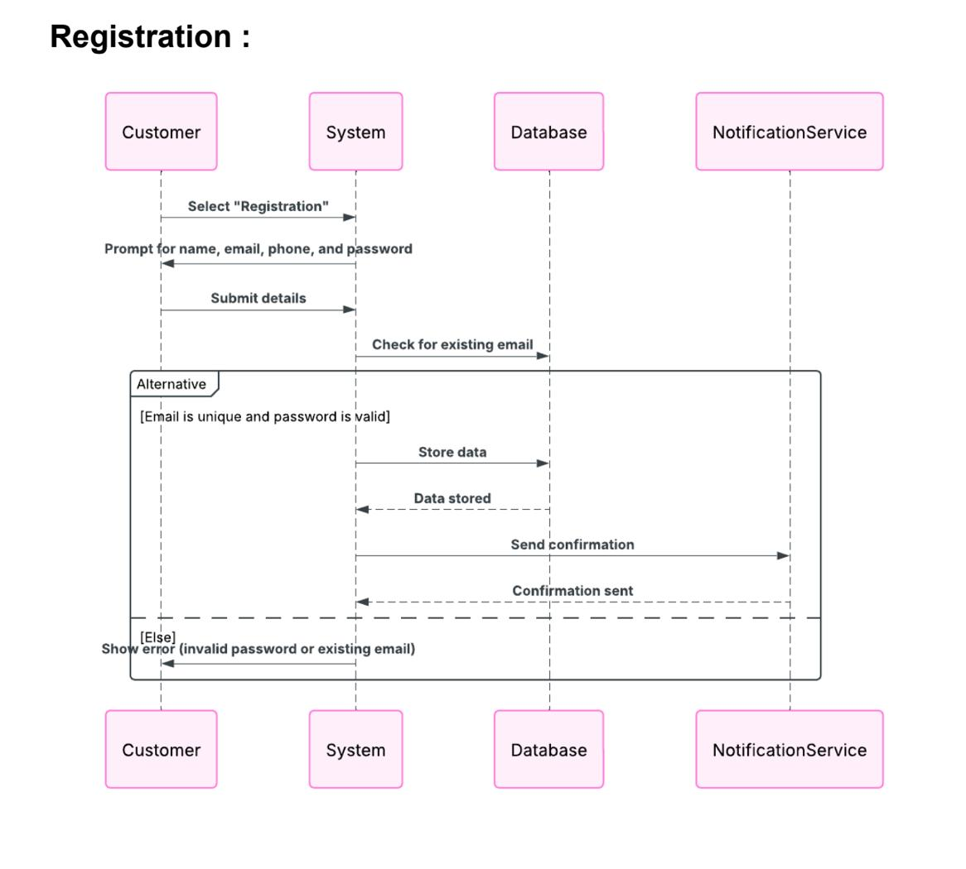
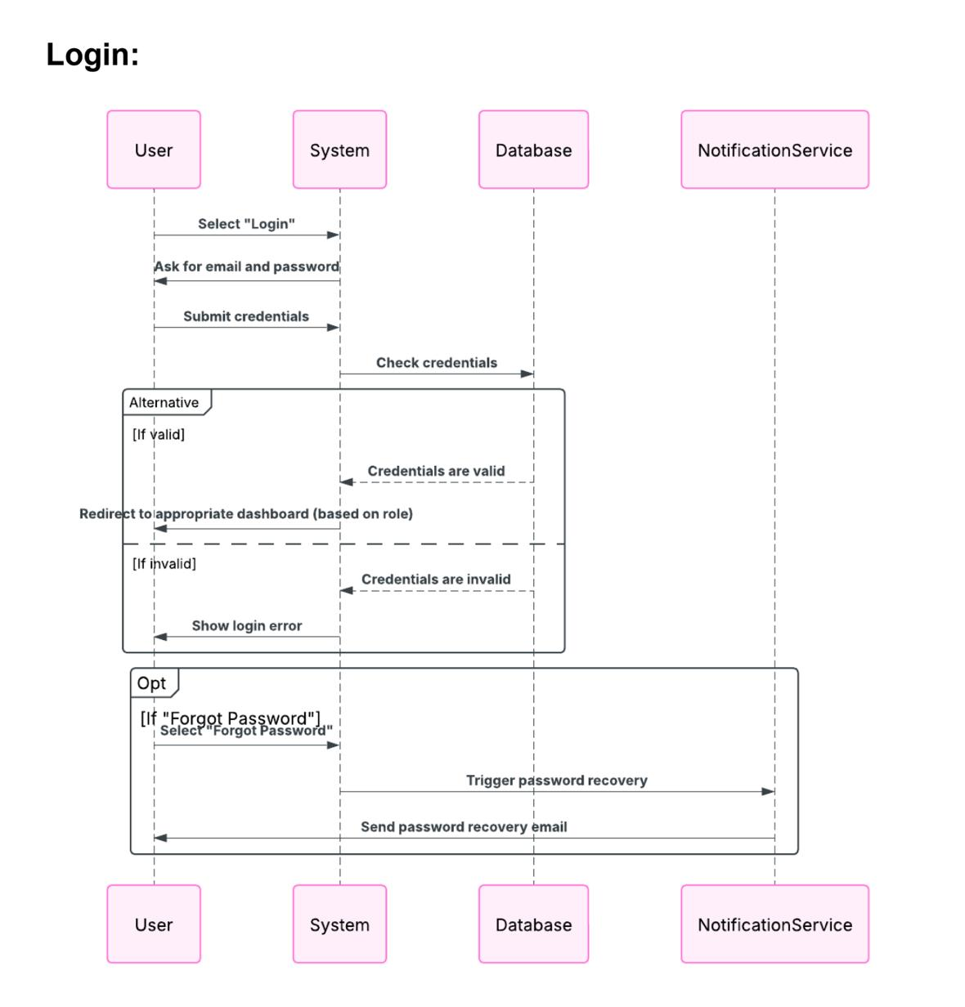
Sequence Diagrams

Slide 9
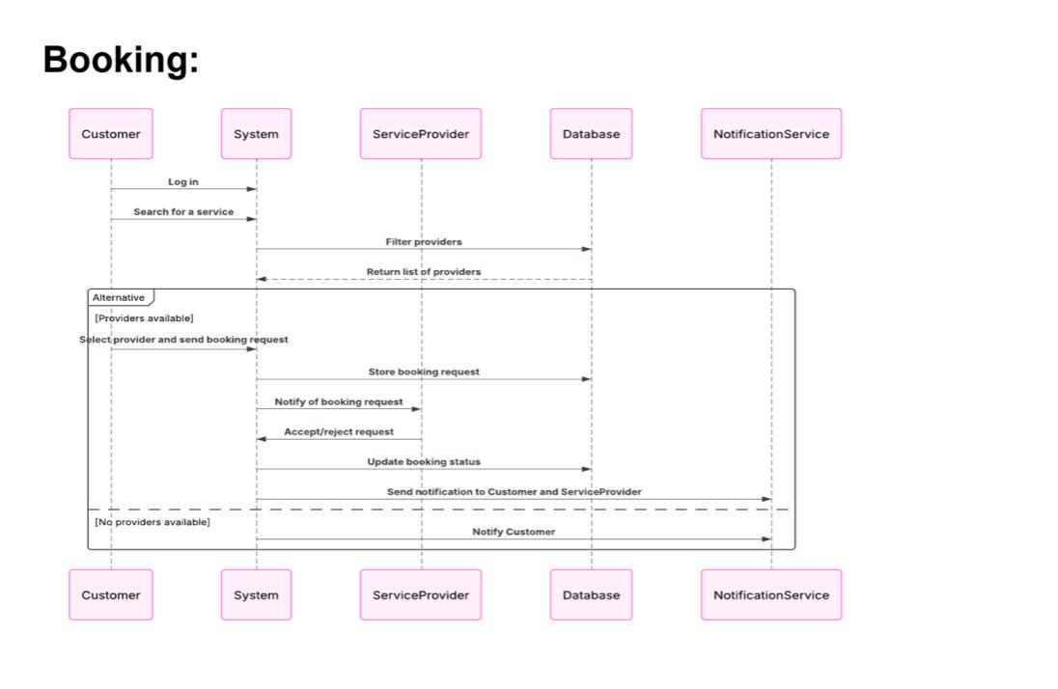
Sequence Diagrams

Slide 10
Factory Method Pattern
Type: Creational Pattern
Where in Fixly
Used for: Controlled object creation
When creating different types of users (Customer, ServiceProvider, Admin) under a common USER interface/class.
Example:
UserFactory.createUser(userType) → returns ServiceProvider or Customer object
Benefit: Centralizes object creation logic, ensures consistency, and supports extensibility (e.g., adding new user types easily).

Slide 11



Observer Pattern
Type: Behavioral Pattern
Where in Fixly
Used for: Event-driven actions and notifications
When booking status changes, payment succeeds, or complaint is resolved, multiple modules need to react (e.g., notify customer, update earnings, send email).
Example:
Subject: Booking
Observers: Payment, Notification, Commission, AdminDashboard
Benefit: Promotes loose coupling and real-time updates without tightly linking modules.

Slide 12

Decorator Pattern
Type: Structural Pattern
Used for: Extending service listings or user profiles dynamically
Where in Fixly:
When adding premium features to a service provider or highlighted listings in the marketplace.
Example:
Base service listing → can be decorated with “Featured”, “Discounted”, or “Urgent” tags.
Benefit: Enhances objects dynamically without altering their core structure.

Slide 13
Composite Pattern
Command Pattern
Type: Structural Pattern
Type: Behavioral Pattern
Used for: Service categories hierarchy
Used for: Handling user actions like booking, cancellation, complaint submission
Where in Fixly:
Where in Fixly:
SERVICE\_CATEGORY has a parent-child relationship, enabling nested categories (e.g., “Home Services → Cleaning → Deep Cleaning”).
Each user operation (book service, make payment, cancel booking) can be treated as a command with undo/redo or transaction rollback.
Benefit: Simplifies recursive category structures and uniform handling of parent/child elements.
Benefit: Increases modularity and helps in maintaining a history of operations.

Slide 14
THANK YOU

