Slide 1
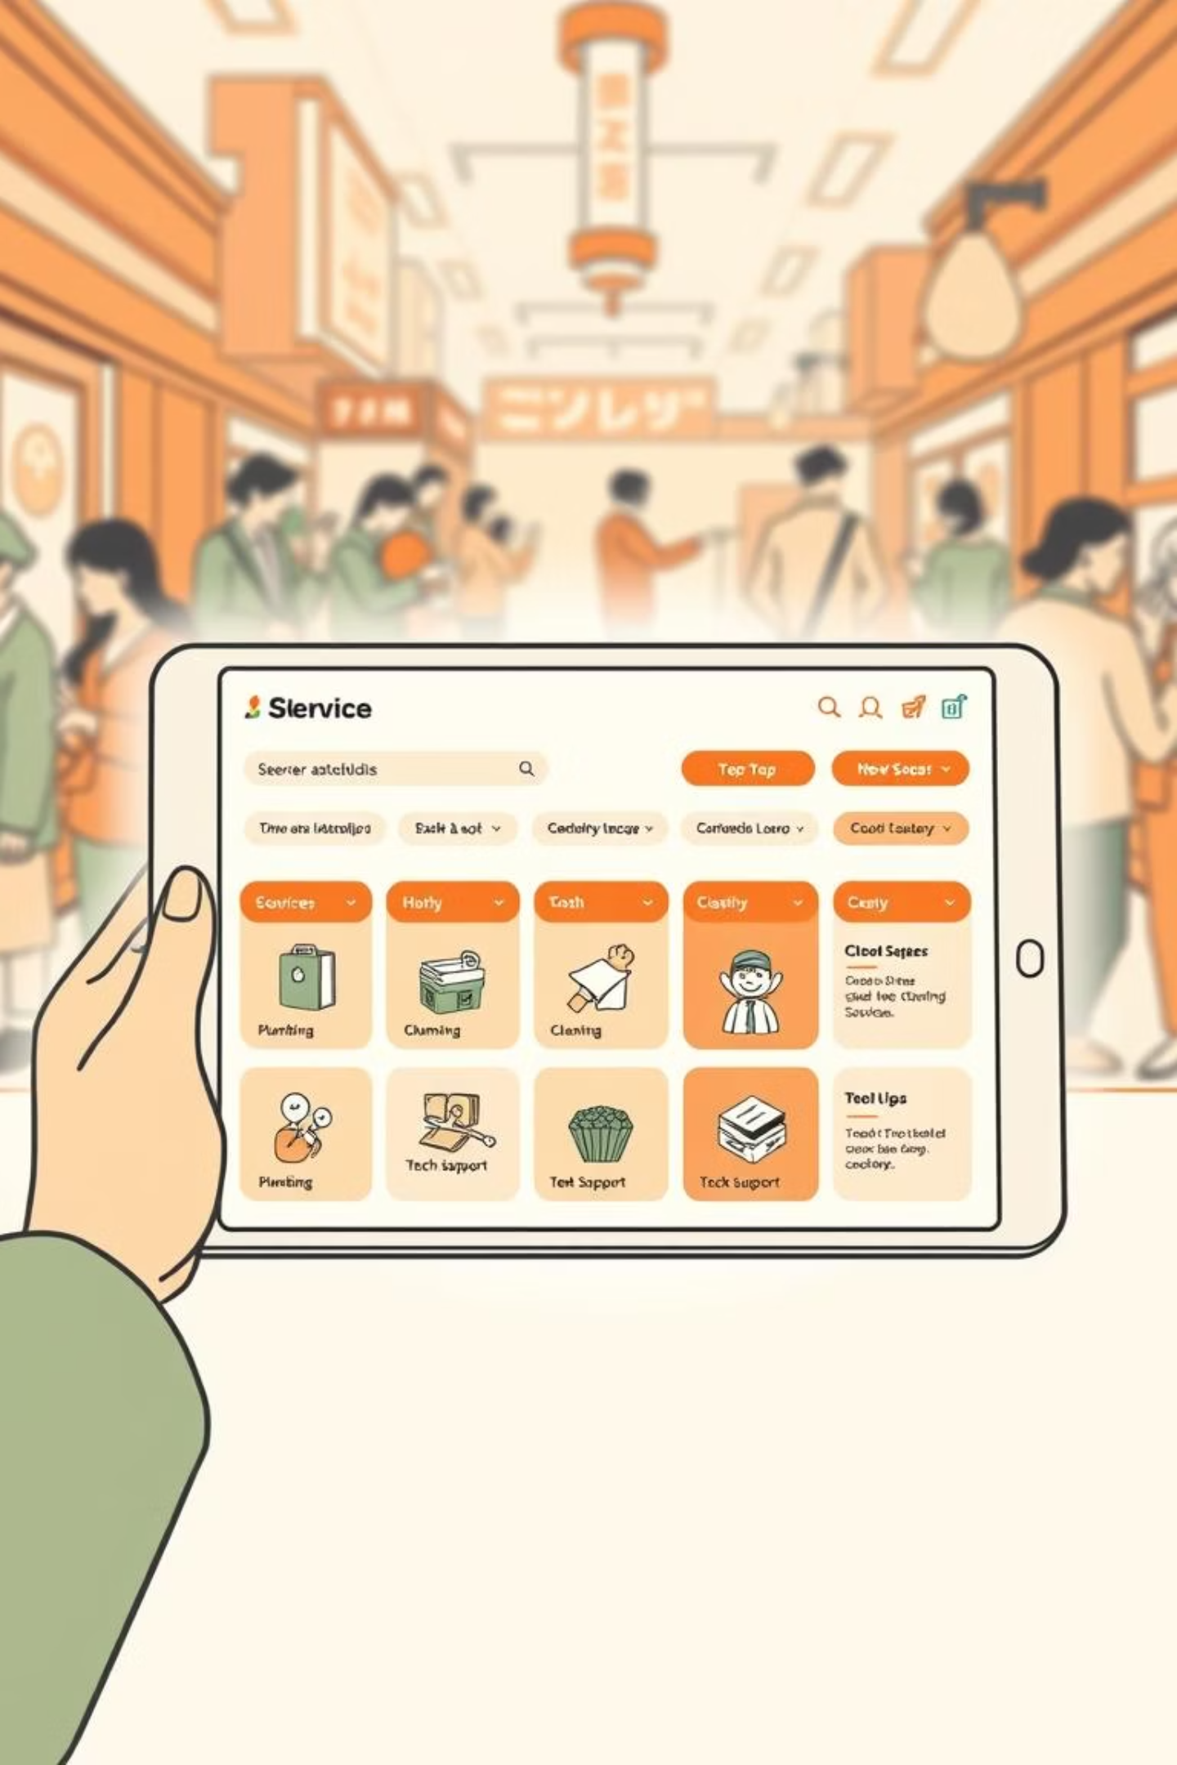
FIXLY: Convenience at Your Doorstep
Connecting customers with skilled professionals, effortlessly.

Slide 2
Overview & Agenda
Welcome to the future of service marketplaces. This presentation will introduce Fixly, a revolutionary platform designed to simplify access to professional services and empower service providers.
01
02
Introduction to Fixly
Problem & Solution
What is Fixly and why was it created?
Addressing market challenges and Fixly's unique approach.
03
04
Target Users & Use Cases
Platform Scope & Features
Who benefits from Fixly and how it's applied.
A detailed look at Fixly's capabilities for all users.
05
06
Technology Stack
Team Introduction
The robust foundation powering Fixly.
Meet the dedicated individuals behind Fixly.

Slide 3
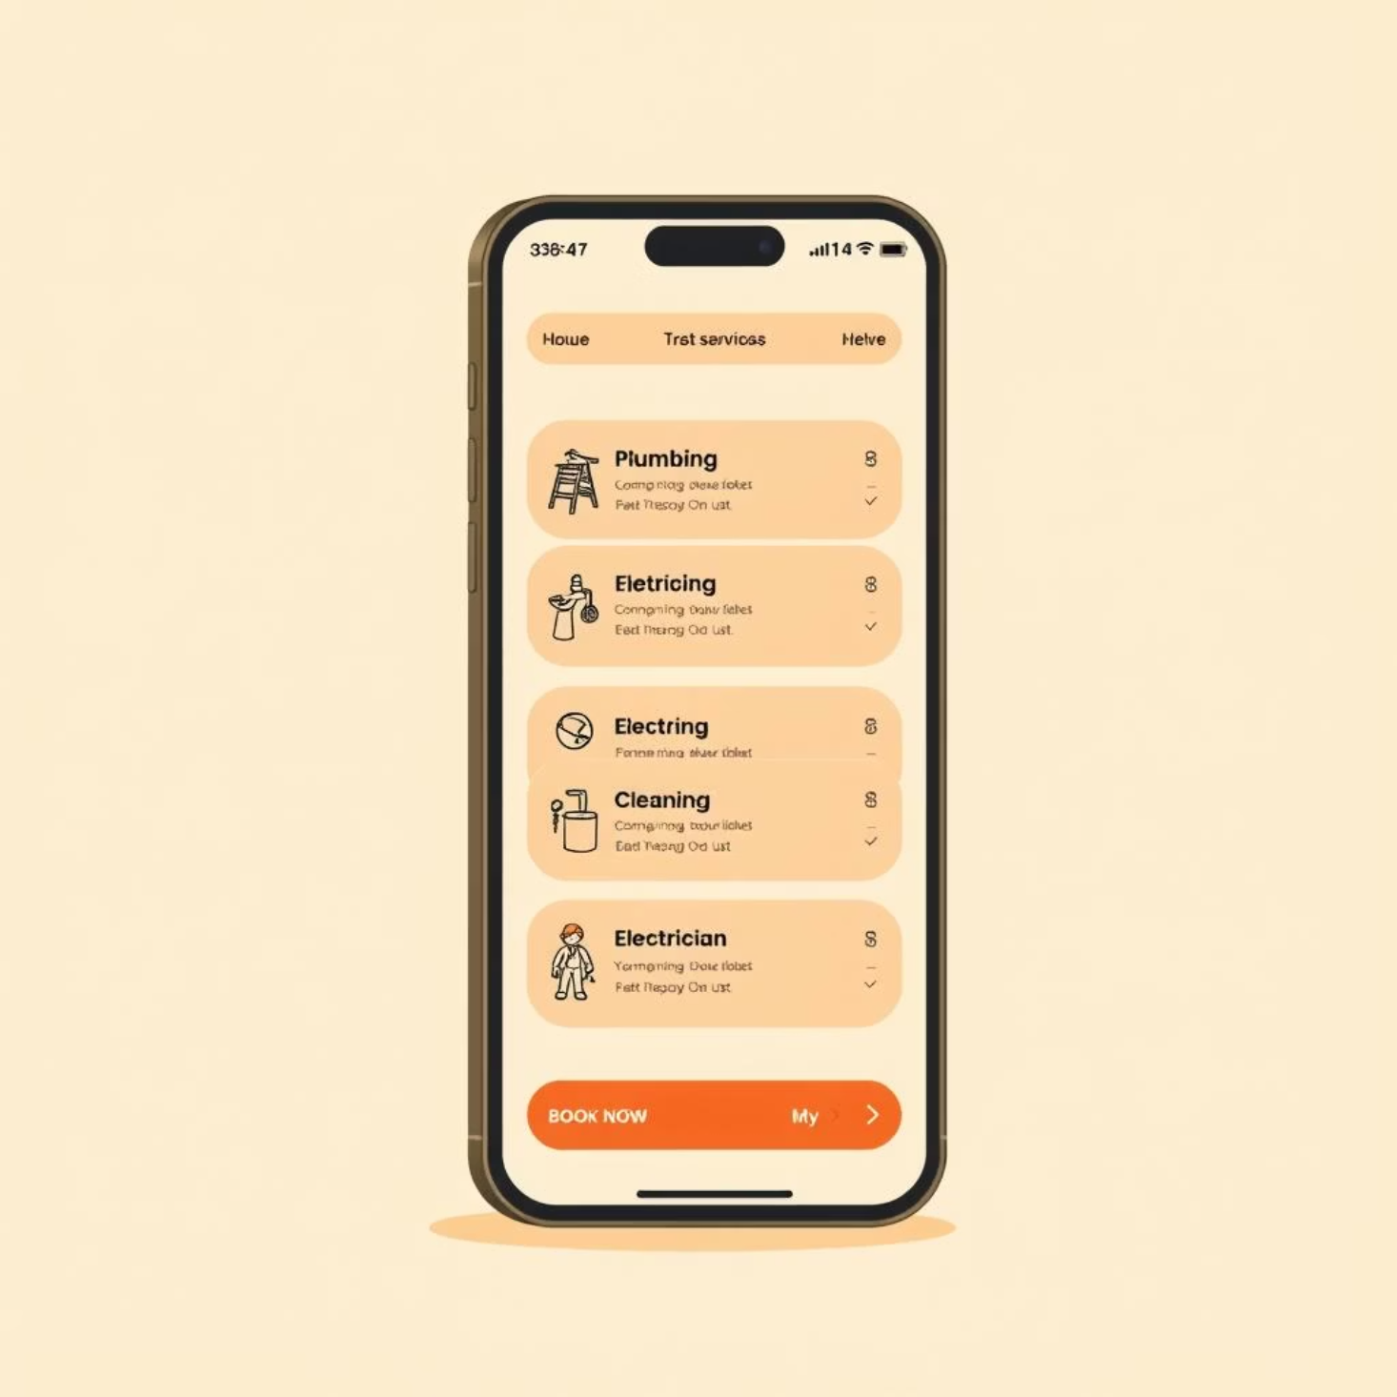
Introducing Fixly
Fixly is a web-based platform tailored to create seamless connections between service providers and customers. Acting as a virtual marketplace, it allows professionals to showcase their services while customers can book appointments, make payments securely, and receive timely support.
Key features include service listings, secure transactions, real-time communication, analytics, customer feedback mechanisms, and a robust rewards program. With its user-friendly design and powerful tools, Fixly redefines convenience, making service access effortless and reliable.

Slide 4


The Problem: Finding Reliable Service
For Customers:
For Service Providers:
Uncertainty: Difficulty finding skilled and trustworthy professionals.
Low Visibility: Struggling to showcase skills and gain new clients.
Lack of Transparency: Hidden costs, unclear pricing, and unverified service quality.
Inefficient Management: Lack of tools for appointments, payments, and feedback.
Inconvenience: Scheduling conflicts and limited communication channels.
Limited Growth: Challenges in building long-term trust and scaling their business.
The absence of a centralized, user-friendly platform creates inefficiencies, dissatisfaction, and missed opportunities on both sides.

Slide 5




The Fixly Solution
Fixly bridges the gap between customers and service providers, transforming the service ecosystem into an efficient and trustworthy marketplace.
Seamless Connections
Trust & Transparency
Direct links between those needing services and those offering them.
Verified profiles, transparent pricing, and robust feedback systems.
Empowering Tools
Secure Transactions
For providers to manage, schedule, and grow their businesses.
Hassle-free payments and financial tracking.
Fixly simplifies the entire service process, making professional services accessible, trustworthy, and hassle-free for everyone.

Slide 6



Who Benefits? Our Target Users
Customers (Households & Businesses)
Service Providers (Professionals & Small Businesses)
Platform Administrators (Fixly Team)
Individuals and companies seeking reliable, transparent, and easy-to-book household or commercial services like plumbing, cleaning, or IT support.
The dedicated team overseeing user management, dispute resolution, performance monitoring, and ensuring the smooth operation and trust of the Fixly platform.
Independent skilled professionals and small businesses looking for a platform to gain visibility, manage bookings, and engage with clients efficiently.

Slide 7
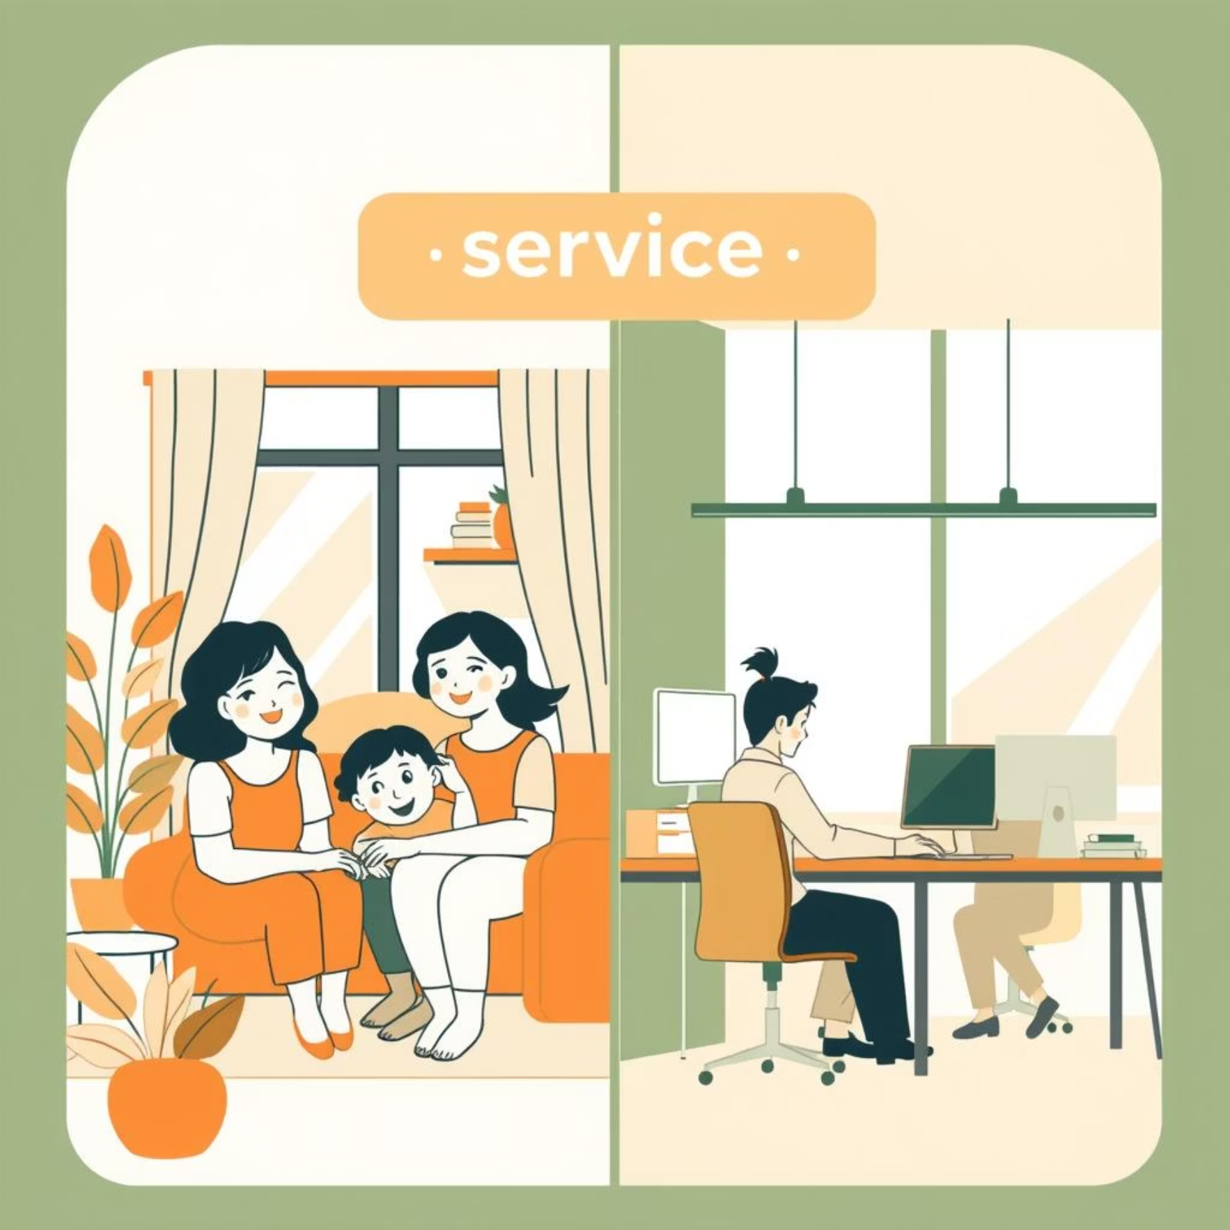

Real-World Use Cases
Fixly is designed for diverse scenarios, simplifying service delivery and access.
Household & Business Services
Provider Growth & Engagement
A customer books an electrician for urgent repair or schedules weekly home cleaning.
A plumber lists new services, using analytics to identify peak booking times.
An office books IT support on a monthly contract, tracking invoices through Fixly.
Clients and providers message each other in real-time, receiving updates on rescheduled bookings.
Automated notifications and post-service reviews further enhance reliability and trust for all users.

Slide 8
Comprehensive Platform Scope & Features
Customer Features
Service Provider Features
Platform & Admin Features
Seamless registration & authentication.
Profile & service listing management.
Real-time communication & notifications.
Service browsing, booking, and management.
Appointment scheduling & calendar integration.
Resource sharing & support services (FAQs, help desk).
Secure online payments.
Secure payment collection & tracking.
Reward & loyalty systems.
Feedback, reviews, and ratings.
Admin dashboard for user/service/payment management.
Analytics dashboards for performance.
Loyalty and rewards programs.
Direct client communication tools.
Monitoring reviews, complaints, and performance.

Slide 9








The Power Behind Fixly: Technology Stack
Frontend
Authentication
JWT-based Authentication
ReactJS, HTML, CSS, JavaScript
Backend
Payment Gateway
Razorpay
NodeJS, Express.js
Database
Hosting
Vercel & Render
MongoDB
Media Storage
Version Control
Git & GitHub
Cloudinary

Slide 10

Meet the Team
Fixly is brought to you by the dedicated efforts of Group 13 from IT644 - WS & SOA.
Group Members:
202412031 - Kachhadiya Smit - Team Lead & Project Manager
202412052 - Krishn Navadiya - Backend Developer
202412036 - Katharotiya Harsh - BackEnd Developer & Product Owner
202412030 - Kachhadiya Princy - FrontEnd Developer
202412043 - Lakkad Vishva - UI/UX Designer & Business Analyst
202412044 - Limbachiya Parth - QA Tester & Solution Architecture
202412104 - Shekhda Miraj - FrontEnd Developer
202412010 - Asodariya Gaurav - Technical Writer
Group No.: 13
Presented: August 26, 2025
Thank you for your time. We believe Fixly will transform how people access and provide services.

