Slide 1

Comparative Analysis of Decision Tree and Random Forest Algorithms for Predicting Startup Success
Presented by:
Gouri Dumale (G49564205) Nemi Makadia (G29362869)
Bhanu Sai Praneeth Sarva (G46159306)
Smit Pancholi (G31443926)

Slide 2

introduction
In the dynamic landscape of startups, understanding the intricacies of company data is pivotal for making informed decisions. The startup ecosystem is a vibrant and ever-evolving landscape where innovation, risk-taking, and strategic decisions shape the trajectory of emerging companies
At the heart of every startup's journey is funding – the life force that propels ideas into reality. Our mission is to dive into this world, decipher the connection between startups and their funding sources, and uncover the secrets behind success.
It's not just about numbers; it's about understanding how startups strategize, grow, and tackle challenges. We're peeling back the layers, examining the relationships between funding, market sectors, and locations. The goal of our project is to distill practical insights, making complex data accessible.

Slide 3

Problem statement
In this study, we aim to compare the performance of two prominent machine learning algorithms, Decision Tree and Random Forest, in predicting the success of startups using a comprehensive dataset.
Algorithmic Comparison:
Apply the Decision Tree algorithm to predict startup success based on available features.
Implement the Random Forest algorithm, an ensemble technique, and assess its performance in comparison to the Decision Tree.
Performance Metrics:
Evaluate and compare key performance metrics, including accuracy, precision, recall, and F1 score, for both Decision Tree and Random Forest models.
Investigate the stability and generalization ability of the models through cross-validation.

Slide 4

Dataset overview
Size: Approximately 54,000 rows and 39 columns.
Information: Diverse range of company-related data.
Key Columns: Company names, URLs, market sectors, geographical details, founding dates, funding round details, and company status.
Investment Types: Seed funding, venture capital, equity crowdfunding, undisclosed investments, convertible notes, debt financing, angel investments, grants, private equity, post-IPO equity, post-IPO debt, secondary market transactions, product crowdfunding, and rounds labeled A to H.

Slide 5

Data preprocessing
The important features we have performed pre preprocessing are funding_total, first_funded_at, last_funded_at where we have used pandas lib and converted object data type to int and date format data type
For funding_total_usd, we have used regex with pandas to modify the column values and changed them from object dtype to int dtype

Slide 6

Exploratory data analysis
Finding Pearson Correlation between numerical features of the data
Top 5 markets with highest count of startups
Distribution of funding across top 5 markets
Number of startups across the years

Slide 7
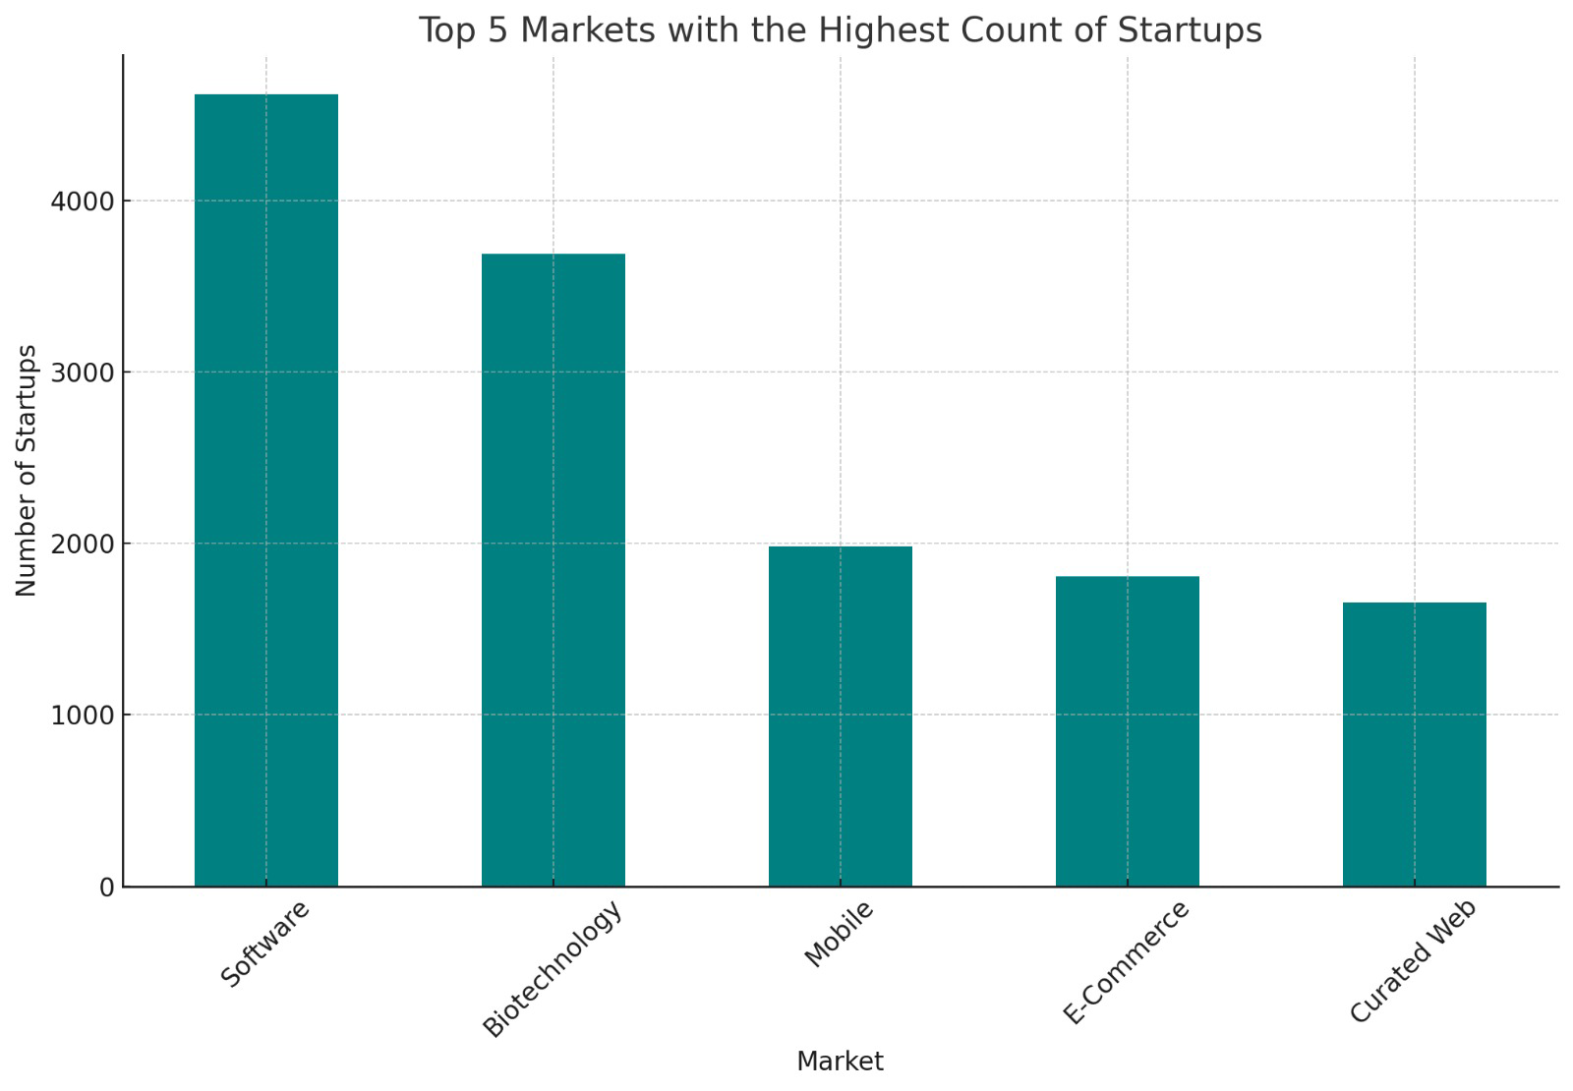
EDA results
Top 5 markets with highest count of startups
The 'Software' market has the highest number of startups
Following software, 'Biotechnology' is the second most common market. This indicates a strong startup presence in the biotech sector
The presence of ‘Mobile’, 'E-Commerce’ and ‘Curated Web’ among the top markets shows that these sectors continue to be a popular area for startup innovation and growth.

Slide 8
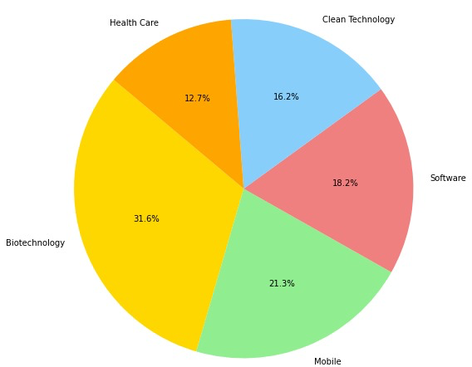
Eda results
Distribution of funding across top 5 markets
Biotechnology has the largest share of funding, which indicates that this market is highly capitalized.
The Mobile sector is another major recipient of funding.
The Software sector also holds a significant portion of the funding
Both Health Care and Clean Technology hold notable portions of the funding pie.

Slide 9
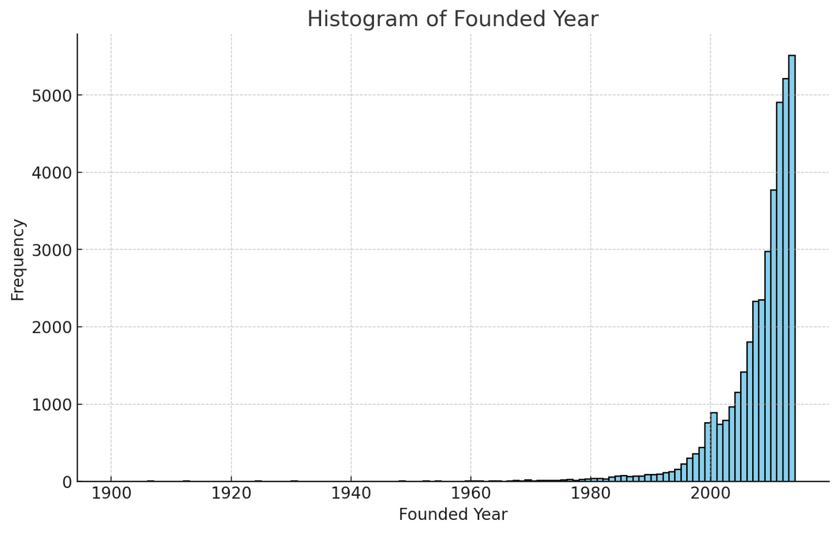
Eda results
Number of startups across the years
There is a substantial increase in the number of startups during the late 20th and early 21st centuries.
The histogram shows a particularly sharp increase in the number of startups founded around the year 2000.
There is a noticeable decline in the number of startups founded in the few years before 2014, which is the last year shown in the histogram.

Slide 10
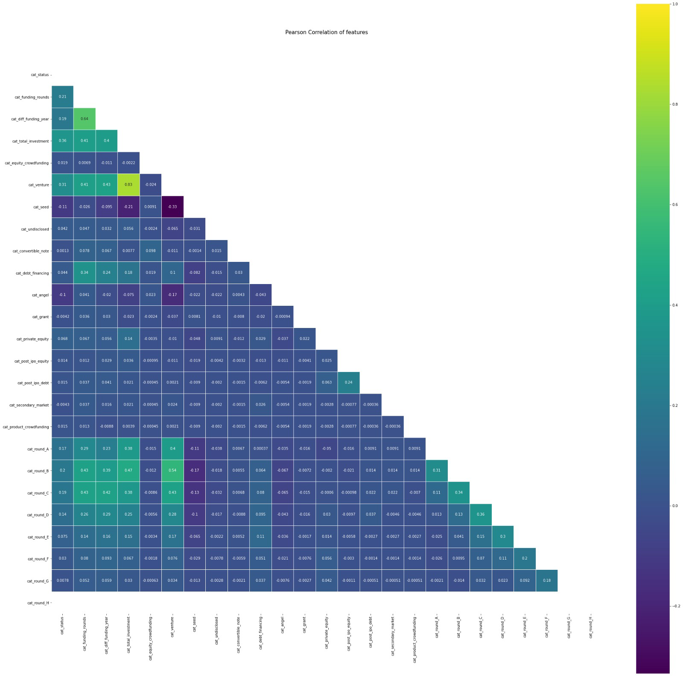
eda results
Pearson Correlation matrix was generated to check the correlation between the important features in the data
The highest correlation coefficient is approximately 0.90 and it is between the funding_total_usd and debt_financing features. This suggests a very strong positive linear relationship, where an increase in one feature is associated with an increase in the other.
The lowest correlation coefficient is approximately -0.09 and it is between the founded_year and venture features. This is a very weak negative linear relationship, suggesting that there is almost no linear association between these two features.

Slide 11
methodology
Decision Tree Algorithm for Startup Dataset:
1. Feature Importance
2. Hyperparameter Tuning
3. Visualization
4. Permutation Importance
Random Forest Algorithm for Startup Dataset:
1. Ensemble Method
2. Feature Importance in Random Forest
3. Hyperparameter Tuning in Random Forest
4. Cross-Validation with Custom Metric

Slide 12
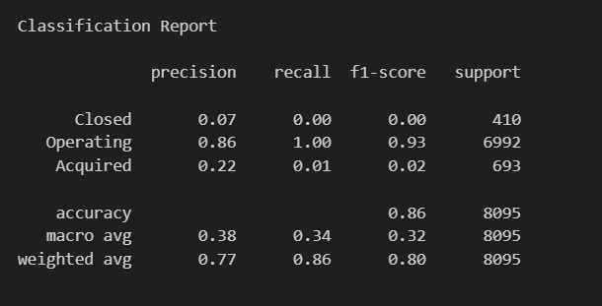
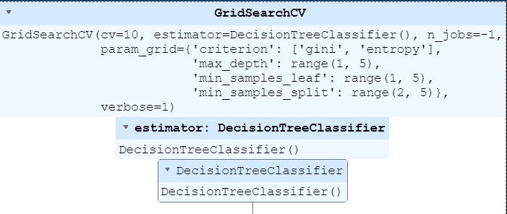
results
Decision Tree Model:

Slide 13
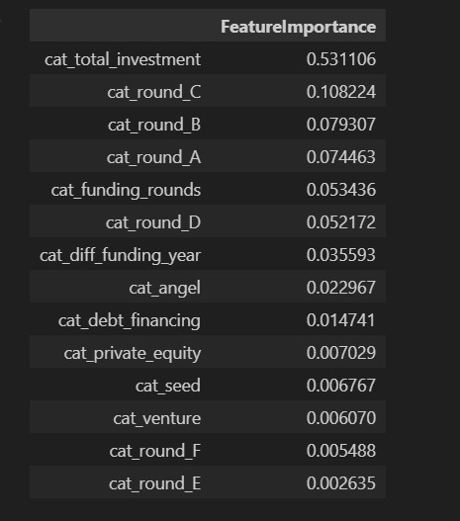
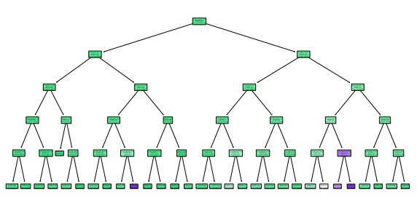
Results
Decision Tree Visualization

Slide 14
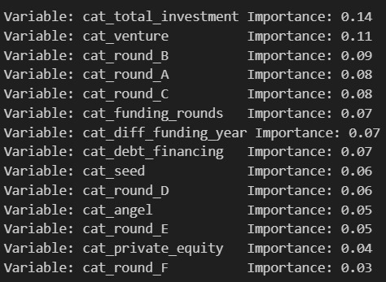
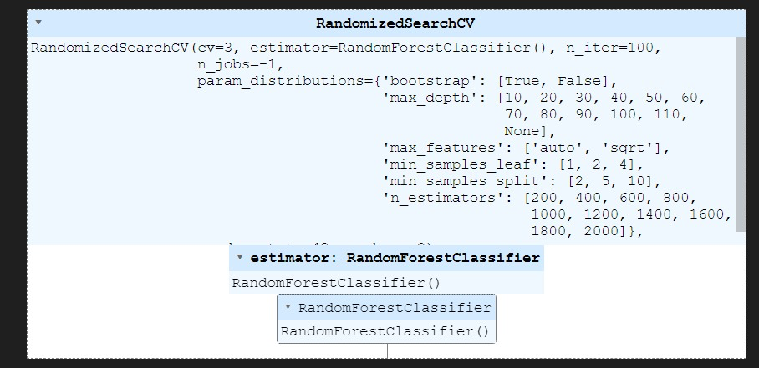
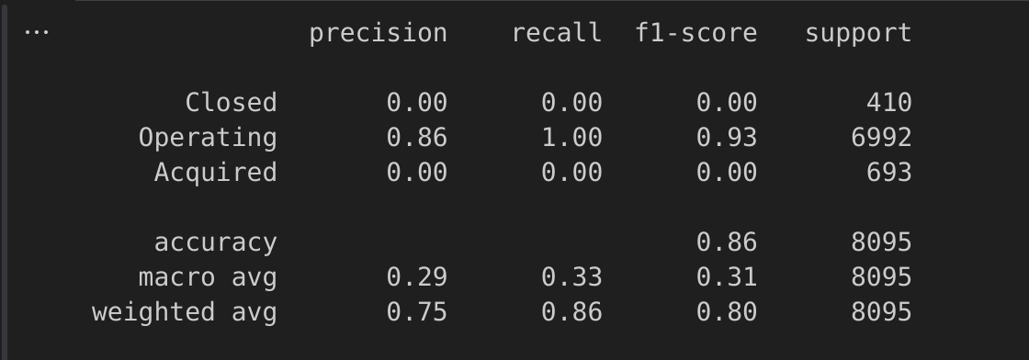
results
Random Forest Model

Slide 15
conclusion
Considering the marginal differences in macro averages and the ability of the Decision Tree model to identify a small fraction of the minority classes, it can be argued that the Decision Tree model performs slightly better than the Random Forest model, particularly in terms of generalizability across different classes.

Slide 16
Thank you!

