Slide 1

TALK TO A PRESIDENT
NLP PRESENTATION
GROUP 2
Disha Kacha (G21218299)
Sairam Venkatachalam (G45613249)
Smit Pancholi (G31443926)
Devarsh Sheth (G33776499)

Slide 2
INTRODUCTION
Our project aims to develop an intelligent chatbot that interacts with a dataset of English-translated speeches from U.S. and Russian leaders.
The chatbot enables users to pose questions and retrieve relevant information from historical speeches, making political narratives more accessible, by employing NLP techniques like vector embeddings and Retrieval-Augmented Generation (RAG)
This tool not only simplifies exploration of historical discourse but also facilitates insights into leadership styles and decision-making across different eras.

Slide 3
MOTIVATION
Political speeches encapsulate the values, ideologies, and challenges of their time, offering a rich resource for understanding historical and cultural contexts.
However, the sheer volume and complexity of these records can make manual analysis impractical.
Our project addresses this challenge by developing a chatbot that provides an interactive way to speak with leaders of different eras, retrieving and summarizing relevant content efficiently.
By focusing on speeches from U.S. and Russian leaders, this project allows users to compare perspectives, fostering deeper engagement with historical events and leadership approaches through the power of NLP.

Slide 4
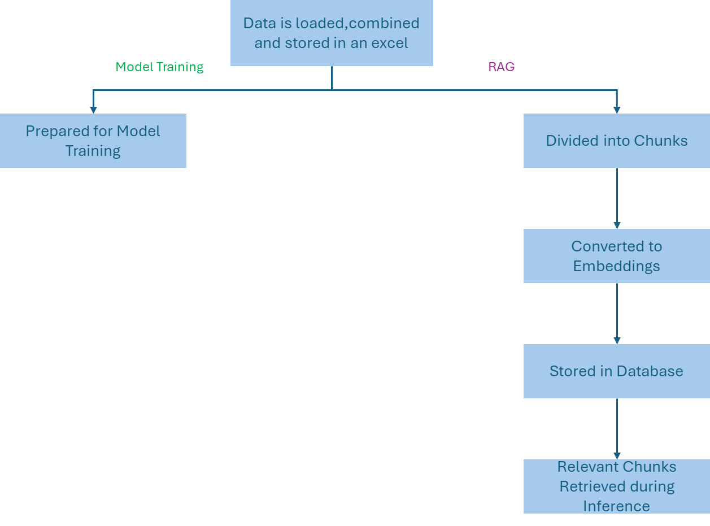
DATA FLOW

Slide 5
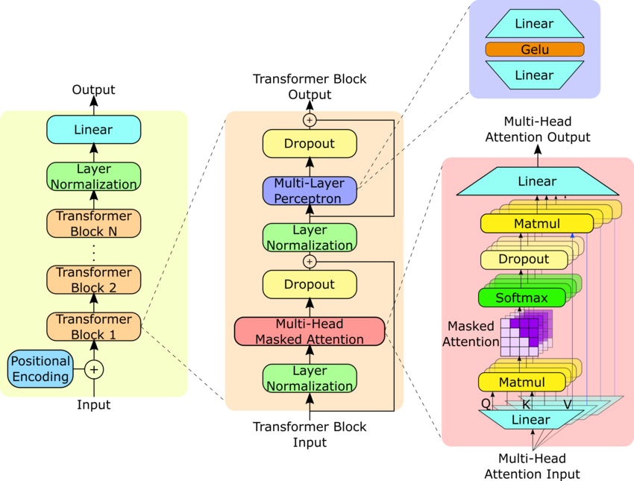
MODEL ARCHITECHURE - FINE TUNED GPT-2

Slide 6

OTHER MODELS USED
These Pre-trained models have more than 7 Billion Parameters, making it 70 times larger than our fine-tuned model

Slide 7
RETRIEVAL AUGMENTED GENERATION (RAG)
Cosine similarity for ranking.
Measures semantic closeness between query and text chunks for precise context retrieval.
Sentence Transformer for Embedding.
Encodes both questions and transcript chunks into vector embeddings, enabling precise context retrieval and ranking.
Top 5 Chunk Retrieval
Extracts and combines the most relevant 5 chunks into a context, ensuring high-quality input for response generation.
ChromaDB for Vector Store
Stores precomputed embeddings in a scalable and efficient vector database, enabling fast and accurate similarity-based retrieval.

Slide 8
PERFORMANCE EVALUATION
Human-in-the-Loop A manual review process was integrated to validate and improve model outputs.
Using a human-in-the-loop approach enhances evaluation by capturing nuances that automated metrics like BLEU or ROUGE miss.
It ensures contextual understanding, subjective judgment, and holistic evaluation, covering aspects like relevance, tone, and fluency.
Humans can also provide specific feedback for improvement, making the process more adaptable to real-world scenarios.
This approach validates the model's performance beyond numbers, ensuring it meets user needs effectively.

Slide 9
STREAMLIT

Slide 10
THANKYOU!

