Slide 1


Dinal Chauhan (10)
Smit Patel (81)
BSC(I.T)
sem-6
J P Dawar institute of information science and technology

Slide 2
Index
Introduction
Scope
Objective
Data Dictionary
ER Diagram
Advantages
Disadvantages

Slide 3
Introduction
In Quick Search, Admin provides theme structure to vendors (shopkeeper), as per the requirement of the vendor they can select and unselect.
Vendors have choice to insert data into the theme or not, if any tab like service or product is not necessary then he/she can ignore.
User can visit the site of selected shop and also see location of the selected shop. It provides online searched solution to user and also provides themes to vendor.
The overall goal of this website is that it is available for anybody and anywhere.
This saves a lot of time and money of the user and as well as vendor.

Slide 4
Scope
User can search vendors as per their need and based on that search user are able to see the related shop. User can see only that shops which are registered by the vendor.
User can see the website of a vendors only after he/she is login into the website.
Vendor allow to register his/her shop and add the details of product, service, shop logo, slider image, testimonials, team, contact, about and search details.
If the vendor is approved by the admin then he/she is able to select the theme for his/her website.
Admin are authorised to approve or disapprove the vendor. The password is send to the vendor on his/her email id when admin approve the vendor.

Slide 5
Objectives
Admin Module
Login :Admin can change his/her password.
Manage Vendor: Admin can add vendor.Admin can approved vendor and mail them password for login.
Manage Business : Admin can keep updating the business category and business type
Manage Theme : Admin can keep updating the theme when new theme are launch.

Slide 6
Objectives
Vendor Module
Login/Signup: Vendor can SignUp as well as login with authentication.
Vendor can change his/her password.
Vendor can manage the logo , slider details, about, products, services , social media, team, testimonials, contact and search details by adding, updating and deleting the information.
Vendor can update thier profile

Slide 7
Objectives
User Module
Login/Signup : User can create new account in website.
User can create their own password.
User can visit the site for the selected shop and also see the location of the selected shop.

Slide 8
Data Dictionary
about
Field | DataType | Size | Key | description
About_id | Int | 11 | Primary Key | Stores id of about us.
Vendor_id | Int | 11 | Foreign Key | Stores id of vendor
Banner_image | Text | - | - | Stores image path.
About_image | Text | - | - | Stores image path.
Description | Text | - | - | Stores the goal of vendor`s shop
About_mission | Text | - | - | Stores the mission of vendor`s shop.
About_vision | Text | - | - | Stores the vision of vendor`s shop
About_success | Text | - | - | Stores the success of vendor`s shop.

Slide 9
admin
Field | DataType | Size | Key | Description
admin_id | Int | 11 | Primary key | Stores id of Admin
admin_name | Varchar | 255 | Unique Key | Stores name of admin
admin_password | Varchar | 255 | - | Stores password of admin
admin_email | varchar | 255 | Unique Key | Stores admin email id
category
Field | DataType | Size | Key | Description
category_id | Int | 11 | Primary Key | Stores id of category
category_name | Varchar | 255 | Unique Key | Stores name of category
category_image | Text | - | - | Stores image path

Slide 10
contact
Field | DataType | Size | Key | Description
contact_id | Int | 11 | Primary Key | Stores id of contact.
vendor_id | Int | 11 | Foreign Key | Stores id of Vendor
phone_no1 | Bigint | 10 | - | Stores mobile no. of vendor.
phone_no2 | Bigint | 10 | - | Stores mobile no. of vendor.
email | Varchar | 255 | - | Stores email id of vendor.
address | Varchar | 255 | - | Stores address of vendor`s shop.
contact_image | Text | - | - | Stores path of image
contact_name | Varchar | 255 | - | Stores name of contacted vendor.
latitude | double | - | - | Stores geometric latitude value of shop address
longitude | double | - | - | Stores geometric longitude value of shop address

Slide 11
Logo
Field | DataType | Size | Key | Description
logo_id | Int | 11 | Primary Key | Stores id of logo
vendor_id | Int | 11 | Foreign Key | Stores id of vendor
image | Text | - | - | Stores image path
Product
Field | DataType | Size | Key | Description
product_id | Int | 11 | Primary Key | Stores vendor`s product id
vendor_id | Int | 11 | Foreign Key | Stores vendor id
title | Varchar | 255 | Unique Key | Stores title of product.
product_image | Text | - | - | Stores image path of product.
banner_image | Text | - | - | Stores image path
product_price | Int | 11 | - | Stores price of product.
description | Text | - | - | Stores description of product.
sortorder | Int | 11 | - | Stores sort no. of product.
short_description | Varchar | 255 | - | Stores short description of product.

Slide 12
Search
Field | DataType | Size | Key | Description
search_id | Int | 11 | Primary Key | Stores id of search.
shop_name | varchar | 255 | - | Stores name of shop .
description | text | - | - | Stores description of shop.
keyword | Varchar | 255 | - | Stores the key words of shop
vendor_id | int | 11 | - | Stores vendor id
Slider
Field | DataType | Size | Key | Description
slider_id | Int | 11 | Primary Key | Stores id of slider
vendor_id | Int | 11 | Foreign Key | Stores id of vendor
slider_image | Text | - | - | Stores path of image

Slide 13
service
Field | DataType | Size | Key | Description
service_id | Int | 11 | Primary Key | Stores id of services.
title | varchar | 255 | Unique Key | Stores title (name) of service.
description | text | - | - | Stores description of service.
banner_image | text | - | - | Stores path of banner image
service_image | Text | - | - | Stores path of service image
sortorder | int | 11 | - | Stores sort no. of service.
vendor_id | int | 11 | Foreign Key | Stores id of vendor
icon | Text | - | - | Stores icon path for service
short_description | Varchar | 255 | - | Stores short description of service
Slider
Type
Field | DataType | Size | Key | Description
type_id | Int | 11 | Primary Key | Stores d of type
type_name | Varchar | 255 | Unique Key | Stores the type of business

Slide 14
Team
Field | DataType | Size | Key | Description
team_id | Int | 11 | Primary Key | Stores id of team
designation | Varchar | 255 | - | Stores designation of team member
team_image | text | - | - | Stores image path
name | Varchar | 255 | - | Stores name of team member
short_description | Varchar | 255 | - | Stores short description of team member
vendor_id | int | 11 | Foreign Key | Stores id of vendor
Testimonial
Field | DataType | Size | Key | Description
testimonial_id | Int | 11 | Primary Key | Stores id of testimonials
designation | Varchar | 255 | - | Stores designation of person
title | Varchar | 255 | - | Stores name of person
review | Varchar | 255 | - | Stores review of person
vendor_id | int | 11 | - | Stores id of vendor

Slide 15
Theme
Field | DataType | Size | Key | description
theme_id | Int | 11 | Primary Key | Stores id of theme
theme_name | Varchar | 255 | - | Stores name of theme
theme_url | Text | - | Unique Key | Stores path of theme.
theme_icon | Text | - | - | Stores path of theme icon.
User
Field | DataType | Size | Key | Description
user_id | Int | 11 | Primary Key | Stores id of user
user_name | Varchar | 255 | - | Stores name of user
password | Varchar | 255 | - | Stores password of user
contact_no | Bigint | 10 | - | Stores contact number of user
email | Varchar | 255 | Unique Key | Stores email of user

Slide 16
Vendor
Field | DataType | Size | Key | description
vendor_id | Int | 11 | Primary Key | Stores vendor (Shopkeeper) ID.
shop_name | Varchar | 255 | Unique Key | Stores name of vendor`s shop.
vendor_image | Text | - | - | Stores path of vendor image
vendor_name | Varchar | 255 | - | Stores name of vendor.
vendor_email | Varchar | 255 | - | Stores email id of vendor.
vendor_contacno | Bigint | 10 | - | Stores mobile no. of vendor.
vendor_company_idproof | Text | - | - | Stores path of company idproof
description | Text | - | - | Stores short description of vendor`s shop
address | Varchar | 255 | - | Stores address of vendor`s shop.
password | Varchar | 255 | - | Stores password of vendor.
registration_date | Date | - | - | Stores registration date of vendor.
category_id | Int | 11 | Foreign Key | Stores business category of vendor`s shop
type_id | Int | 11 | Foreign Key | Stores business type of vendor`s shop
approve | Int | 11 | - | Stores vendor’s approval notification
theme_id | Int | 11 | Foreign Key | Stores vendor`s selected theme id.

Slide 17
Social media
Field | DataType | Size | Key | Description
socialmedia_id | Int | 11 | Primary Key | Stores id of social media
vendor_id | Int | 11 | Foreign Key | Stores id of vendor
link | Varchar | 255 | - | Stores link of social media
media_name | Varchar | 255 | - | Stores name of social media

Slide 18
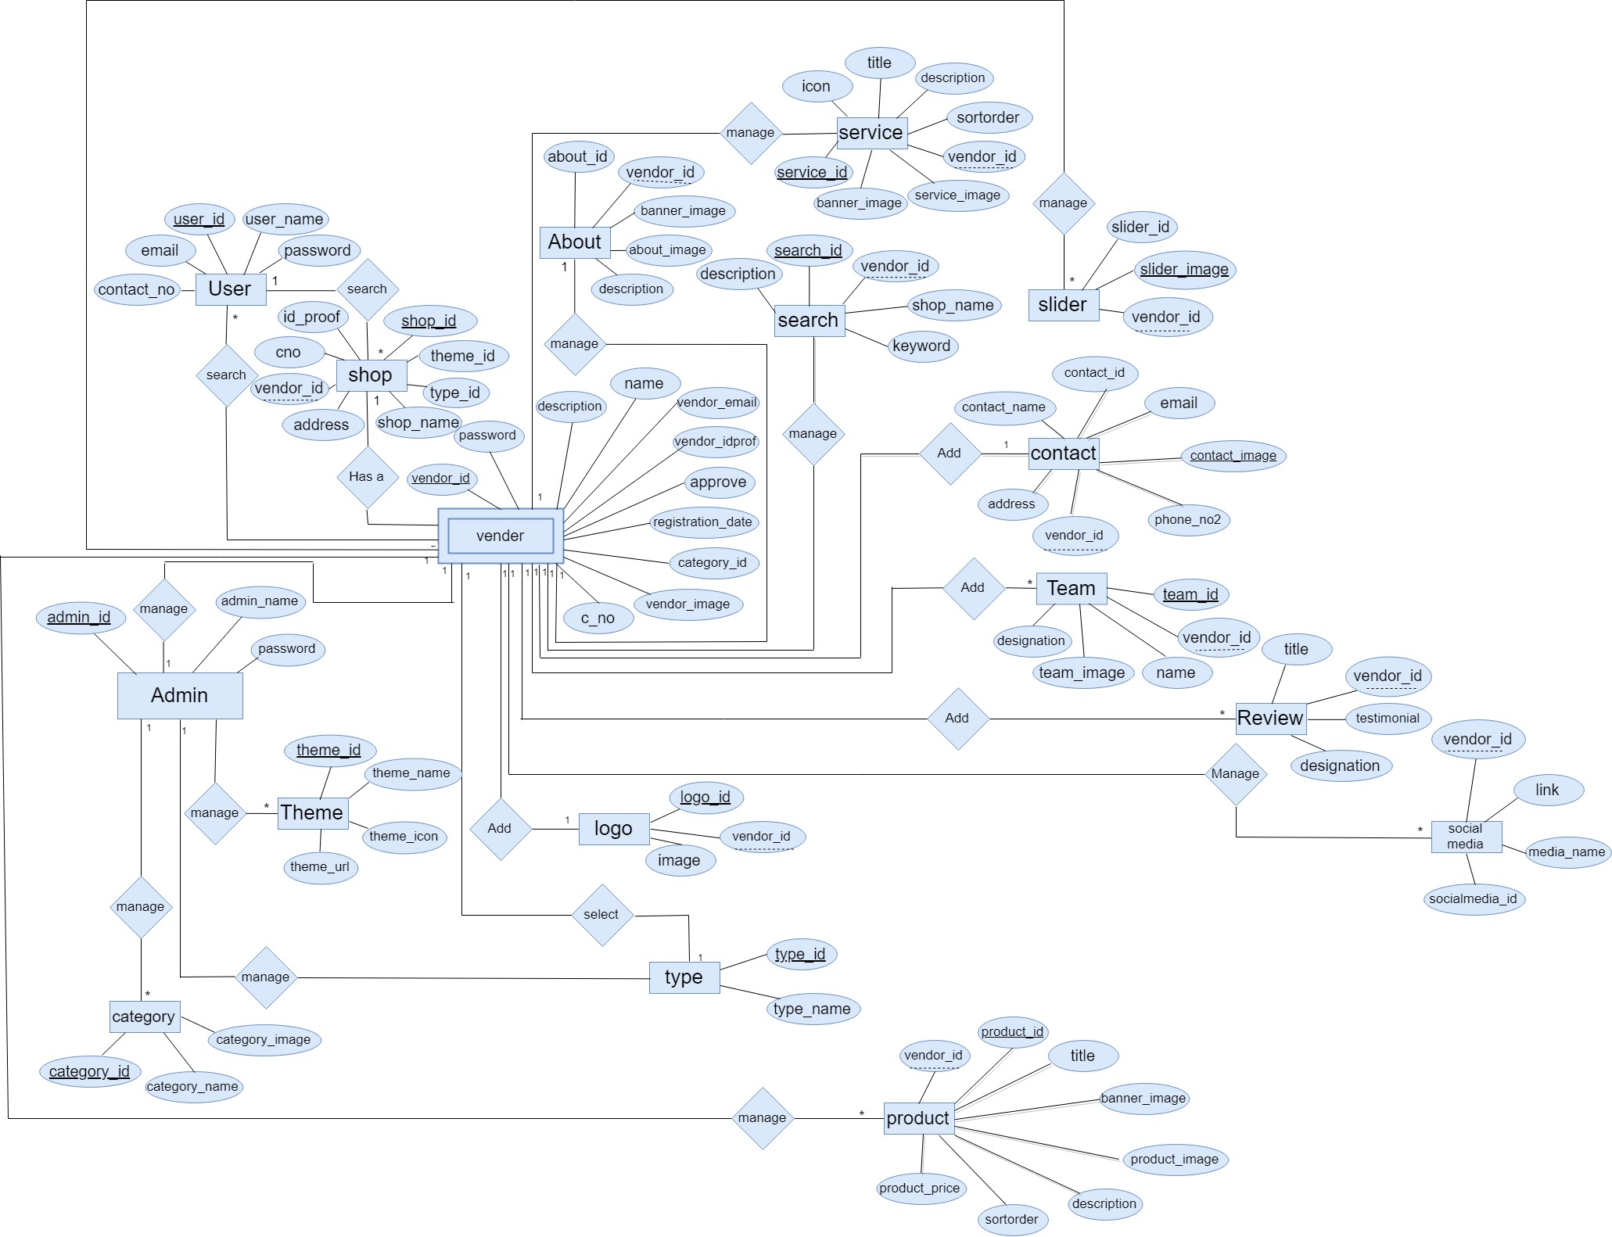
ER Diagram

Slide 19
Advantages
To find any Shops with their path easily.
Vendors can able to make website without coding, they only wants to entered their details

Slide 20
Disadvantages
The quick search cannot provide online payment system to the vendor.
In theme, cannot provides online buying for particular shop and other shops like travel agency for that online booking.
This system cannot provide login via various application like facebook , google+ etc.
The quick search cannot provide the facility out of surat .

Slide 21
Thank You

