Slide 1

ROBOTECHNOS

Slide 2

◆ PROBLEM STATEMENT:
INSUFFICIENT MEDICAL SUPPORT SYSTEM IN
REMOTE VILLAGES AND HILLY AREAS
◆ CATEGORY OF PROBLEM STATEMENT:
SOFTWARE
◆ PS NUMBER:
ST890
◆ MENTOR:
DR.MANIVEL KANDASAMY

Slide 3
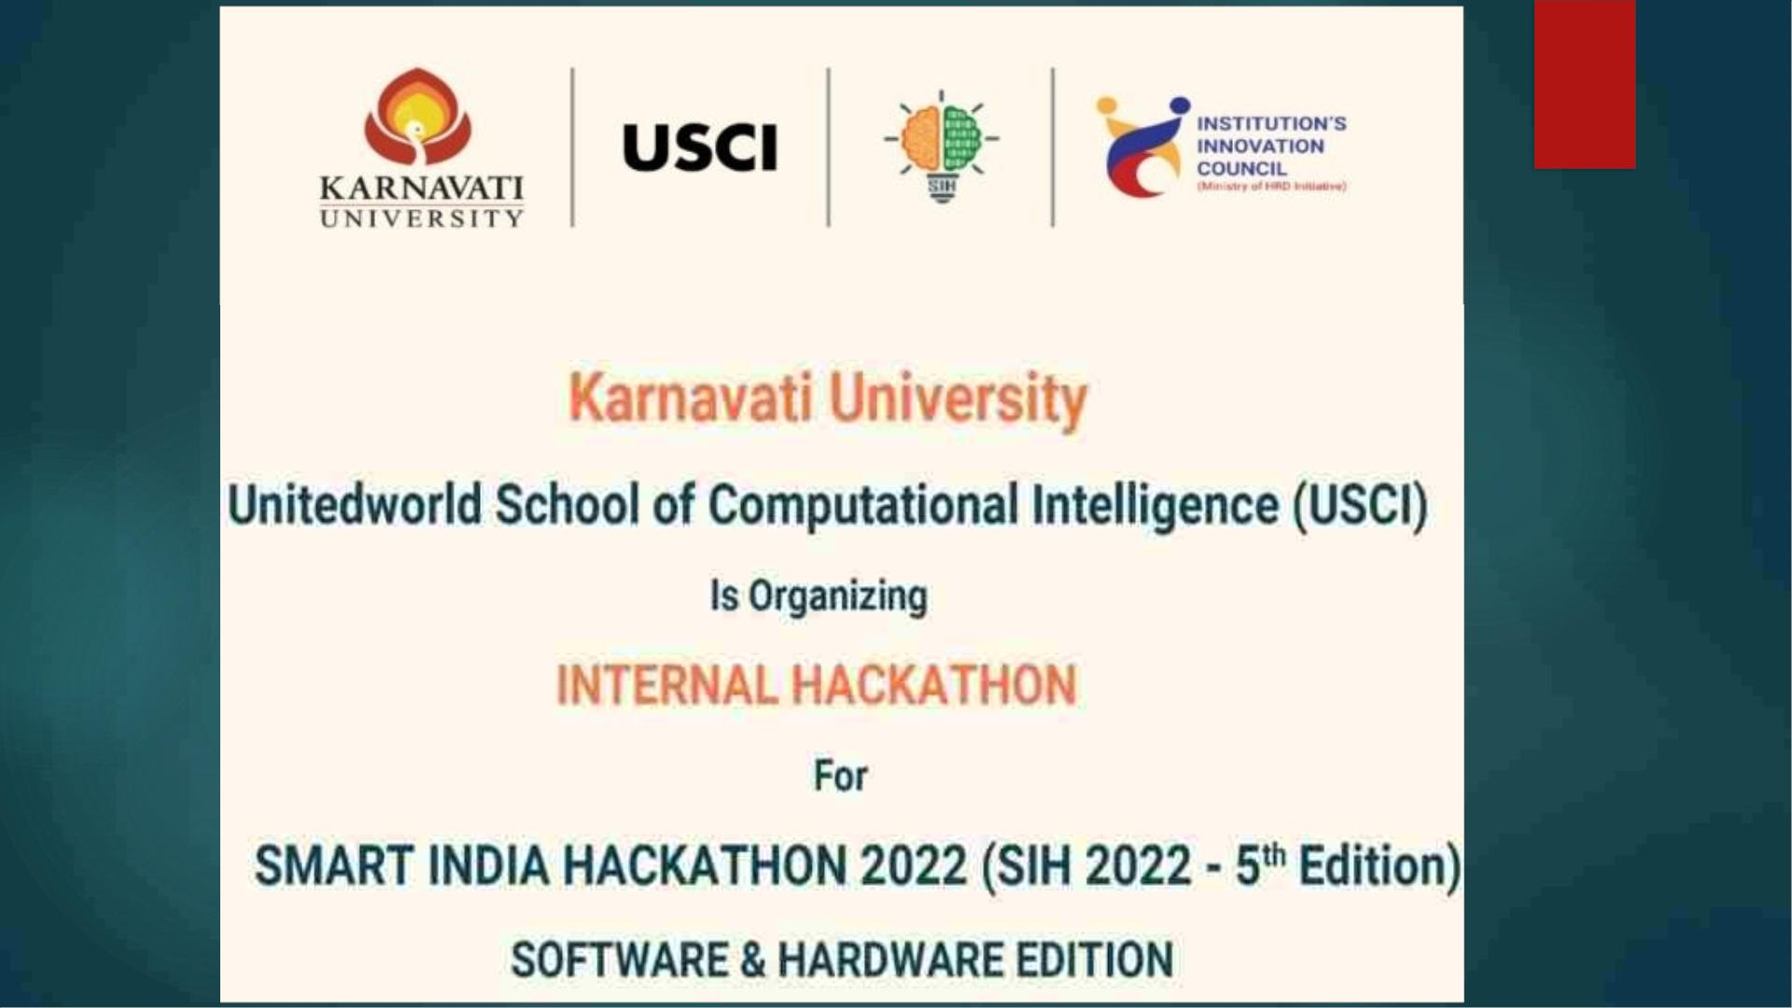

Slide 4
ABSTRACT:
◆ Health care is a fundamental right of every human being. A lot of people
still reside in hilly areas.
◆ Individuals in hilly areas often have poor access to healthcare because of
poor accessibility and availability of standard healthcare systems and socio
-cultural factors affecting their perception of health compared to the urban
population.
◆ Though there is a projected decrease in the absolute percentage of the
world’s population dwelling in hilly areas by 2050, there is also a projected
increase needing of prioritizing health.
◆ This problem statement primarily discusses the critical factors that
disadvantage the hill population. It also considers the methods used to
work out hilly area healthcare delivery strategies to decrease this disparity
in hilly areas’ medical facilities.

Slide 5
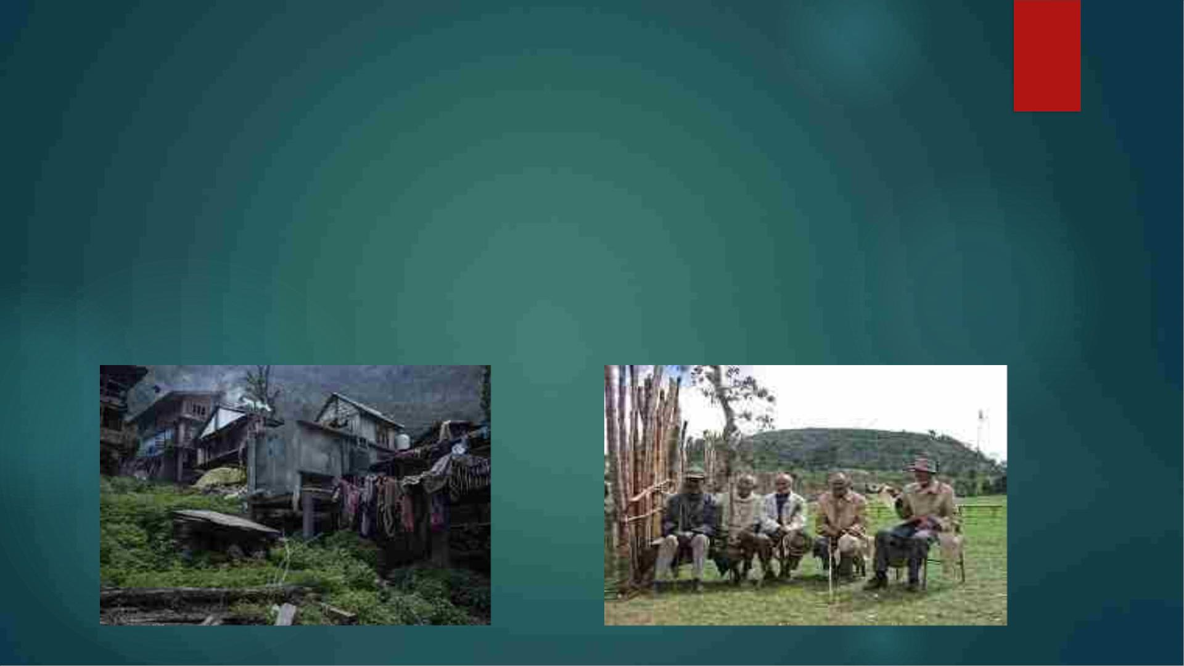
◆ As all of us know ,Healthcare is a fundamental right of every human
being and everyone’s responsibility .
◆ When healthcare is viewed as a right and a responsibility, the
state’s active role in maintaining its people’s health becomes even
more pro-active. There has always been an inverse distribution of
medical services in hilly areas when compared to the urban
population, which is often referred to as the inverse care law.

Slide 6
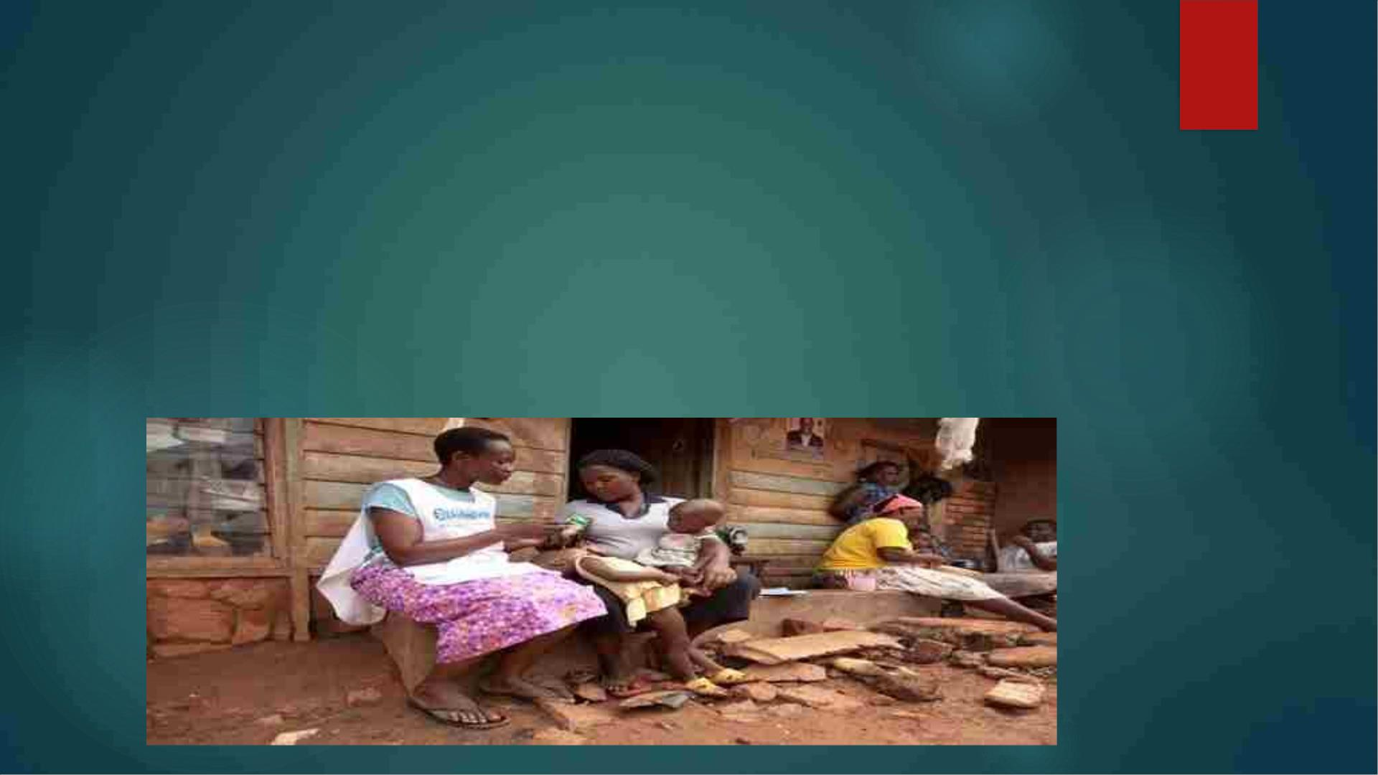
◆ There has always been an inverse distribution of medical services in
hilly areas when compared to the urban population, which is often
referred to as the inverse care law.
◆ Barriers to healthcare access are systematic hindrances that may
interfere with access to healthcare systems.ꢀ

Slide 7
Delivery drones
◆ There are a wide range of expected positive effects of drone
delivery including economic benefits, convenience, and delivery of
time critical goods and services to difficult to reach places.
◆ There are a number of drone services which show enough potential
such as AMAZON , ALPHABET and other tech giants who are hailing
it as a future of e-commerce fulfillment.
◆ For a glance , we can see an example of delivery drone started in
india: swiggy tests 300+ drone deliveries for food, medicine without
any accident in a trial, food delivery Unicon Swiggy and integrated
aerospace company ANRA technologies have jointly conducted
over 300 run lead deliveries of food and medicines in India.

Slide 8
◆ For the solution to this sensitive problems we can use drones to transfer
medicare and other equipments in hilly areas and remote villages. But we
can not use delivery drones to transfer a much of heavy materials but the
things like medicines, bandages, and other healthcare's are easily
transferable.
◆ Now the process to transfer is not simple. The factors to keep in mind while
designing the drones which can used for this purpose are the pay load, pick
up pattern and the landing of the drone. The most important part is to
understand the landing pattern because there is a possibility that the product
which is carried by the drone can get damaged by the wrong landing
pattern.
◆ so we are working on how to control the landing speed of drone depending
upon its weight which is carried by the drone. so our idea is to create a drone
which have censors that helps the drone to identify the weight of material
which is carried by the drone and can control the landing speed of drone to
safely deliver the medicare products.

Slide 9

WHY DELIVERY DRONES??
◆ 1. Cost
Drones being cheaper than delivery vehicles end up saving logistical
costs, including labour costs.
◆ 2. Speed
They guarantee faster delivery, within a timeframe of minutes to few hours
depending on the retailer origin and customer location.
◆ 3. Mobility
As drones work on coordinates, they can go anywhere – over mountains,
lakes, parks, etc., thus eliminating road traffic.

Slide 10
◆ 4. Tracking
This delivery mechanism allows Real-time tracking of the package for both merchants
and customers.
◆ 5. Environmentally friendly
In comparison to other delivery vehicles, drones leave a small carbon footprint.
◆ 6. Perishable Goods
Due to their faster delivery, drones can quickly deliver perishable foods or medical
supplies efficiently.
◆ 7. Traffic congestion
Drone deliveries help in combating traffic as there is a lot of vehicles on the road.

Slide 11

SOLUTIONS TO THE CHALLENGES!!
◆ 1. Legality
Since drone deliveries are not legal in all regions, we can try and get a
universal approval which is needed for these deliveries for mass
adoption.
◆ 2. Package size
Drone delivery is restricted to smaller products, thus cannot deliver
larger items.
So we are working on a design which can adjust the payload for the
following.

Slide 12
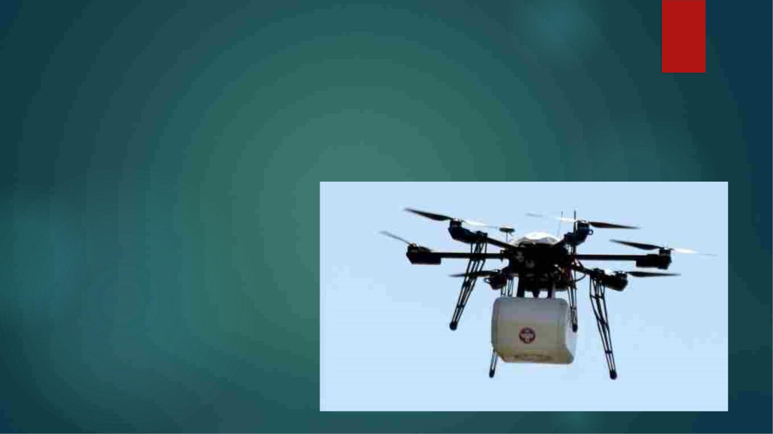
◆ 3. Weather
Weather constraints affect drone deliveries. Bad weather like high
winds, heavy rains, or snow restricts deliveries.
So for this we’re about to use the material which is strong and rust free
to survive in the hilly areas with fog and mist. Which also requires a
good camera quality

Slide 13
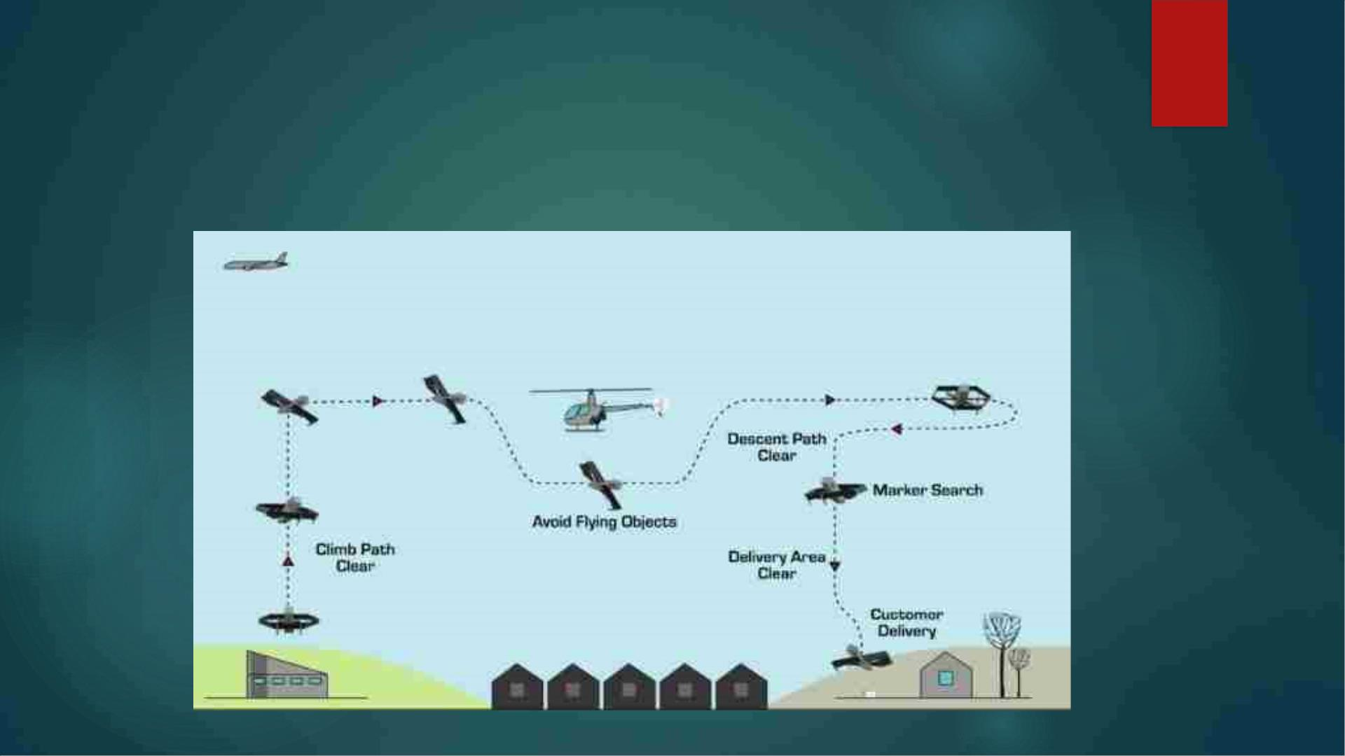
◆ when ready, the drones takes of vertically, flies to the packet pick
up spot, hovers about 7 meters (23 feet) off the ground and uses a
winch to lower a specialized hook .once the package is attached
to the hook by the merchant, the wind pulls of the package and
secures it firmly to the aircraft for flight delivery.

Slide 14
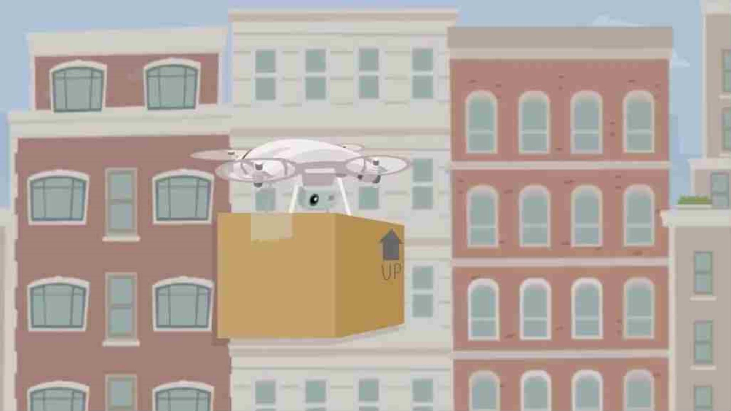

Slide 15
◆ The main efforts in drone software development will be focused on the
enablement of more advanced autonomous capabilities. From a
software developer’s perspective, this is a golden age of development on
these platforms
◆ Our software enables measurements and scales representations.
◆ Real-time Access & Control With cloud connectivity over 4G/LTE gain real-
time flight data and control, from a remote location. Equip drones to
automatically carve paths taking in consideration no-fly zones, elevation
and obstacle avoidance Manage and operate your whole delivery fleet
in real-time using a single web-based dashboard. Precise Landing on the
landing sites to precisely hover or land for package delivery. Trigger drone
actions based on the sites.
◆ there’s everything from the autopilot actually managing the rotors and
keeping the drone in the air, planning the path the drone will take,
collecting useful data from onboard sensors, to getting it all back to the
cloud platform, making gigabytes and terabytes of images useful and
feasible to collect and analyze in the user’s browser.

Slide 16
THANK YOU!!

